Slide 1
Computing in the Classroom
Semester 1
Week 2
Judy Robertson

Slide 2
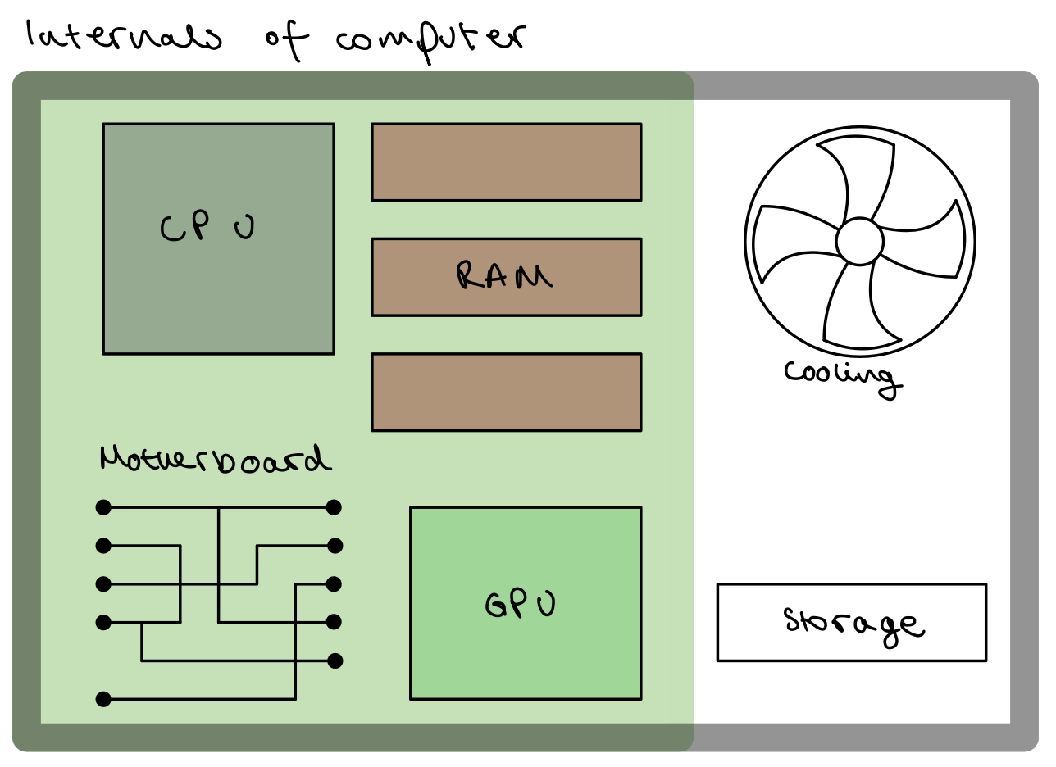
Lucas

Slide 3
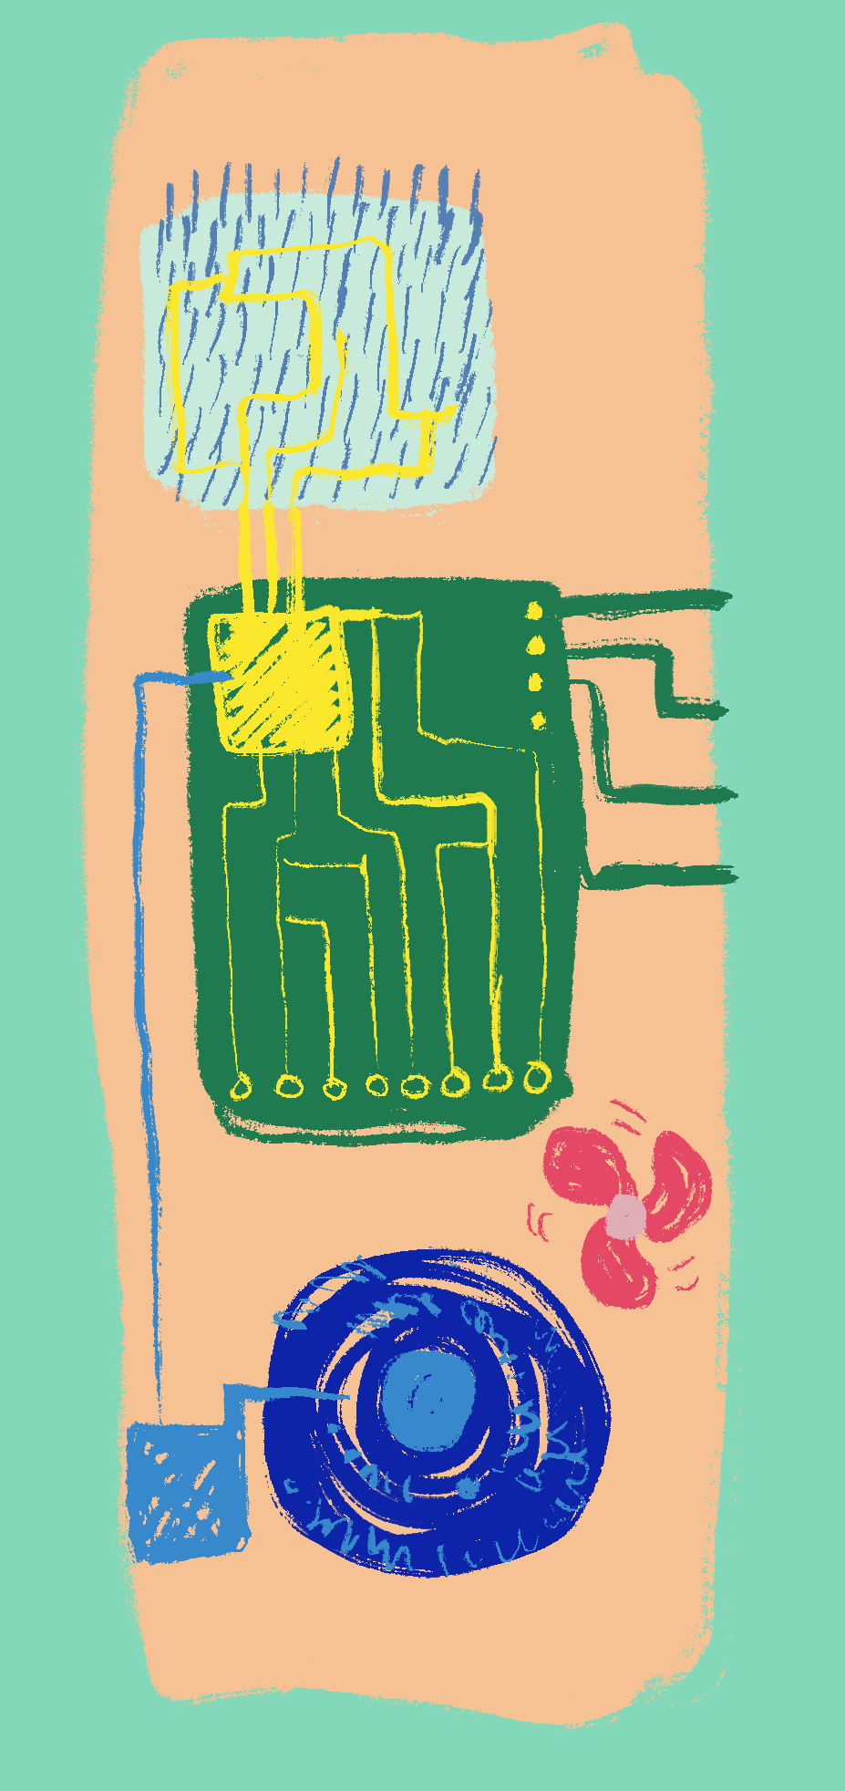
Antonia

Slide 4
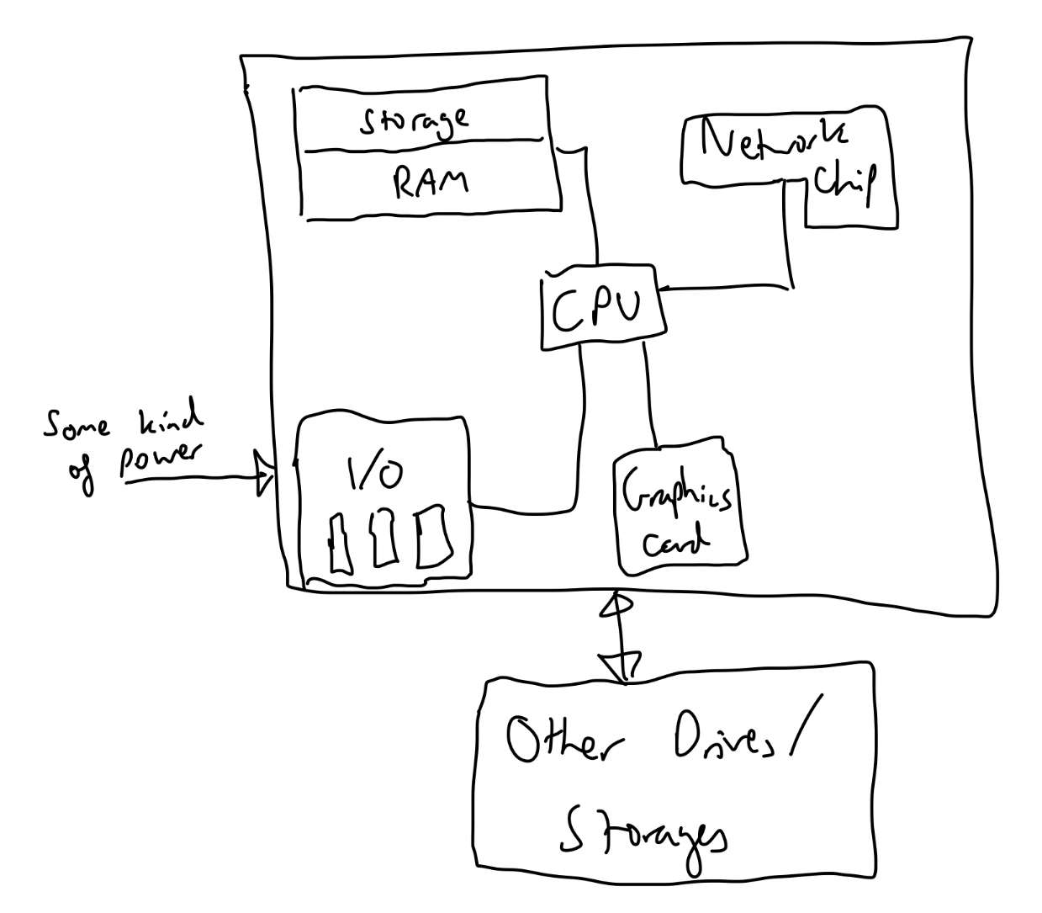
Ben

Slide 5
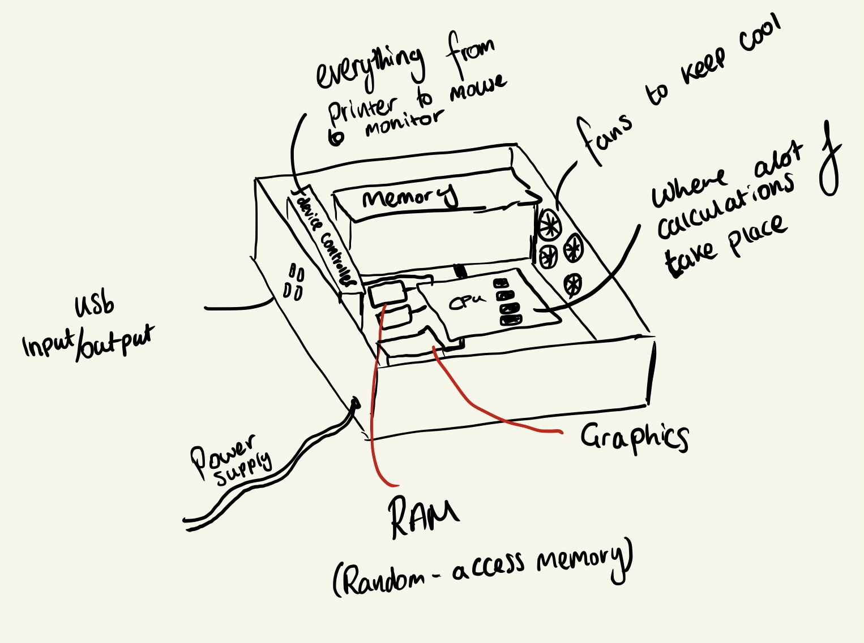
Eric

Slide 6
Children’s drawings
what did you notice were misconceptions/gaps across the drawings?

Slide 7

What does AI draw?
Dalle-2 with the prompt: “Please draw what’s inside a computer”

Slide 8
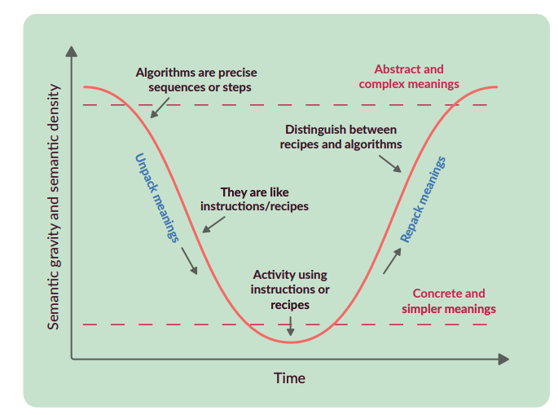

Slide 9
From the discussion boards
TL:DR When explaining something using a semantic curve, how do you handle underlying concepts? Ignore them? Explain them immediately? Or explain them before/after you describe what you set out to?
Notes:
As I was reading about semantic waves, I was thinking about things I've had to explain recently, how I would typically describe a topic, and if I could make my descriptions better follow this structure. Anyway, as most of my mates at Uni are all 4th years, a big topic of conversation at the moment is dissertations. As most of my friends aren't computer scientists, I often explain the computing topic my diss is on (website fingerprinting).
When I'm describing website fingerprinting to people with little background knowledge, I often end up making reductive descriptions of underlying concepts so that my explanation isn't long-winded. So, for example, I would describe an internet packet as just a chunk of data sent over the internet and won't even refer to metadata but instead talk about how each packet has source and destination addresses (and why this could be a problem).
Obviously, it doesn't really matter if my friends have a deep knowledge of networks, so I think these concepts are pretty ok for me to just skip over. But this leads to the question of how you should handle underlying concepts used in an explanation. Would it be better for learning and understanding if you predefined things that you will use in your explanation, or defined them during or after? And what if that concept would need its own semantic curve? Would it be more harmful to the overall description of a topic if every time you came across a concept, you were sidetracked into a new semantic curve to explain what that concept is?
Thought this might be an interesting question to discuss...

Slide 10
Videos examples
Nicole, Demott and Dayyan
“We all wrote the script together in person and then recorded our lines, we tried make use of ChatGPT for some of the more abstract things like GPU however Dayyáns original example proved more understandable and simple so we decided against using any of ChatGPTs examples.”
Andrew
Eric
Toni - https://www.youtube.com/watch?v=wlr8rGsFBbg

Slide 11
Next week – scratch programming

