Slide 1

Models of Neurons 3: The Integrate and Fire Neuron
Angus Chadwick, ANC
School of Informatics, University of Edinburgh, UK
Computational Neuroscience (Lecture 5, 2023/2024)

Slide 2
Overview of Lecture
Types of model in neuroscience (abstract vs detailed)
The leaky integrate and fire (LIF) model
Models for synapses: conductances and currents

Slide 3
Types of Neuron Model
Neuron models may be biophysically detailed or simple and abstract
Detailed models often have many free parameters, cannot be solved mathematically and are difficult to draw general conclusions from when simulated
Abstract models may overlook important phenomena in real biological neurons
The level of detail included in a model is typically chosen based on the phenomena we would like to understand

Slide 4
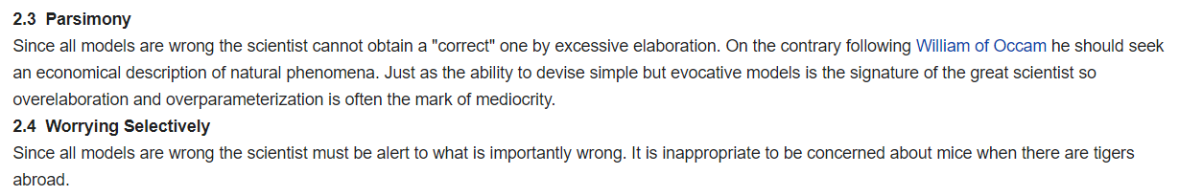
Abstraction in Modelling
“Everything should be made as simple as possible, but no simpler.” (Einstein)
“All models are wrong; some models are useful” (George Box)

Slide 5
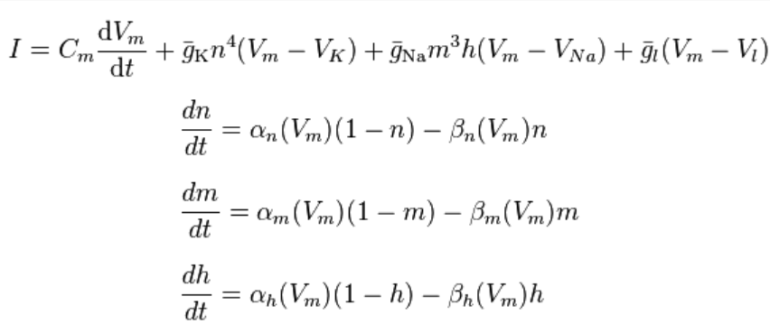
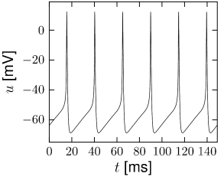

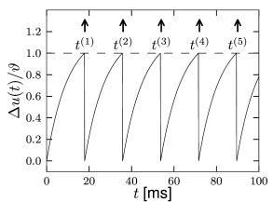
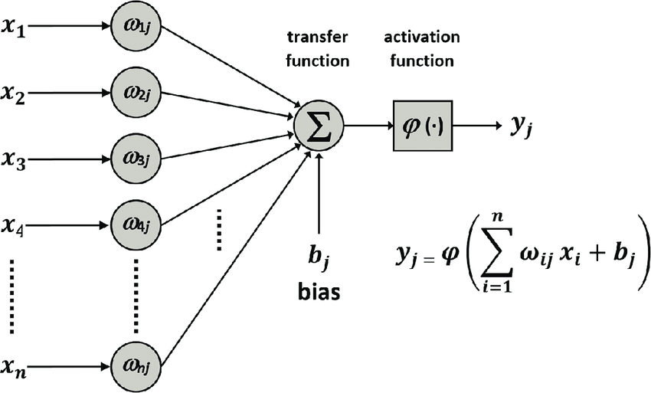
Types of Neuron Model: Simplified vs Biologically Detailed
Complex/Biophysically Detailed
Hodgkin-Huxley
Hodgkin-Huxley
(Explains action potential biophysically. Computationally expensive and largely unamenable to formal analysis.)
Membrane potential
Intermediate Complexity
Leaky Integrate and Fire
Leaky Integrate and Fire
(Abstracts away biophysics of action potentials. Can be analysed in some cases.)
Membrane potential
Simple/Abstract
Transfer Function
(Lacks spiking or dynamics, but easily analysed.)

Slide 6
The Leaky Integrate and Fire Model
The Hodgkin-Huxley model is computationally expensive and analytically intractable
Often we don’t care about the specific ionic currents or the biophysics of action potential generation
Can we build a simpler model for the spiking activity of a neuron?
What details can we throw away? What are the essential properties of the Hodgkin-Huxley model that we want to keep/abstract away?

Slide 7
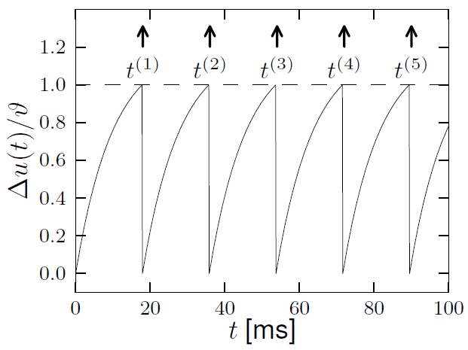
The Leaky Integrate and Fire Model
Answer: the Leaky Integrate and Fire model. We consider only the passive membrane potential dynamics, and approximate the action potential with a threshold-reset rule
Response to Constant Current Input
Membrane potential

Slide 8
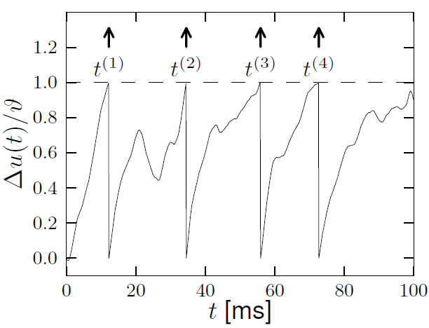
The Leaky Integrate and Fire Model
Answer: the Leaky Integrate and Fire model. We consider only the passive membrane potential dynamics, and approximate the action potential with a threshold-reset rule
Response to Constant Current Input
Response to Time-Varying Current
Membrane potential
Membrane potential

Slide 9
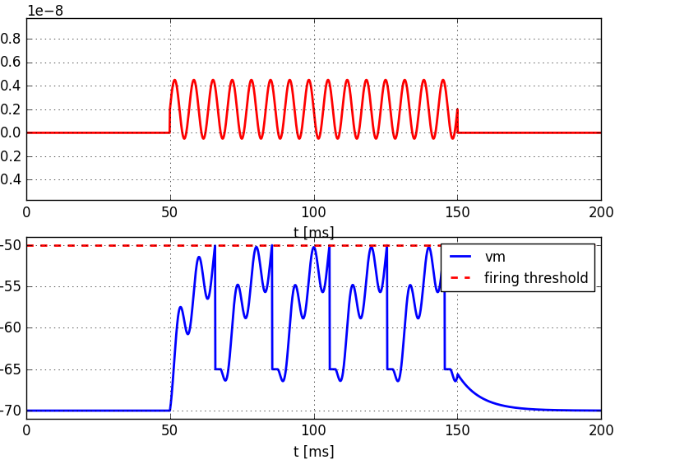
The Leaky Integrate and Fire Model
Answer: the Leaky Integrate and Fire model. We consider only the passive membrane potential dynamics, and approximate the action potential with a threshold-reset rule
Response to Constant Current Input
Input
Current
Response to Time-Varying Current
Response to Sinusoidal Current
Membrane potential
Membrane potential
Membrane
potential

Slide 10
The Leaky Integrate and Fire Model
The LIF neuron obeys the following passive dynamics and threshold-reset rule:
Passive Dynamics:
(while V < Vthreshold)

Slide 11
The Leaky Integrate and Fire Model
The LIF neuron obeys the following passive dynamics and threshold-reset rule:
Passive Dynamics:
(while V < Vthreshold)
Reset Rule (mathematical):

Slide 12
The Leaky Integrate and Fire Model
The LIF neuron obeys the following passive dynamics and threshold-reset rule:
Passive Dynamics:
(while V < Vthreshold)
Reset Rule (mathematical):
Reset Rule (numerical):

Slide 13
The Leaky Integrate and Fire Model
The LIF neuron obeys the following passive dynamics and threshold-reset rule:
It has a hand-chosen resting potential, spike threshold, and spike reset voltage
The dynamics are passive/linear everywhere except at spike times
Passive Dynamics:
(while V < Vthreshold)
Reset Rule (mathematical):
Reset Rule (numerical):

Slide 14

The Leaky Integrate and Fire Model
The LIF neuron obeys the following passive dynamics and threshold-reset rule:
It has a hand-chosen resting potential, spike threshold, and spike reset voltage
The dynamics are passive/linear everywhere except at spike times
Every time the neuron resets, we say the neuron has fired a spike:
Passive Dynamics:
(while V < Vthreshold)
Reset Rule (mathematical):
Reset Rule (numerical):

Slide 15
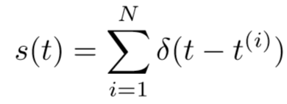
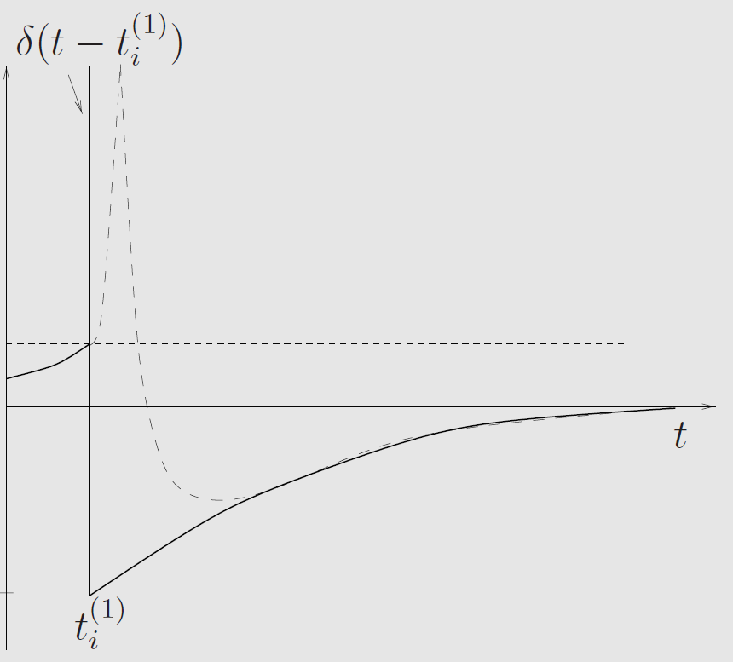
The Leaky Integrate and Fire Model
Although the LIF model doesn’t actually exhibit spikes, we often write down the spike train as:
In other words, we model spikes as Dirac delta functions
This is a purely aesthetic choice when plotting the
membrane potential
However, we use this spike train equation often
when modelling synaptic currents and firing statistics
Membrane potential

Slide 16
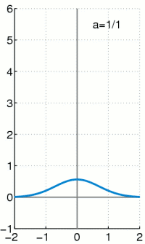
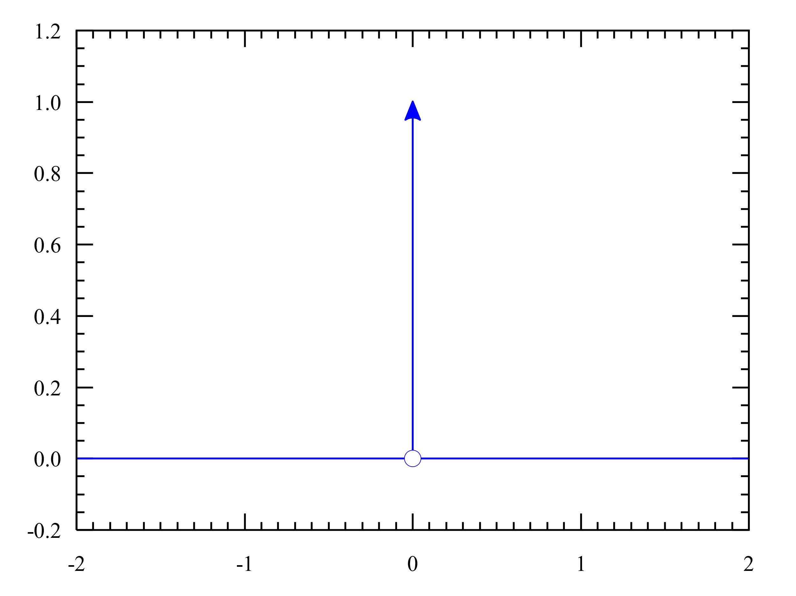
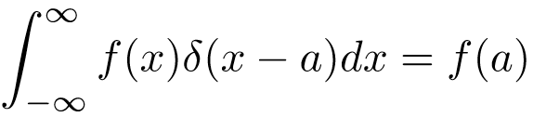
The Dirac Delta Function
The Dirac delta function is the limit of a Gaussian whose width goes to zero and integral remains constant
It has many nice properties which make it convenient choice for analytical calculations
Because we generally don’t care about the shape of an action potential, it serves as a good approximation when thinking of spikes as identical and instantaneous point events
Alternative definition: for any function f(x), delta function gives

Slide 17
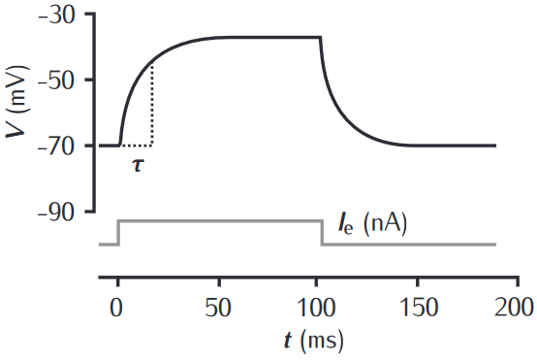



The Leaky Integrate and Fire Model – Current Threshold
How much current does it take to make an LIF neuron spike?
For time-independent Iext:
Thus, the neuron will therefore never spike if the current is below a current threshold:

Slide 18
The Leaky Integrate and Fire Model – Current Threshold
How much current does it take to make an LIF neuron spike?
For time-independent Iext:
Thus, the neuron will therefore never spike if the current is below a current threshold:

Slide 19
The Leaky Integrate and Fire Model – Current Threshold
How much current does it take to make an LIF neuron spike?
For time-independent Iext:
Thus, the neuron will therefore never spike if the current is below a current threshold:

Slide 20
The Leaky Integrate and Fire Model – Current Threshold
How much current does it take to make an LIF neuron spike?
For purely passive dynamics (i.e., ignoring voltage threshold):
For time-independent Iext:
Thus, the neuron will therefore never spike if the current is below a current threshold:

Slide 21
The Leaky Integrate and Fire Model – Current Threshold
How much current does it take to make an LIF neuron spike?
For purely passive dynamics (i.e., ignoring voltage threshold):
For time-independent Iext (already derived in previous lecture):
Thus, the neuron will therefore never spike if the current is below a current threshold:

Slide 22

The Leaky Integrate and Fire Model – Current Threshold
How much current does it take to make an LIF neuron spike?
For purely passive dynamics (i.e., ignoring voltage threshold):
For time-independent Iext (already derived in previous lecture):
Thus, the neuron will therefore never spike if the current is below a current threshold:

Slide 23
The Leaky Integrate and Fire Model – Current Threshold
How much current does it take to make an LIF neuron spike?
For purely passive dynamics (i.e., ignoring voltage threshold):
For time-independent Iext (already derived in previous lecture):
Thus, the neuron will never spike if the current is below a current threshold:

Slide 24
The Leaky Integrate and Fire Model – Current Threshold
How much current does it take to make an LIF neuron spike?
For purely passive dynamics (i.e., ignoring voltage threshold):
For time-independent Iext (already derived in previous lecture):
Thus, the neuron will never spike if the current is below a current threshold:

Slide 25
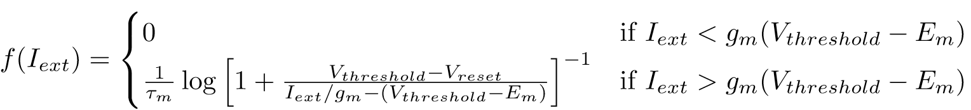
The Leaky Integrate and Fire Model – f-I Curve
Given a constant current input, we have the following solution (while under threshold):
Assume that the current input is strong enough to cause spikes. If the neuron has just spiked at time t=0, when will it spike next?
The f-I curve describes the spike frequency as a function of current input. Using our expression for T and that f=1/T, we have:

Slide 26
The Leaky Integrate and Fire Model – f-I Curve
Given a constant current input, we have the following solution (while under threshold):
Assume that the current input is strong enough to cause spikes. If the neuron has just spiked at time t=0, when will it spike next? To answer this, we need to insert the following boundary conditions in the above equation:
T

Slide 27
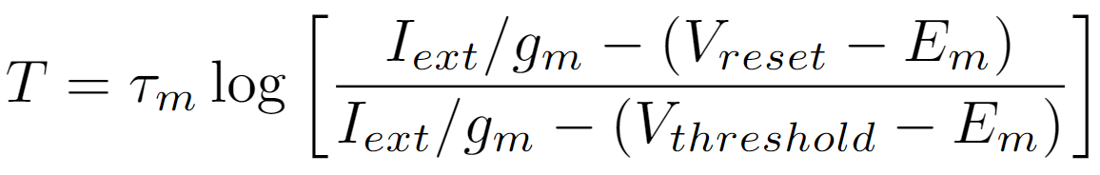
The Leaky Integrate and Fire Model – f-I Curve
Given a constant current input, we have the following solution (while under threshold):
Assume that the current input is strong enough to cause spikes. If the neuron has just spiked at time t=0, when will it spike next? To answer this, we need to insert the following boundary conditions in the above equation:
T is the interspike interval, the firing rate is f=1/T – note that the neuron will fire at T, 2T, 3T, etc.
T

Slide 28
The f-I Curve
For currents above the spiking threshold the interspike interval T is:

Slide 29
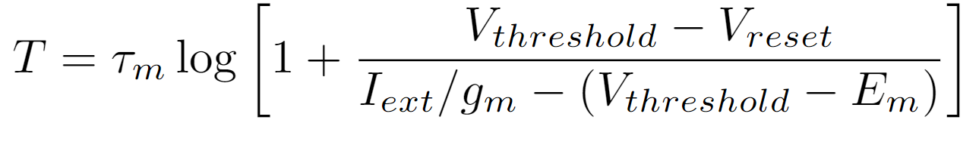
The f-I Curve
For currents above the spiking threshold the interspike interval T is:
Or equivalently:

Slide 30
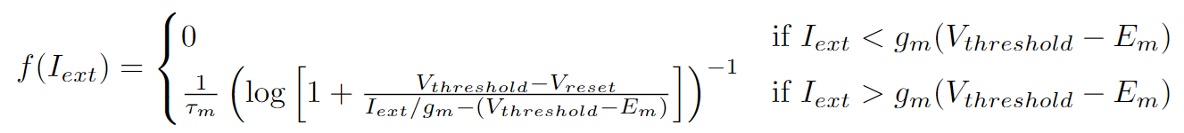
The f-I Curve
For currents above the spiking threshold the interspike interval T is:
Or equivalently:
For currents below threshold the neuron never spikes….
So the f-I curve must be:

Slide 31
The f-I Curve – Limiting Behaviour
How does this function behave? Does it look like real neurons/the Hodgkin-Huxley model? Useful to look at limiting behaviour (e.g., strong input currents).

Slide 32
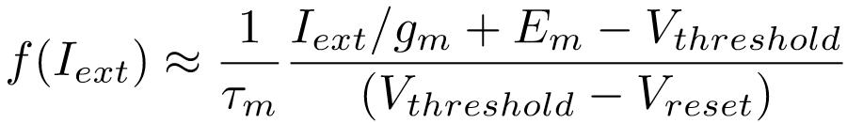
The f-I Curve – Limiting Behaviour
How does this function behave? Does it look like real neurons/the Hodgkin-Huxley model? Useful to look at limiting behaviour (e.g., strong input currents).
For strong input currents, using log(1+1/x) = 1/x (for large x):
Firing rate is zero below current threshold and linear for large current input - a bit like a ReLU. But it does something nonlinear in between…

Slide 33
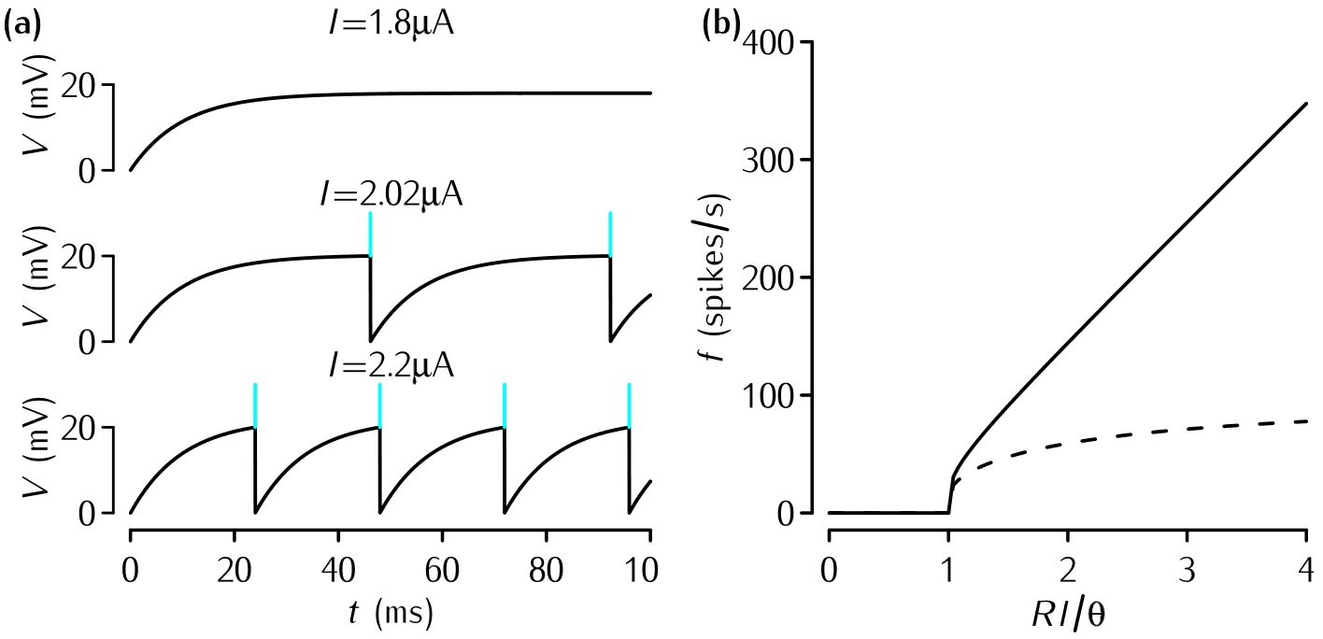
The f-I Curve – LIF vs Hodgkin-Huxley
Leaky Integrate and Fire (Analytical Solution)
Membrane potential
Input Current (Iext)

Slide 34
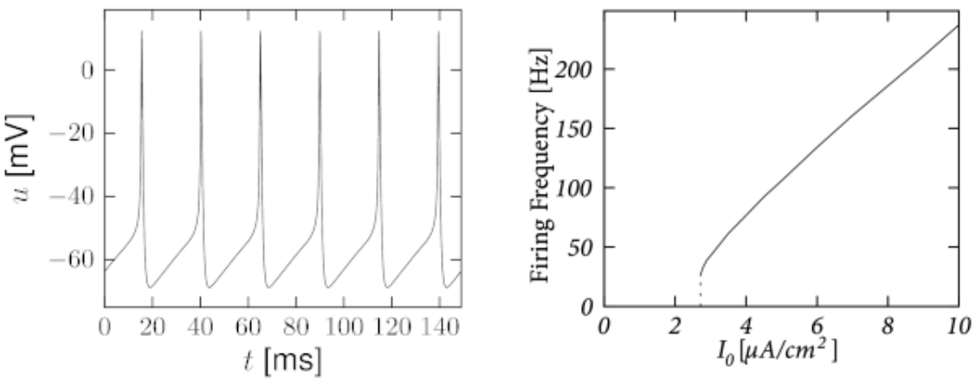
The f-I Curve – LIF vs Hodgkin-Huxley
Leaky Integrate and Fire (Analytical Solution)
Hodgkin-Huxley (Numerical Calculation)
Membrane potential
Membrane potential
Input Current (Iext)
Input Current (Iext)
Simplification/abstraction has allowed to obtain a model in which certain essential features of the Hodgkin-Huxley model can be distilled and understood analytically.

Slide 35
The Leaky Integrate and Fire Model - Summary
The LIF model combines a mechanistic approach to modelling passive membrane dynamics with a phenomenological approach to modelling action potentials
This makes it more computationally efficient and analytically tractable compared to the HH model
The HH model doesn’t have a well-defined voltage threshold - the LIF model is unrealistic in that sense. However, both HH and LIF have a well-defined current threshold…
The basic LIF model is too simple to capture various features of biological neurons, however it can be augmented in order to model relevant features of biological neurons (refractory period, spike rate adaptation, etc.)
For most large-scale simulations of spiking networks, variants on the LIF model are the standard choice

Slide 36
Synapses
Neurons communicate via synapses
Up until now, we have considered current that flows from an electrode into a neuron, or through voltage-gated ion channels
Do synapses behave like electrodes, or do they behave in a different manner? How can we model them?
Understanding this is crucial for making sense of how neurons communicate with one another, and how networks of neurons behave

Slide 37
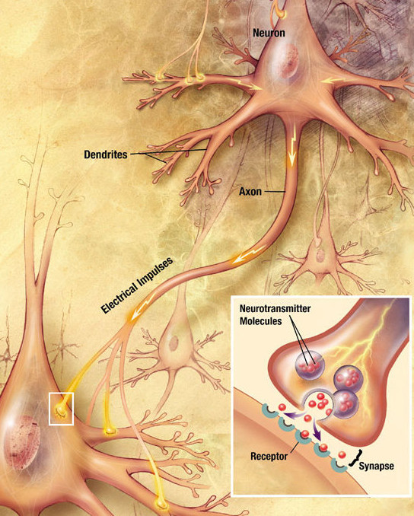
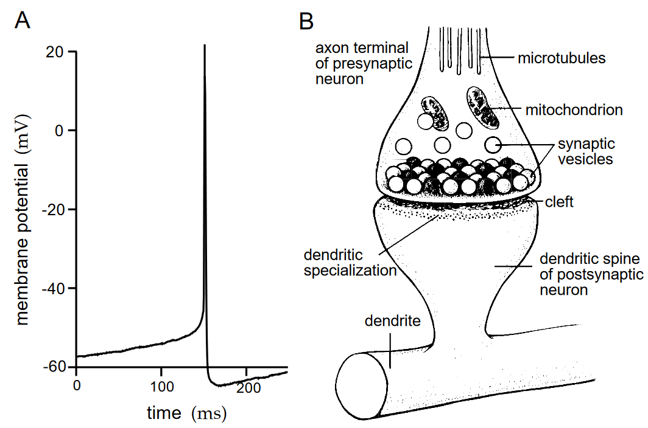
Synapses
Synapses “connect” one neuron’s axon to another’s dendrite (usually!) They are the means by which neurons communicate
They don’t physically connect, but instead release neurotransmitter across a small gap called the synaptic cleft.
The neurotransmitter then binds to the postsynaptic cell membrane, causing currents to flow into the cell

Slide 38
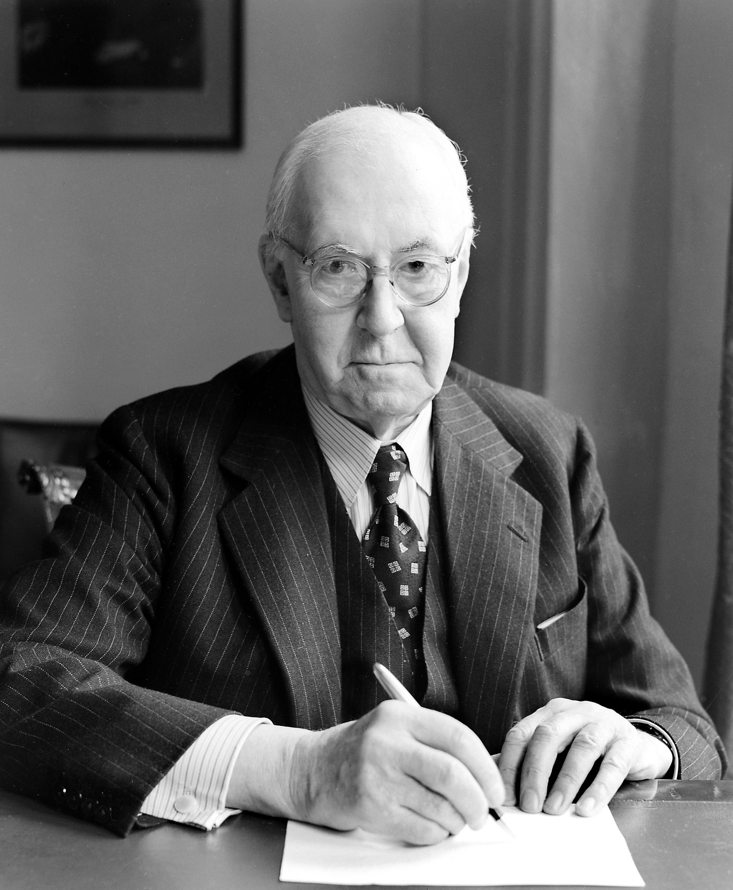
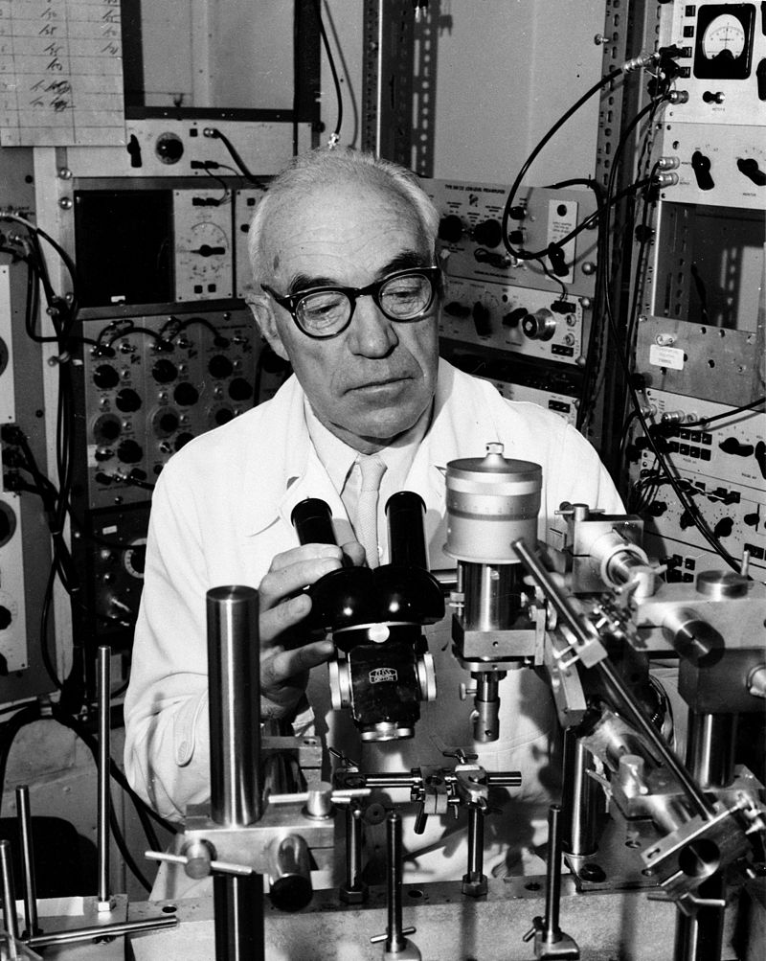
Dale’s Principle
Each neuron only releases one kind of neurotransmitter across all of its synapses (Dale’s Principle; there are occasional exceptions)
“It is to be noted, further, that in the cases for which direct evidence is already available, the phenomena of regeneration appear to indicate that the nature of the chemical function, whether cholinergic or adrenergic, is characteristic for each particular neurone, and unchangeable” (Henry Dale, 1934)
"I proposed that Dale’s Principle be defined as stating that at all the axonal branches of a neurone, there was liberation of the same transmitter substance or substances.“ (John Eccles, 1974)
For our purposes, each neuron is either excitatory or inhibitory!

Slide 39
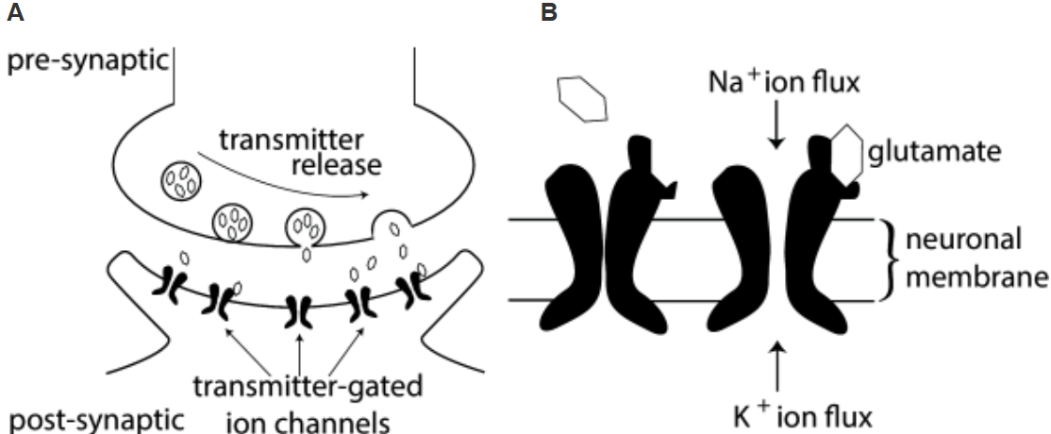
Modelling Synapses
Synapses function in a fundamentally different manner to injected currents:
When an action potential arrives at the pre-synaptic side, molecules called neurotransmitter are released into the synaptic cleft
The neurotransmitters diffuse across and bind to the post-synaptic cell membrane, which causes ion channels to open and current to flow into the post-synaptic cell

Slide 40
Synaptic Currents – Conductance-Based Models
A simple model for the synaptic current is:
gsyn(t) is the post-synaptic membrane conductance, V is the post-synaptic membrane potential, Esyn is the postsynaptic reversal potential

Slide 41
Synaptic Currents – Conductance-Based Models
A simple model for the synaptic current is:
gsyn(t) is the post-synaptic membrane conductance, V is the post-synaptic membrane potential, Esyn is the postsynaptic reversal potential
gsyn(t) captures the opening and closing of the ion channels due to neurotransmitter binding, which changes the conductance of the post-synaptic membrane temporarily

Slide 42
Synaptic Currents – Conductance-Based Models
A simple model for the synaptic current is:
gsyn(t) is the post-synaptic membrane conductance, V is the post-synaptic membrane potential, Esyn is the postsynaptic reversal potential
gsyn(t) captures the opening and closing of the ion channels due to neurotransmitter binding, which changes the conductance of the post-synaptic membrane temporarily
Esyn is the post-synaptic voltage at which no net current will flow through these ion channels.

Slide 43
Synaptic Currents – Conductance-Based Models
A simple model for the synaptic current is:
gsyn(t) is the post-synaptic membrane conductance, V is the post-synaptic membrane potential, Esyn is the postsynaptic reversal potential
gsyn(t) captures the opening and closing of the ion channels due to neurotransmitter binding, which changes the conductance of the post-synaptic membrane temporarily
Esyn is the post-synaptic voltage at which no net current will flow through these ion channels.
For example, excitatory synapses have a reversal potential of 0 mV, because they let both potassium (-80 mV) and sodium (+50 mV) flow through. Inhibitory synapses have a reversal potential of around -80 mV, because they let chloride (-75 mV) or potassium (-80 mV) flow through.

Slide 44
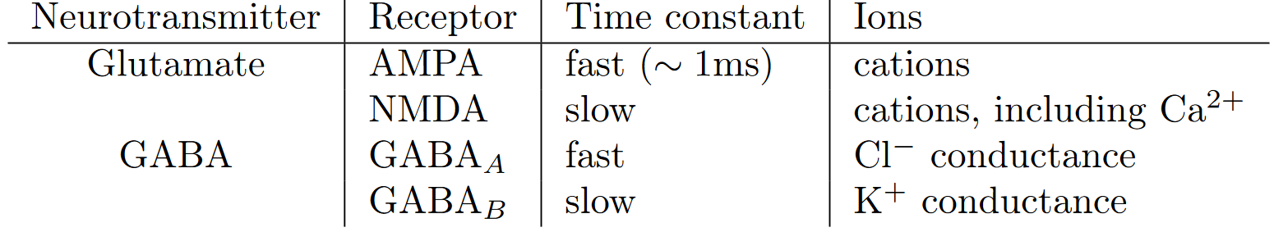
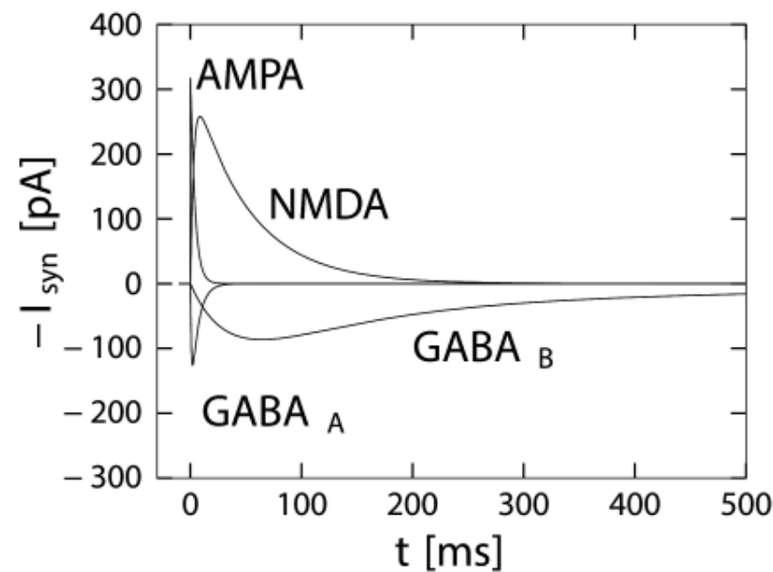
The Main Synaptic Currents/Receptors

Slide 45
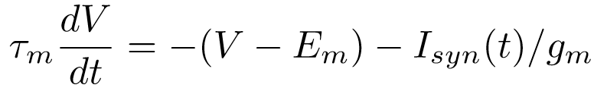
Synaptic Currents – Conductance-Based Models
We modelled the synaptic current as:
A neuron with passive membrane potential dynamics will respond to this synaptic current as:
But we haven’t specified gsyn(t) yet. As usual there are many possible models, ranging from biologically detailed to heavily simplified approximations.
Note also that we could use a Hodgkin Huxley model for the membrane dynamics.

Slide 46
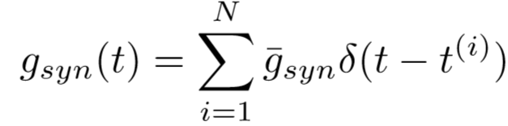


Synaptic Currents – Delta Models
One way to model synaptic conductances is to model all of the complicated biophysics of ion channels, vesicles, diffusion across the synaptic cleft, etc. Usually we opt for much simpler models.
One of the simplest models for the synaptic conductance is the Dirac delta function (an instantaneous pulse):
where are presynaptic spike times and is the magnitude of post-synaptic conductances
This model is useful for analytical calculations, but is too simple to capture many interesting phenomena (such as the slow timecourse of NMDA or GABAb conductances)

Slide 47
Synaptic Currents – Exponential Model
An alternative model treats the conductance as:

Slide 48
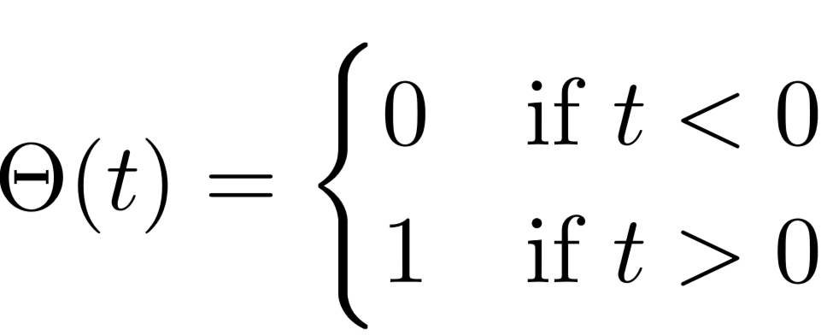
Synaptic Currents – Exponential Model
An alternative model treats the conductance as:
Heaviside
step function:

Slide 49
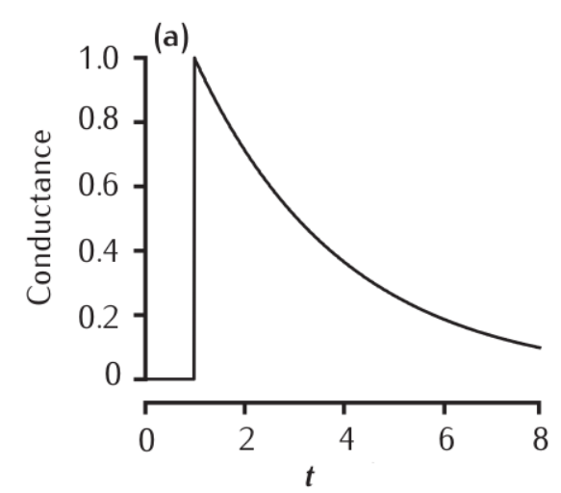

Synaptic Currents – Exponential Model
An alternative model treats the conductance as:
This models synaptic conductance as an instantaneous rise followed by an exponential decay for each spike
This makes some sense – neurotransmitter will be quickly released and bind to the postsynaptic cell membrane, causing ions to transiently flow through, with a roughly exponential time course
It’s a reasonable approximation for AMPA or GABAa (which are fast)
Heaviside
step function:

Slide 50
Synaptic Currents – Rise and Decay Times
Not all synaptic currents can be fit to a simple exponential. Some have slow rise times and/or multiple decay times
Voltage-Clamped Postsynaptic Currents
(modelled)

Slide 51
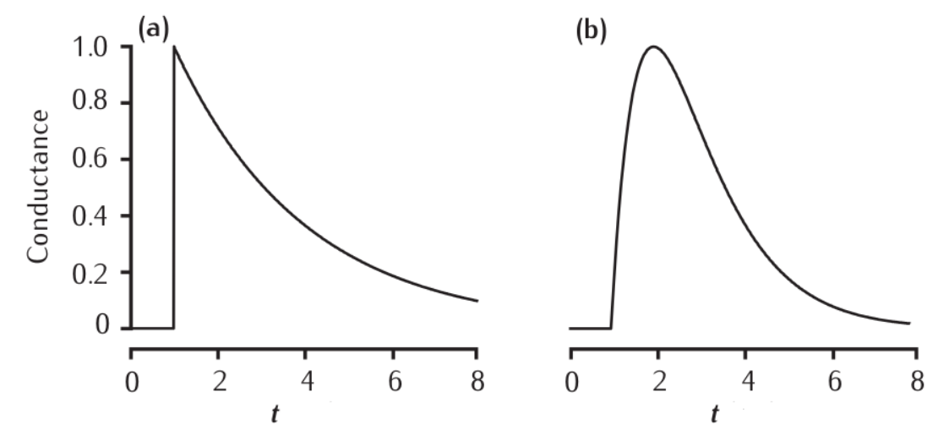
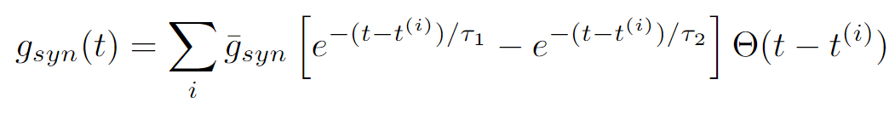
Synaptic Currents – Rise and Decay Times
Not all synaptic currents can be fit to a simple exponential. Some have slow rise times and/or multiple decay times
Exponential
Dual Exponential
Voltage-Clamped Postsynaptic Currents
(modelled)

Slide 52
Accounting for Multiple Rise and Decay Times
A yet more flexible model assumes three separate time constants (1 rise + 2 decay):
This model can replicate the time courses of the main excitatory (AMPA, NMDA) and inhibitory (GABAa, GABAb) synaptic currents
Note: the models we have considered are phenomenological – they fit a curve to the observed time courses without positing a biological/physical mechanism
More complex mechanistic models consider voltage-dependence of synaptic conductances, vesicle release, diffusion of neurotransmitter, and many other details (we won’t cover these in this course!)
rise of conductance
fast decay
slow decay

Slide 53

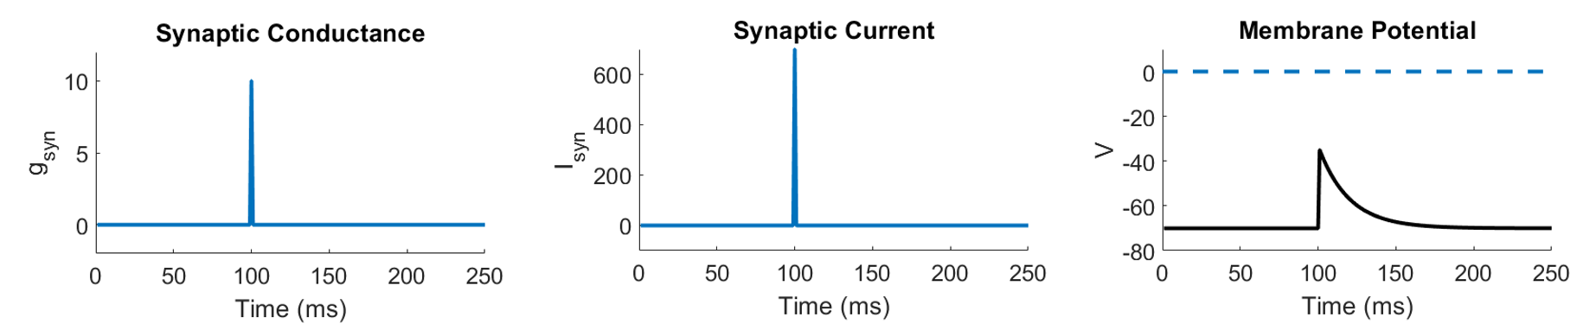
Example - Delta Synapse (Excitatory)
presynaptic spike time

Slide 54
Example - Delta Synapse (Excitatory)
presynaptic spike time

Slide 55
Example - Delta Synapse (Excitatory)
excitatory reversal potential
presynaptic spike time

Slide 56
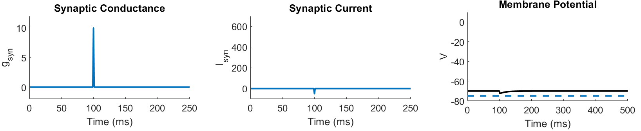
Example - Delta Synapse (Inhibitory)
presynaptic spike time
inhibitory reversal potential

Slide 57
Example - Delta Synapse (Inhibitory)
What happens if you hold the membrane potential at the excitatory reversal potential (e.g., via voltage clamp)?

Slide 58
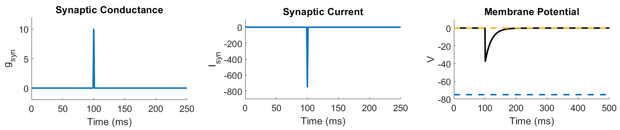
Example - Delta Synapse (Inhibitory)
What happens if you hold the membrane potential at the excitatory reversal potential (e.g., via voltage clamp)?
excitatory reversal potential
presynaptic spike time
inhibitory reversal potential
This voltage clamp technique is used experimentally to infer excitatory and inhibitory synaptic currents entering a neuron!

Slide 59
Summary - Synapses
Neurons communicate via synapses
When an action potential arrives at the pre-synaptic side, a cascade of biochemical events causes molecules called neurotransmitters to be released into the synaptic cleft
These molecules bind to the post-synaptic cell membrane, causing ion channels to open
There are two main types of synapse, excitatory and inhibitory, that release different kinds of neurotransmitter that elicit positive or negative currents
There are a wide range of models for synapses, ranging from complex biophysical models to extremely simple phenomenological models

Slide 60
Summary – Combining Neuron and Synapse Models
We have so far considered two neuron models: Hodgkin-Huxley and leaky integrate and fire
We have also considered multiple synapse models at varying levels of abstraction
How do we choose an appropriate set of models for a given application?
Answer: use the simplest possible models that can capture the phenomena in question
It is rare to see a large-scale network models using Hodgkin-Huxley neurons and/or biophysically-detailed synapses (but see e.g. the Human Brain Project for a counterexample)
The notion of biological plausibility is subjective – to an AI researcher deep networks are biologically plausible, but to a molecular biologist the Hodgkin-Huxley model is overly simplified…

Slide 61
Bibliography
Neuronal Dynamics Ch. 1&2 (Gerstner) https://neuronaldynamics.epfl.ch/online/index.html
Theoretical Neuroscience Ch. 5-6 (Dayan and Abbott)
http://www.gatsby.ucl.ac.uk/~lmate/biblio/dayanabbott.pdf
Mathematical Foundations of Neuroscience Ch. 1 (Ermentrout and Terman)
http://www.math.pitt.edu/~bdoiron/assets/ermentrout-and-terman-ch-1.pdf
Dynamical Systems in Neuroscience Ch. 1-2 (Izhikevich) https://www.izhikevich.org/publications/dsn.pdf

