Slide 1

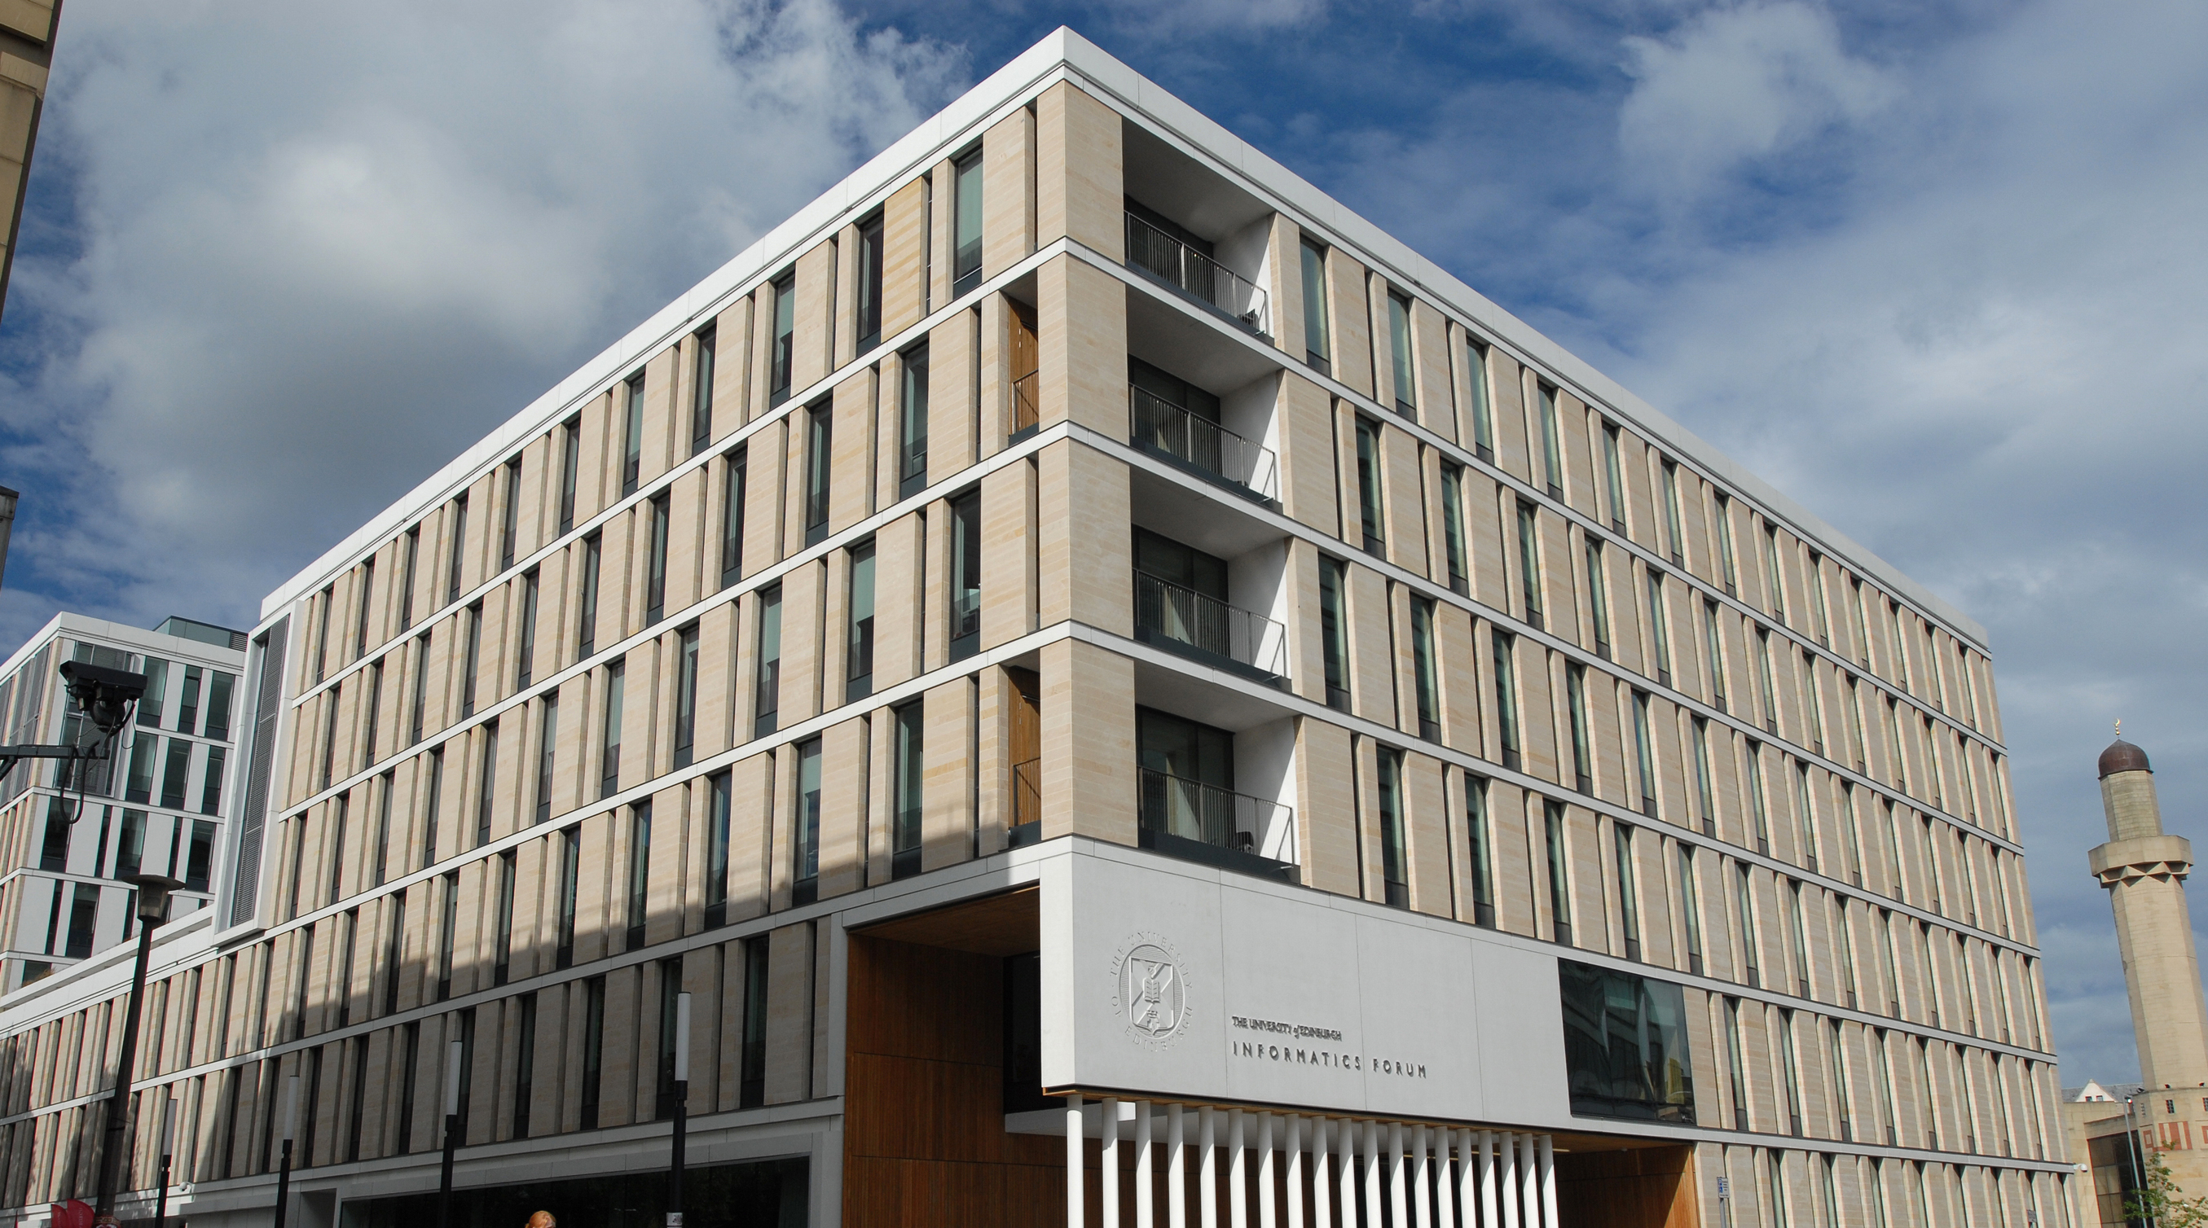
Informatics Project Proposal:
Tutorial 1: What is an IPP?
INFR11137: Informatics Project Proposal

Slide 2
Content
Here are the essential outcomes of today’s tutorial:
‘Elevator pitch’: Introduce yourself and meet your tutor and tutorial group
Understand the structure of an IPP
Review a previous IPP example
Notes:
Note to tutors: Please feel free to use these slides or develop your own methods but please make sure that you cover these three items.
YOU MUST RECORD ATTENDANCE – using EUCLID’s ‘Student attendance recording’ tool. We will email you with instructions for how to do that!
YOU MIGHT HAVE STUDENTS WHO ARE NOT OFFICIALLY IN YOUR GROUP ESPECIALLY DURING STRIKE DAYS. PLEASE REORD THEM AS WELL. THANKS

Slide 3
Elevator pitch (10-15mins)
This activity will follow an ‘elevator pitch’ format, aimed at focusing your attention to distil and deliver information in an efficient manner.
In this tutorial, the ‘elevator pitch’ requires you to introduce yourself in 60s (maximum 200 words).

Slide 4
Elevator pitch
For your brief presentation today, here are some guiding questions:
What is your name?
Where are you from?
What did you do before this MSc?
What would you like to do after completing the MSc?
Please, post this elevator on our Piazza forum, within the folder “tutorialgroupX”, where X is your tutorial group number
Notes:
For Tutors:
Please post a note on Piazza forum, in the folder “tutorialgroupX” (where X is the number of your group) and invite your students to add their ‘elevator pitch’. You can use the text below. At the beigining of the tutorial, intorduce yourself and ask each student to introduce themselves in 60s. Please, keep the time strictly to be able to cover the other 2 items.
===
For the NOTE on Piazza forum:
Dear Students,
Please post your 'elevator pitch' for the following tutorial (Tutorial X) under this note. This week elevator pitch' requires introducing yourself in 60s (maximum 200 words).
Here are some guiding questions:
What is your name?
Where are you from?
What did you do before this MSc?
What would you like to do after completing the MSc?
Thank you, and see you in the tutorial,
[Tutor Name]

Slide 5
Structure of project proposal (10 mins)
Open the IPP template on Github:
https://github.com/bfranke1973/IPP-Template/blob/master/main.tex
Go through each section with your tutor to understand what each section is about
Ask questions to clarify different components of the IPP
Notes:
For Tutors:
Please walk the students through the template so they get a feel for each section. Encourage them to ask questions. We will have tutorials or other content on things like risk planning, project management etc in coming weeks.

Slide 6
IPP example - read (10 mins)
You were asked to read 1 past IPP report in preparation for the first tutorial
Please take 10 minutes to familiarize yourselves with the texts once again
Notes:
For Tutors:
It was suggested to the students to read past IPP example 8 ahead of the tutorial in order to be prepared for discussion
*However, the tutors can suggest a different IPP example for their own group(s) to work on, if they consider other reports to be more relevant for their group(s)
You might want to allow for up to 10 minutes for the students to read and get acquainted with the text if they haven’t read the material prior to coming to class.

Slide 7
IPP example - discussion (10 mins)
You will work in groups/pairs (if possible) to discuss the past IPP example (any modification and improvement).
Give at least one improvement for the IPP example.
Notes:
For Tutors:
Invite your students to share their points.

Slide 8
Final Discussion (5 mins)
The main IPP components are:
  Abstract,
  Motivation (including Problem Statement, Research Hypotheses …)
  Background and Related Work,
  Programme and Methodology,
  Evaluation, Expected Outcomes,
  Research Plan, Milestones and Deliverables,
  References
2. You reviewed a prior IPP
Notes:
For Tutors:
For 1, please summarise the main components of an IPP: Abstract, Motivation (including Problem Statement, Research Hypotheses and Objectives, Timeliness and Novelty…), Background and Related Work, Programme and Methodology, Evaluation, Expected Outcomes, Research Plan, Milestones and Deliverables, References
For 2, please highlight the strengths and weaknesses of the IPP you reviewed and the main suggestions for improvement.
Encourage your students to ask questions at the end of tutorial, but also on Piazza. Encourage them to post on Piazza their elevator pitch each week and to comment on other colleagues’ pitches.

