Slide 1
Exploring Design Paradigms:
Methods, Ethics & Inclusivity
Aditi Surana
Design Informatics, University of Edinburgh

Slide 2
Computer Science / Informatics background
MFA in Design & Technology
Service Design / Design Researcher in Industry
Design Researcher at IDI / DCODE Network on AI Governance

Slide 3
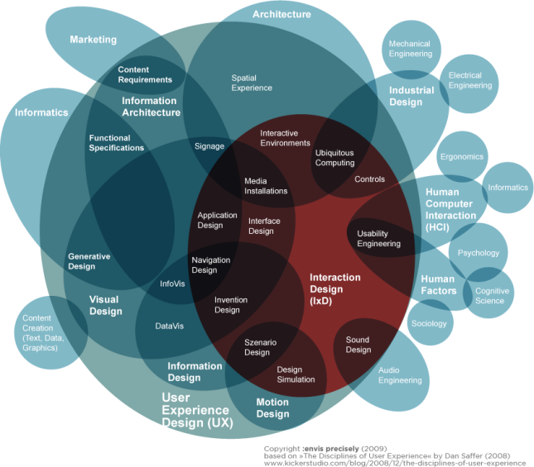

Slide 4
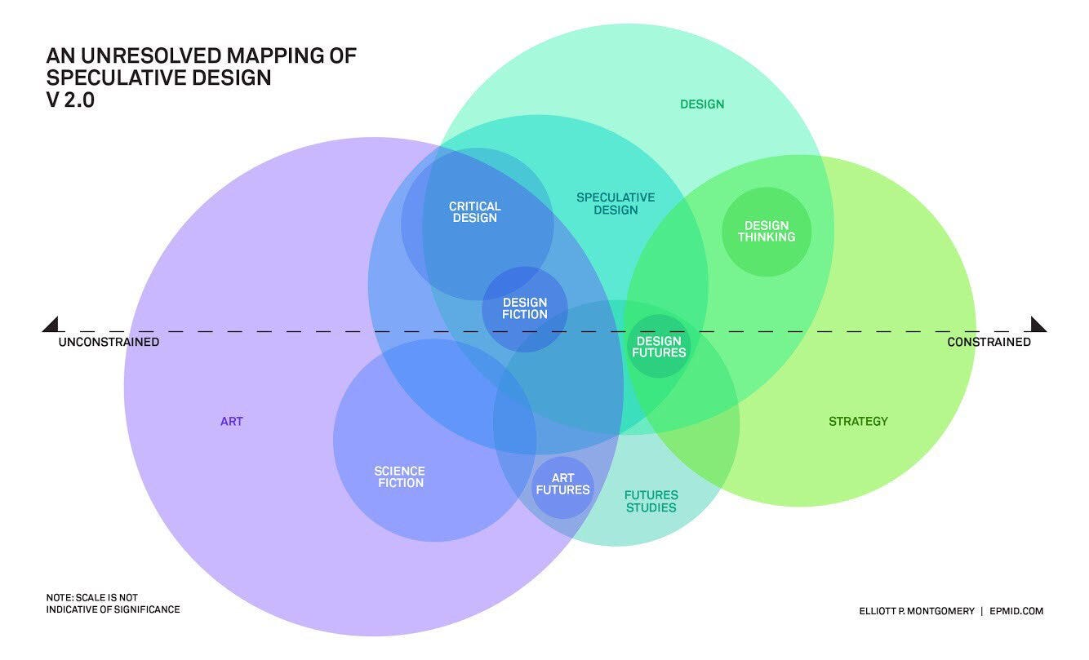
https://www.epmid.com/Mapping-Speculative-Design

Slide 5
Design is building something while working on behalf of the public / audience / user

Slide 6
Design is building something while working on behalf of the public / audience / user
Design is informed by methods in Psychology, Sociology, Anthropology, Art, Informatics and more

Slide 7
Why Design Ethics?

Slide 8


“Dark patterns are carefully crafted interfaces that trick people into making decisions or performing actions that they otherwise would not.”
https://www.toptal.com/designers/ux/dark-patterns

Slide 9
Activity 1: Find dark patterns
(5-7 mins)
https://bit.ly/3FReIUe

Slide 10
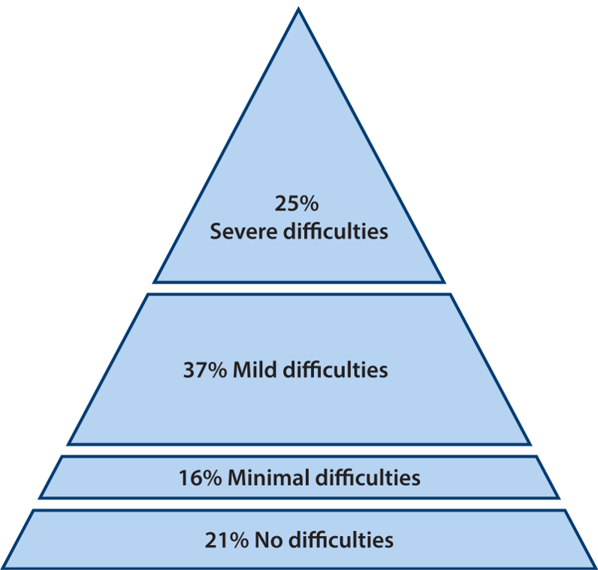
Inclusive Design
“The design of mainstream products and/or services that are accessible to, and usable by, as many people as reasonably possible ... without the need for special adaptation or specialised design. ”
https://www.inclusivedesigntoolkit.com/whatis/whatis.html

Slide 11
Activity 2: Inclusive Design in practice
(20 mins)
https://bit.ly/3FReIUe

Slide 12
Design – tech collaborations
and speaking the language

Slide 13
Questions?

