Slide 1




The University of Data: Exploring students’ perspectives on datafication in higher education
Joe Noteboom
Professional Issues Guest Lecture
20 October 2023

Slide 2
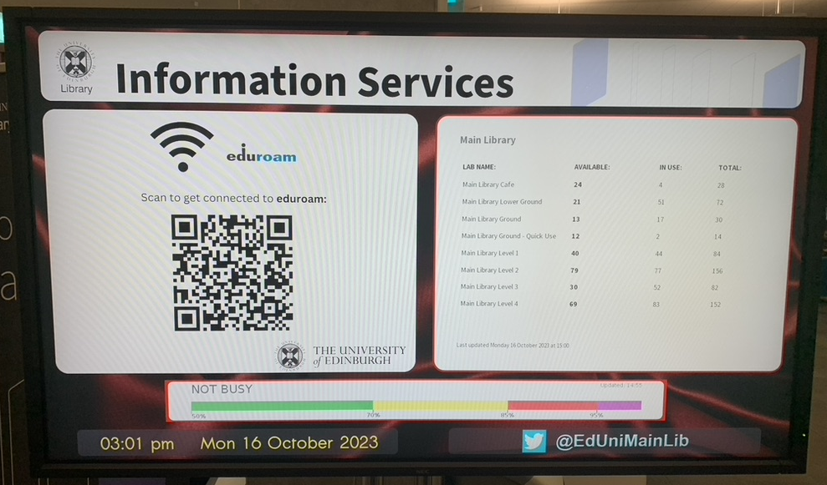

Slide 3
Library Occupancy Monitoring
Rationale: concerns from students about lack of study space
Proposed solution: IoT-based usage monitoring & visualization
Potential data sources:
  Under-desk monitors
  Gate entry & exit records
  Wifi access points
Outputs: traffic light system for students & management reporting
Source: Domínguez, Andrés, Ewan Klein, Charles Raab, and James Stewart. 2020. ‘Ethical and Responsible IoT: The Edinburgh Initiative’. European Journal of Law and Technology 11 (2). https://ejlt.org/index.php/ejlt/article/view/756.

Slide 4
Student Wellbeing Pilot
Background: rising student mental health referrals / support needs
Proposed solution: analysis of student engagement data to identify ‘at risk’ students (with external company Solutionpath)
Potential data sources:
  Learn usage
  Library resource usage
  Student record data
Outputs: report on feasibility / usefulness of analysis
Source: https://uoe.sharepoint.com/sites/StudentAnalytics/SitePages/Learning-Analytics---Student-Wellbeing.aspx

Slide 5
Discussion
Choose one of the case studies:
  Library Occupancy Monitoring
  Student Wellbeing Pilot
With a partner, discuss:
  How much did you know about this project before the lecture?
  Do you think it would be useful?
  What issues might it present?
  How would you feel about your data being used for this purpose?

Slide 6
Datafication in higher education
Datafication = “the transformation of human life into data through processes of quantification, and the generation of different kinds of value from data” (Mejias & Couldry 2019)
Promises: improved understanding of learning; personalized teaching, support, services; more efficient management of resources
Problems: reduction of education to what can be measured; erosion of privacy, student and teacher autonomy; new and existing inequalities; transfer of power and value to private companies
Further reading: Selwyn, Neil, and Dragan Gašević. 2020. ‘The Datafication of Higher Education: Discussing the Promises and Problems’. Teaching in Higher Education 25 (4): 527–40. https://doi.org/10.1080/13562517.2019.1689388.

Slide 7
The University of Data project
Purpose: to understand what students think about datafication & explore what this means for the relationship between students, the university and wider society
Methods:
  University of Edinburgh as ethnographic case study
  Workshops & interviews with students from different disciplines
  Walking & mapping to sensitise students to questions around data and explore their relationships with technologies & the university

Slide 8
Students & everyday datafication
“The increased entanglement between the practices of everyday life and digital technologies is deeply significant for understanding the digital society in which we live, precisely because datafication is itself becoming so ubiquitous and so ordinary. If we lose sight of the everyday, we miss the greater part of datafication's social dynamics and material effects. But more than that - we sail straight past the very place where people feel these processes most deeply, and where they have the most capacity to act upon them, albeit in constrained and ethically complicated ways.” (Burgess et al 2022, p34)

Slide 9
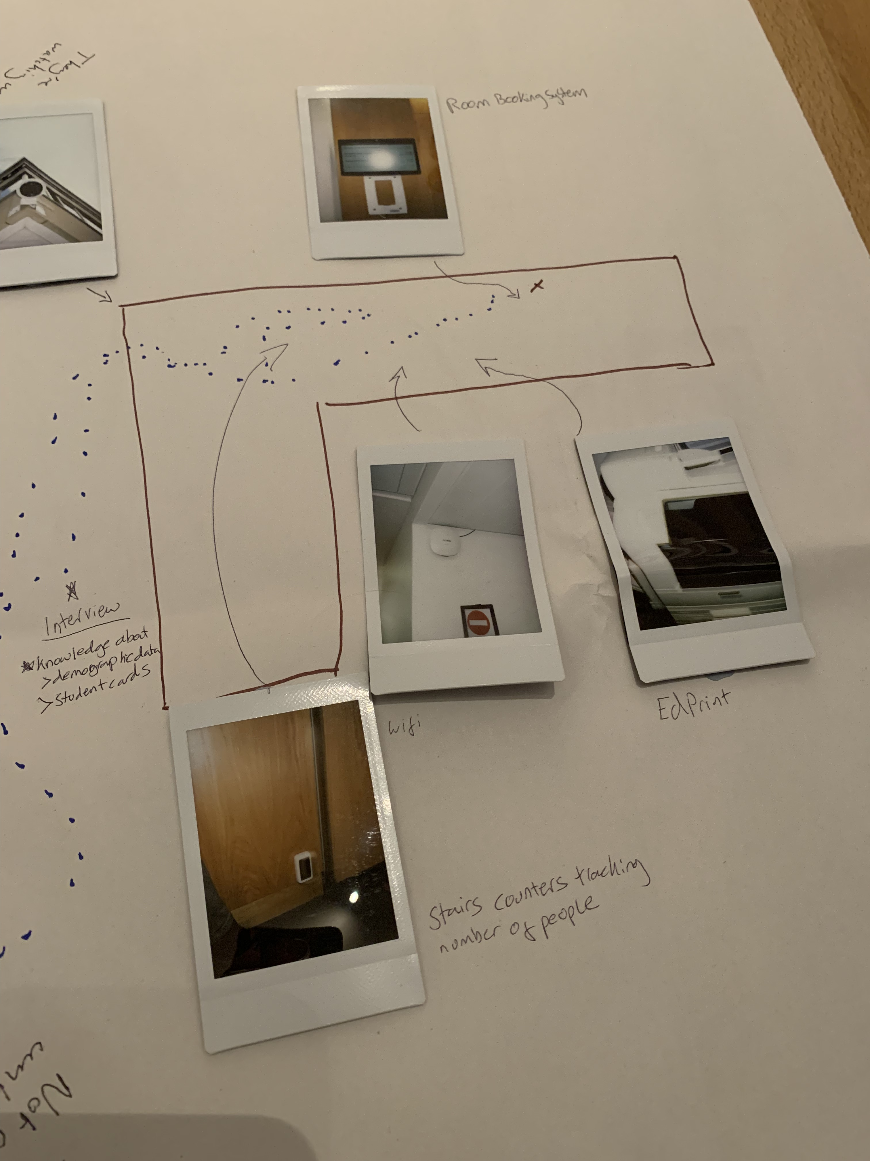
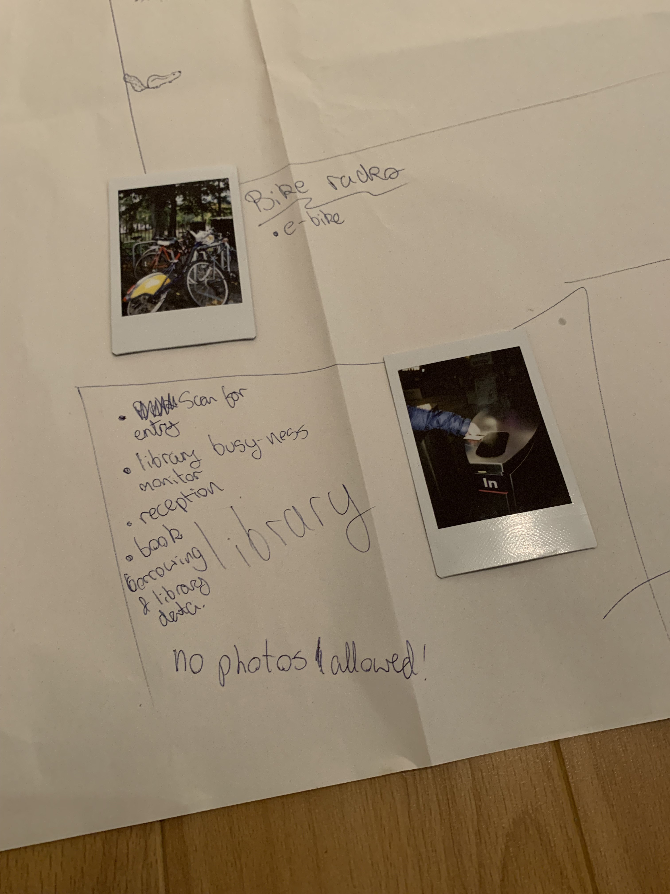
Data walking

Slide 10
Findings
Awareness & understanding
Possibilities
Concerns
Student-university relations

Slide 11
Awareness
Generally low level of awareness, interest in how student data is used – ubiquitous but invisible, taken for granted
Find it boring, unconcerned, ‘blissful ignorance’
Lack of information from university (but no one has read privacy statement)
University data practices insignificant compared to everyday use of platforms (social media, Spotify, etc)

Slide 12
Possibilities
Enhanced teaching and individualized student support
Improved user experience (e.g., building access, Learn)
Better information provision (study spaces, opportunities)
University resource optimization (room allocation, planning)
Support for student projects
To satisfy a sense of curiosity (‘I like the idea that when you die, you get a stats page’)

Slide 13
Concerns
Data not meaningful reflection of student life, activity
Loss of privacy, feeling of surveillance
Added stress and/or shame
Fear of potential data misuse (data breaches, bad actors)
Lack of consent, information from university
Lack of control over third party platforms

Slide 14
Student-university relations
Generally high level of trust in university data practices
  Good reputation, public institution
  Research ethics processes, care for students
  …but also, data immaturity/incompetence
Complicated by strikes, handling of pandemic, perception of university business model, partnerships with private companies
Overshadowed by feelings of resignation, disinterest, powerlessness

Slide 15
In sum…
Before workshops, participants were largely unaware of and unconcerned about university data practices
They did, however, identify several ways in which student data could be used to improve the student experience & fears and concerns regarding the use of student data
Feelings about data were closely tied to participants’ overall feelings about the university, with generally high, albeit unenthusiastic, levels of trust

Slide 16
So what? Data & student agency (1)
For many, higher education is fundamentally about student transformation and self-formation (Ashwin 2020, Marginson 2023) → important = student agency
Current data relations are primarily top-down, with students giving up their data to the university (& other actors) in exchange for (ostensibly) improved services and an enhanced experience
This encourages students to behave as passive data subjects, promoting ‘digital resignation’ (Draper & Turow 2019) rather than agency over data & education

Slide 17
So what? Data & student agency (2)
Alternate accounts have argued for the ‘radical participation’ (Knox 2022) of students (& staff) in digital governance and the involvement of students in decisions about how their data is collected and used
This could draw on traditions of student involvement in university governance, as well as forms of democratic and participatory data governance from other sectors
Student participation in data governance could also provide an important site for the development of ‘critical data literacies’ (Pangrazio & Selwyn 2019) that are increasingly essential for citizenship

Slide 18
Student data agency: four scenarios
The Jury: At the start of each academic year, the UoE Data Jury is chosen by sortition to represent the university community in matters of digital governance. The jury is composed of a representative sample of students, staff and external partners and regularly meets to deliberate on decisions around data collection and use. When a data-related decision arises affecting the university, from the procurement of digital infrastructure to privacy policies to the design of analytics dashboards, the jury is convened to deliberate and make a decision on behalf of the community. ​
The Union: Frustrated by the top-down nature of university data governance, UoE staff and students come together in solidarity to campaign for their data rights. Representatives from EUSA, UCU and other unions find common cause in resisting harmful data practices, from the use of discriminatory surveillance systems to algorithmic management techniques. The union uses data activist tactics such as subject-access requests and counter-mapping to assert the rights of its members with respect to data within the university.​
The Cooperative: Inspired by the platform cooperativism movement, all UoE digital infrastructure is brought under community control. The platforms that the university relies on are no longer owned by tech corporations, but instead open-source infrastructure operated and maintained in-house by and for the community. Platform data is therefore also owned and controlled by the community, with decisions about how it is collected and used made democratically by the staff, students and external partners most affected by these decisions.​
The Commons: UoE data is made radically open to its community through a new data institution hosted by the Edinburgh International Data Facility. Staff, students and external partners can apply to the institution’s ethics board to access data sets on the university estate, teaching activities and more for projects that seek to generate value for the wider university community. University data supports student projects, community research and institutional experimentation with ‘smart’ technologies.​

Slide 19
Questions/Comments
Did any of the findings surprise you?
What do you relate to? What is missing?
What do you think of the proposed solutions?
Would you like to be more involved in data governance, or are you happy with the status quo?
Feel free to contact me at j.noteboom@ed.ac.uk

Slide 20
References
Ashwin, Paul. 2020. Transforming University Education: A Manifesto. Bloomsbury Publishing.
Burgess, Jean, Kath Albury, Anthony McCosker, and Rowan Wilken. 2022. Everyday Data Cultures. Polity Press.
Draper, Nora A, and Joseph Turow. 2019. ‘The Corporate Cultivation of Digital Resignation’. New Media & Society 21 (8): 1824–39. https://doi.org/10.1177/1461444819833331.
Marginson, Simon. 2023. ‘Student Self-Formation: An Emerging Paradigm in Higher Education’. Studies in Higher Education 0 (0): 1–15. https://doi.org/10.1080/03075079.2023.2252826.
Mejias, Ulises A., and Nick Couldry. 2019. ‘Datafication’. Internet Policy Review 8 (4). https://policyreview.info/concepts/datafication.
Pangrazio, Luci, and Neil Selwyn. 2019. ‘“Personal Data Literacies”: A Critical Literacies Approach to Enhancing Understandings of Personal Digital Data’. New Media & Society 21 (2): 419–37. https://doi.org/10.1177/1461444818799523.

