Slide 1
The anatomy of ISO 42001
Continued – SCSD Lecture 5 Feb 2024

Slide 2
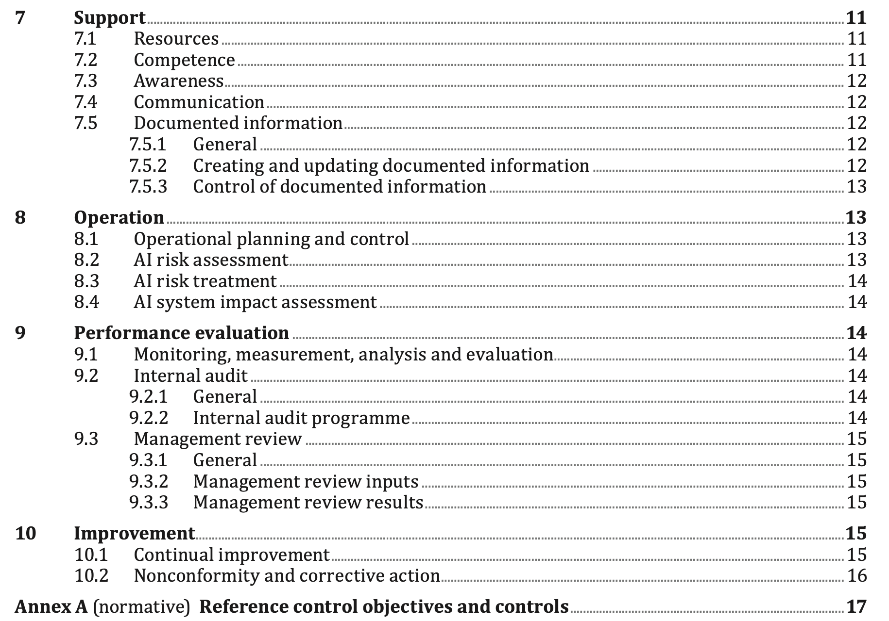
Further contents

Slide 3
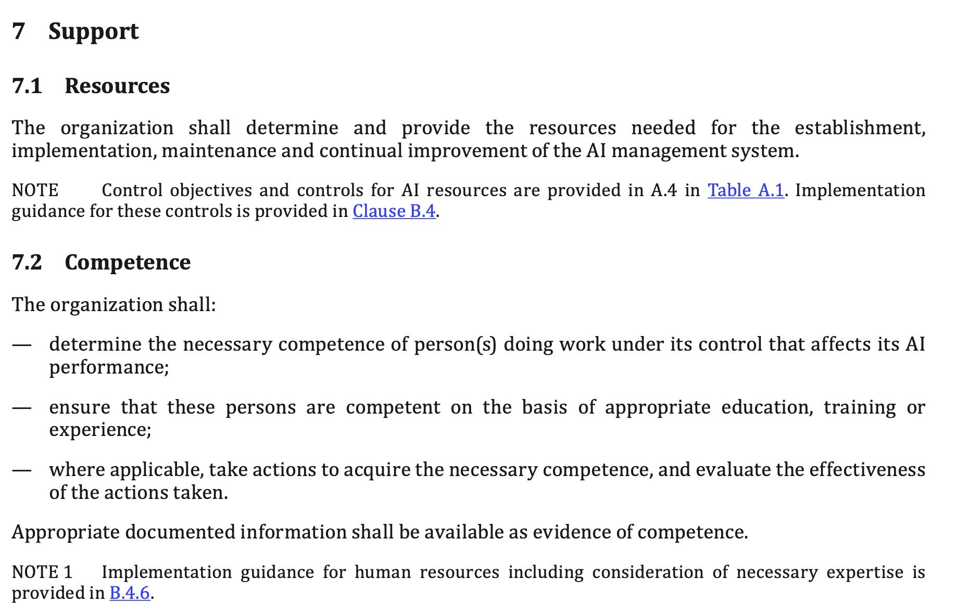
Resourcing and Competence

Slide 4
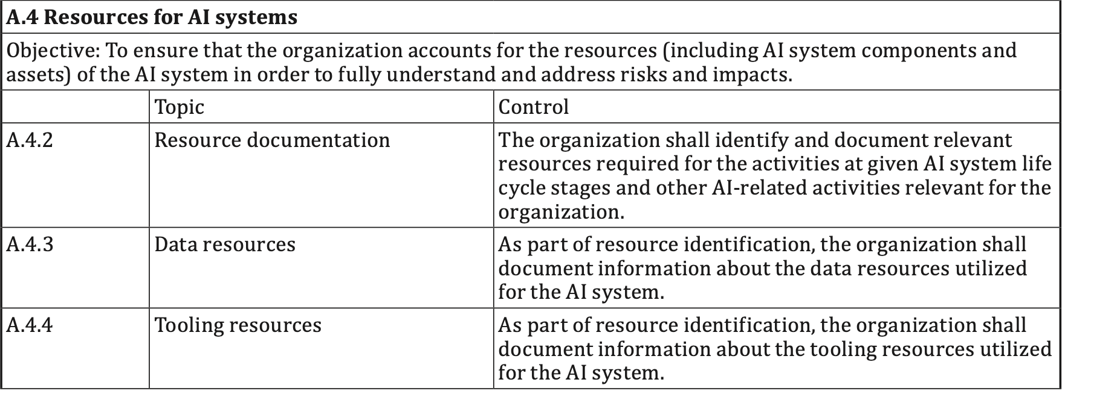
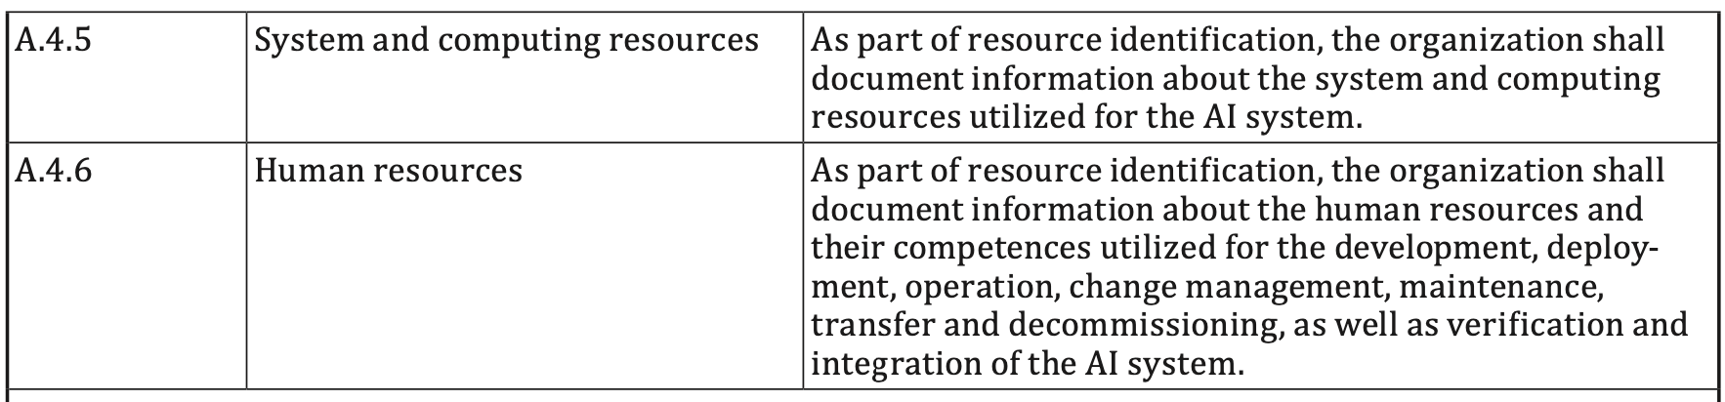
Resourcing

Slide 5
Competence
Roles should be defined with defined competence.
People should be able to demonstrate a match with the competence through education, training, experience,…
This should be documented.

Slide 6
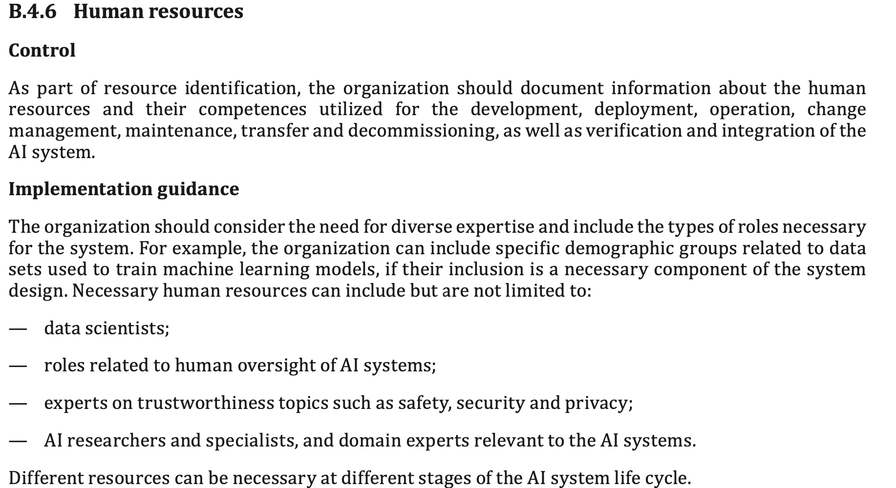
Competence defined (Annexe B: Normative)

Slide 7
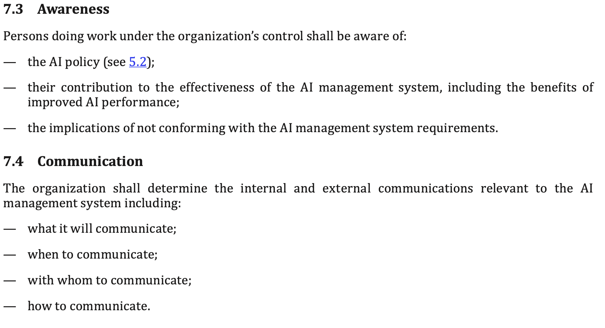
Awareness and Communication

Slide 8
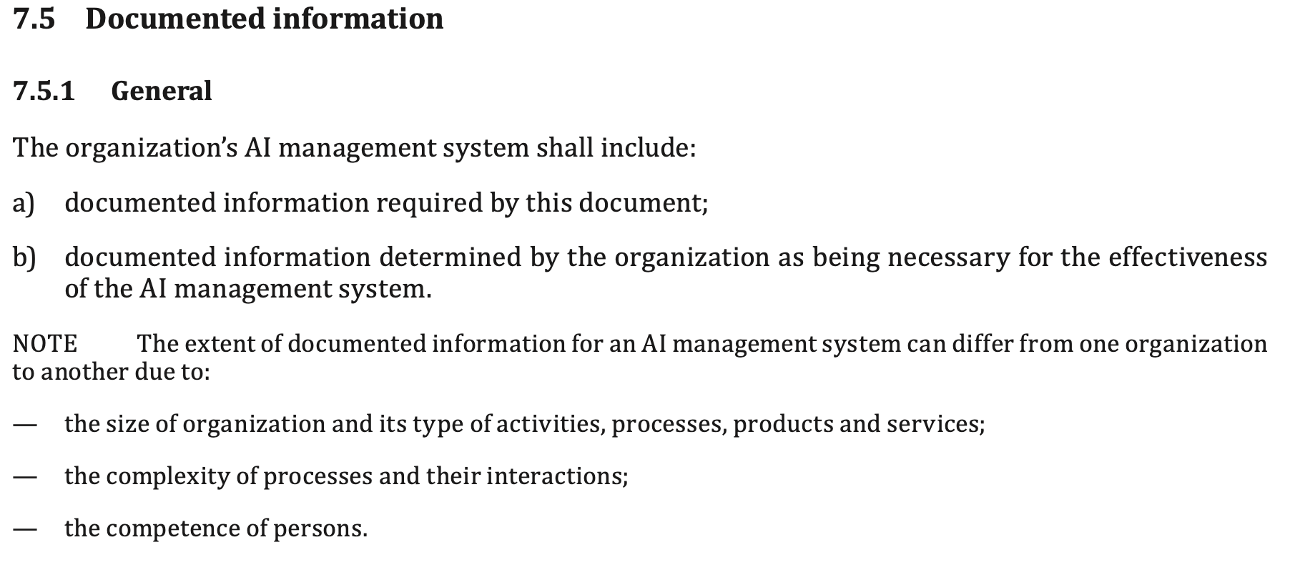
Documentation

Slide 9
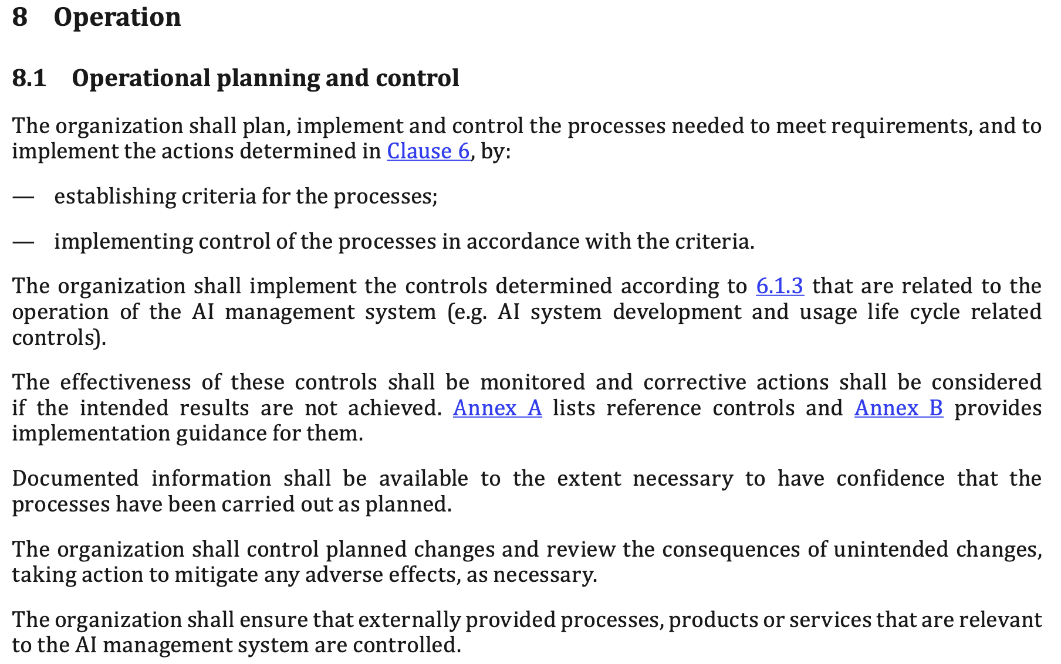
Operation

Slide 10
Operation
The controls are points to monitor – so the appropriate controls need to be identified.
The controls are also points of control so the means of control need to be established.
There is the need for monitoring of the effectiveness of the monitoring and control
Corrective action needs to be in place in the event of ineffectiveness

Slide 11
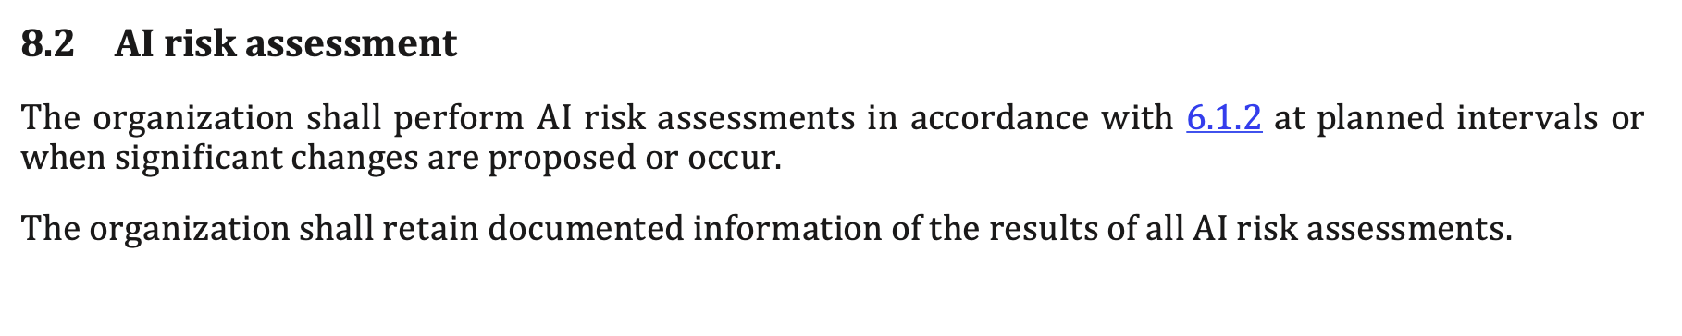
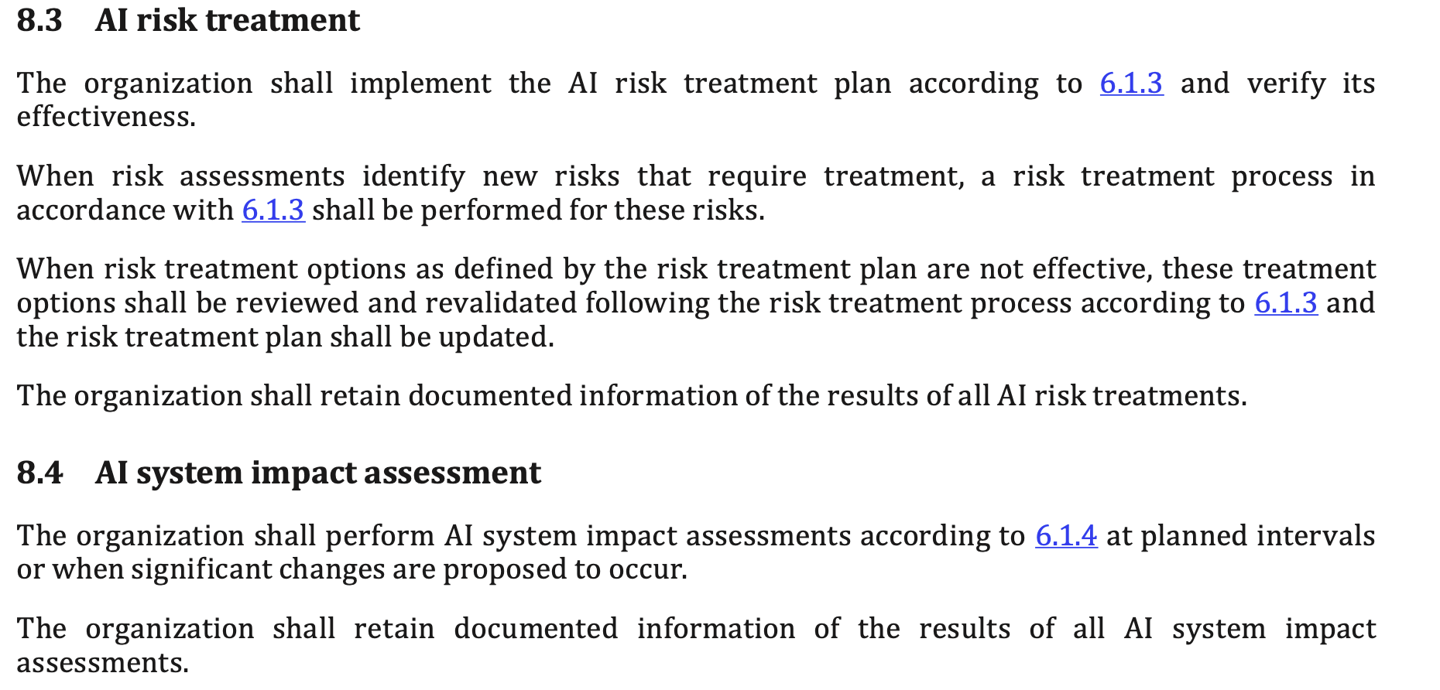
Risk and Impact

Slide 12
Risk and Impact
Continuous review to identify new risks
These need to be documented and treatments identified
Treatments need to be reviewed and monitored for effectiveness.
AI Impact assessment should be carried out routinely and when change is planned – this potentially affects a wide range of stakeholders.

Slide 13
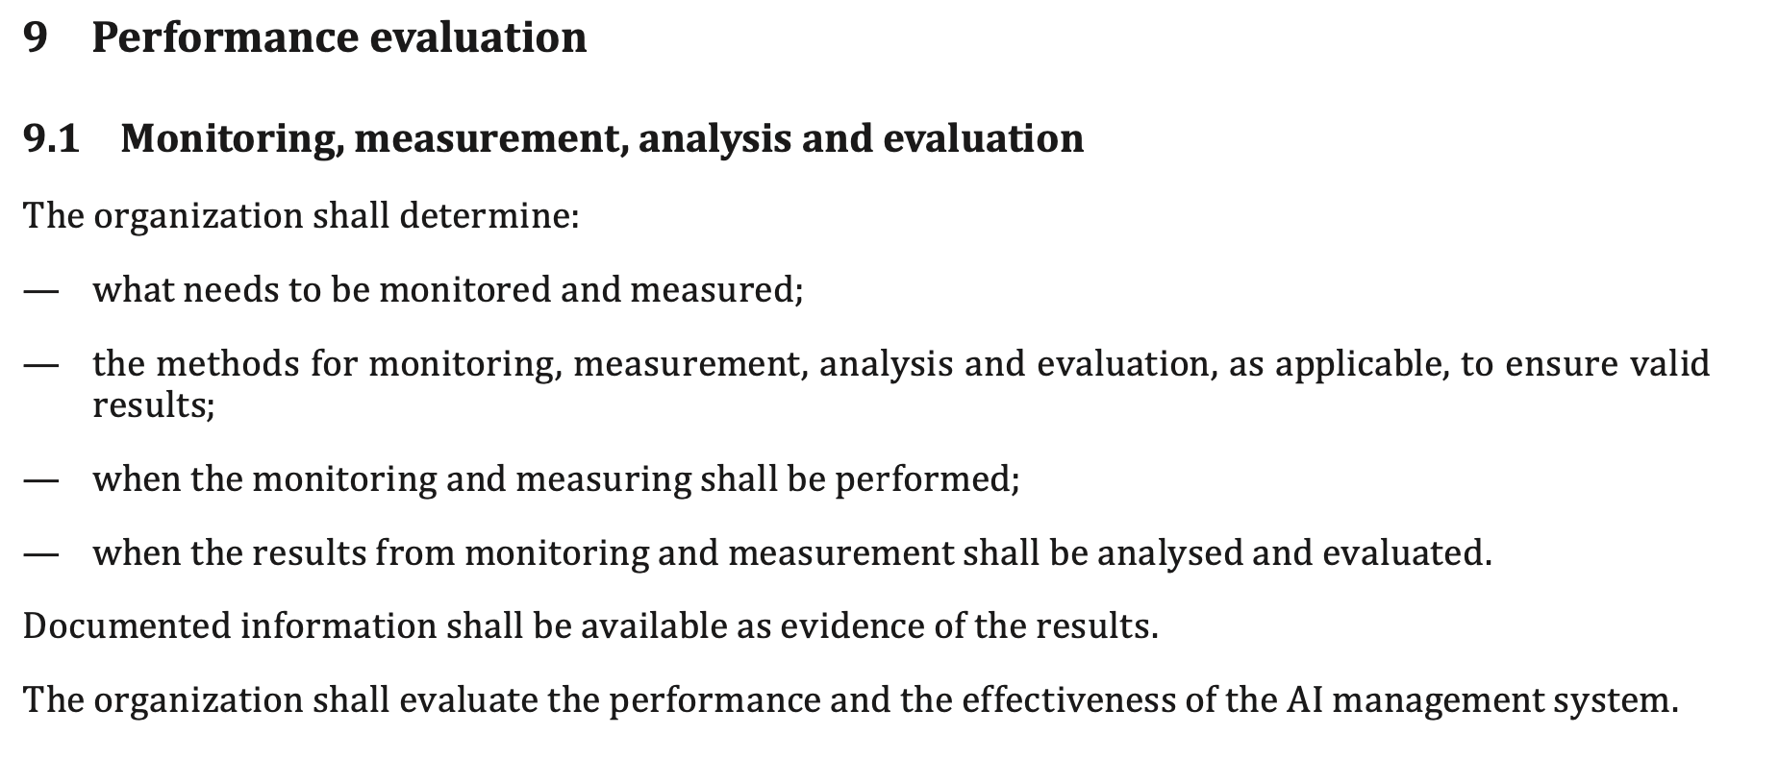
Performance

Slide 14
Performance
The organization determines the desired performance characteristics (and these need to meet the constraints of the standard).
The organization needs to plan for the monitoring and evaluation of the system.
There also needs to be a means to repair poor performance.

Slide 15
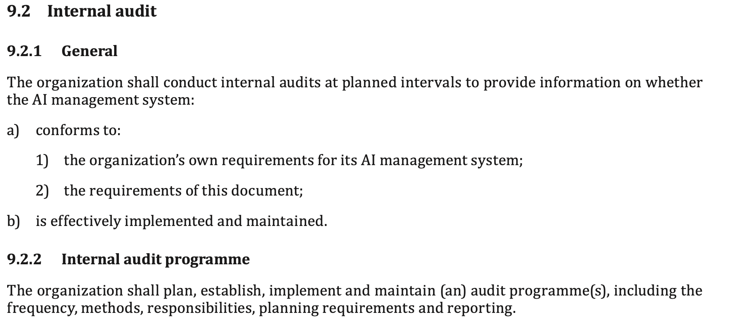
Audit

Slide 16
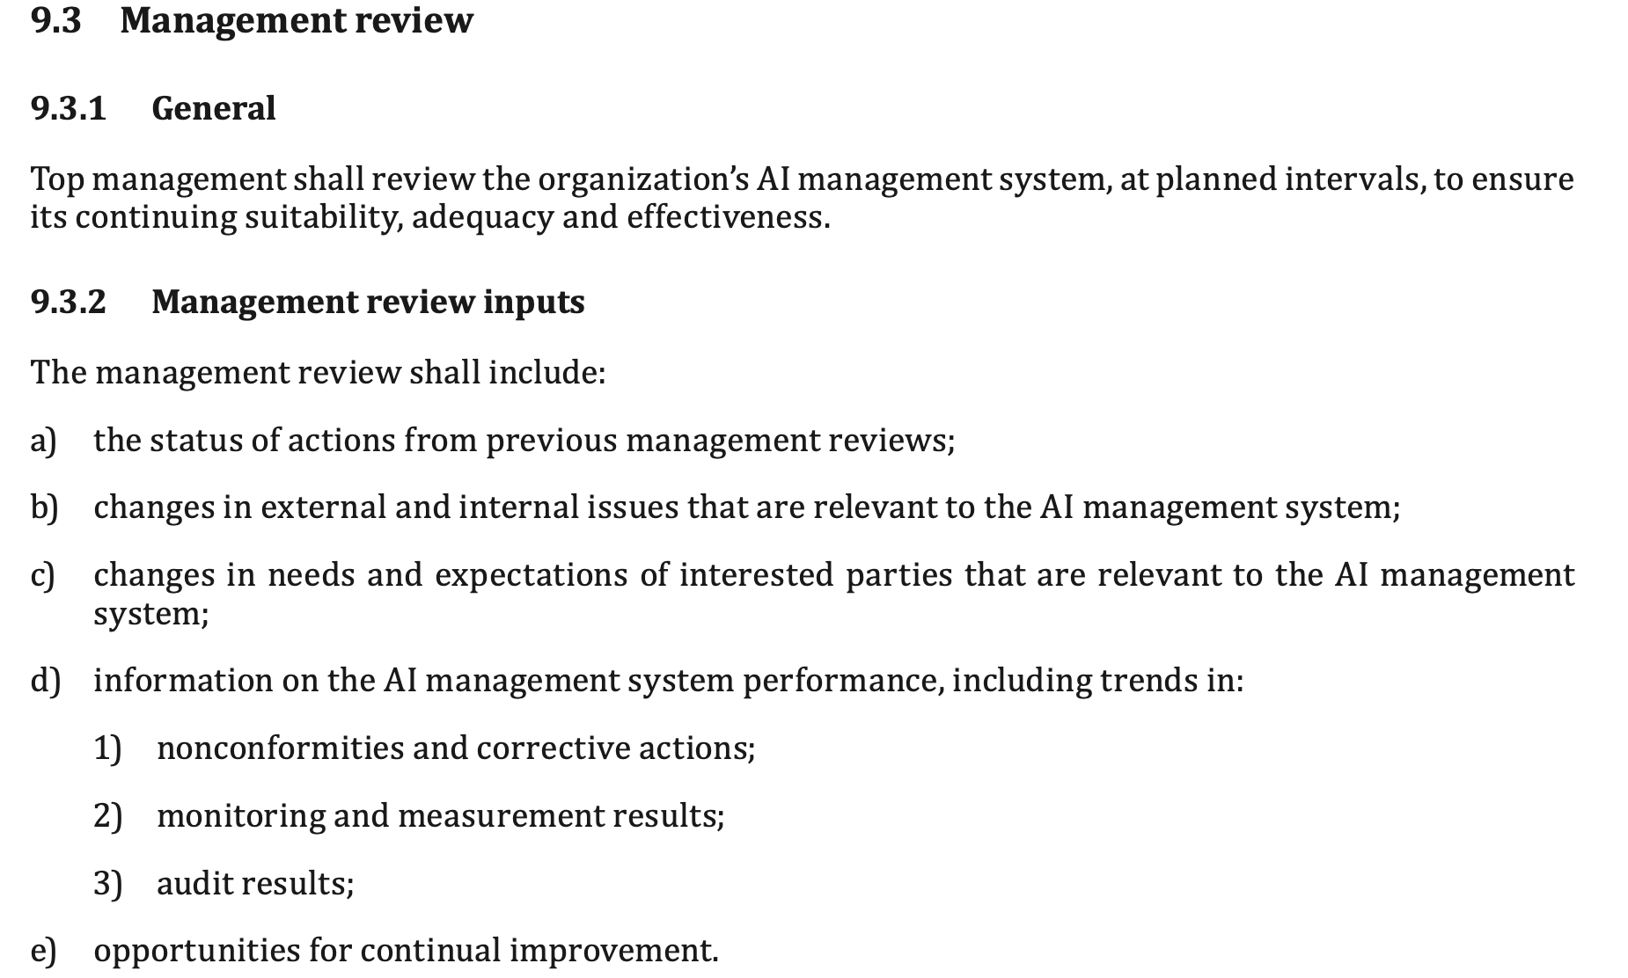
Review

Slide 17
Audit and Review
Audit is a routine task to look at possible non-conformities
Audit feeds into the review process.
The review process determines actions to be taken in response to monitoring , performance and audit.

Slide 18
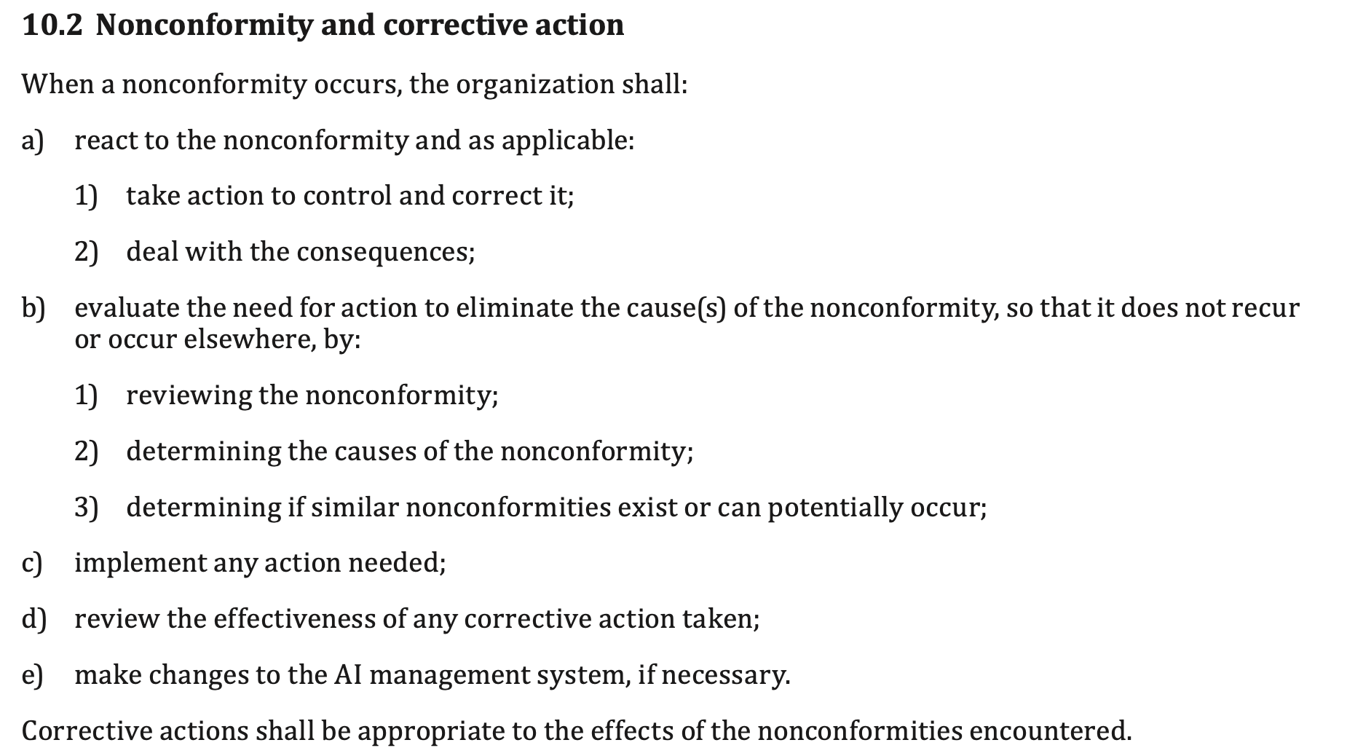
Nonconformity

Slide 19
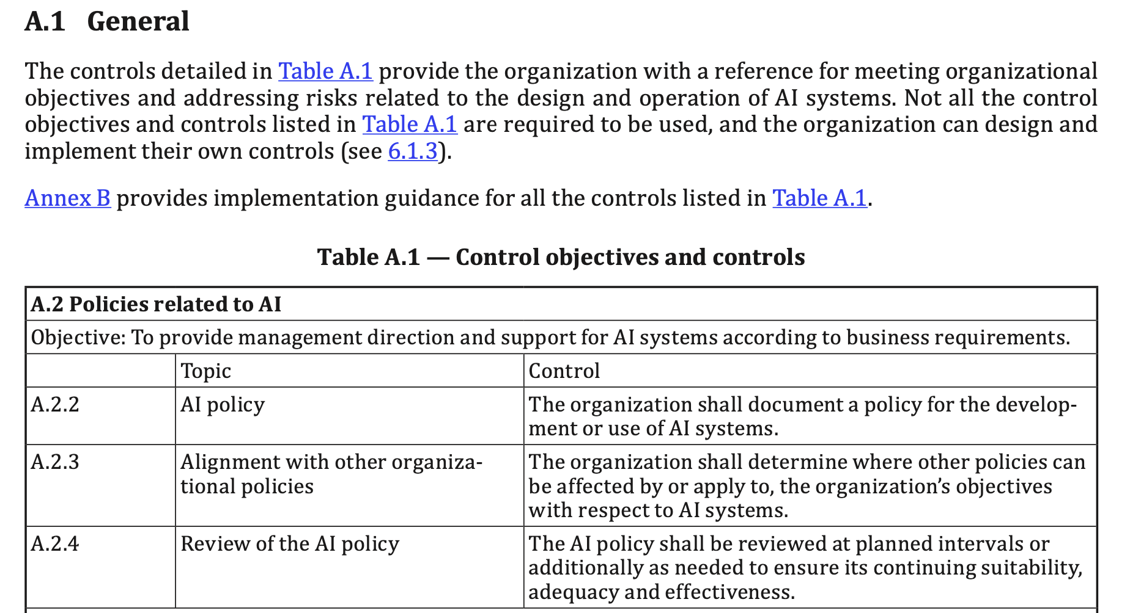

Slide 20
Controls
A 2.2: This relates to the origination of policy. Here the organization needs to check a policy is in place that covers all the AI systems controlled by the organization. There is control over the policymaking process.
A 2.3: This relates to the alignment with other policies. There is a need to monitor that this check has been carried out. Monitoring will identify possible failures of the process. There is control over the approach to checking and monitoring alignment
A 2.4: This ensures that reviews occur regularly and that they are correctly scoped. Monitoring checks the revisions improve performance. There is control over the review process.

