Slide 1
Evidence from Standards
SCSD Lecture
Monday 4 March

Slide 2
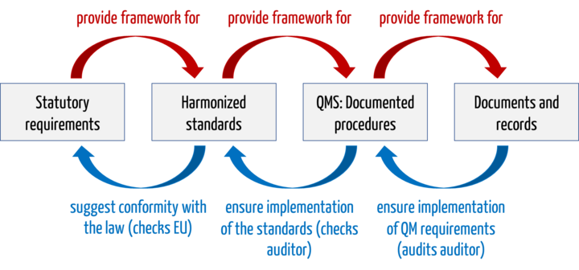
Standards and Regulation
Johner Institute

Slide 3
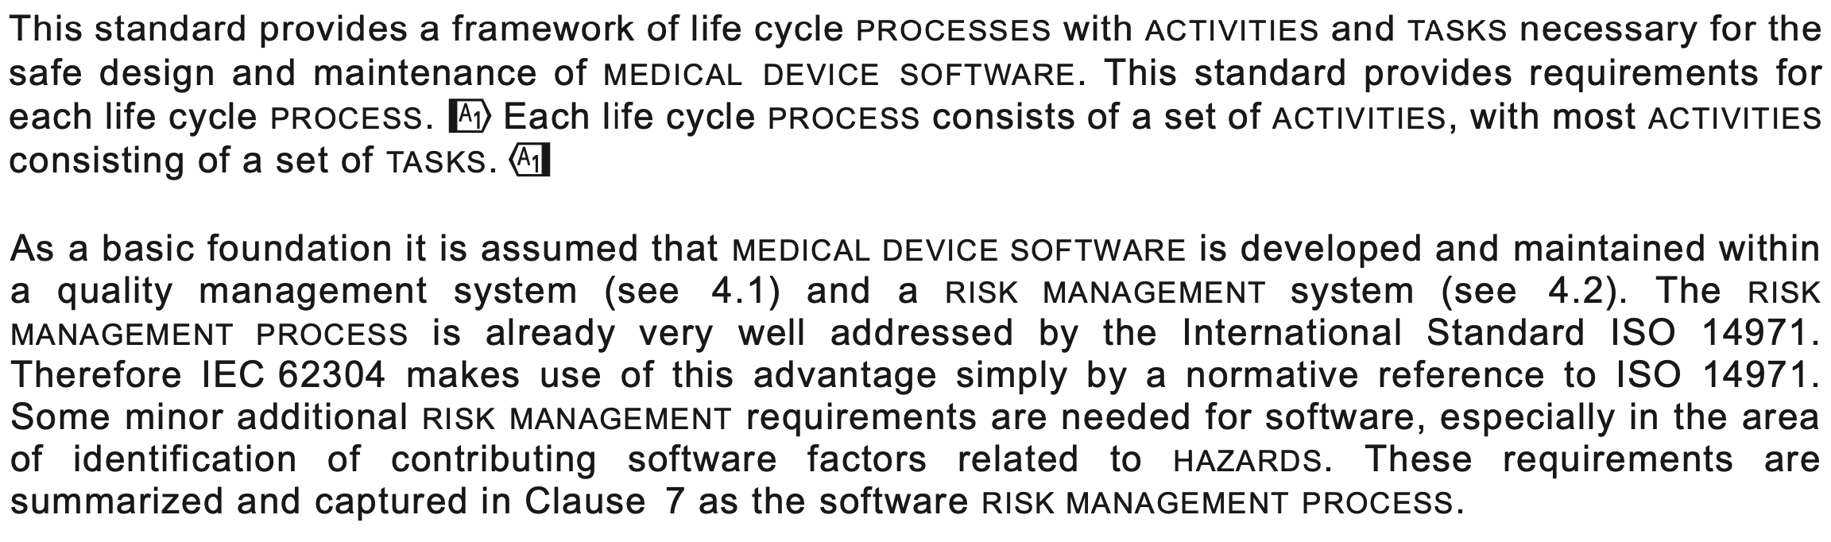
IEC 62304

Slide 4
Structure of IEC 62304
Clause 4: General Requirements – QMS, Risk, Safety, Legacy Software
Clause 5: Software Development Process – see next slides
Clause 6: Software Maintenance Process – see next slides
Clause 7: Software Risk Management Process – ISO 14971
Clause 8: Software Configuration Management Process
Clause 9: Software Problem Resolution Process
Appendix A provides a rationale for the clauses of the standard against software safety classes
Appendix B provides informative guidance on the provisions of the standard
Appendix C covers the relationship to other standards
Appendix D covers implementation of the standard

Slide 5
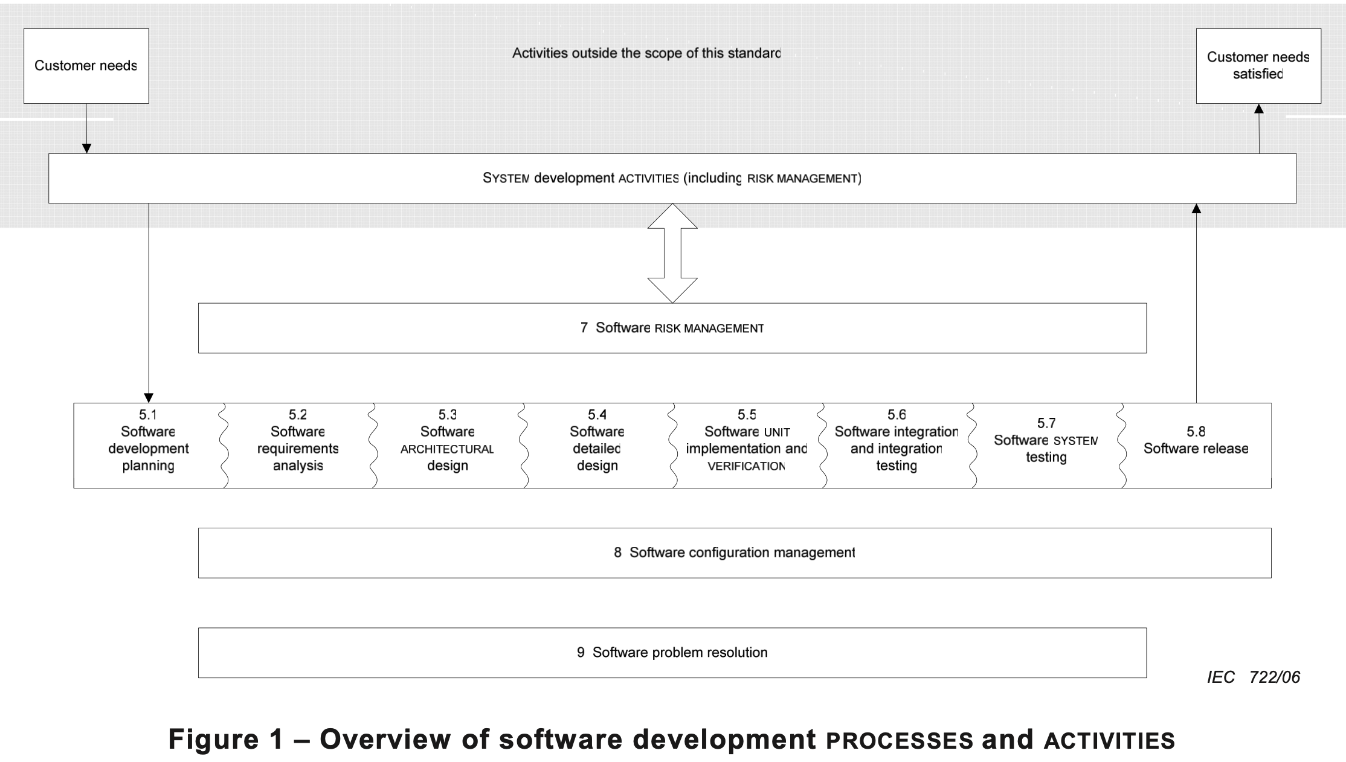

Slide 6
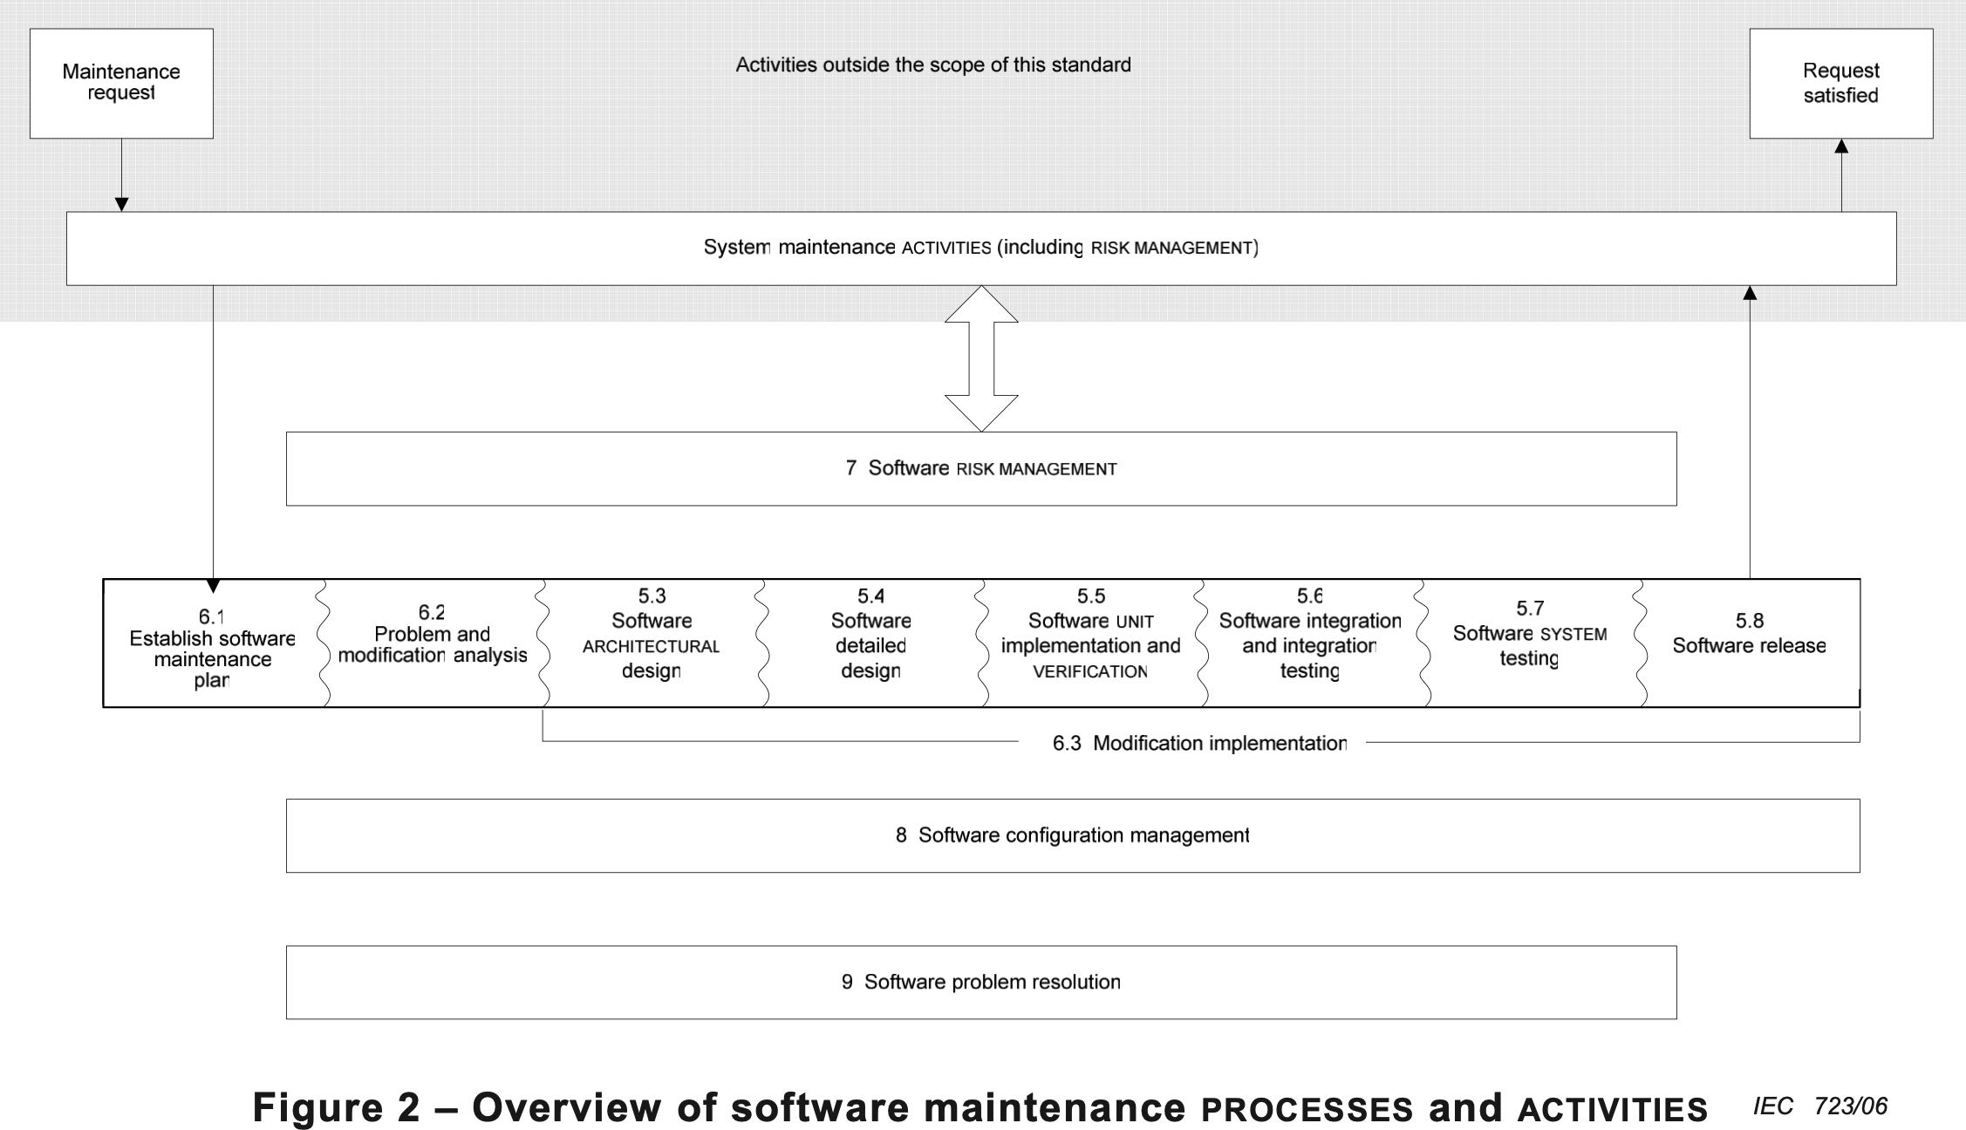

Slide 7
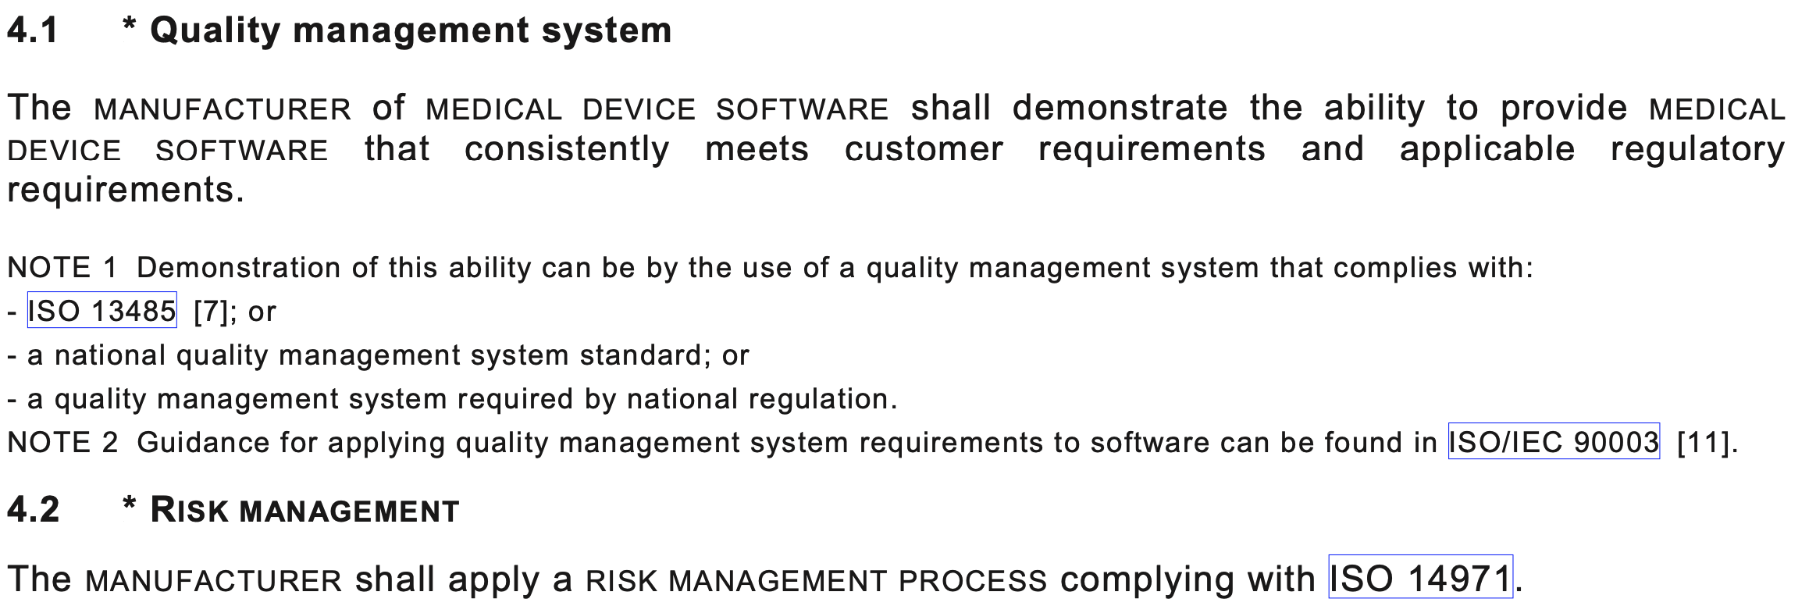
Quality Management and Risk Management

Slide 8
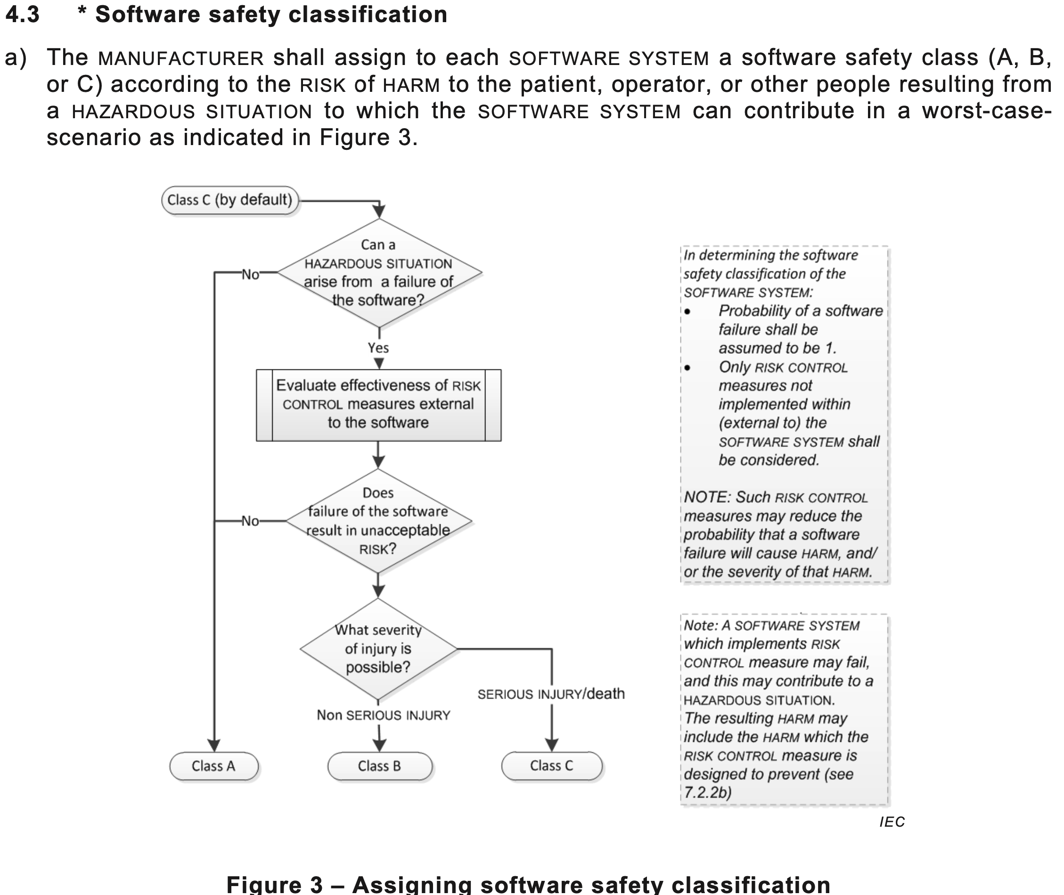

Slide 9
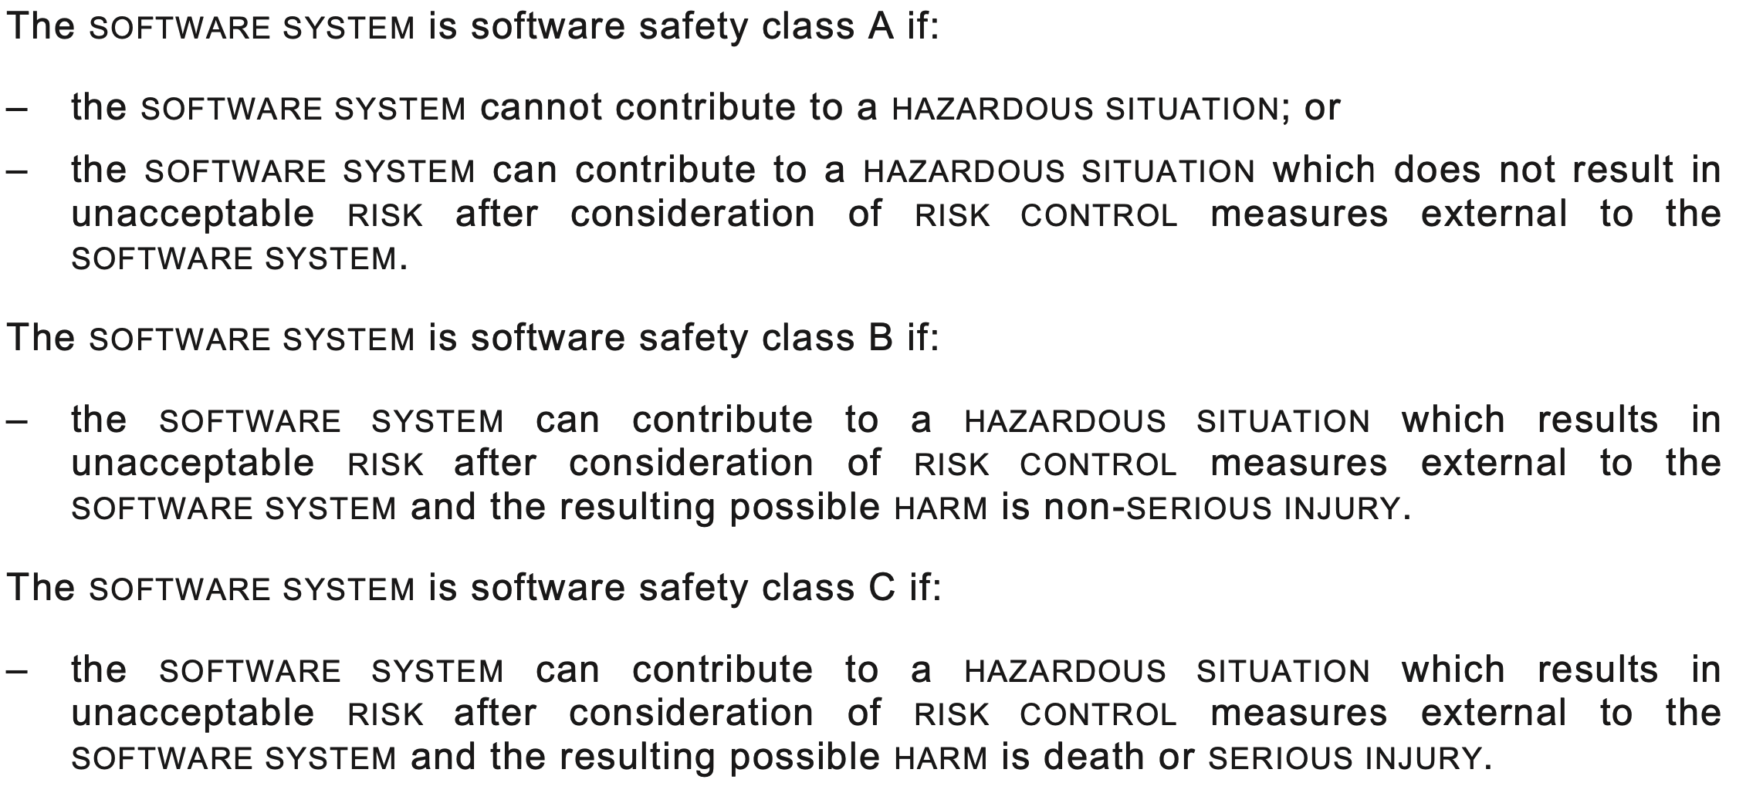
Safety Classes

Slide 10
Legacy Systems
Permits a manufacxturer of the software to avoid the requirements of clauses 5-9.
By risk managing the legacy software against the standard approach and closing any gaps.

Slide 11
Clause 5 (waterfall stages)
5.1: Software Development Planning
5.2 Software Requirements Planning
5.3 Software Architectural Design
5.4 Software Detailed Plan
5.5 Software Unit Implementation
5.6 Software Integration and Integration Testing
5.7 Software System Testing

Slide 12
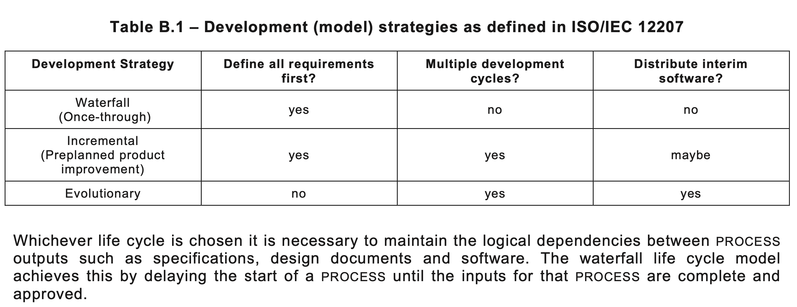
Realising Clause 5

Slide 13
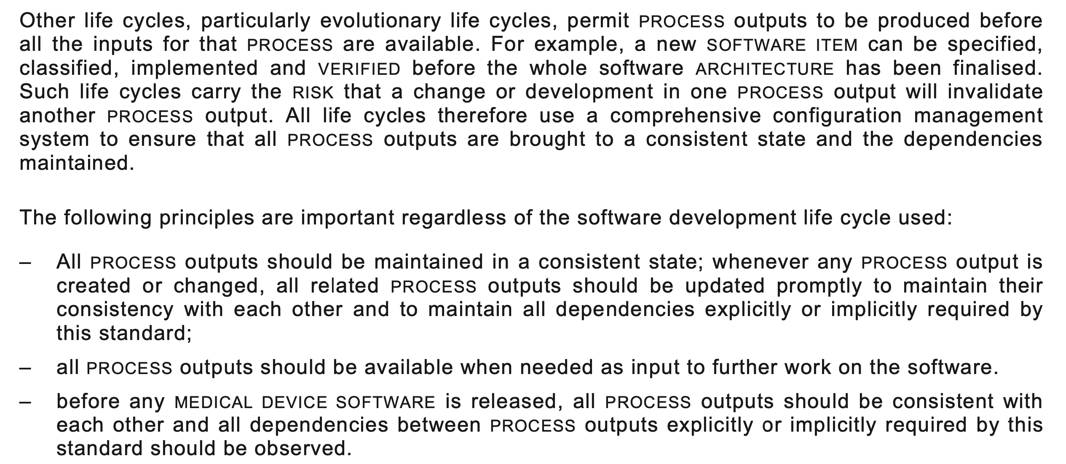
Consistency

Slide 14
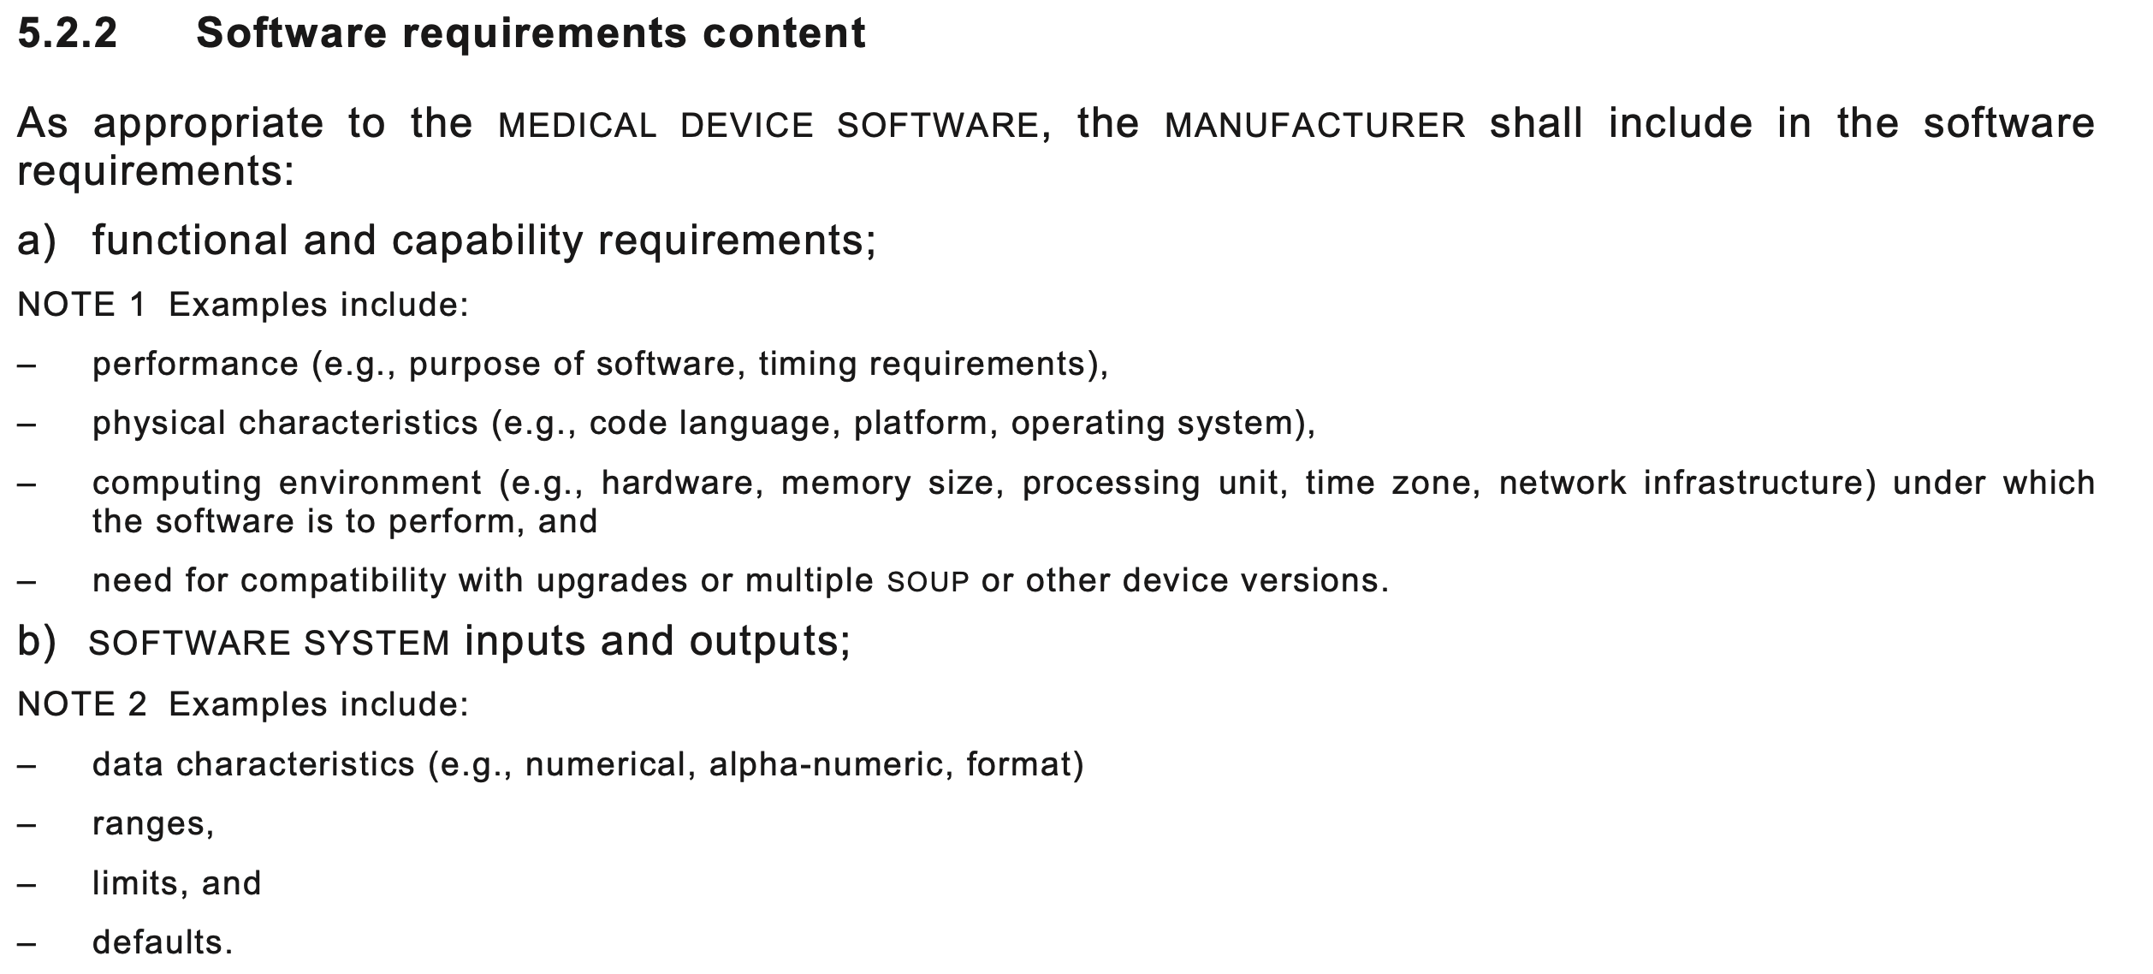
Subclauses provide detail e.g. 5.2.2

Slide 15
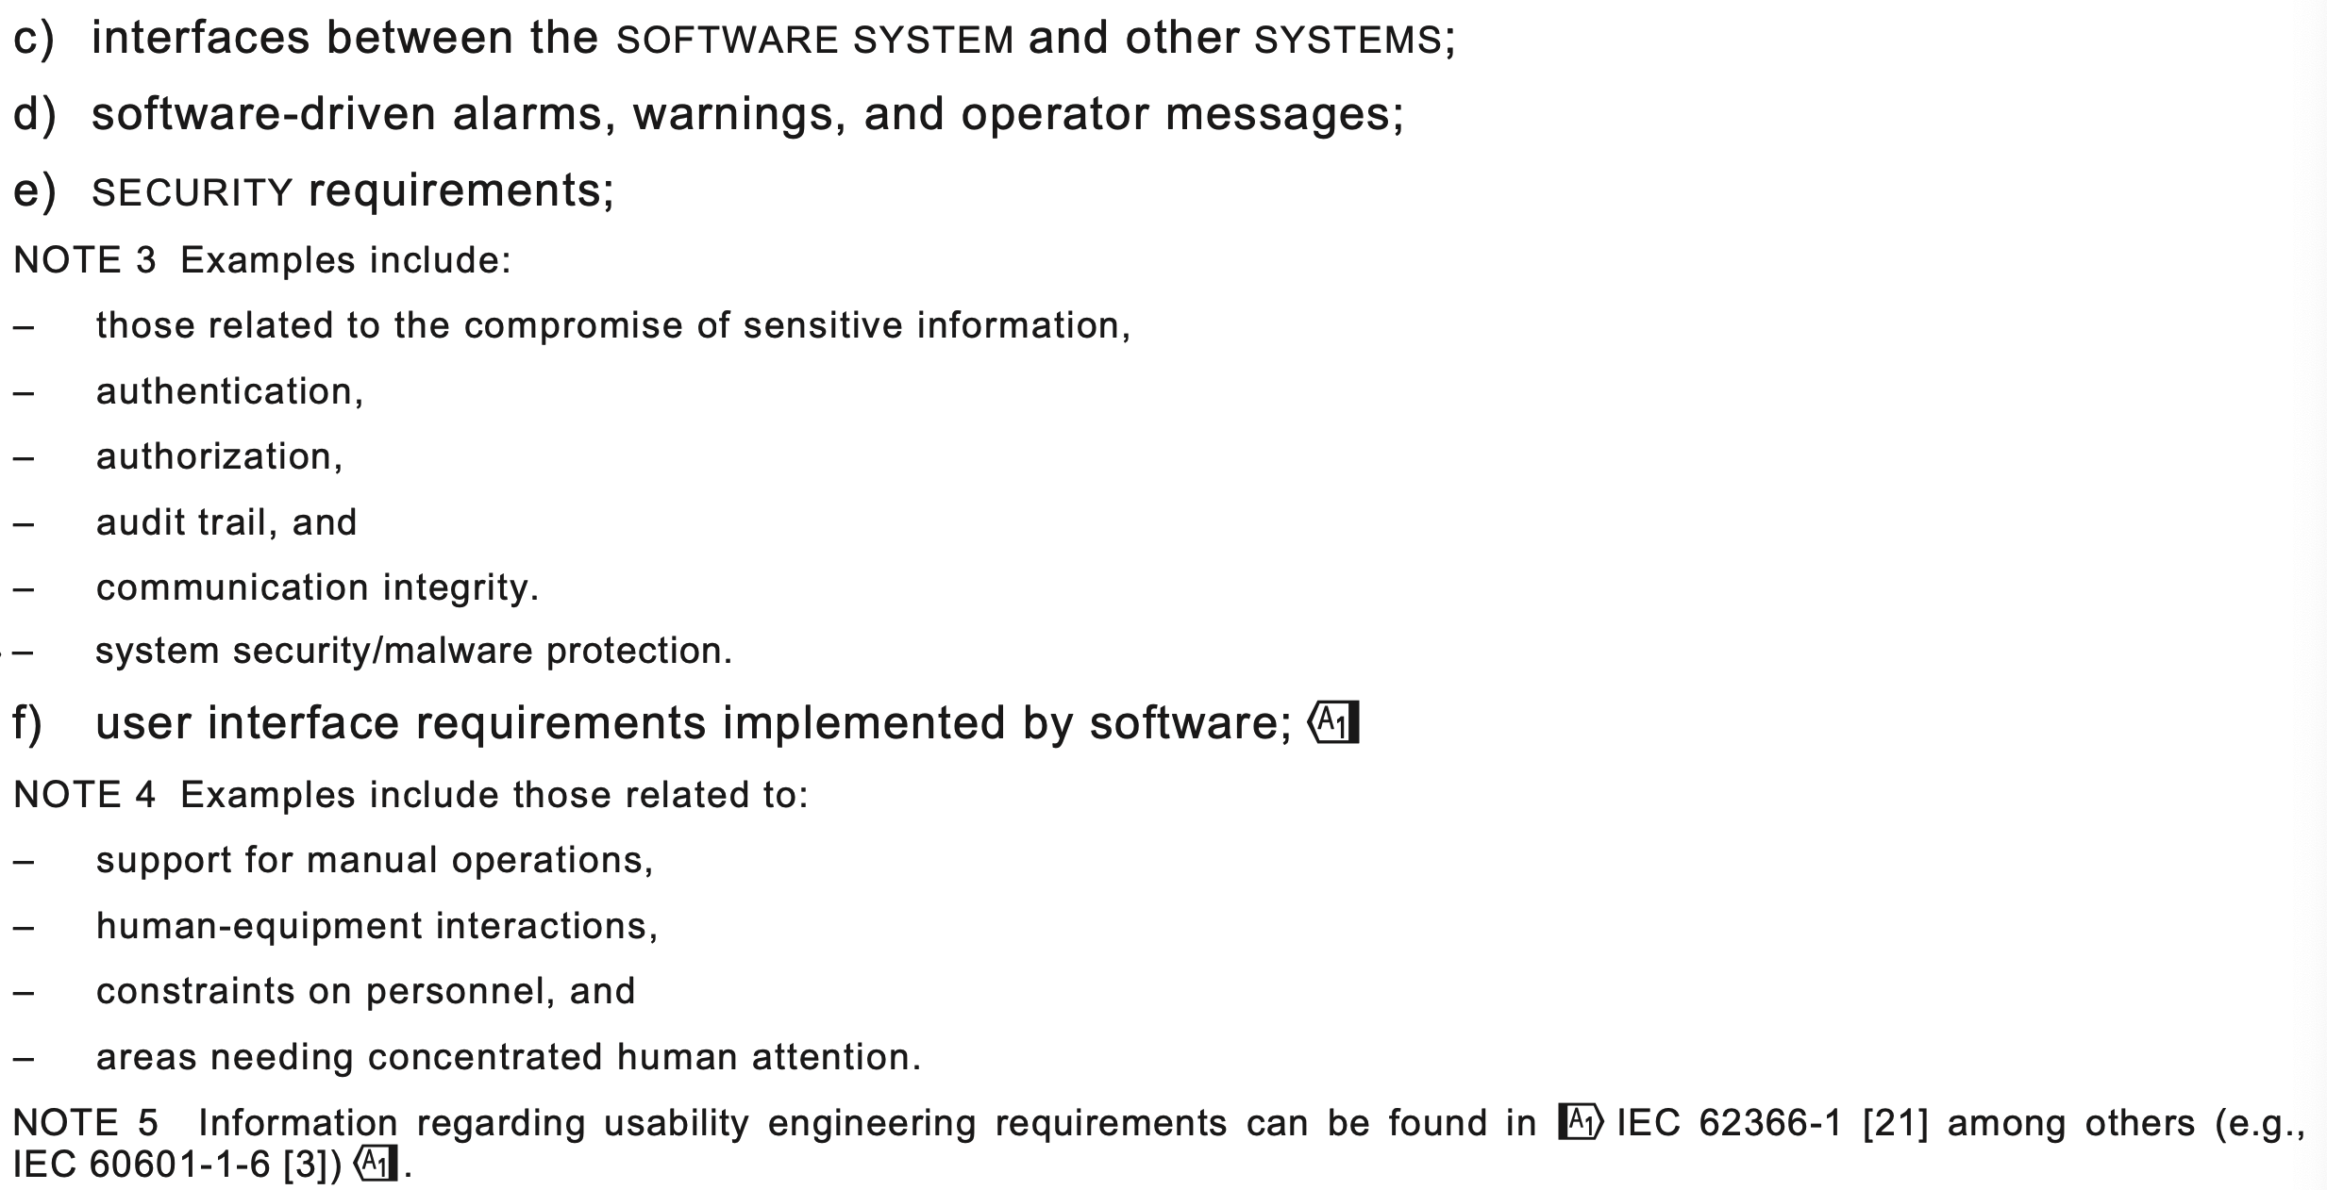
5.2.2 Continued

Slide 16
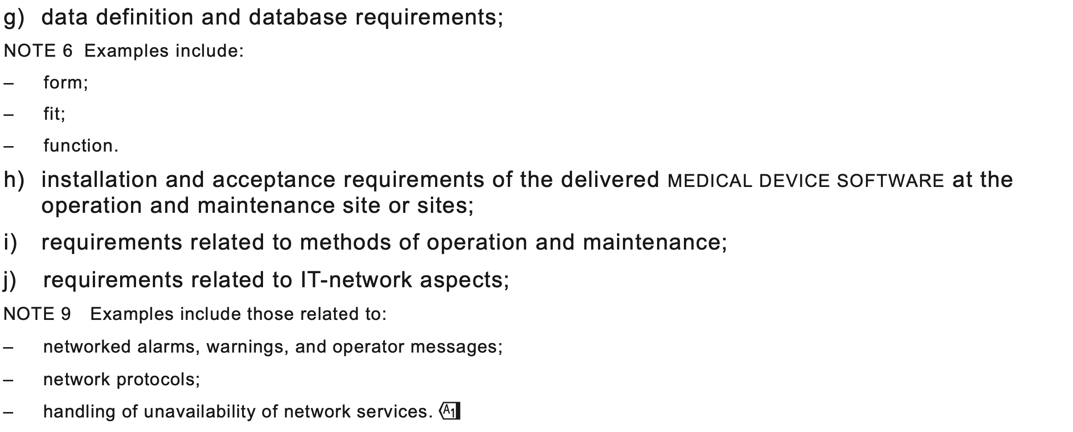
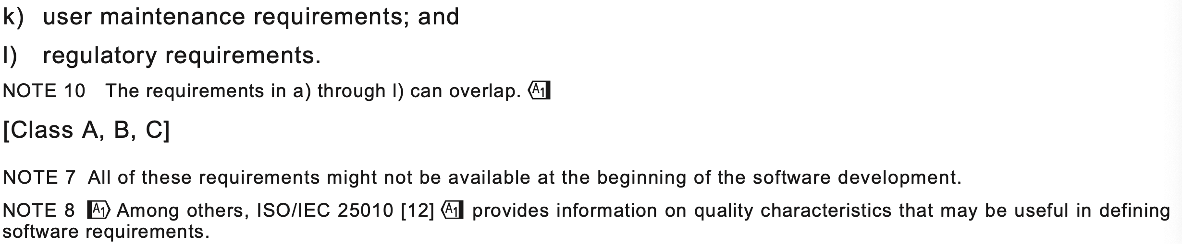
5.2.2 Concluded

Slide 17
Clause 6: Software Maintenance Process
6.1 Establish Software Maintenance Plan
6.2 Problem and Modification analysis
6.3 Modification Implementation

Slide 18
Clause 7: Software Risk Management Process
7.1 Analysis of Software Contributing to Hazardous Situations: involves identifying software items and identifying how they might cause hazardous situations (particular mention of SOUP)
7.2 Risk Control Measures: all the situations identified in 7.1 should have appropriate risk control measures and they should be added to requirements and development planning.
7.3 Verification of Risk Control Measures
7.4 Risk Management of Software Changes: ensuring that changes to software are subject to similar measures to the original software.

Slide 19
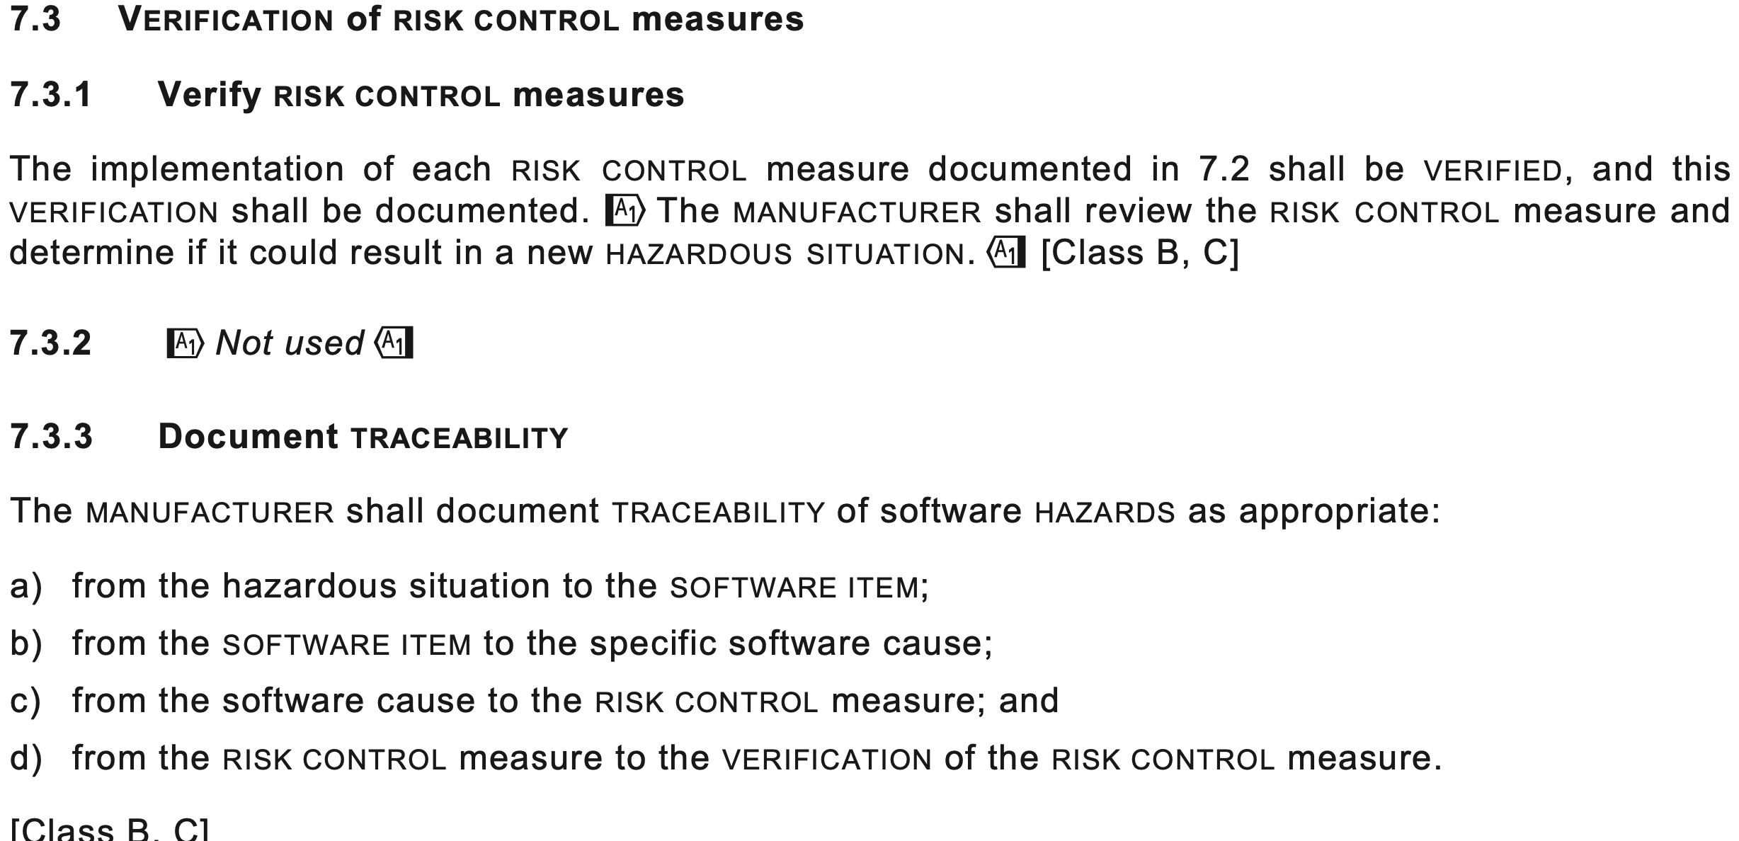
Verification of Risk Control Measures

Slide 20
Summary
IEC 62304 is primarily concerned with safety and processes to guarantee safety.
The emphasis is on the risk of the product in operation.
Processes are structured to ensure risk is managed effectively
This is achieved by:
  prescribing processes that are sensitive to risk classification
  Requiring effective risk management (ISO 14971)
  Requiring that quality is effectively managed (ISO 13485)
  ISO 13485 requires effective document management that organizes the evidence generated by the process

