Slide 1
Safety Systems
SCSD Lecture 14 Mar 2024

Slide 2
IEC 61508
61508 is the basic standard for the safety of software-controlled equipment.
Over the next two lectures we will consider this in some detail because it introduces the basic ideas that have been incorporated into many standards for software products.
This will allow us to consider some specific techniques and how they are deployed.
61508 Considers the risks arising from the operation of the Equipment under control (EUC)
It is comprehensive but gives particular consideration to the realization of software.

Slide 3
APPLICATION OF IEC 61508
There is equipment under control (EUC) which, with its control system, poses risks to its surroundings
The risks will be reduced to tolerable levels by safety functions
Safety functions are performed by E/E/PE systems

Slide 4
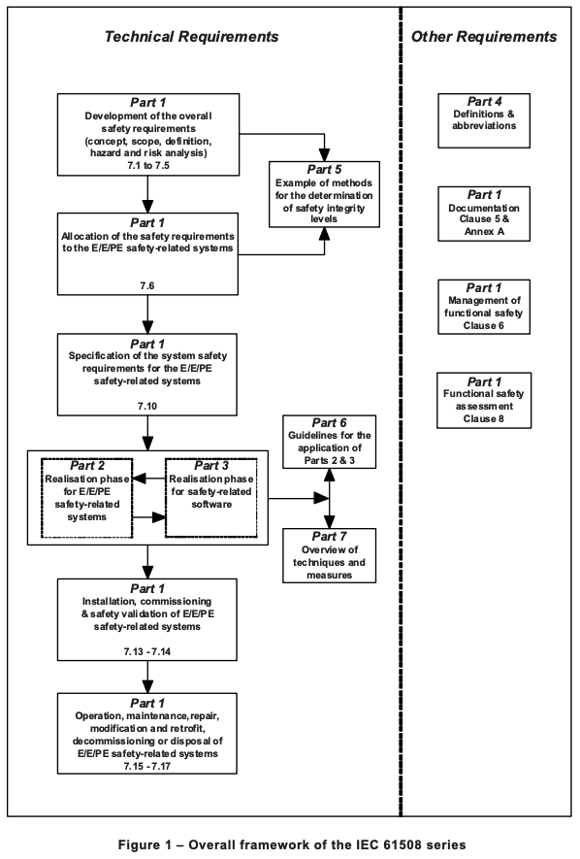
Overall Structure of 61508 series
We are mainly concerned with software.
However, software can only be responsibe for harm via the EUC.
Here we concentrate on Part 3: realization phase for safety-related software.

Slide 5
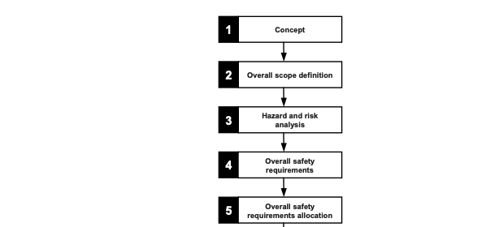
IEC 61509 Lifecycle

Slide 6
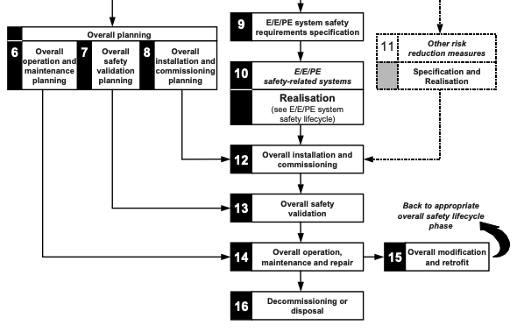
IEC 61509 Lifecycle

Slide 7
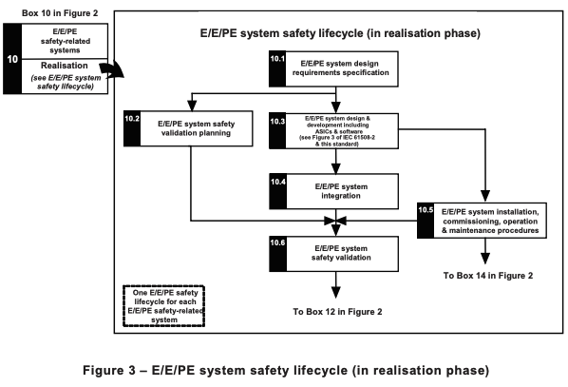
Hardware Realisation

Slide 8
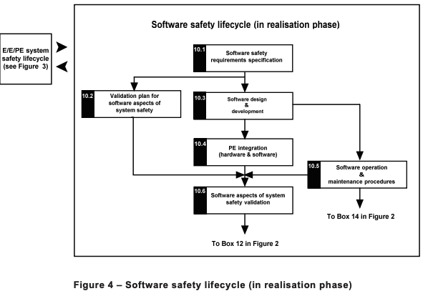
Software Realisation

Slide 9
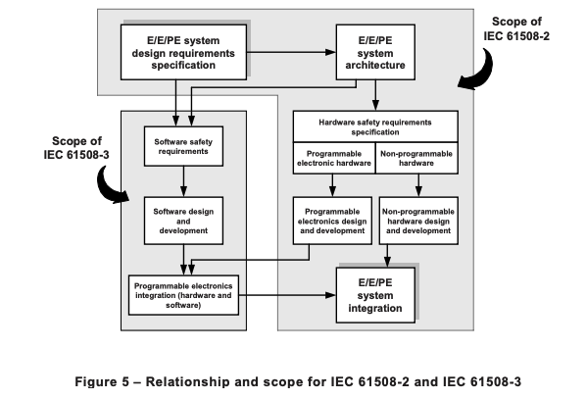
IEC 61508 Hardware/Software relationship

Slide 10
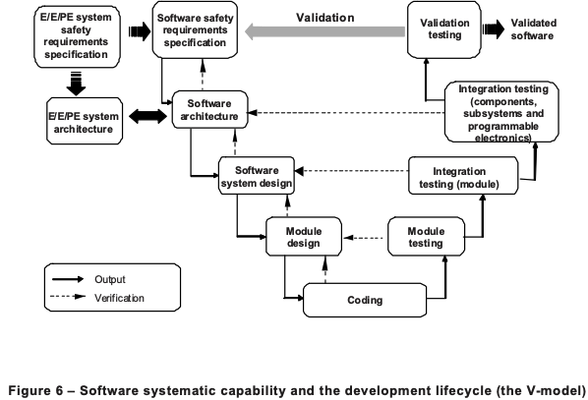
IEC 61508 Software Development Lifecycle

Slide 11
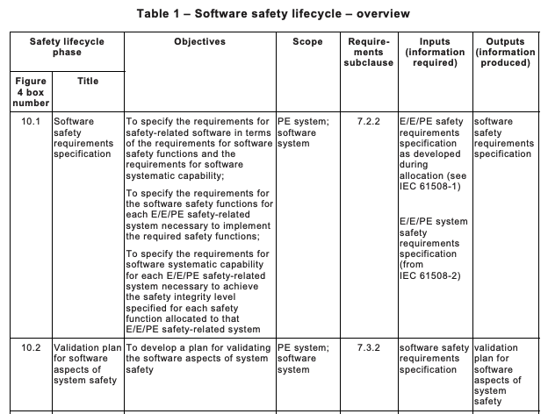
Software Lifecycle Detailed Overview

Slide 12
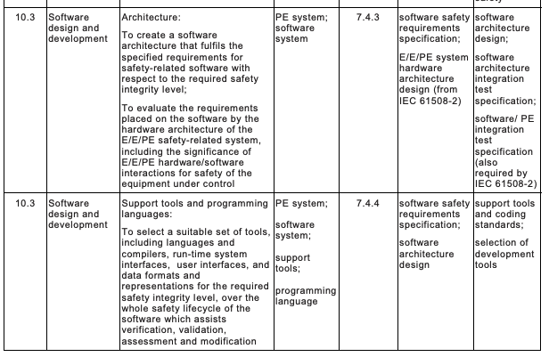
Software Lifecycle

Slide 13
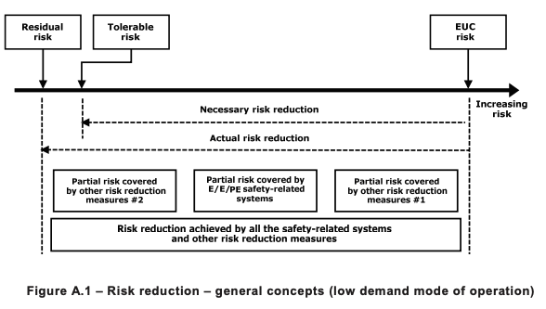
Risk guides the level of rigour in development

Slide 14
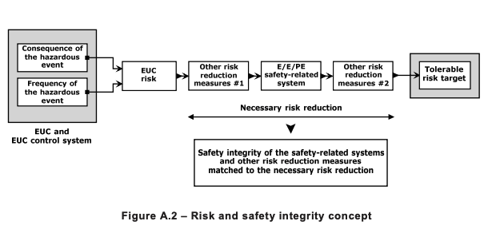
Risk reduced to tolerable levels

Slide 15
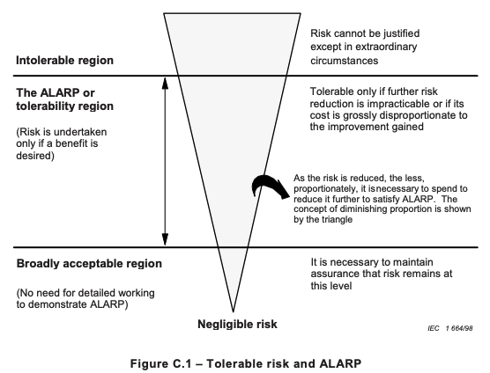
ALARP: One approach to achieving tolerable risk

Slide 16
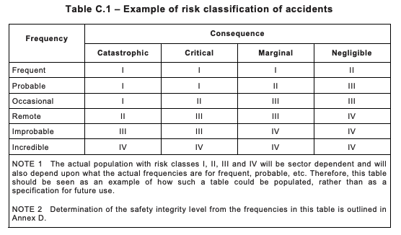
Risk Classes

Slide 17
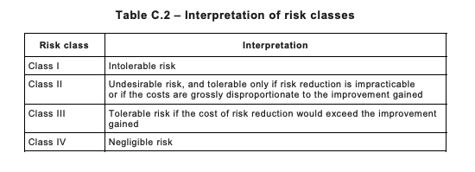
Risk Classes

Slide 18
Summary
Introduced IEC 61508
The overall lifecycle
The software lifecycle
Risk
How risk informs software development
Next lecture we will consider how this influences development practice

