Slide 1
Interrelated standards

Slide 2
Interrelated standards
All standards cite other standards since the aim is to keep the standard focused.
ISO 42001 is focused on the management of AI so it avoids many areas of concern in the use of AI.
ISO 42001 refers out to many standards. How relevant they are, depends on the application.
The next slides consider some of these standards, for example:
  ISO/IEC 23894, Information technology — Artificial intelligence — Guidance on risk management
  ISO/IEC TR 24027, Information technology — Artificial intelligence (AI) — Bias in AI systems and AI aided decision making
  ISO/IEC TR 24029-1, Artificial Intelligence (AI) — Assessment of the robustness of neural networks — Part 1: Overview

Slide 3
Generic Standards
For most domains of interest there are some generic standards that should be considered.
In the case of ISO 42001 there are two standards that are clearly relevant:
ISO/IEC 23053, Framework for Artificial Intelligence (AI) Systems Using Machine Learning (ML) - This provides the overall framework for the use of AI.
ISO/IEC 23894, Information technology — Artificial intelligence — Guidance on risk management – This provides the risk management framework that should be employed from the initiation of any project involving AI through to end of life.

Slide 4
Generic Standards: Lifecycle
ISO/IEC 5338: 2023, Information technology — Artificial intelligence — AI system life cycle process
  This provides the overall lifecycle for systems involving – this goes beyond the software to include all aspects of the system.
  This is a comprehensive standard and covers all aspects of the lifecycle without over specifying

Slide 5
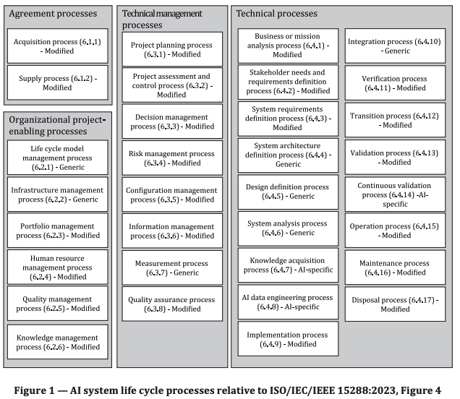

Slide 6
Generic Standards: Quality
Any lifecycle will specify quality systems to ensure the processes produce product of adequate quality.
ISO 9001, Quality management systems — Requirements
  This is the basis of all ISO quality management standards
ISO 13485, Medical devices — Quality management systems — Requirements for regulatory purposes
  Relates to meeting the requirements of the Medical Device Regulation
ISO/IEC 25059, Software engineering — Systems and software Quality Requirements and Evaluation (SQuaRE) — Quality model for AI systems
  Software Quality Model

Slide 7
Generic Standards: Data Quality
ISO 8000-2, Data quality — Part 2: Vocabulary
ISO/IEC 5259 (all parts), Data quality for analytics and machine learning (ML)

Slide 8
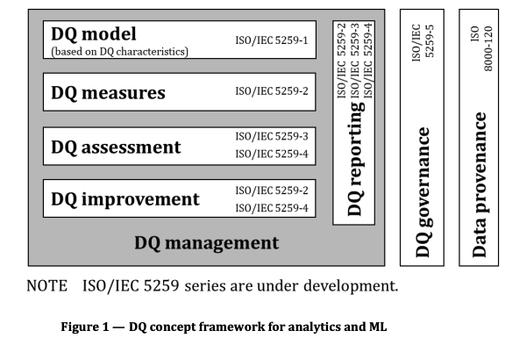

Slide 9
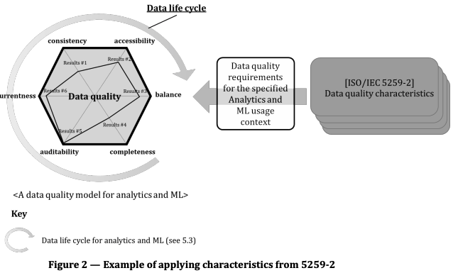

Slide 10
Generic Standards: Security
ISO/IEC 27000:2018, Information technology — Security techniques — Information security management systems — Overview and vocabulary
ISO/IEC 27701, Security techniques — Extension to ISO/IEC 27001 and ISO/IEC 27002 for privacy information management — Requirements and guidelines
ISO/IEC 27001, Information security, cybersecurity and privacy protection — Information security management systems — Requirements
ISO/IEC 29100, Information technology — Security techniques — Privacy framework

Slide 11
Specific areas of interest
Some standards are highly relevant in some context and not in others.
So, in considering what standards to comply with there is a need to take the context into consideration.
ISO/IEC TR 24027, Information technology — Artificial intelligence (AI) — Bias in AI systems and AI aided decision making
  This standard is specifically oriented to looking at decision taking and bias in decision taking
  This standard is likely to be important if you are working with data you suspect may have bias or the data is being used to train systems that will have significant impact on the users.
  It advises on how to detect and mitigate bias in ML

Slide 12
Some standards deal with specific technologies
As a particular technology becomes more widespread, then standards emerge that deal with the characteristics of the technology
ISO/IEC TR 24029-1, Artificial Intelligence (AI) — Assessment of the robustness of neural networks — Part 1: Overview
  This standard is in place to help users of neural networks deal with the robustness of neural networks.
  It is known the these can be susceptible to small changes in configuration and the environment of use.
  This standard is highly relevant for systems using neural nets in situations where robustness is a key property of the ML model.

Slide 13
Implementation technology
ISO/IEC 19944-1, Cloud computing and distributed platforms ─ Data flow, data categories and data use — Part 1: Fundamentals

Slide 14
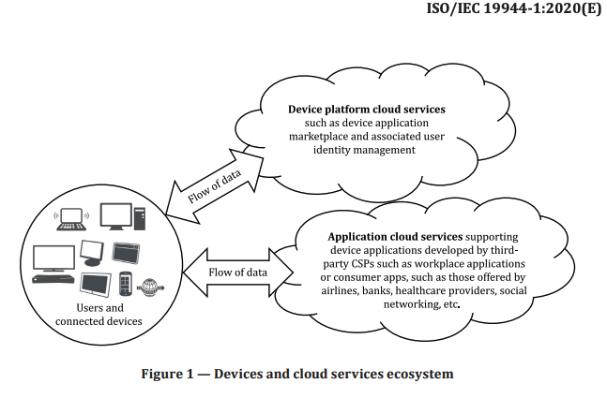
Useful introduction to a new technology

Slide 15
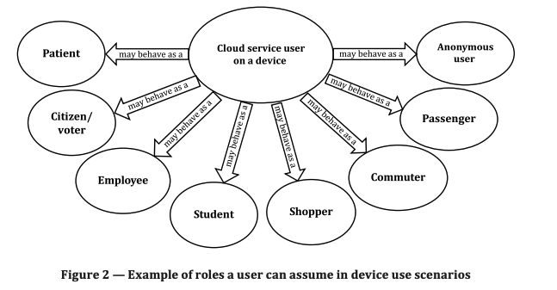
Useful in specifying different roles

Slide 16
Ethics
For many classes of system there are important ethical considerations.
Increasingly we are encouraged to consider the ethical consequences of deployment.
It is likely that standards such as this are a key part of our relevant standards
ISO/IEC TR 24368, Information technology — Artificial intelligence — Overview of ethical and societal concerns

Slide 17
Usability
ISO 9241-210, Ergonomics of human-system interaction — Part 210: Human-centred design for interactive systems

Slide 18
Requirements
The chosen standards will contain a (possibly large) collection of requirements on the product and process for producing the product.
For example:
  The organization shall define and document verification and validation measures for the AI system and specify criteria for their use.
Capturing the set of requirements, you need to meet in order to comply is a key part of the compliance process.

Slide 19
The impact of requirements
The organization shall define and document verification and validation measures for the AI system and specify criteria for their use.
This specifies methods and how they should be used.
Imposes a requirement on the management of the process.
The types of V and V an their use will depend on the application area
  Standards may be very lax or stringent depending on the application.
This requirement will impose constraints on both the process and the product.

Slide 20
Summary
In developing a lifecycle approach for a particular class of products it is valuable to:
  Choose what you know to be a highly relevant standard for your product class.
  Look at the standards referred to in the key standard and use this as a basis to begin exploring the different aspects of your class of systems.
  Use this to sketch out the key product requirements.
  Also consider process aspects since there are likely to be process standards you can use.

