Slide 1
Standards Compliant Software Development

Slide 2
Course Organiser
Stuart Anderson
soa@ed.ac.uk
Room: Informatics Forum 3.46
Phone: 0131 650 5191
Office Hour: 09:30-10:30 on Wednesday

Slide 3
Work Pattern
Lectures (planned weeks 1-9):
  Monday 1000-1050: 50 George Square, room G.05
  Thursday 1000-1050: MST_G.03 - Doorway 6, Medical School, Teviot
Tutorials(planned weeks 2-9):
  Tuesday 1410-1500: AT_2.07, Appleton Tower
  OR
  Wednesday 1110-1200: AT_2.07, Appleton Tower
  Even numbered weeks you will meet with your group
  Odd numbered weeks you meet with your group and the tutor.

Slide 4
Assessment
There is one coursework.
It requires you write recommendations for the process an organization should adopt to develop systems that comply to the relevant standards for its domain of application.
You choose the domain of application.
In doing this exercise you will demonstrate the extent to which you have achieved the learning outcomes for the course.
The coursework will be issued on Monday 22 January 2024
In addition, there will be a quiz for each Learning Outcome that will allow you demonstrate the basic achievement of the Learning Outcome.

Slide 5
Learning Outcomes (LO)
These characterize what you will gain by passing the course.
In SCSD the LOs structure the course and we will spend around two weeks focusing on each of the LOs in turn.
The grading scheme for the assessed work is also structured by the LOs where the grade for each LO contributes 20-30% of the final grade.
To pass the course you need to demonstrate you have achieved the LOs. Each LO has some grading criteria associated with it.

Slide 6
Learning Outcome 1
Describe the structure of typical standards and regulation for a range of domains of application.
  Range of domains considered
  Diversity of the chosen domains
  Clarity of identifying relevant standards
  Quality of the analysis of standards to identify overlaps and conflicts
  Quality of the analysis of standards to identify differences and gaps

Slide 7
Learning Outcome 2
Explain and motivate the goals set by regulation and standards and how they influence the requirements for compliant systems.
For a group of related standards:
  Quality of the analysis of a group of standards for comprehensiveness
  Quality of the analysis of a group of standards for interdependency
  Quality of the overview of how do they constrain the systems
  Quality of the explanation of the motivation for constraints on products
  Quality of the explanation of the motivation for constraints on process

Slide 8
Learning Outcome 3
Given an example system and standard or regulation, justify what evidence would be needed to comply with the regulation or standard
For a group of related standards:
  Quality of the analysis of what needs to be evidenced
  Quality of the identification of the means of evidencing
  Quality of the analysis of how much evidence is necessary
  Quality of the analysis of how evidence can be shared across standards
  Quality of the analysis of the effort needed to generate appropriate evidence

Slide 9
Learning Outcome 4
Given an example system development process and standard or regulation, evaluate how effective the process can be in generating evidence of compliance to the standard or regulation
  Coverage of key aspects identified in (3)
  Where/How is evidence produced and managed in the process
  Assessment of quality of products
  How well is the process instrumented?
  What is possible in terms of identifying improvement

Slide 10
Schedule
Week 1 (15-21 January): Introduction, overview, anatomy of a standard.
Weeks 2-3 (22 Jan - 4 February): Considering standards such as JSON, HTML, DICOM that constrain the format of data. We consider how these are specified, the web of standards they rest within and how we ensure compliance.
Weeks 4-5 (5 – 18 February): Considering standards such as the International Classification of Disease, HL7 and how these are linked to data access. We consider the drivers on the creation of these standards and how they shape activities making use of them.

Slide 11
Schedule
Weeks 6-7 (19 Feb – 4 March): Considering standards that proscribe certain features or patterns, particularly in programming languages. For example MISRA C, and SPARK ADA that are oriented to supporting the development of safe software. We consider the use of constraints in standards and how to generate evidence of compliance with constraints.
Weeks 8-9 (5 -18 March): Considering standards that specify management of activities e.g. risk management and how layers of standards relate to one another (e.g ISO 14971 is a specialization of the generic risk management standard to Medical Devices. We consider how management standards constrain the control and production of evidence.

Slide 12
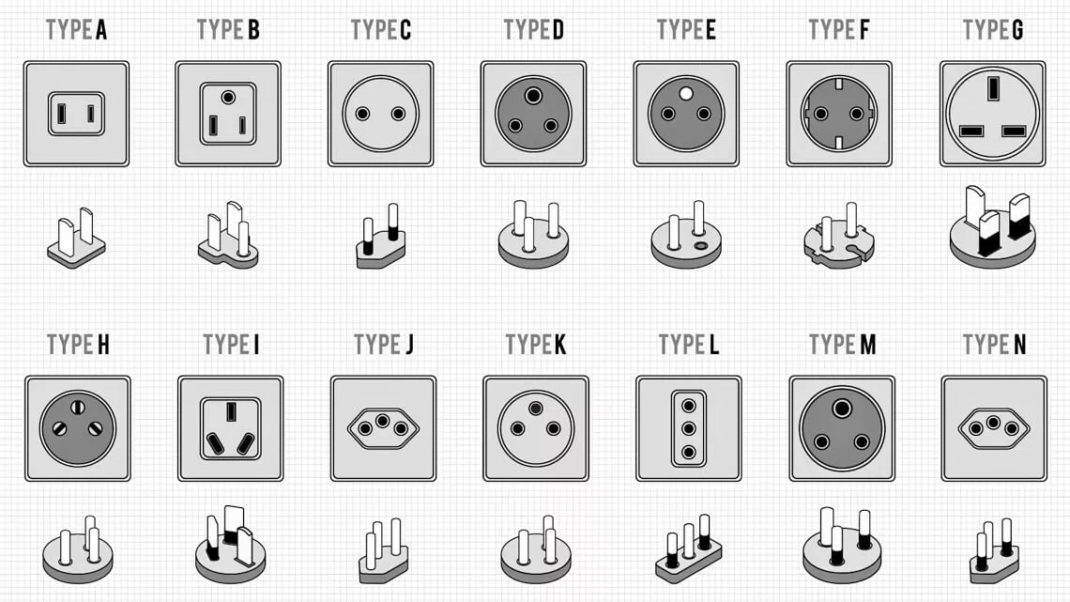
Standards Are Everywhere…

Slide 13
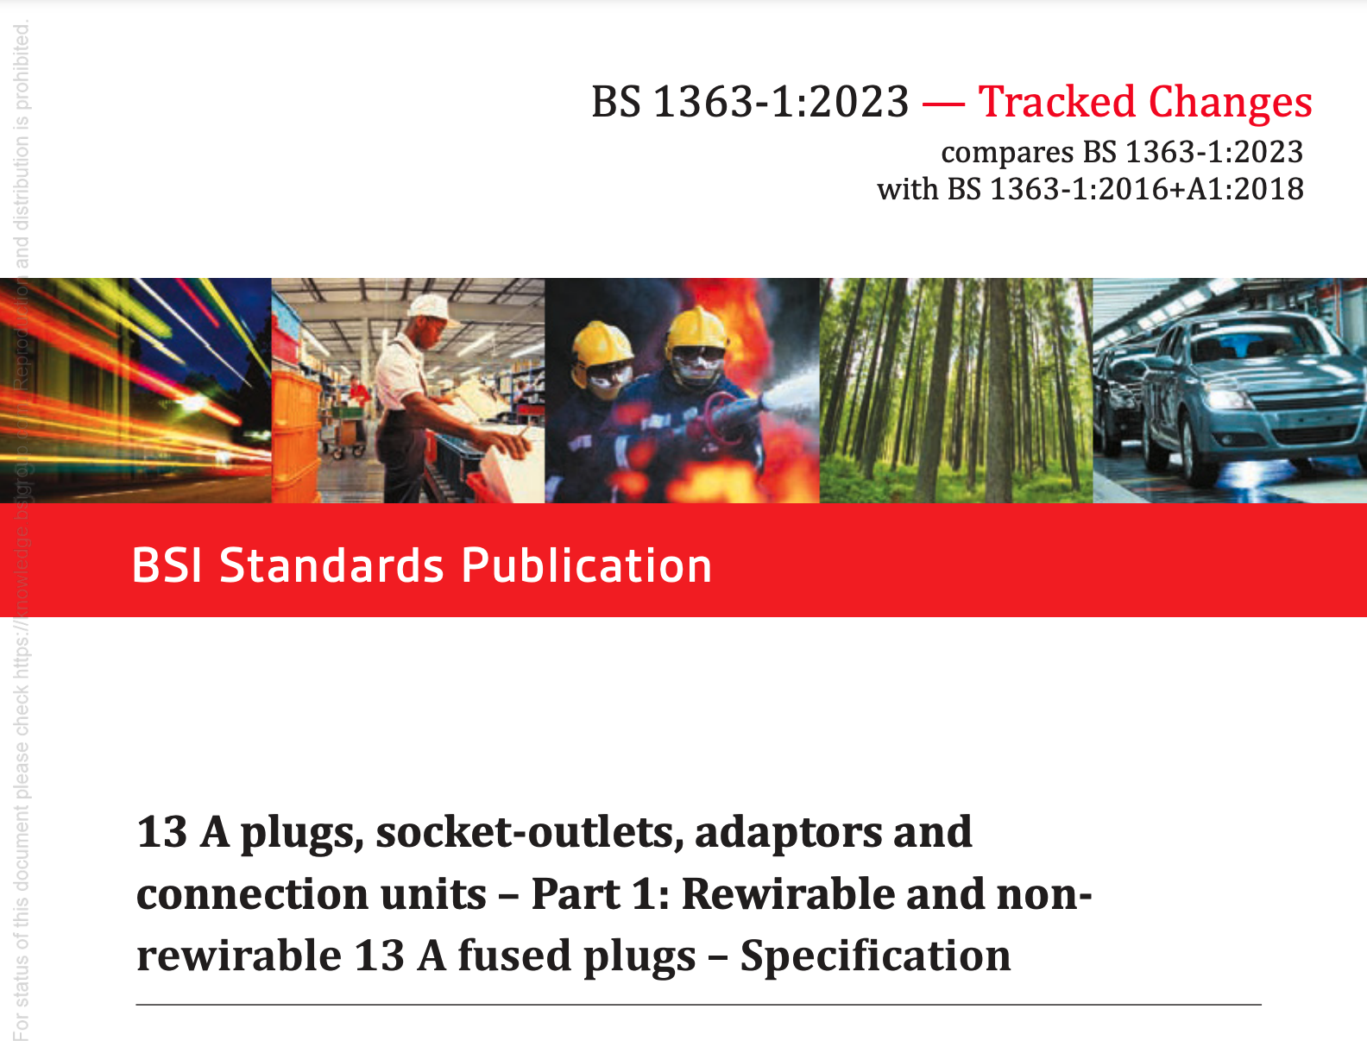
Standards are Complex…
This is more than 80 pages long
Is the first part of a five-part series
  Part 2: 13 A switched and unswitched socket-outlets – Specification
  Part 3: Adaptors – Specification
  Part 4: 13 A fused connection units: switched and unswitched – Specification
  Part 5: Fused conversion plugs
Is still under revision – revised versions 2023, and previously 2018
Began in 1947:
  Two pole and earthing pin fused plugs and shuttered socket outlets for A-C circuits up to 250 volts (not intended for use on D.C.circuits).

Slide 14
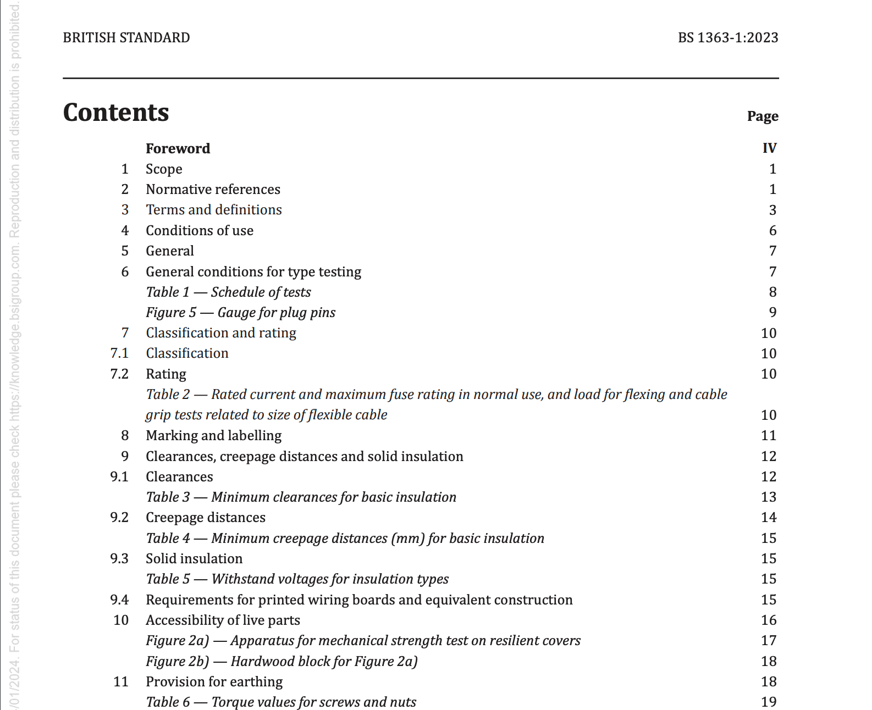

Slide 15
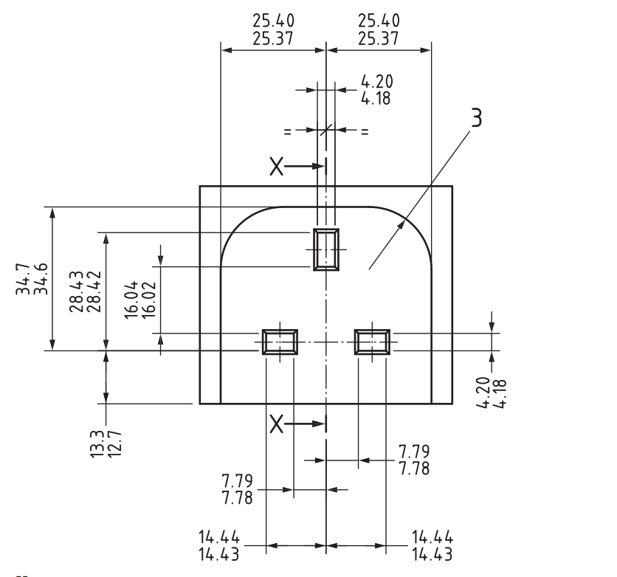
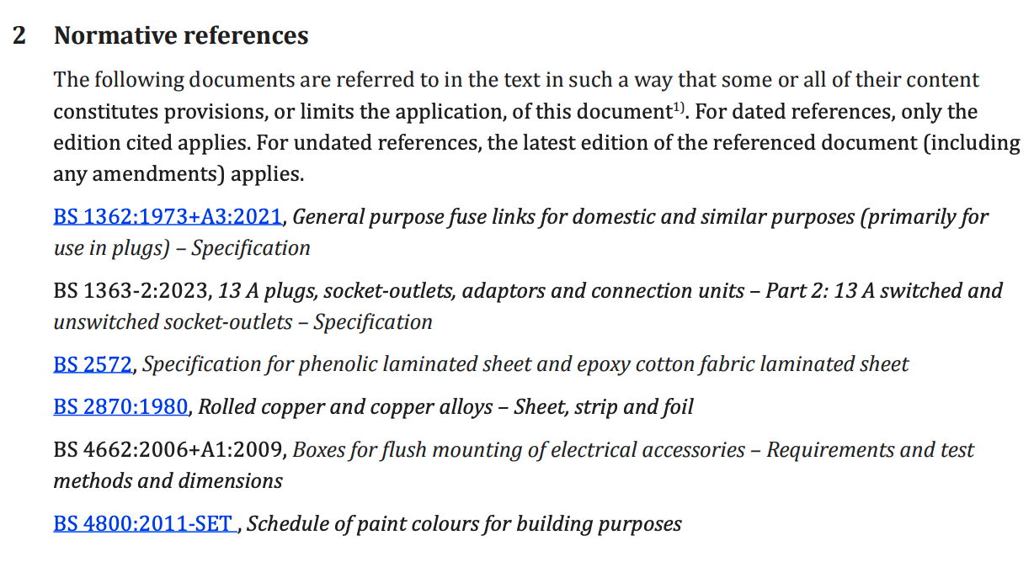
Detailed and Extensive
- This list runs on for a page and a half…

Slide 16
Safety
Many standards are set to ensure the safety of different user types (so in the case of electric sockets this includes: the domestic user, installers, electricity supply companies, …)
The electrical socket standard is specifying a product so it places very specific requirements e.g. that conductors are made of brass and there is a minimum percentage of copper in the brass.
The standard is shaped by, and shapes the supply infrastructure.
Revisions generally aim to increase safety by mitigating a specific risk that has been identified in use.

Slide 17
Interoperability
The electric socket standard is usually uniform over a large area and is entirely taken for granted.
The standards are set so that connection methods to the electricity supply enable interoperability – all mains electrical applicance conform to the standard.
To enable this, the standard must be quite specific, e.g. the positioning and sizing of physical elements are carefully specified.
Deviating from the standard would be a significant commercial disadvantage to a supplier of goods.

Slide 18
Innovation and Competition
Standards filter out non-compliant designs any many such designs could be potentially dangerous or have significant disadvantages.
Standards frame a market and encourage well-ordered competition that benefits consumers by encouraging innovation both to improve the function and value for money.
Agreed international standards are a way of combatting the poer of large multinationals
  A. Bradford, ‘The Brussels Effect: How the European Union Rules the World’, Faculty Books, Mar. 2020, [Online]. Available: https://scholarship.law.columbia.edu/books/232
Some argue that some standards inhibit innovation (e.g. data protection standards, or AI standards) while other argue the benefit exceeds the cost in innovation.

Slide 19
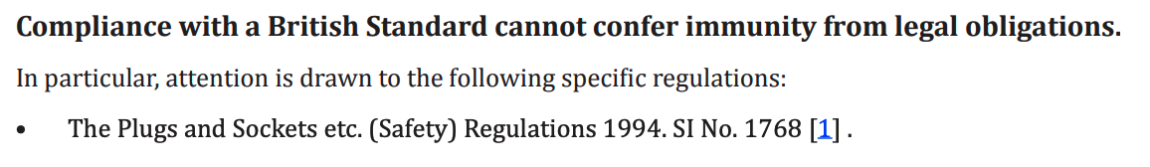
Liability and Consumer Protection
Notice that standards guide the user to compliance, regulations have legal force.
Standards compliance will help to ensure legal compliance but cannot guarantee it.
Compliance in a particular area indicates that the product has some value

Slide 20
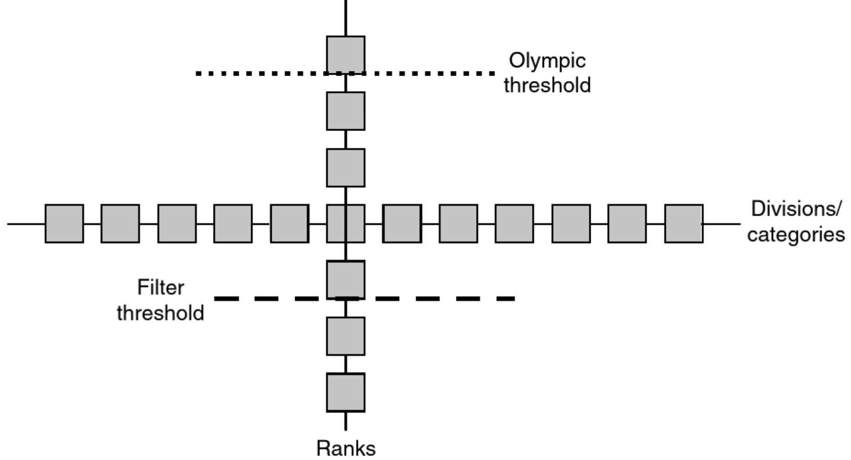
Types of Standard In general
Winning (aka Olympic)
Ranking (some means of combining factors)
Filtering (maybe on multiple factors)
Classifying (often used in reporting/understanding, e.g. the International Classification of Diseases)
Busch Lawrence. Standards : Recipes for Reality. 1st ed. MIT Press; 2011.

Slide 21
Types of Software-Related Standard
Capturing a format – JSON, HTML, DICOM …
Capturing knowledge (some sort of ontology): HL7
Constraining an activity: MISRA C, SPARK ADA, …
Constraining a process: Risk Management, Quality Management, Software Testing

Slide 22
Standards for Tasks/Processes
Standards on Quality Management are the basis of the operation of companies aiming to produce a series of products that comply with standards or can pass regulatory scrutiny.
These include many software engineering-related standards.
They differ from standards that specify the characteristics of a particular entity, instead they attempt to standardize a “production system” that repeated generates products that meet a defined quality standard.

Slide 23
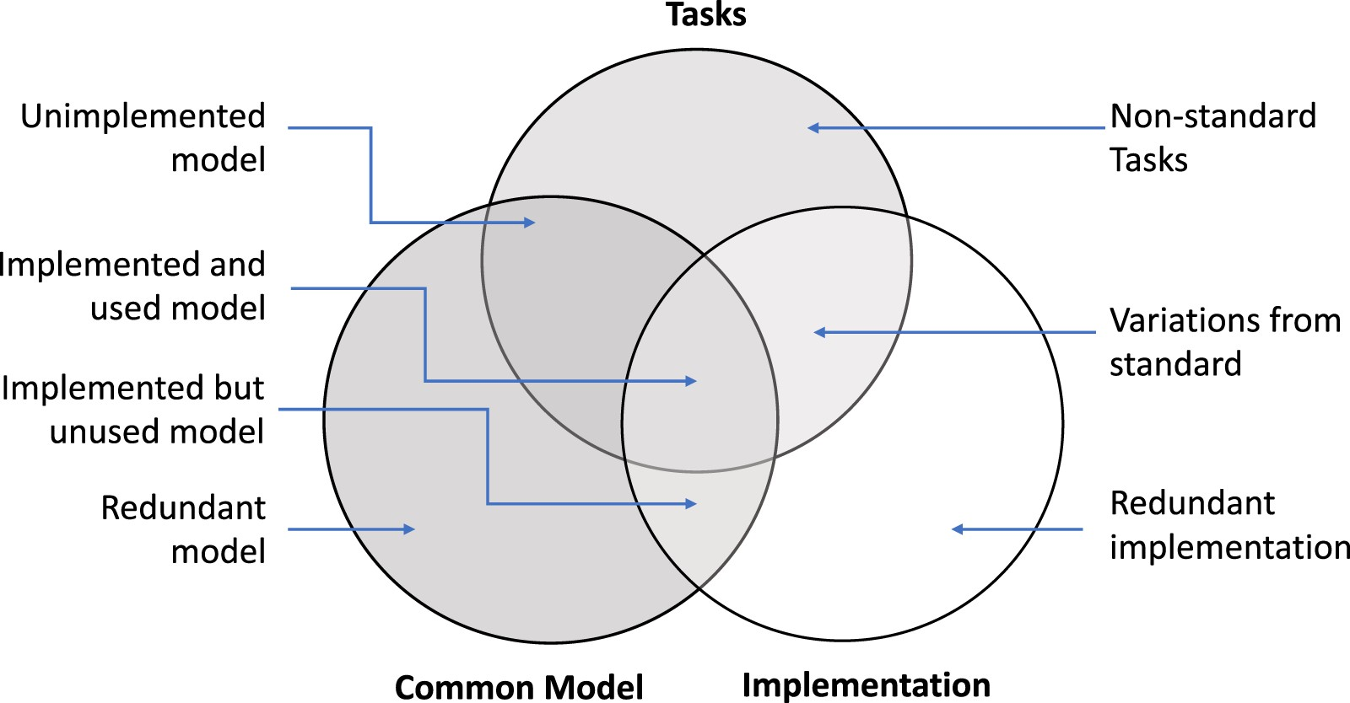

Tasks, Models, Implementations
Notes:
Figure 1. The standard problem manifests as differences between what is standardized in a common model, how much of that model is implemented in the real world, and the purposes to which an implemented common model is applied.
Unless provided in the caption above, the following copyright applies to the content of this slide: © The Author(s) 2023. Published by Oxford University Press on behalf of the American Medical Informatics Association. All rights reserved. For permissions, please email: journals.permissions@oup.comThis article is published and distributed under the terms of the Oxford University Press, Standard Journals Publication Model (https://academic.oup.com/pages/standard-publication-reuse-rights)

Slide 24
Summary
We have covered the basic structure of the course.
Considered some of the roles that standards fulfill
Considered different types of standard
Begun to consider how to analyse standards.
To begin exploring standards, see: https://www.ed.ac.uk/information-services/library-museum-gallery/finding-resources/subject-guides/databases-standards WARNING: this gives access to copyright protected material and copies are only for your personal use and should not be copied, shared or distributed. Failure to observe this is a violation of the University Computing Regulations.

