Slide 1
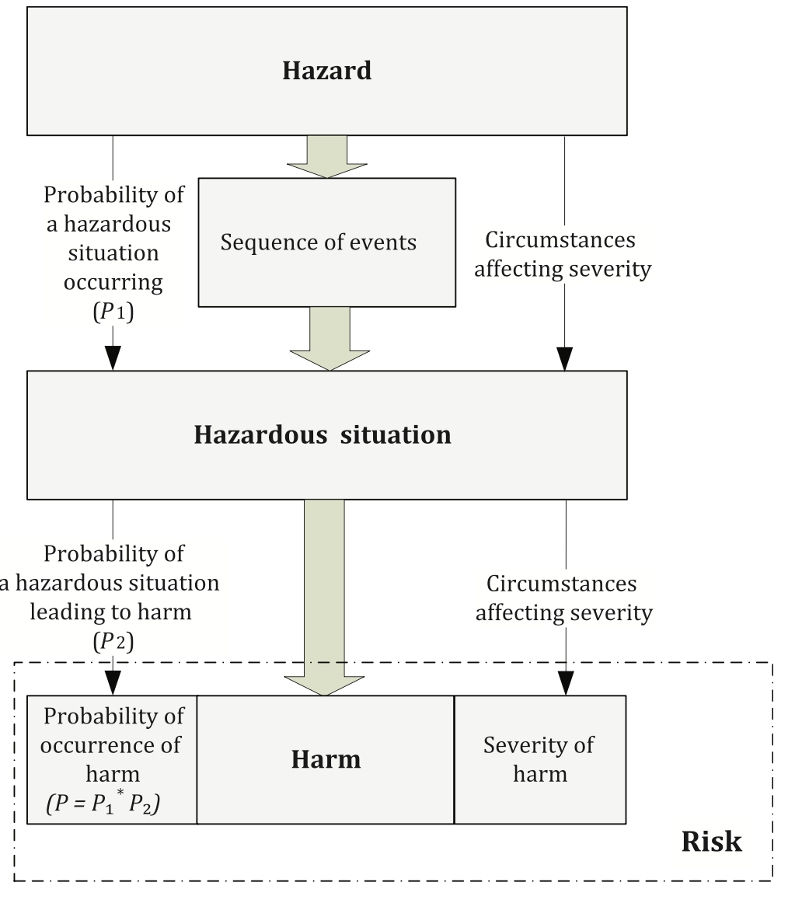
ISO 14971

Slide 2
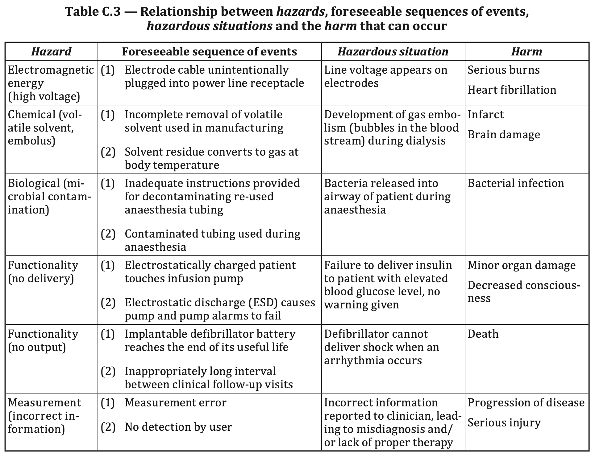
ISO 14971

Slide 3
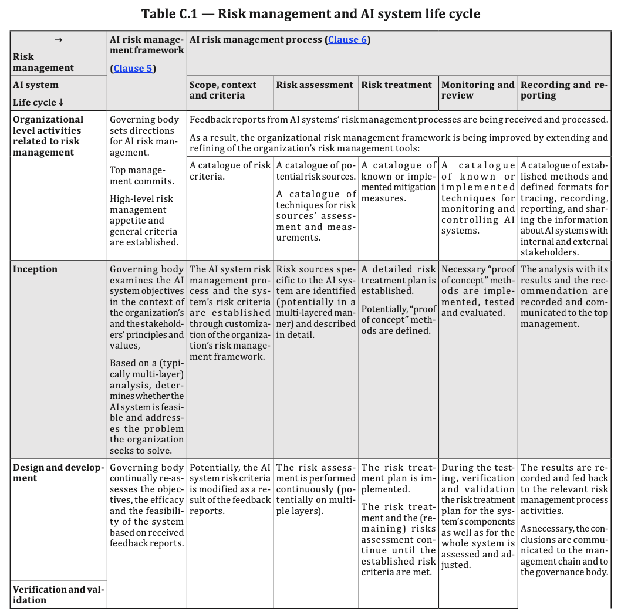
ISO 23894

Slide 4
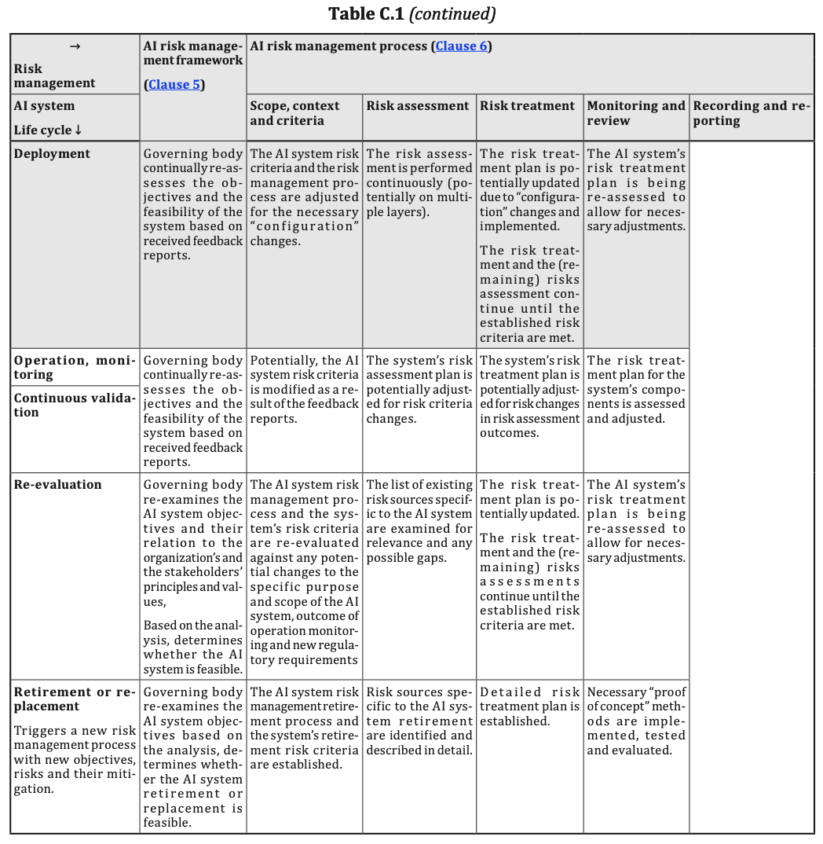
ISO 23894

Slide 5
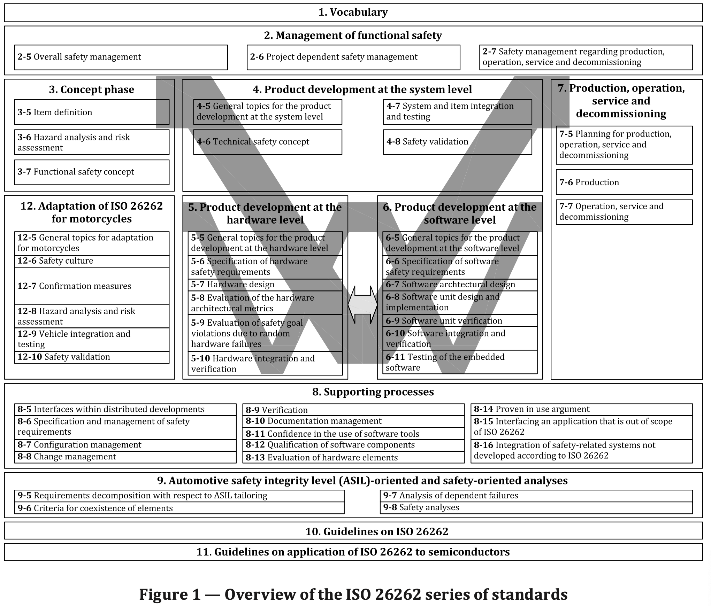
ISO 26262

Slide 6
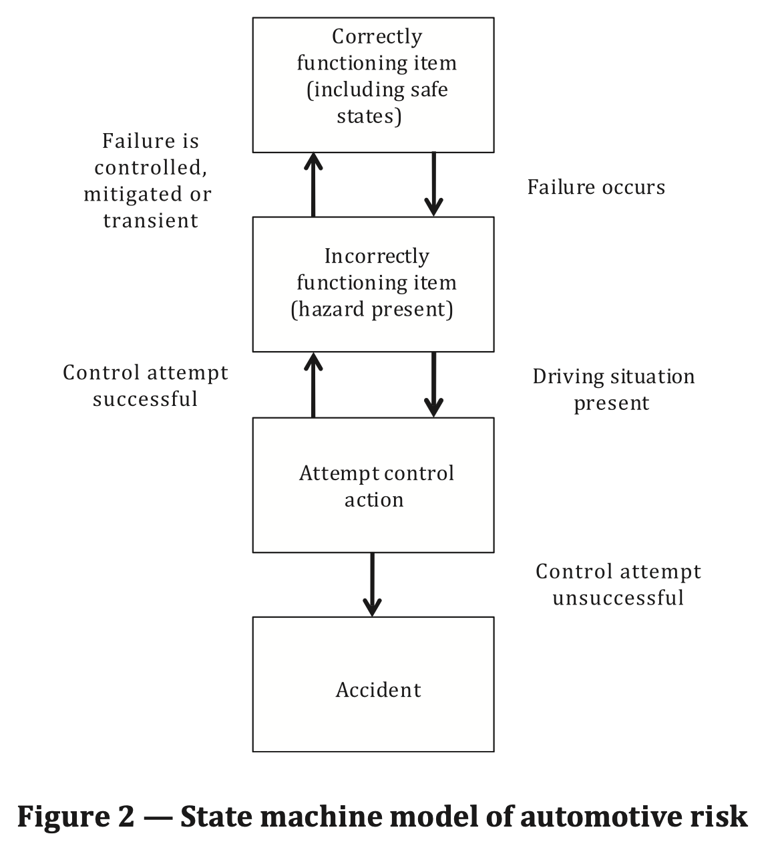
ISO 26262

Slide 7
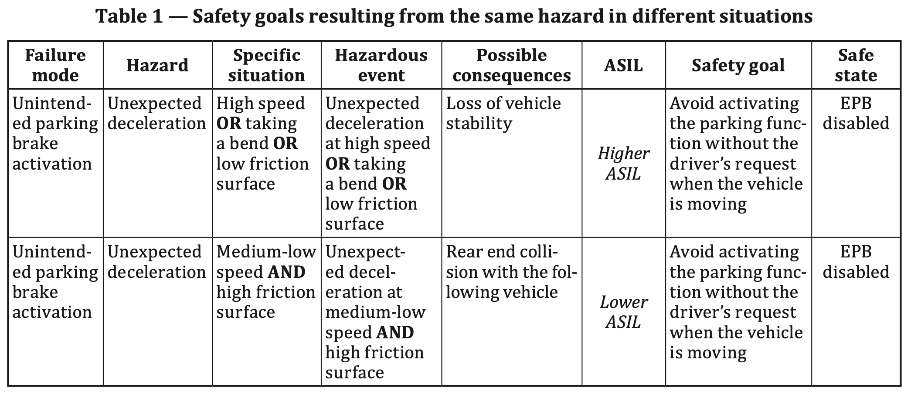
ISO 26262

Slide 8
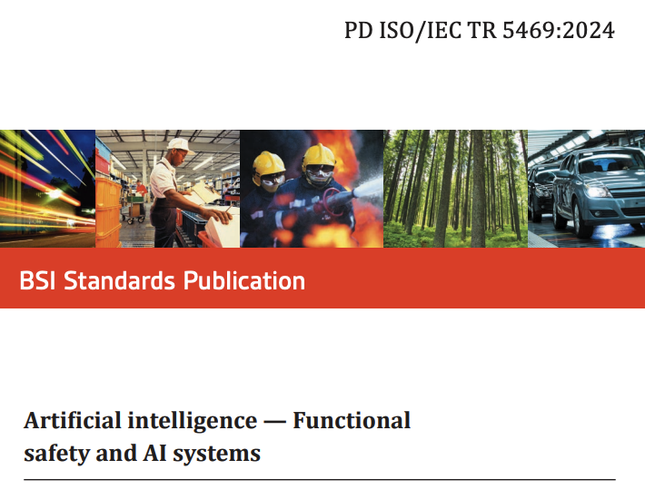
PD ISO/IEC TR 5469:2024

Slide 9
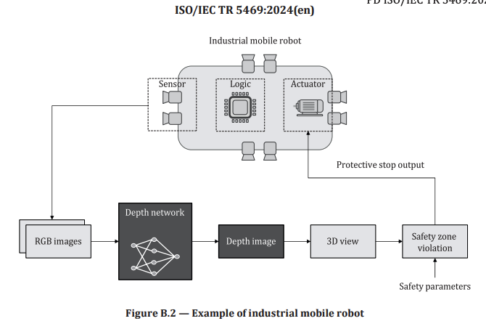
PD ISO/IEC TR 5469:2024

Slide 10
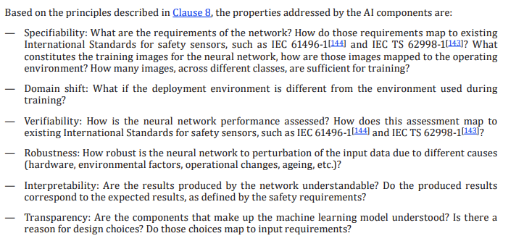
PD ISO/IEC TR 5469:2024

Slide 11
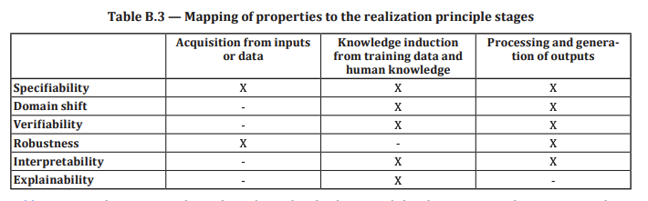
PD ISO/IEC TR 5469:2024

Slide 12
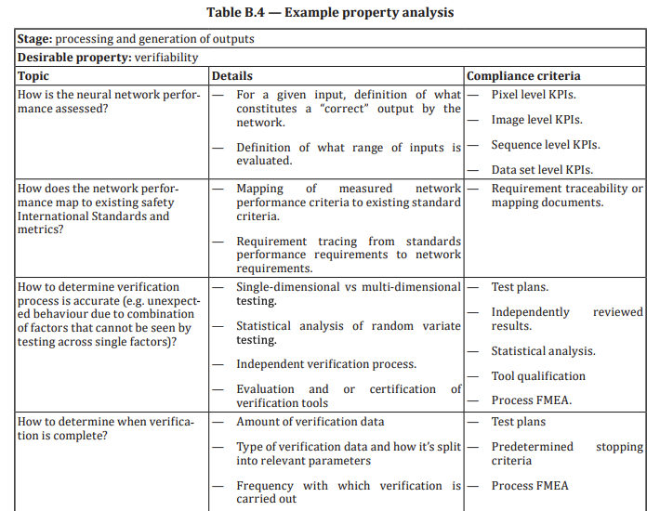
PD ISO/IEC TR 5469:2024

