Slide 1
Risk Management
SCSD 11th March 2024

Slide 2
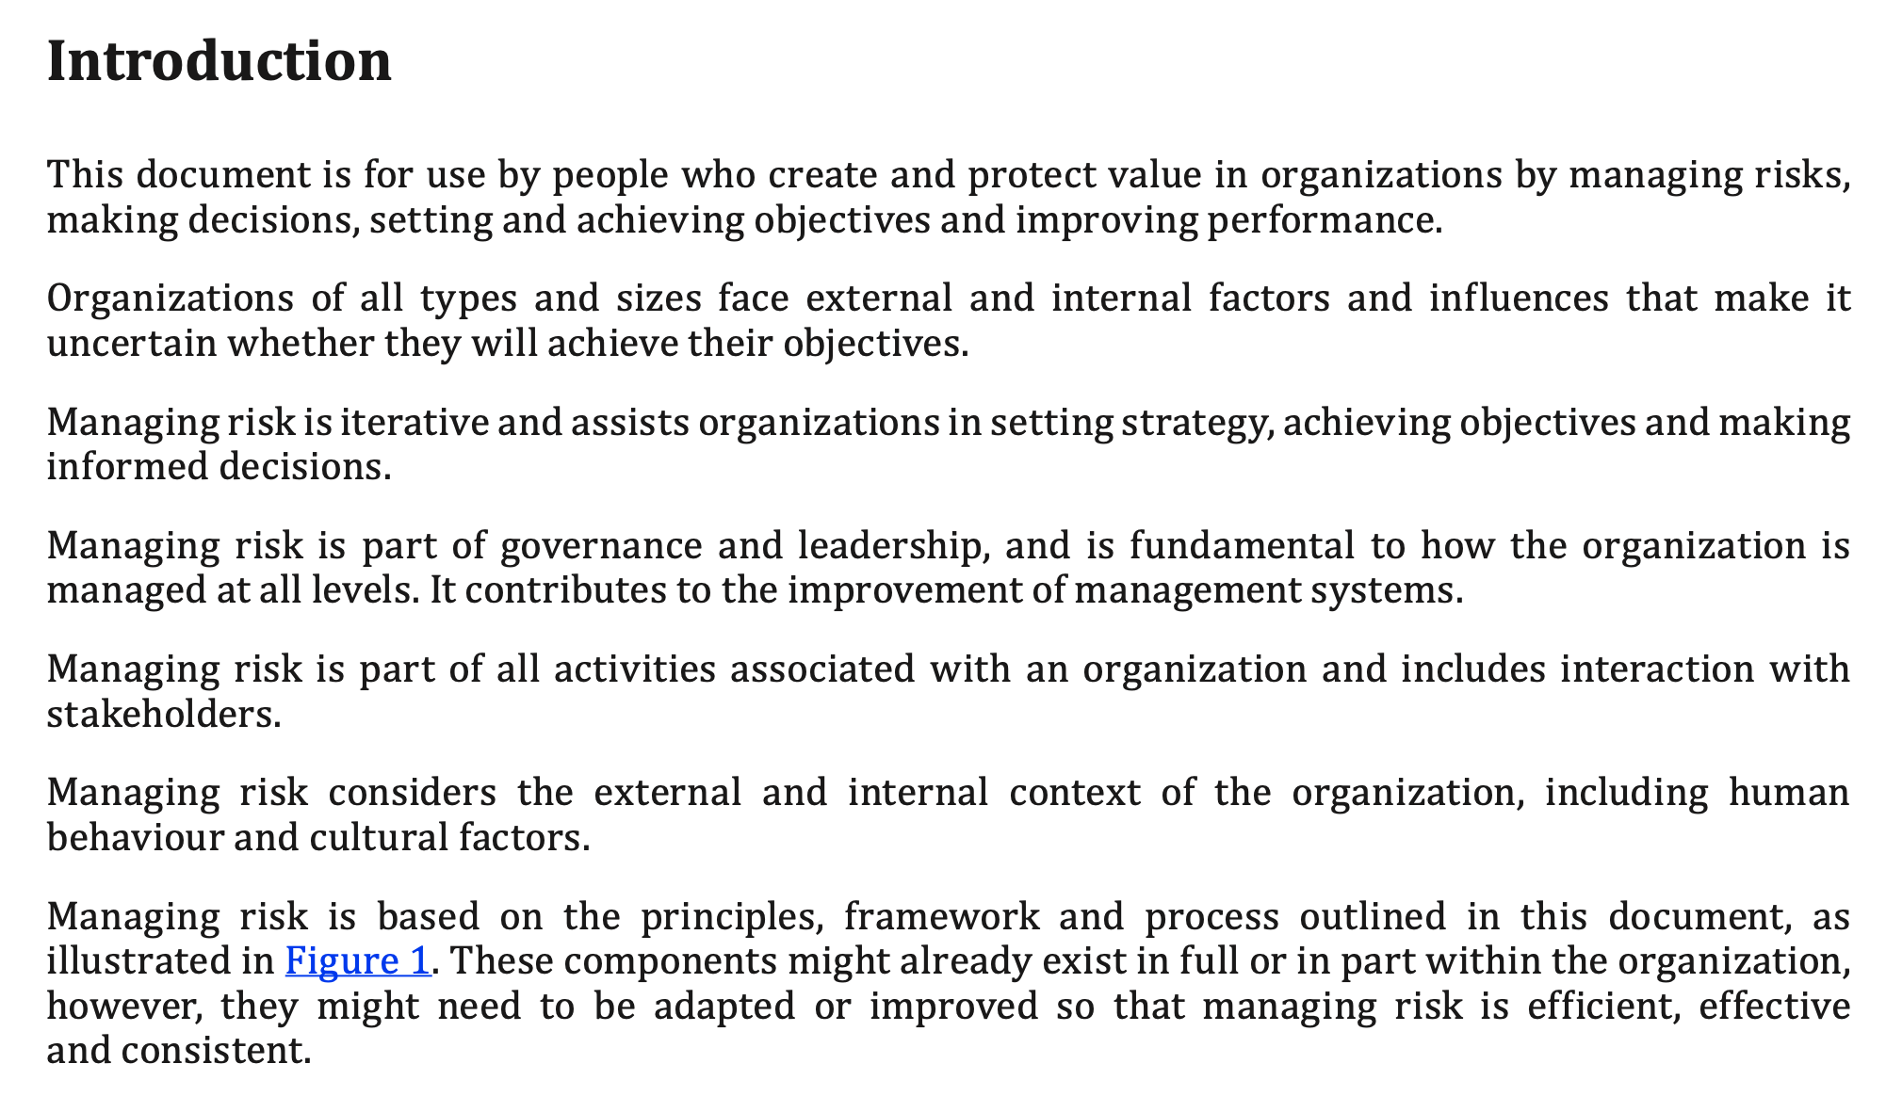
ISO 31000:Risk Management - Guidelines

Slide 3
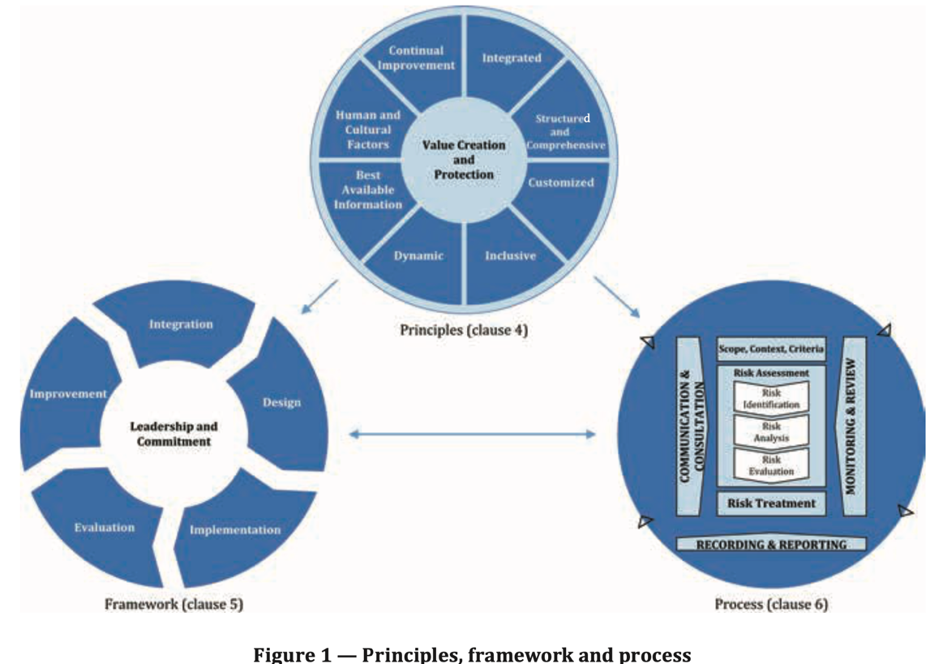
Clauses 4, 5 and 6 – Main elements of 31000

Slide 4
Definitions
risk: effect of uncertainty on objectives
risk management: coordinated activities to direct and control an organization with regard to risk
stakeholder: person or organization that can affect, be affected by, or perceive themselves to be affected by a decision or activity
risk source: element which alone or in combination has the potential to give rise to risk
event: occurrence or change of a particular set of circumstances
consequence: outcome of an event affecting objectives
likelihood: chance of something happening
control:measure that maintains and/or modifies risk

Slide 5
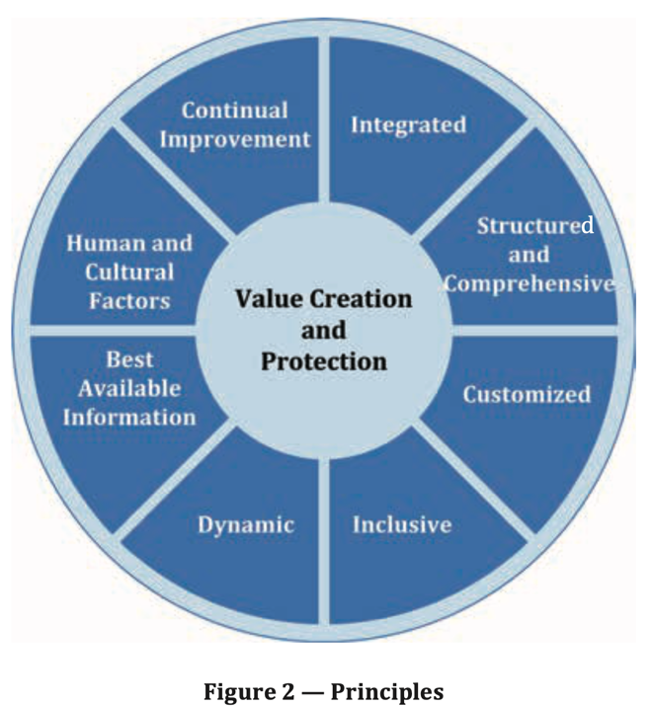
ISO 31000 Principles (Clause 4)
Integrated: Risk management is an integral part of all organizational activities. b)
Structured and comprehensive: A structured and comprehensive approach to risk management contributes to consistent and comparable results.
Customized: The risk management framework and process are customized and proportionate to the organization’s external and internal context related to its objectives.
Inclusive: Appropriate and timely involvement of stakeholders enables their knowledge, views and perceptions to be considered. This results in improved awareness and informed risk management.
Dynamic: Risks can emerge, change or disappear as an organization’s external and internal context changes. Risk management anticipates, detects, acknowledges and responds to those changes and events in an appropriate and timely manner.

Slide 6
ISO 31000 Principles (Clause 4)
Best available information: The inputs to risk management are based on historical and current information, as well as on future expectations. Risk management explicitly takes into account any limitations and uncertainties associated with such information and expectations. Information should be timely, clear and available to relevant stakeholders.
Human and cultural factors: Human behaviour and culture significantly influence all aspects of risk management at each level and stage.
Continual improvement: Risk management is continually improved through learning and experience.

Slide 7
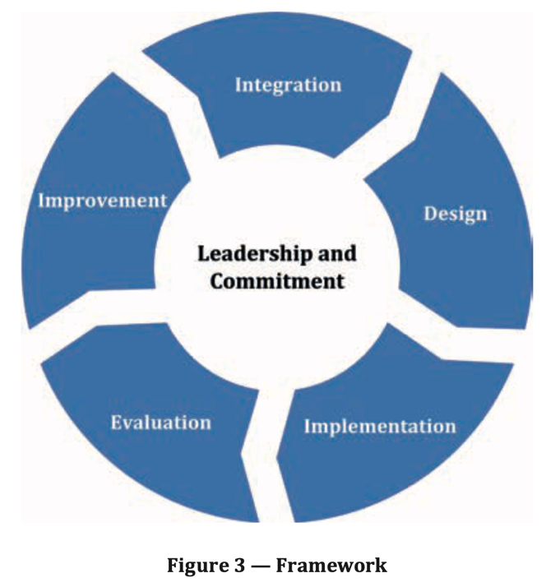
ISO 31000 Framework (Clause 5)
Leadership and commitment are the key elements to ensure:
  Risk management is integrated into all activities
  Aligned to the needs of the organization and pursued systematically and engages with all in the organization
  Top management is accountable for the management of risk and oversight bodies oversee risk management

Slide 8
Integration of Risk Management
Risk management takes place in all parts of an organization
Risk management shouls be incorporated into governance of the organization
Management structure translates governance into objectives and strategies
Risk management accountability and oversight roles are a key part of governance
Integration is iterative, dynamic and ongoing.

Slide 9
Design of the risk management framework
Understanding the organization and its internal and external context.
Commitment to articulating risk management.
Assigning organizational roles, authorities, responsibilities and accountabilities.
Allocating resources.
Establishing communication and consultation

Slide 10
Integration, Evaluation, Improvement
Implementation:
  Plans that include timing and resources
  Identifying roles – where, when, how, and by whom different types of decision are taken
  Processes are well defined and aligned with risk management.
Evaluation:
  is the risk management framework good at managing risk? (How to measure?)
  Decide if it is still fit for purpose in supporting business objectives
Improvement:
  Adapting to take account of internal and external change
  Continually improving to strengthen risk management

Slide 11
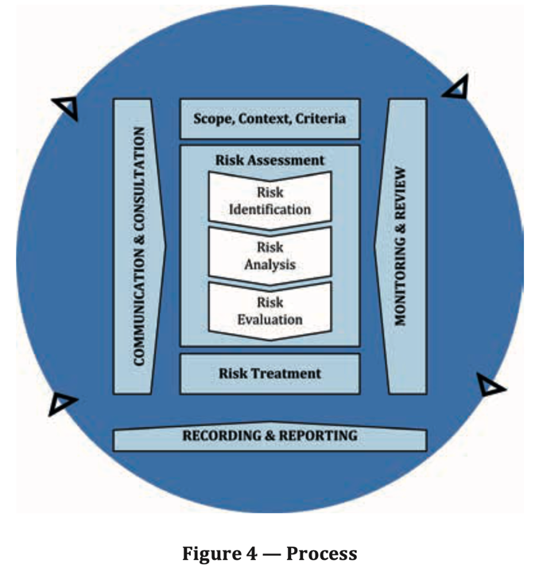
ISO 31000: Process (Clause 6)
Communication and consultation: good risk management need to bring people and information from across the organization
Scope, context, criteria: frames risk assessment by establishing what risk assessment is supposed to be doing, where it comes from and how to decide on how serious a risk is.

Slide 12
Risk Identification
Finding risks
Look for uncertainties and the different possibilities arising from these.
Use techniques like SWOT (Strengths, Weaknesses, Opportunities, Threats) to evaluate the organization and identify uncertainty.
Possible internal and external events should be identified and their consequences outlined, …

Slide 13
Risk Analysis
Refine the analysis of risks
Estimate likelihood of events
Estimate the consequences of events
Explore complexity and connectivity of the collection of risks
Explore timing and volatility
Estimate sensitivity to change and confidence in estimates
Estimate the effectiveness of existing controls

Slide 14
Risk Evaluation
Support decisions with recommendations:
  No further action
  Consider risk treatment options
  Do additional analysis
  Maintain existing controls
  Reconsider the risk management objective for this class of risk

Slide 15
Risk Treatment
Overall: consider treatment options, plan and implement treatment, assess effectiveness, decide if further treatment is necessary.
Treatment options:
  Avoid the risk by not doing the risky activity.
  Deciding the risk/opportunity balance justifies the risk
  Changing the risk by removing the source; changing likelihood, changing consequences OR deciding the risk is acceptable.
Preparing and implementing risk treatment plans
  Explain the plan, who is responsible for approving and implementing
  Actions, resources, performance measures, constraints, reporting and measurement, timing

Slide 16
Monitoring, review, recording, reporting
Establish indicators and expected values
Establish mechanisms to collect indicator values
Review against expected values and implement change if risk management needs improvement.
Establish a reporting framework and what will be reported and how this is retained and acted on.

Slide 17
ISO 31000 is Generic
This covers all types of risk.
ISO 14971 is specifically about the management of risk in Medical Devices
ISO 14971 is more specific both in context and process

Slide 18
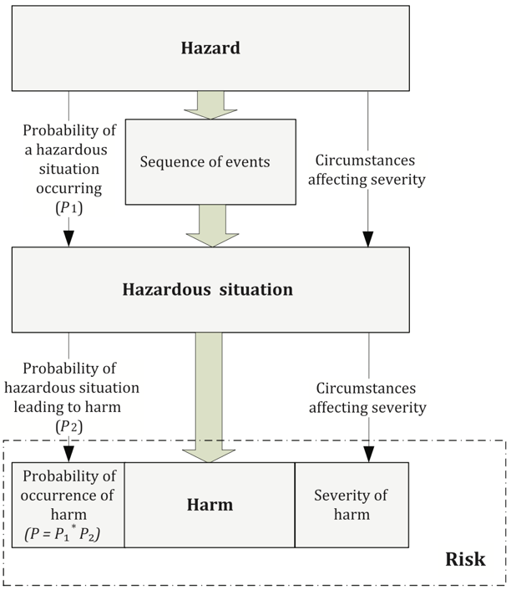
ISO 14891: Risk Management of Med Devices
Oriented towards manufacturers.
Aiming at controlling hazards by assessing probability of occurrence and severity.

Slide 19
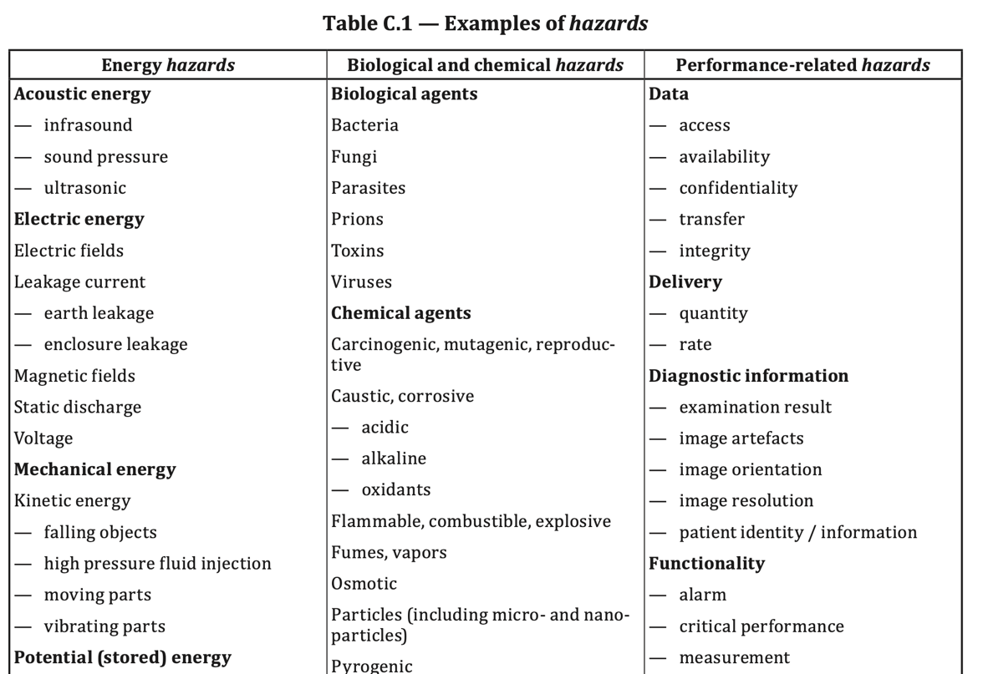
Hazards can be exemplified

Slide 20
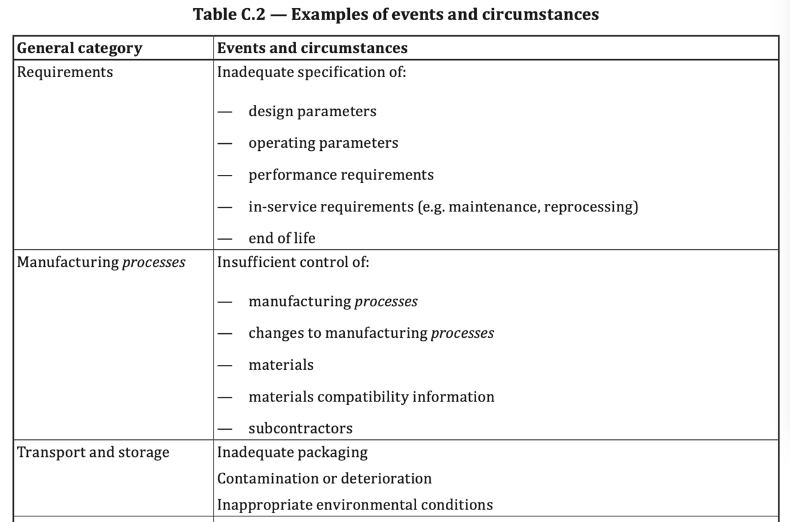
Sequence of Events can be exemplified

Slide 21
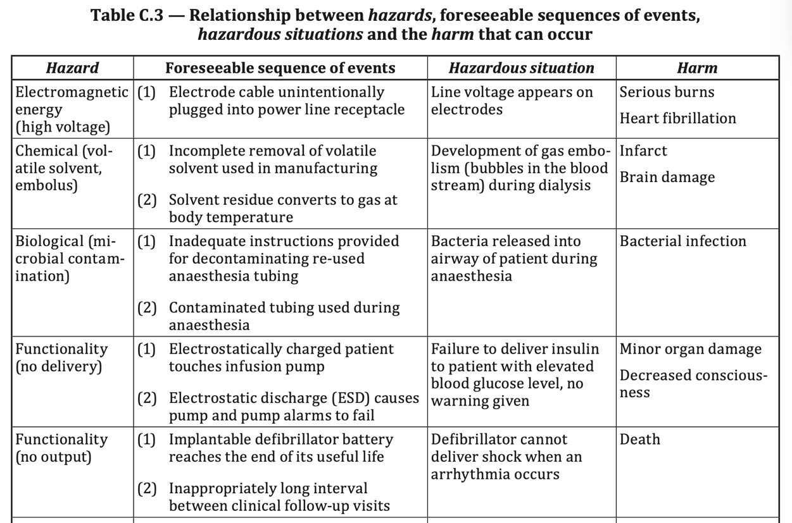
Hazard, Events, Hazardous Situation, Harm

Slide 22
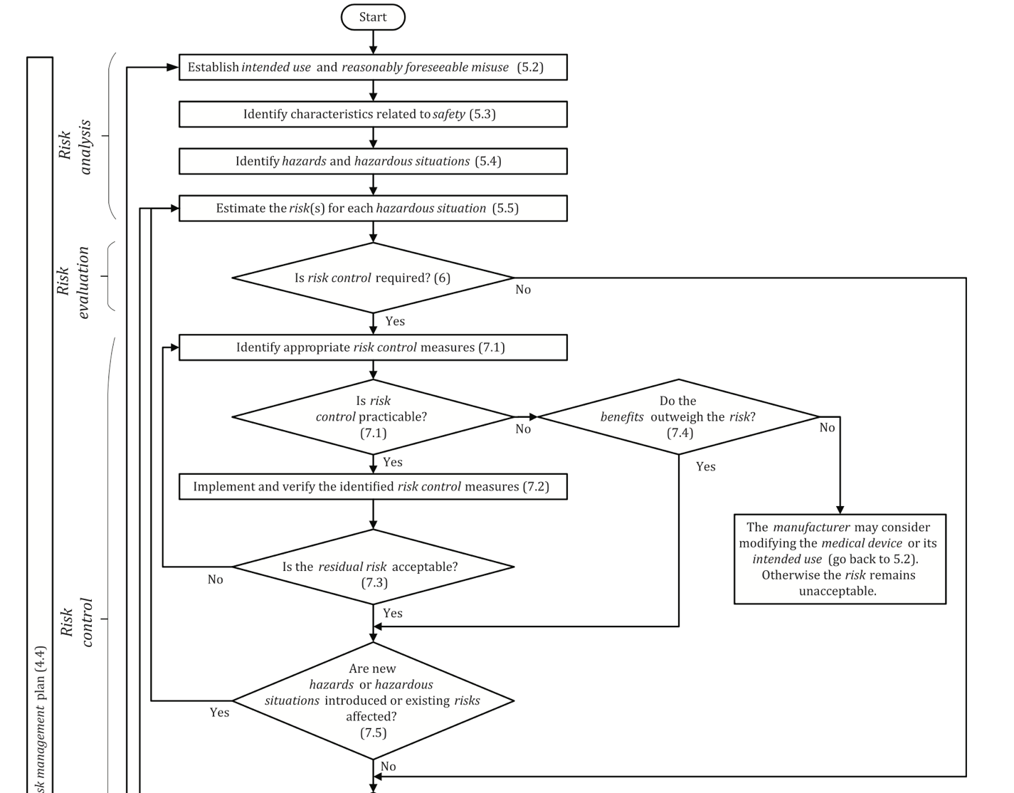

Slide 23
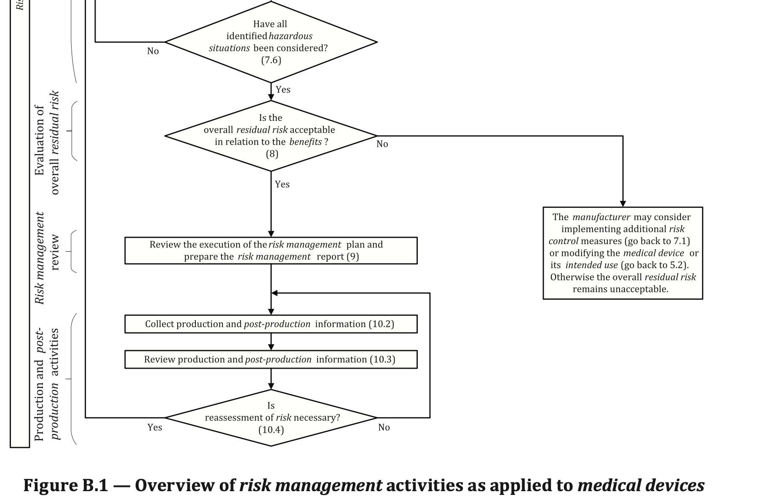

Slide 24
Generic Software Engineering Risk Management
ISO 15288: System Lifecycle
ISO 12207: Software Lifecycle
ISO 16085: Risk Management

Slide 25
Summary
ISO 31000 covers the completely generic approach to risk management.
As a result, there are general principles, but the standard can make few requirements
Looking at a particular domain the lifecycle (EN 62304) and the incorporated risk management (ISO 14971) can be much more specific around device risk.
The generic systems and software lifecycles and risk management are more specific than the overarching standard (ISO 31000)

