Slide 1
Finite Models

Slide 2
Learning objectives
Be able to explain the relationship between a finite state abstraction and the original system and describe some consequences of this when the model is used to approximate the original system.
Learn how to model program control flow with graphs
Learn how to model the software system structure with call graphs
Learn how to model finite state behavior with finite state machines

Slide 3
Properties of Models
Compact: representable and manipulable in a reasonably compact form
  What is reasonably compact depends largely on how the model will be used
Predictive: must represent some salient characteristics of the modeled artifact well enough to distinguish between good and bad outcomes of analysis
  no single model represents all characteristics well enough to be useful for all kinds of analysis
Semantically meaningful: it is usually necessary to interpret analysis results in a way that permits diagnosis of the causes of failure
Sufficiently general: models intended for analysis of some important characteristic must be general enough for practical use in the intended domain of application

Slide 4

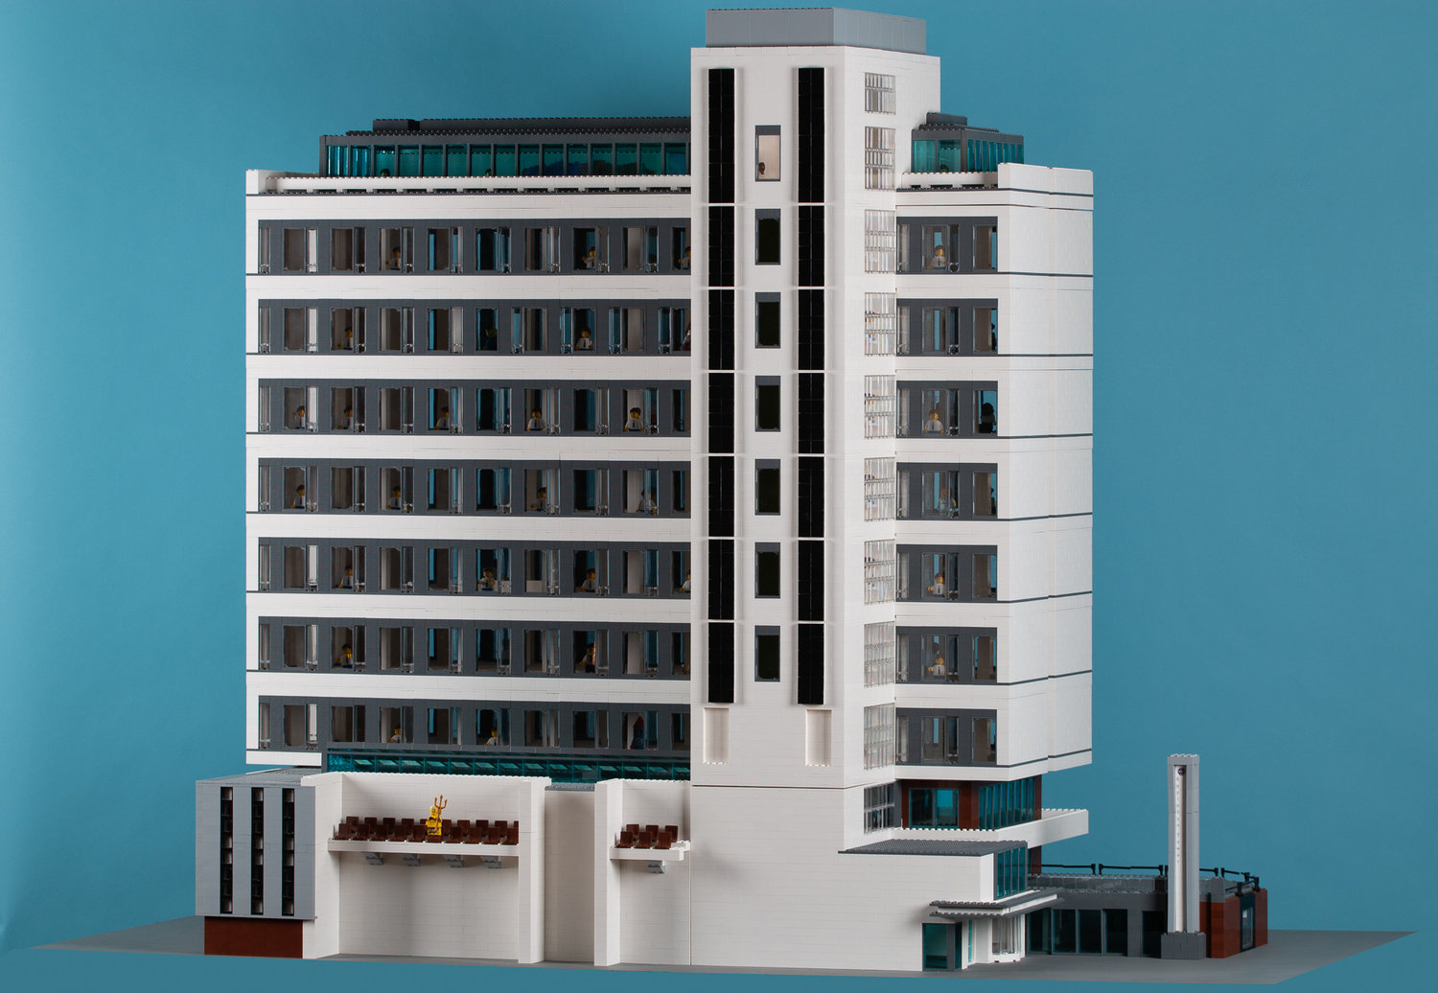
Models approximate/abstract

Slide 5
Graph Representations: directed graphs
Directed graph:
  N (set of nodes)
  E (relation on the set of nodes ) edges
Nodes: {a, b, c}
Edges: {(a,b), (a, c), (c, a)}
a
b
a
c
b
c

Slide 6
Graph Representations: labels and code
We can label nodes with the names or descriptions of the entities they represent.
  If nodes a and b represent program regions containing assignment statements, we might draw the two nodes and an edge (a,b) connecting them in this way:
x = y + z;
a = f(x);

Slide 7
Multidimensional Graph Representations
Sometimes we draw a single diagram to represent more than one directed graph, drawing the shared nodes only once
  class B extends (is a subclass of) class A
  class B has a field that is an object of type C
extends relation
NODES = {A, B, C}
EDGES = {(A,B)}
includes relation
NODES = {A, B, C}
EDGES = {(B,C)}
a
b
c

Slide 8
Finite Abstraction of Behavior
an abstraction function suppresses some details of program execution
it lumps together execution states that differ with respect to the suppressed details but are otherwise identical

Slide 9
(Intraprocedural) Control Flow Graph
nodes = regions of source code (basic blocks)
  Basic block = maximal program region with a single entry and single exit point
  Often statements are grouped in single regions to get a compact model
  Sometime single statements are broken into more than one node to model control flow within the statement
directed edges = possibility that program execution proceeds from the end of one region directly to the beginning of another

Slide 10
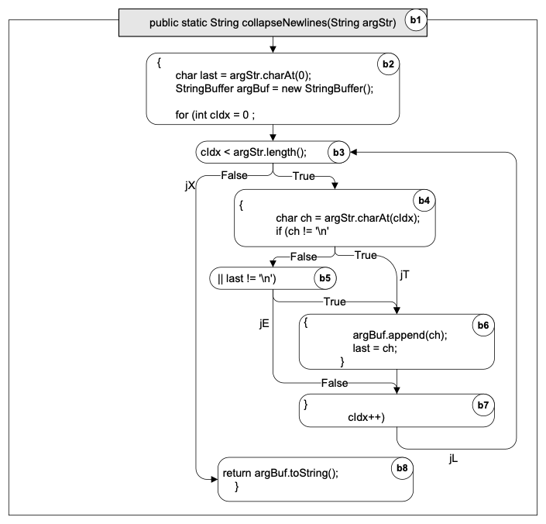
Example of Control Flow Graph
public static String collapseNewlines(String argStr)
{
char last = argStr.charAt(0);
StringBuffer argBuf = new StringBuffer();
for (int cIdx = 0 ; cIdx < argStr.length(); cIdx++)
{
char ch = argStr.charAt(cIdx);
if (ch != '\n' || last != '\n')
{
argBuf.append(ch);
last = ch;
}
}
return argBuf.toString();
}

Slide 11
Linear Code Sequence and Jump (LCSJ)
From | Sequence of basic blocs | To
Entry | b1 b2 b3 | jX
Entry | b1 b2 b3 b4 | jT
Entry | b1 b2 b3 b4 b5 | jE
Entry | b1 b2 b3 b4 b5 b6 b7 | jL
jX | b8 | ret
jL | b3 b4 | jT
jL | b3 b4 b5 | jE
jL | b3 b4 b5 b6 b7 | jL
Essentially subpaths of the control flow graph from one branch to another

Slide 12
Interprocedural control flow graph
Call graphs
  Nodes represent procedures
    Methods
    C functions
    ...
  Edges represent calls relation

Slide 13
Overestimating the calls relation
The static call graph includes calls through dynamic bindings that never occur in execution.
public class C {
public static C cFactory(String kind) {
if (kind == "C") return new C();
if (kind == "S") return new S();
return null;
}
void foo() {
System.out.println("You called the parent's method");
}
public static void main(String args[]) {
(new A()).check();
}
}
class S extends C {
void foo() {
System.out.println("You called the child's method");
}
}
class A {
void check() {
C myC = C.cFactory("S");
myC.foo();
}
}
A.check()
C.foo()
S.foo()
CcFactory(string)

Slide 14
Contex Insensitive Call graphs
public class Context {
public static void main(String args[]) {
Context c = new Context();
c.foo(3);
c.bar(17);
}
void foo(int n) {
int[] myArray = new int[ n ];
depends( myArray, 2) ;
}
void bar(int n) {
int[] myArray = new int[ n ];
depends( myArray, 16) ;
}
void depends( int[] a, int n ) {
a[n] = 42;
}
}
main
C.foo
C.bar
C.depends

Slide 15
Contex Sensitive Call graphs
public class Context {
public static void main(String args[]) {
Context c = new Context();
c.foo(3);
c.bar(17);
}
void foo(int n) {
int[] myArray = new int[ n ];
depends( myArray, 2) ;
}
void bar(int n) {
int[] myArray = new int[ n ];
depends( myArray, 16) ;
}
void depends( int[] a, int n ) {
a[n] = 42;
}
}
main
C.foo(3)
C.bar(17)
C.depends(int(3),a,2)
C.depends (int(3),a,2)

Slide 16
Context Sensitive CFG exponential growth
A
1 context A
B
C
2 contexts AB AC
D
E
4 contexts ABD ABE ACD ACE
F
G
8 contexts …
H
I
16 calling contexts …
J

Slide 17
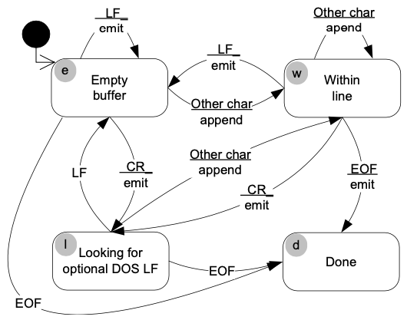
Finite state machines
Graph representation (Mealy machine)
Tabular representation
 | LF | CR | EOF | other
e | e/emit | e/emit | d/- | w/append
w | e/emit | e/emit | d/emit | w/append
l | e/- |  | d/- | w/append
finite set of states (nodes)
set of transitions among states (edges)

Slide 18
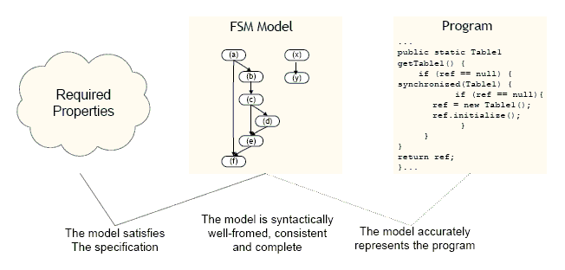
Using Models to Reason about System Properties
Notes:
Internal properties:
completeness
determinism
The executions of a model (paths through the FSM) may satisfy (or not) some desired property
The finite state machine model should accurately represent possible behaviors of the program
Equivalently, the program should be a correct implementation of the finite state machine model

Slide 19
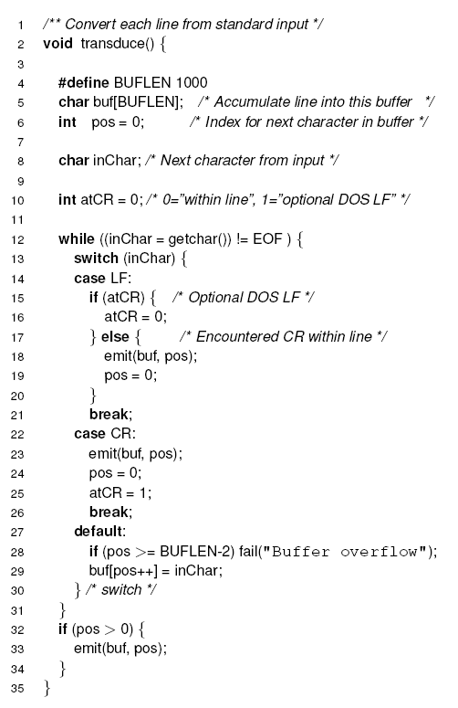
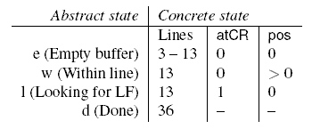
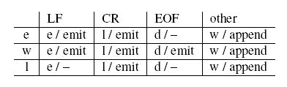
Abstraction Function

Slide 20
Summary
Models are simpler than the artifact they describe to be understandable and analyzable
Must be sufficiently detailed to be useful in a particular context
Flow Graphs are built from software
FSM can be built before software to document intended behavior or explore designs
FSM can be the basis for tools such as statecharts: https://statecharts.dev/

