Slide 1
Software Testing
Overview

Slide 2
Learning objectives
Be able to describe the role of software quality in the specification, design/construction, and operation of software.
Be able to outline the main software verification and validation activities.
Be able to identify some key criteria for selecting and combining different techniques used in software quality assurance.

Slide 3
Engineering processes
Focus of Engineering Processes
  Ensuring the product is fit for purpose in use
  Ensuring the process is reproduceable
  Reflecting on and improving the process
Engineering Processes
  Aim to build the right thing (validation) – meets the needs of use
  Aim to build the thing right (verification) – the thing you built does what you want
  Collect data throughout specification, design/construction, operation to: improve the product, improve the engineering process
Software Engineering:
  Works with products that are deeply embedded in organisations and people’s lives, so:
    Needs change continuously in many contexts
    Processes need to be responsive: Agile, DevOps, Continuous Integration/Deployment,

Slide 4
Software Quality in the Engineering Process
Software Quality Assurance (SQA) is increasingly embedded in all aspects of the Engineering process because the later quality problems are recognized the more costly it is to fix them.
This embedding is in practices such as:
  Test driven development: tests are the specification (roughly speaking)
  DevOps uses data collected from operation to:
    Continuously validate the requirements and recognize requirement change.
    Identify software quality issues.
The software engineering process involves:
  Identifying and validating requirements using operational data and other sources
  Constructing the means to verify the product meets the requirement (e.g. tests)
  Developing a verified product (e.g. Test Driven Design)
  Deploying the product and gathering operational data to inform decisions on development (and more)

Slide 5
Example proto-AirBnB
This is intended to be realistic without being a historically accurate account:
  Proto-AirBnB was mainly aimed at sofa surfers of people who wanted a very cheap room and the user community had quite high trust of each other.
  Proto-AirBnB expanded to a much larger population with a wider range of accommodation.
  Scammers started to appear, and operational data suggested that this was increasing.
  Validation against operational data identified a missing requirement, that people needed to be accurately identified.
  Users are required to be fully identified – spec developed – tests developed
  New version with this feature is deployed – operational data sees decline in scams.
  [Do you see any issue in requiring people to upload a passport image and have it verified?]

Slide 6
Challenges of Software
For many systems there are also many stakeholders often with competing and conflicting requirement (can you think of examples?)
Systems might depend on unreliable infrastructure (e.g. libraries, operating systems, comms, …)
Software often has complex, exploitable, errors e.g. buffer overruns, “one off” issues in the use of arrays (e.g. UoE ISG mail problem)
Software is often ”open” to a wide range of potential users and abusers.
Example
If an elevator can safely carry a load of 1000 kg - it can also safely carry any smaller load
a service may work perfectly most of the time but:
  It might fail because some service it uses has failed or is insufficiently resourced
  It might fail because of a denial of service attack.
  It may not adequately check for SQL injection and will fail under some circumstances

Slide 7
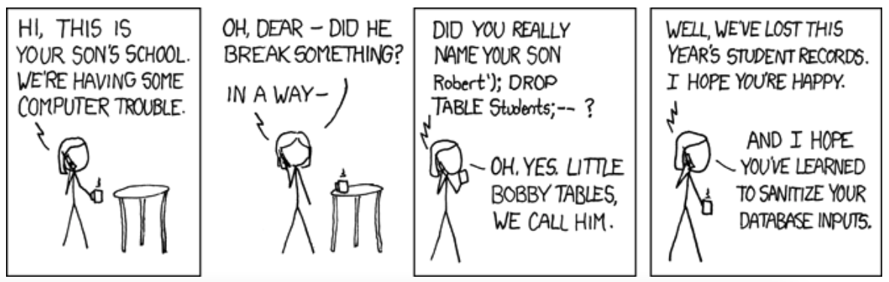
Software can have users with conflicting needs

Slide 8
New technologies
New Technologies
  Can reduce error e.g. Natural Language AI models can do very accurate autocomplete so avoiding a range of issues
  But can lead to errors of over reliance or introduce new issues e.g. some of the Natural Language models can be quite racist depending on their training.
New development approaches can introduce new kinds of faults
examples
  Machine Learning introduces a wide range of ethical issues.
  Poorly designed web services can be subject to a wide range of resource issues.

Slide 9
Choosing Approaches
Particular domains will have established practice and often will have standards or regulation to comply with.
Test designers must
  Design the testing process
    To assure the required level of quality
    Meet the cost constraints (notice that this may be impossible)
  Design a specific solution that suits
    the problem
    the requirements
    the development environment
Have a look at the risks Forum: http://catless.ncl.ac.uk/risks/ for example see this: http://catless.ncl.ac.uk/Risks/33/44#subj6

Slide 10
Five Basic Engineering Questions
What is the role of software quality assurance in development processes?
Software quality assurance has a range of techniques – how do we choose where to use them?
What does it mean for a product to be “ready”?
How do we maintain the quality of the product as it evolves in line with the contexts of use?
Why and how can the process be improved?
  Identifying process issues
  Fixing process issues

Slide 11
Q1:What is the role of SQA in development processes?
SQA starts as soon as we start to consider making a software product
  The quality we aim for has an impact on cost, time to completion, customer satisfaction, product liability, … so we must start looking at SQA from when we initiate a project
SQA is necessary through whole lifetime of the product, including any decommissioning activity (decommissioning can be tricky) because:
  The world changes and so the specification changes to adapt the behaviour of the product to its environment.
  The infrastructure underpinning the production process and the product in operation will change over time and we need to assure the quality of the product is maintained.

Slide 12
Early start: from feasibility study
The feasibility study of a new project must take into account the required qualities and their impact on the overall cost
At this stage, quality-related activities include
  risk analysis
  measures needed to assess and control quality at each stage of development.
  assessment of the likely evolution of the product and its quality
  contribution of quality control activities to development cost and schedule.

Slide 13
Continuous Integration and Deployment
Many systems evolve continuously and are deployed continuously to add new features to the system of to fix issues identified in operation or by SQA activities. Typical activities include:
  analysis of customer requests, operational data, to identify new requirements
  Mapping those requirements to SQA elements like tests
  Embed the new SQA elements into the development process
    For example, if a new feature has been identified it may be appropriate to branch the development, extend the requirements and corresponding tests and develop until the system passes all tests and then merge back into the main development.

Slide 14
2: Software quality assurance has a range of techniques – how do we choose where to use them?
No single SQA technique can serve all purposes
We choose a technique appropriate for the quality we are trying to assure:
  Effectiveness for different features
  example: statistical testing for bias in machine learning versus functional testing to assure safety
  Applicability at different points in a project
  example: analysis of operational data to identify missing functions
  Differences in purpose
  example: statistical testing to measure reliability
  Tradeoffs in cost and assurance
  example: for key features it may be necessary to commit high levels of resource to assure high confidence that the system has the feature (e.g. for some avionic systems the standard requires fewer than one failure in 10⁹ flying hours)

Slide 15
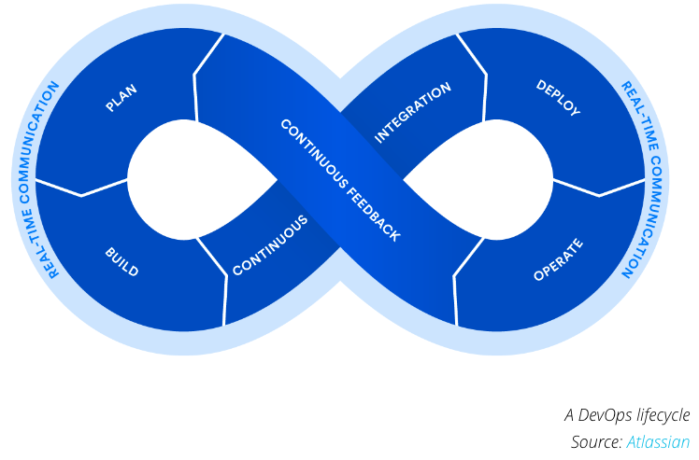
SQA in the lifecycle
Fig 1.1 of Y&P gives a detailed breakdown of activities across a classical lifecycle.
DevOps is far more common now.
How do you think the “map” provided by Fig 1.1 translates onto a DevOps lifecycle?
We will discuss next lecture.

Slide 16
3: What does it mean for a product to be “ready”?
SQA is aimed at assuring that the product is fit for purpose:
  Software for an autonomous vehicle has different criteria from
  A simple game for a phone
Software can deviate from the specification in a range of ways e.g. it may fail in some way, it may fail to meet a requirement on some measurable feature (e.g. performance, mean time to failure, mean time to repair, …)
For example, software contains a collection of “faults” that are caused by incorrect programming or other issue, if they are executed, they may result in in an erroneous state and after some time the system may fail as a consequence of the erroneous state.
SQA is resource bounded in most cases, so this places limits on Quality
In a DevOps environment the test set typically includes tests corresponding to ALL requirements (including measure on attribute) so passing the tests is the stage when the product is ready.

Slide 17
Specifications often include dependability
Availability measures the quality of service in terms of running versus down time
Mean time between failures (MTBF) measures the quality of the service in terms of time between failures
Reliability indicates the fraction of all attempted operations that complete successfully

Slide 18
Dependability – how to define?
In a Web application users take 50 interactions to reach the final point where they authorize a credit card charge.
The software always operates flawlessly up to the point of authorization, but on half the attempts it charges the wrong amount.
What is the reliability of the system?
If we count the fraction of individual interactions that are correctly carried out, only one operation in 100 fail: The system is 99% reliable.
If we count entire sessions, only 50% reliable, since half the sessions result in an improper credit card charge

Slide 19
4: How do we maintain the quality of the product as it evolves in line with the contexts of use?
Software products operate for many years, and may change on a daily basis (e.g. Microsoft Teams…):
  They adapt to environment changes
  They evolve to serve new and changing user requirements.
In DevOps processes
  The QA is continually update to be in line with the specification
  The DevOps process should define what data should be collected and how it needs to be interpreted.
  The QA mechanisms to some extent “document” the software.
  The QA mechanisms could be adequate to demonstrate the software complies with regulations

Slide 20
5: How can the development process itself be improved?
Why change the development process? If in multiple projects the product is demonstrably not meeting the specification.
How might this arise?
  The translation of a specification to some QA technique is flawed.
  There are issues in the implementation of the QA process
  There are resource issues and insufficient resource is being devoted to QA processes.
Also, the development process should be reviewed to eliminate unnecessary resource use e.g. duplication, use of a high resource technique where a lower resource approach would be adequate,…

Slide 21
Improving a DevOps process
Monitoring will typically include anomaly reporting alomg with a range of other behavioural data.
Analyze monitoring data to identify recurring anomalies that impair the deployed version of the system.
Analyze the gathered data on the anomalies – if the data does not allow the cause of the anomalies, analyze the situation and change the monitoring data and analysis process.
Implement the change of process and monitor it retains effectiveness on past cases.

Slide 22
An example of process improvement
During operation monitoring identifies attempts at SQL injection by a range of users.
Analysis identifies specific circumstance where this could lead to loss of data
Action plan: Identify components that could be vulnerable to SQL injection and require that systems using these components include mandatory SQL injection tests.

Slide 23
Summary
The quality assurance process has three different goals:
  Improving a software product
  assessing the quality of the software product
  improving the quality process
We need to combine several SQA techniques through the software process
Choice of techniques depend on organization and application domain.
Cost-effectiveness depends on the extent to which techniques can be re-applied as the product evolves.
Planning and monitoring are essential to evaluate and refine the quality process.

