Slide 1
Functional testing

Slide 2
Learning objectives
Be able to explain the rationale for systematic (non-random) selection of test cases
  Be able to explain the principles of partition testing and its underlying assumptions
Be able to explain why functional test selection is a primary, base-line technique
  Why we expect a specification-based partition to help select valuable test cases
Distinguish functional testing from other systematic testing techniques

Slide 3
Functional testing
Functional testing: Deriving test cases from program specifications
    Functional refers to the source of information used in test case design, not to what is tested
Also known as:
  specification-based testing (from specifications)
  black-box testing (no view of the code)
Functional specification = description of intended program behavior
  either formal or informal
Notes:
There is a potential confusion of terminology here. Some writers use the term “functional” to distinguish tests of functionality from tests of non-functional program qualities, such as usability. (Often these writers also treat performance and robustness as “non-functional” attributes, although this is questionable.) We use the term “functional” as it has long been used in the testing research community.

Slide 4
Systematic vs Random Testing
Random (uniform):
  Pick possible inputs uniformly
  Avoids designer bias
    A real problem: The test designer can make the same logical mistakes and bad assumptions as the program designer (especially if they are the same person)
  But treats all inputs as equally valuable
Systematic (non-uniform):
  Try to select inputs that are especially valuable
  Usually by choosing representatives of classes that are apt to fail often or not at all
Functional testing is systematic testing

Slide 5

Why Not Random?
Non-uniform distribution of faults
Example: Java class “roots” applies quadratic equation:
  Incomplete implementation logic: Program does not properly handle the case in which b² - 4ac =0 and a=0
  Failing values are sparse in the input space — needles in a very big haystack. Random sampling is unlikely to choose a=0.0 and b=0.0
Notes:
Instructor suggestion: Ask students to attempt to calculate how many uniform random test cases it would take, on average, to find this bug. Encourage them to perform a quick, back-of-the-envelope calculation using reasonable assumptions.
If we assume 32-bit floating point numbers, and that all 32-bit patterns represent legal and distinct numbers (which is not true), then there would be 2^32 different floating point numbers, thus a chance of 1 in 2^32 of choosing zero randomly. The chance of choosing the pair (0.0, 0.0) would then be 1 in 2^64, a very large number.
Since not all bit patterns are valid and distinct floating point numbers, and since very small values of a may cause a detectable failure, in practice random testing will do a little better than this calculation indicates ... but not enough better to make it at all effective. It will take millions of random test cases, on average, to find this bug, while picking a few special values based on the specification will find it very quickly.

Slide 6
Consider the purpose of testing ...
To estimate the proportion of needles to hay, sample randomly
  Reliability estimation requires unbiased samples for valid statistics. But that’s not our goal!
To find needles and remove them from hay, look systematically (non-uniformly) for needles
  Unless there are a lot of needles in the haystack, a random sample will not be effective at finding them
  We need to use everything we know about needles, e.g., are they heavier than hay? Do they sift to the bottom?
Notes:
Students (and others!) can get confused about testing strategies because they don’t make a clear distinction between reliability estimation and testing for the purpose of product improvement. The current chapter and the next few all deal with testing for the purpose of finding program faults.

Slide 7
Systematic Partition Testing
Failures are sparse in the space of possible inputs ...
... but dense in some parts of the space
Failure (valuable test case)
No failure
The space of possible input values
(the haystack)
If we systematically test some cases from each part, we will include the dense parts
Functional testing is one way of drawing pink lines to isolate regions with likely failures
Notes:
We can think of all the possible input values to a program as little boxes ... white boxes that the program processes correctly, and colored boxes on which the program fails. Our problem is that there are a lot of boxes ... a huge number, and the colored boxes are just an infinitessimal fraction of the whole set. If we reach in and pull out boxes at random, we are unlikely to find the colored ones.
Systematic testing says: Let’s not pull them out at random. Let’s first subdivide the big bag of boxes into smaller groups (the pink lines), and do it in a way that tends to concentrate the colored boxes in a few of the groups. The number of groups needs to be much smaller than the number of boxes, so that we can systematically reach into each group to pick one or a few boxes.
Functional testing is one variety of partition testing, a way of drawing the pink lines so that, when one of the boxes within a pink group is a failure, many of the other boxes in that group may also be failures. Functional testing means using the program specification to draw pink lines.

Slide 8
The partition principle
Exploit some knowledge to choose samples that are more likely to include “special” or trouble-prone regions of the input space
  Failures are sparse in the whole input space ...
  ... but we may find regions in which they are dense
(Quasi*-)Partition testing: separates the input space into classes whose union is the entire space
        *Quasi because: The classes may overlap
Desirable case: Each fault leads to failures that are dense (easy to find) in some class of inputs
  sampling each class in the quasi-partition selects at least one input that leads to a failure, revealing the fault
  seldom guaranteed; we depend on experience-based heuristics
Notes:
Note: Partitioning only makes sense if there is some plausible reason for believing that failures may be concentrated in one part or another.
Another way of looking at the same supposition: We hope that any member of a partition is a good representative of the rest, i.e., either all executions in a given bucket execute correctly or most of them fail.
To call them “equivalence classes” is a stretch, but we try to devise ways of partitioning that, based on experience, at least sometimes form classes that are equivalent in the sense that all of the executions in a given class are failures even when the proportion of failures in the whole input space is very small.

Slide 9
Functional testing: exploiting the specification
Functional testing uses the specification (formal or informal) to partition the input space
  E.g., specification of “roots” program suggests division between cases with zero, one, and two real roots
Test each category, and boundaries between categories
  No guarantees, but experience suggests failures often lie at the boundaries (as in the “roots” program)
Notes:
This repeats points from an earlier slide, but a quick reminder of what functional testing is may be useful at this point. If you want to push the needle-in-a-haystack analogy, we can think of functional testing as using what we know about haystacks to select the parts where needles are most likely to be found.
With respect to the partition principle: The specification gives us a way to draw pink lines, or to divide the haystack into smaller piles that tend to contain either lots of needles or none.

Slide 10
Why functional testing?
The base-line technique for designing test cases
  Timely
    Often useful in refining specifications and assessing testability before code is written
  Effective
    finds some classes of fault (e.g., missing logic) that can elude other approaches
  Widely applicable
    to any description of program behavior serving as spec
    at any level of granularity from module to system testing.
  Economical
    typically less expensive to design and execute than structural (code-based) test cases
Notes:
Of all the kinds of information we could use in partitioning the input space, why is functional (black-box) testing especially important?

Slide 11
Early functional test design
Program code is not necessary
  Only a description of intended behavior is needed
  Even incomplete and informal specifications can be used
    Although precise, complete specifications lead to better test suites
Early functional test design has side benefits
  Often reveals ambiguities and inconsistency in spec
  Useful for assessing testability
    And improving test schedule and budget by improving spec
  Useful explanation of specification
    or in the extreme case (as in XP), test cases are the spec

Slide 12
Functional versus Structural:
Classes of faults
Different testing strategies (functional, structural, fault-based, model-based) are most effective for different classes of faults
Functional testing is best for missing logic faults
  A common problem: Some program logic was simply forgotten
  Structural (code-based) testing will never focus on code that isn’t there!

Slide 13
Functional vs structural test: granularity levels
Functional test applies at all granularity levels:
  Unit (from module interface spec)
  Integration (from API or subsystem spec)
  System (from system requirements spec)
  Regression (from system requirements + bug history)
Structural (code-based) test design applies to relatively small parts of a system:
  Unit
  Integration

Slide 14
Steps: From specification to test cases
1. Decompose the specification
      If the specification is large, break it into independently testable features to be considered in testing
2. Select representatives
  Representative values of each input, or
  Representative behaviors of a model
      Often simple input/output transformations don’t describe a system. We use models in program specification, in program design, and in test design
3. Form test specifications
      Typically: combinations of input values, or model behaviors
4. Produce and execute actual tests

Slide 15
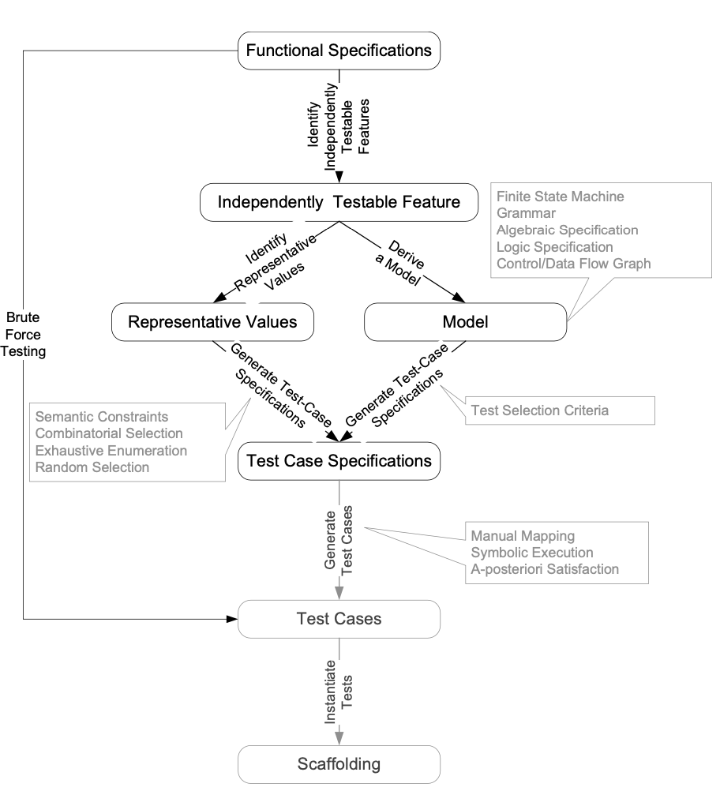
From specification to test cases
Notes:
(This is essentially the same information on the previous slide, restated graphically)
A systematic approach to functional testing can be broken down into steps.
First, we break the specification down into independently testable features. This may be trivial if the “specification” is, for example, an interface specification for a single module, but if we are starting from a requirements specification of a whole system then we can expect to break it down into a large number of features for further consideration.
The next step depends on the kind of specification, and might even vary from feature to feature. For some kinds of specifications it is natural to directly identify inputs and choose representative values. For other kinds of specification, especially those that describe some complex behavior that varies over time, we will need to derive some kind of model ... but this is not really extra work, because we will need to derive some kind of model to design the system anyway. (The chapter on model-based testing describes how some important kinds of design model can be used in test design.)
Whether we chose representative values of inputs directly or defined a more suitable model from which to derive representative inputs or behaviors, what we generate next are test specifications rather than fully instantiated test cases. For example, a test case specification might require an input to be “a string of 3 alphabetic characters”, while a corresponding test case would set that value to “xmt”. A test case will also require scaffolding, including some kind of test oracle to distinguish incorrect from correct behavior.
Generating test case specifications often involves combining representative values, as described in the next chapter on combinatorial testing. Scaffolding and run-time support for testing is discussed in chapter 17 on test execution.

Slide 16
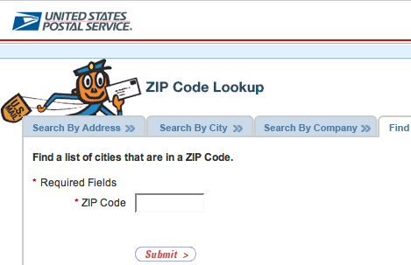
Simple example: Postal code lookup
Input: ZIP code (5-digit US Postal code)
Output: List of cities
What are some representative values (or classes of value) to test?
Notes:
Here is a very simple example taken from the U.S. Postal Service web site. Ask students to suggest a breakdown of values before showing next slide.

Slide 17
Example: Representative values
Simple example with
one input, one output
Note prevalence of boundary values (0 cities, 6 characters) and error cases
Correct zip code
  With 0, 1, or many cities
Malformed zip code
  Empty; 1-4 characters; 6 characters; very long
  Non-digit characters
  Non-character data
Notes:
Here is a possible breakdown of values. Note that while there is only one input, we have considered the output value (a list) as well. Also note that these are mostly classes of values, rather than concrete values --- i.e., we have parts of test case specifications, not concrete test cases.
The prevalence of boundary and error values is typical (and program faults are also disproportionately found in boundary case and error handling).
Did students come up with each of these? If not, do they agree that each of these is a significant case to be tested? Did they come up with any others, and if so, can they explain why the representatives they came up with are also significant cases to be tested?

Slide 18
Summary
Functional testing, i.e., generation of test cases from specifications is a valuable and flexible approach to software testing
  Applicable from very early system specs right through module specifications
(quasi-)Partition testing suggests dividing the input space into (quasi-)equivalent classes
  Systematic testing is intentionally non-uniform to address special cases, error conditions, and other small places
  Dividing a big haystack into small, hopefully uniform piles where the needles might be concentrated

