Slide 1
Model based testing

Slide 2
Learning Objectives
Be able to explain the role of models in devising test cases
    Principles underlying functional and structural test adequacy criteria, as well as model-based testing
Explain some examples of model-based testing techniques
    A few of the most common model-based techniques, representative of many others
Be able to explain, devise and refine other model-based testing techniques
    Grasp the basic approach and rationale well enough to apply it in other contexts

Slide 3
Why model-based testing?
Models used in specification or design have structure
    Useful information for selecting representative classes of behavior; behaviors that are treated differently with respect to the model should be tried by a thorough test suite
    In combinatorial testing, it is difficult to capture that structure clearly and correctly in constraints
We can devise test cases to check actual behavior against behavior specified by the model
    “Coverage” similar to structural testing, but applied to specification and design models
    Structural coverage is coverage of code while model coverage is coverage of the (abstracted) behaviour.

Slide 4
Deriving test cases from finite state machines
A common kind of model for describing behavior that depends on sequences of events or stimuli
Example: UML state diagrams

Slide 5
From an informal specification…
Maintenance: The Maintenance function records the history of items undergoing maintenance.
If the product is covered by warranty or maintenance contract, maintenance can be requested either by calling the maintenance toll free number, or through the web site, or by bringing the item to a designated maintenance station.
If the maintenance is requested by phone or web site and the customer is a US or EU resident, the item is picked up at the customer site, otherwise, the customer shall ship the item with an express courier.
If the maintenance contract number provided by the customer is not valid, the item follows the procedure for items not covered by warranty.
If the product is not covered by warranty or maintenance contract, maintenance can be requested only by bringing the item to a maintenance station. The maintenance station informs the customer of the estimated costs for repair. Maintenance starts only when the customer accepts the estimate.
If the customer does not accept the estimate, the product is returned to the customer.
Small problems can be repaired directly at the maintenance station. If the maintenance station cannot solve the problem, the product is sent to the maintenance regional headquarters (if in US or EU) or to the maintenance main headquarters (otherwise).
If the maintenance regional headquarters cannot solve the problem, the product is sent to the maintenance main headquarters.
Maintenance is suspended if some components are not available.
Once repaired, the product is returned to the customer.
Multiple choices in the first step ...
... determine the possibilities for the next step ...
... and so on ...

Slide 6
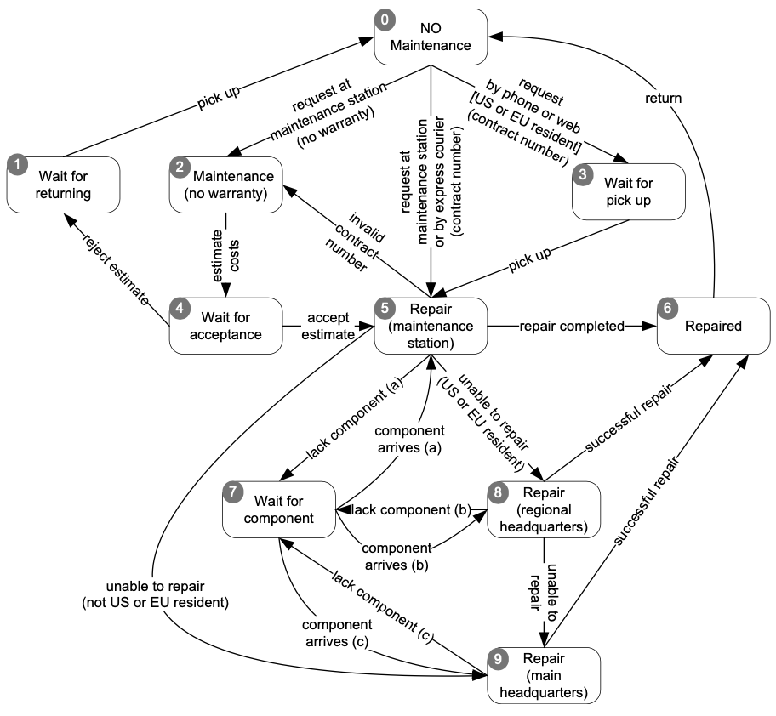
To a Finite State Model
The informal specification allows us to construct an abstract account of the behaviour of the system.
The implemented states will be much more complex with data capturing a richer notion of state (that can influence behaviour).

Slide 7
…to a test suite
Meaning: From state 0 to state 2 to state 4 to state 1 to state 0
TC1 | 0 | 2 | 4 | 1 | 0
TC2 | 0 | 5 | 2 | 4 | 5 | 6 | 0
TC3 | 0 | 3 | 5 | 9 | 6 | 0
TC4 | 0 | 3 | 5 | 7 | 5 | 8 | 7 | 8 | 9 | 6 | 0
Is this a thorough test suite?
How can we judge?

Slide 8
“Covering” finite state machines
State coverage:
  Every state in the model should be visited by at least one test case
Transition coverage
  Every transition between states should be traversed by at least one test case.
  This is the most commonly used criterion
    A transition can be thought of as a (precondition, postcondition) pair

Slide 9
Path sensitive criteria?
Basic assumption: States fully summarize history
    No distinction based on how we reached a state; this should be true of well-designed state machine models
If the assumption is violated, we may distinguish paths and devise criteria to cover them
  Single state path coverage:
    traverse each subpath that reaches each state at most once
  Single transition path coverage:
    “” “” each transition at most once
  Boundary interior loop coverage:
    each distinct loop of the state machine must be exercised the minimum, an intermediate, and the maximum or a large number of times
    Of the path sensitive criteria, only boundary-interior is common

Slide 10
Testing decision structures
Some specifications are structured as decision tables, decision trees, or flow charts. We can exercise these as if they were program source code.

Slide 11
from an informal specification..
Pricing: The pricing function determines the adjusted price of a configuration for a particular customer.
The scheduled price of a configuration is the sum of the scheduled price of the model and the scheduled price of each component in the configuration. The adjusted price is either the scheduled price, if no discounts are applicable, or the scheduled price less any applicable discounts.
There are three price schedules and three corresponding discount schedules, Business, Educational, and Individual.
….
Educational prices: The adjusted price for a purchase charged to an educational account in good standing is the scheduled price from the educational price schedule. No further discounts apply.
…
Special-price non-discountable offers: Sometimes a complete configuration is offered at a special, non-discountable price. When a special, non-discountable price is available for a configuration, the adjusted price is the non-discountable price or the regular price after any applicable discounts, whichever is less

Slide 12
…to a decision table …
 | edu |  | individual
EduAc | T | T | F | F | F | F | F | F
BusAc | - | - | F | F | F | F | F | F
CP > CT1 | - | - | F | F | T | T | - | -
YP > YT1 | - | - | - | - | - | - | - | -
CP > CT2 | - | - | - | - | F | F | T | T
YP > YT2 | - | - | - | - | - | - | - | -
SP < Sc | F | T | F | T | - | - | - | -
SP < T1 | - | - | - | - | F | T | - | -
SP < T2 | - | - | - | - | - | - | F | T
out | Edu | SP | ND | SP | T1 | SP | T2 | SP

Slide 13
…with constraints…
at-most-one (EduAc, BusAc)
at-most-one (YP < YT1, YP > YT2)
YP > YT2 -> YP > YT1
at-most-one (CP < CT1, CP > CT2)
CP > CT2 -> CP > CT1
at-most-one (SP < T1, SP > T2
SP > T2 -> SP > T1

Slide 14
…to test cases
Basic condition coverage
  a test case specification for each column in the table
Compound condition adequacy criterion
  a test case specification for each combination of truth values of basic conditions
Modified condition/decision adequacy criterion (MC/DC)
  each column in the table represents a test case specification.
  we add columns that differ in one input row and in outcome, then merge compatible columns

Slide 15
Example MC/DC
Generate C.1a and C.1b by flipping one element of C.1
 | C.1 | C.1a | C.1b | C.10
EduAc | T | F | T | -
BusAc | - | - | - | T
CP > CT1 | - | - | - | F
YP > YT1 | - | - | - | F
CP > CT2 | - | - | - | -
YP > YT2 | - | - | - | -
SP > Sc | F | F | T | T
SP > T1 | - | - | - | -
SP > T2 | - | - | - | -
out | Edu | * | * | SP
C.1b can be merged with an existing column (C.10) in the spec
Outcome of generated columns must differ from source column

Slide 16
Flowgraph based testing
If the specification or model has both decisions and sequential logic, we can cover it like program source code.

Slide 17
From an informal spec (1 of 3)
Process shipping order: The Process shipping order function checks the validity of orders and prepares the receipt
A valid order contains the following data:
  cost of goods: If the cost of goods is less than the minimum processable order (MinOrder) then the order is invalid.
  shipping address: The address includes name, address, city, postal code, and country.
  preferred shipping method: If the address is domestic, the shipping method must be either land freight, expedited land freight, or overnight air; If the address is international, the shipping method must be either air freight, or expedited air freight.

Slide 18
From an informal spec (2 of 3)
a shipping cost is computed based on
  address and shipping method.
  type of customer which can be individual, business, educational
preferred method of payment. Individual customers can use only credit cards, business and educational customers can choose between credit card and invoice
card information: if the method of payment is credit card, fields credit card number, name on card, expiration date, and billing address, if different than shipping address, must be provided. If credit card information is not valid the user can either provide new data or abort the order

Slide 19
From an informal spec (3 of 3)
The outputs of Process shipping order are
validity: Validity is a boolean output which indicates whether the order can be processed.
total charge: The total charge is the sum of the value of goods and the computed shipping costs (only if validity = true).
payment status: if all data are processed correctly and the credit card information is valid or the payment is invoice, payment status is set to valid, the order is entered and a receipt is prepared; otherwise validity = false.

Slide 20
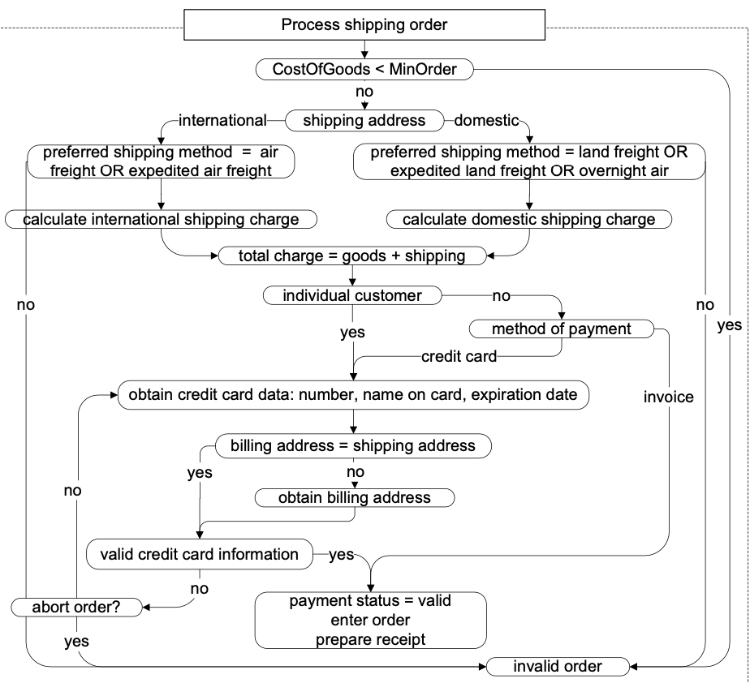
To a Flowgraph
Here conditions often refer to parameters of the function.
Transitions can be determined by conditions on data.
States don’t necessarily fully summarize history as they do in FSM models.

Slide 21
...from the flow graph to test cases
Branch testing: cover all branches
Case | Too Small | Ship Where | Ship Method | Cust Type | Pay Method | Same Address | CC valid
TC-1 | No | Int | Air | Bus | CC | No | Yes
TC-2 | No | Dom | Land | - | - | - | -
TC-3 | Yes | - | - | - | - | - | -
TC-4 | No | Dom | Air | - | - | - | -
TC-5 | No | Int | Land | - | - | - | -
TC-6 | No | - | - | Edu | Inv | - | -
TC-7 | No | - | - | - | CC | Yes | -
TC-8 | No | - | - | - | CC | - | No (abort)
TC-9 | No | - | - | - | CC | - | No (no abort)

Slide 22
Grammar-based testing
Complex input is (or can) often be described by a context-free grammar

Slide 23
Grammars in specifications
Grammars are good at:
  Representing inputs of varying and unbounded size
  With recursive structure
  And boundary conditions
Examples:
  Complex textual inputs
  Trees (search trees, parse trees, ... )
    Note XML and HTMl are trees in textual form
  Program structures
    Which are also tree structures in textual format!

Slide 24
Grammar-based testing
Test cases are strings generated from the grammar
Coverage criteria:
  Production coverage: each production must be used to generate at least one (section of) test case
  Boundary condition: annotate each recursive production with minimum and maximum number of application, then generate:
    Minimum
    Minimum + 1
    Maximum - 1
    Maximum

Slide 25
From an informal specification (1 of 3)...
The Check-configuration function checks the validity of a computer configuration.
The parameters of check-configuration are:
  Model
  Set of components
Notes:
time:1 minute

Slide 26
From an informal specification (2 of 3)...
Model: A model identifies a specific product and determines a set of constraints on available components. Models are characterized by logical slots for components, which may or may not be implemented by physical slots on a bus. Slots may be required or optional. Required slots must be assigned with a suitable component to obtain a legal configuration, while optional slots may be left empty or filled depending on the customers' needs
  Example: The required ``slots'' of the Chipmunk C20 laptop computer include a screen, a processor, a hard disk, memory, and an operating system. (Of these, only the hard disk and memory are implemented using actual hardware slots on a bus.) The optional slots include external storage devices such as a CD/DVD writer.

Slide 27
From an informal specification (3 of 3)...
Set of Components: A set of [slot,component] pairs, which must correspond to the required and optional slots associated with the model. A component is a choice that can be varied within a model, and which is not designed to be replaced by the end user. Available components and a default for each slot is determined by the model. The special value empty is allowed (and may be the default selection) for optional slots. In addition to being compatible or incompatible with a particular model and slot, individual components may be compatible or incompatible with each other.
  Example: The default configuration of the Chipmunk C20 includes 20 gigabytes of hard disk; 30 and 40 gigabyte disks are also available. (Since the hard disk is a required slot, empty is not an allowed choice.) The default operating system is RodentOS 3.2, personal edition, but RodentOS 3.2 mobile server edition may also be selected. The mobile server edition requires at least 30 gigabytes of hard disk.

Slide 28
…to a grammar
<Model> | ::= <modelNumber> <compSequence> <optCompSequence>
<compSequence> | ::= <Component> <compSequence> | empty
<optCompSequence> | ::= <OptionalComponent> <optCompSequence> | empty
<Component> | ::= <ComponentType> <ComponentValue>
<OptionalComponent> | ::= <ComponentType>
<modelNumber> | ::= string
<ComponentType> | ::= string
<ComponentValue> | ::= string

Slide 29
…to a grammar with limits
Model | <Model> | ::= <modelNumber> <compSequence> <optCompSequence>
compSeq1 [0, 16] | <compSequence> | ::= <Component> <compSequence>
compSeq2 | <compSequence> | ::= empty
optCompSeq1 [0, 16] | <optCompSequence> | ::= <OptionalComponent> <optCompSequence>
optCompSeq2 | <optCompSequence> | ::= empty
Comp | <Component> | ::= <ComponentType> <ComponentValue>
OptComp | <OptionalComponent> | ::= <ComponentType>
modNum | <modelNumber> | ::= string
CompTyp | <ComponentType> | ::= string
CompVal | <ComponentValue> | ::= string

Slide 30
…to test cases
“Mod000”
  Covers Model, compSeq1[0], compSeq2, optCompSeq1[0], optCompSeq2, modNum
“Mod000 (Comp000, Val000) (OptComp000)”
  Covers Model, compSeq1[1], compSeq2, optCompSeq2[0], optCompSeq2, Comp, OptComp, modNum, CompTyp, CompVal
Etc…
Comments:
  By first applying productions with nonterminals on the right side, we obtain few, large test cases
  By first applying productions with terminals on the right side, we obtain many, small test cases

Slide 31
Grammar vs. Combinatorial Testing
Combinatorial specification-based testing is good for “mostly indepedendent” parameters
  We can incorporate a few constraints, but complex constraints are hard to represent and use
  We must often “factor and flatten”
    E.g., separate “set of slots” into characteristics “number of slots” and predicates about what is in the slots (all together)
Grammar describes sequences and nested structure naturally
  But some relations among different parts may be difficult to describe and exercise systematically, e.g., compatibility of components with slots

Slide 32
Summary: The big picture
Models are useful abstractions
  In specification and design, they help us think and communicate about complex artifacts by emphasizing key features and suppressing details
  Models convey structure and help us focus on one thing at a time
We can use them in systematic testing
  If a model divides behavior into classes, we probably want to exercise each of those classes!
  Common model-based testing techniques are based on state machines, decision structures, and grammars
    but we can apply the same approach to other models

