Slide 1
Fault-Based Testing

Slide 2
Learning objectives
Be able to explain the basic ideas of fault-based testing
  How to use knowledge of a fault model can be used to create useful tests and judge the quality of test cases
  Explain the rationale of fault-based testing well enough to distinguish between valid and invalid uses
Be able to explain and use mutation testing as one application of fault-based testing principles

Slide 3
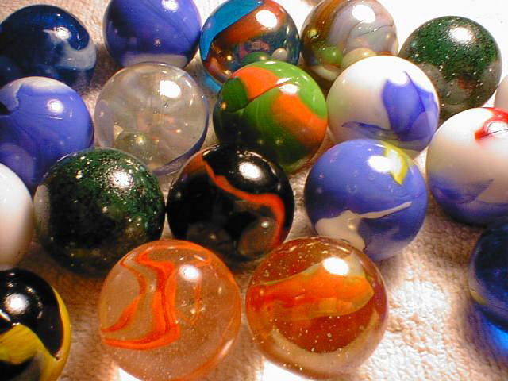
Let’s count marbles ... a lot of marbles
Suppose we have a big bowl of marbles. How can we estimate how many?
  I don’t want to count every marble individually
  I have a bag of 100 other marbles of the same size, but a different color
  What if I mix them?
Photo credit: (c) KaCey97007 on Flickr, Creative Commons license

Slide 4
Estimating marbles
I mix 100 black marbles into the bowl
  Stir well ...
I draw out 100 marbles at random
20 of them are black
How many marbles were in the bowl to begin with?
Notes:
Assuming the marbles mix evenly, so the ratio of black marbles to all marbles in the 100 I draw out is the same as the ratio of black marbles to all marbles in the bowl ...
20 / 100 = 100 / (100 + N)
where N is the number of marbles originally in the bowl.
So 20(100+N) = 100 * 100, which works out to N = 400

Slide 5
Estimating Test Suite Quality
Now, instead of a bowl of marbles, I have a program with bugs
I add 100 new bugs
    Assume they are exactly like real bugs in every way
    I make 100 copies of my program, each with one of my 100 new bugs
I run my test suite on the programs with seeded bugs ...
  ... and the tests reveal 20 of the bugs
  (the other 80 program copies do not fail)
What can I infer about my test suite?

Slide 6
Basic Assumptions
We’d like to judge effectiveness of a test suite in finding real faults, by measuring how well it finds seeded fake faults.
Valid to the extent that the seeded bugs are representative of real bugs
  Not necessarily identical (e.g., black marbles are not identical to clear marbles); but the differences should not affect the selection
    E.g., if I mix metal ball bearings into the marbles, and pull them out with a magnet, I don’t learn anything about how many marbles were in the bowl

Slide 7
Mutation testing
A mutant is a copy of a program with a mutation
A mutation is a syntactic change (a seeded bug)
  Example: change (i < 0) to (i <= 0)
Run test suite on all the mutant programs
A mutant is killed if it fails on at least one test case
If many mutants are killed, infer that the test suite is also effective at finding real bugs

Slide 8
What do I need to believe?
Mutation testing uses seeded faults (syntactic mutations) as black marbles
Does it make sense? What must I assume?
    What must be true of black marbles, if they are to be useful in counting a bowl of pink and red marbles?

Slide 9
Mutation testing assumptions
Competent programmer hypothesis:
  Programs are nearly correct
    Real faults are small variations from the correct program
    => Mutants are reasonable models of real buggy programs
Coupling effect hypothesis:
  Tests that find simple faults also find more complex faults
    Even if mutants are not perfect representatives of real faults, a test suite that kills mutants is good at finding real faults too

Slide 10
Mutation Operators
Syntactic change from legal program to legal program
    So: Specific to each programming language. C++ mutations don’t work for Java, Java mutations don’t work for Python
Examples:
  crp: constant for constant replacement
    for instance: from (x < 5) to (x < 12)
    select from constants found somewhere in program text
  ror: relational operator replacement
    for instance: from (x <= 5) to (x < 5)
  vie: variable initialization elimination
    change int x =5; to int x;

Slide 11
Live Mutants
Scenario:
  We create 100 mutants from our program
  We run our test suite on all 100 mutants, plus the original program
  The original program passes all tests
  94 mutant programs are killed (fail at least one test)
  6 mutants remain alive
What can we learn from the living mutants?

Slide 12
How mutants survive
A mutant may be equivalent to the original program
  Maybe changing (x < 0) to (x <= 0) didn’t change the output at all! The seeded “fault” is not really a “fault”.
    Determining whether a mutant is equivalent may be easy or hard; in the worst case it is undecideable
Or the test suite could be inadequate
  If the mutant could have been killed, but was not, it indicates a weakness in the test suite
  But adding a test case for just this mutant is a bad idea. We care about the real bugs, not the fakes!

Slide 13
Variations on Mutation
Weak mutation
Statistical mutation

Slide 14
Weak mutation
Problem: There are lots of mutants. Running each test case to completion on every mutant is expensive
    Number of mutants grows with the square of program size
Approach:
  Execute meta-mutant (with many seeded faults) together with original program
  Mark a seeded fault as “killed” as soon as a difference in intermediate state is found
    Without waiting for program completion
    Restart with new mutant selection after each “kill”

Slide 15
Statistical Mutation
Problem: There are lots of mutants. Running each test case on every mutant is expensive
    It’s just too expensive to create N² mutants for a program of N lines (even if we don’t run each test case separately to completion)
Approach: Just create a random sample of mutants
  May be just as good for assessing a test suite
    Provided we don’t design test cases to kill particular mutants (which would be like selectively picking out black marbles anyway)

Slide 16
In real life ...
Fault-based testing is a widely used in semiconductor manufacturing
  With good fault models of typical manufacturing faults, e.g., “stuck-at-one” for a transistor
  But fault-based testing for design errors is more challenging (as in software)
Mutation testing is not widely used in industry
  But plays a role in software testing research, to compare effectiveness of testing techniques
  BUT, there are more tools like Stryker, Mutatest, and PIT that make mutation testing more easily adoptable.
Some use of fault models to design test cases is important and widely practiced

Slide 17
Summary
If bugs were marbles ...
  We could get some nice black marbles to judge the quality of test suites
Since bugs aren’t marbles ...
  Mutation testing rests on some troubling assumptions about seeded faults, which may not be statistically representative of real faults
Nonetheless ...
  A model of typical or important faults is invaluable information for designing and assessing test suites

