Slide 1
Basic Principles

Slide 2
Learning objectives for this slideset
Be able to explain why the basic principles underlying Analysis & Testing (A&T) techniques are useful and important
Provide examples of the application of the principles.

Slide 3
A&T Principles (General Engineering)
Partition: divide and conquer [and ensure the interaction of components is simple]
Visibility: making information accessible [at least to the tester/developer]
Feedback: tuning the development process [in test-driven development, test drives the development]

Slide 4
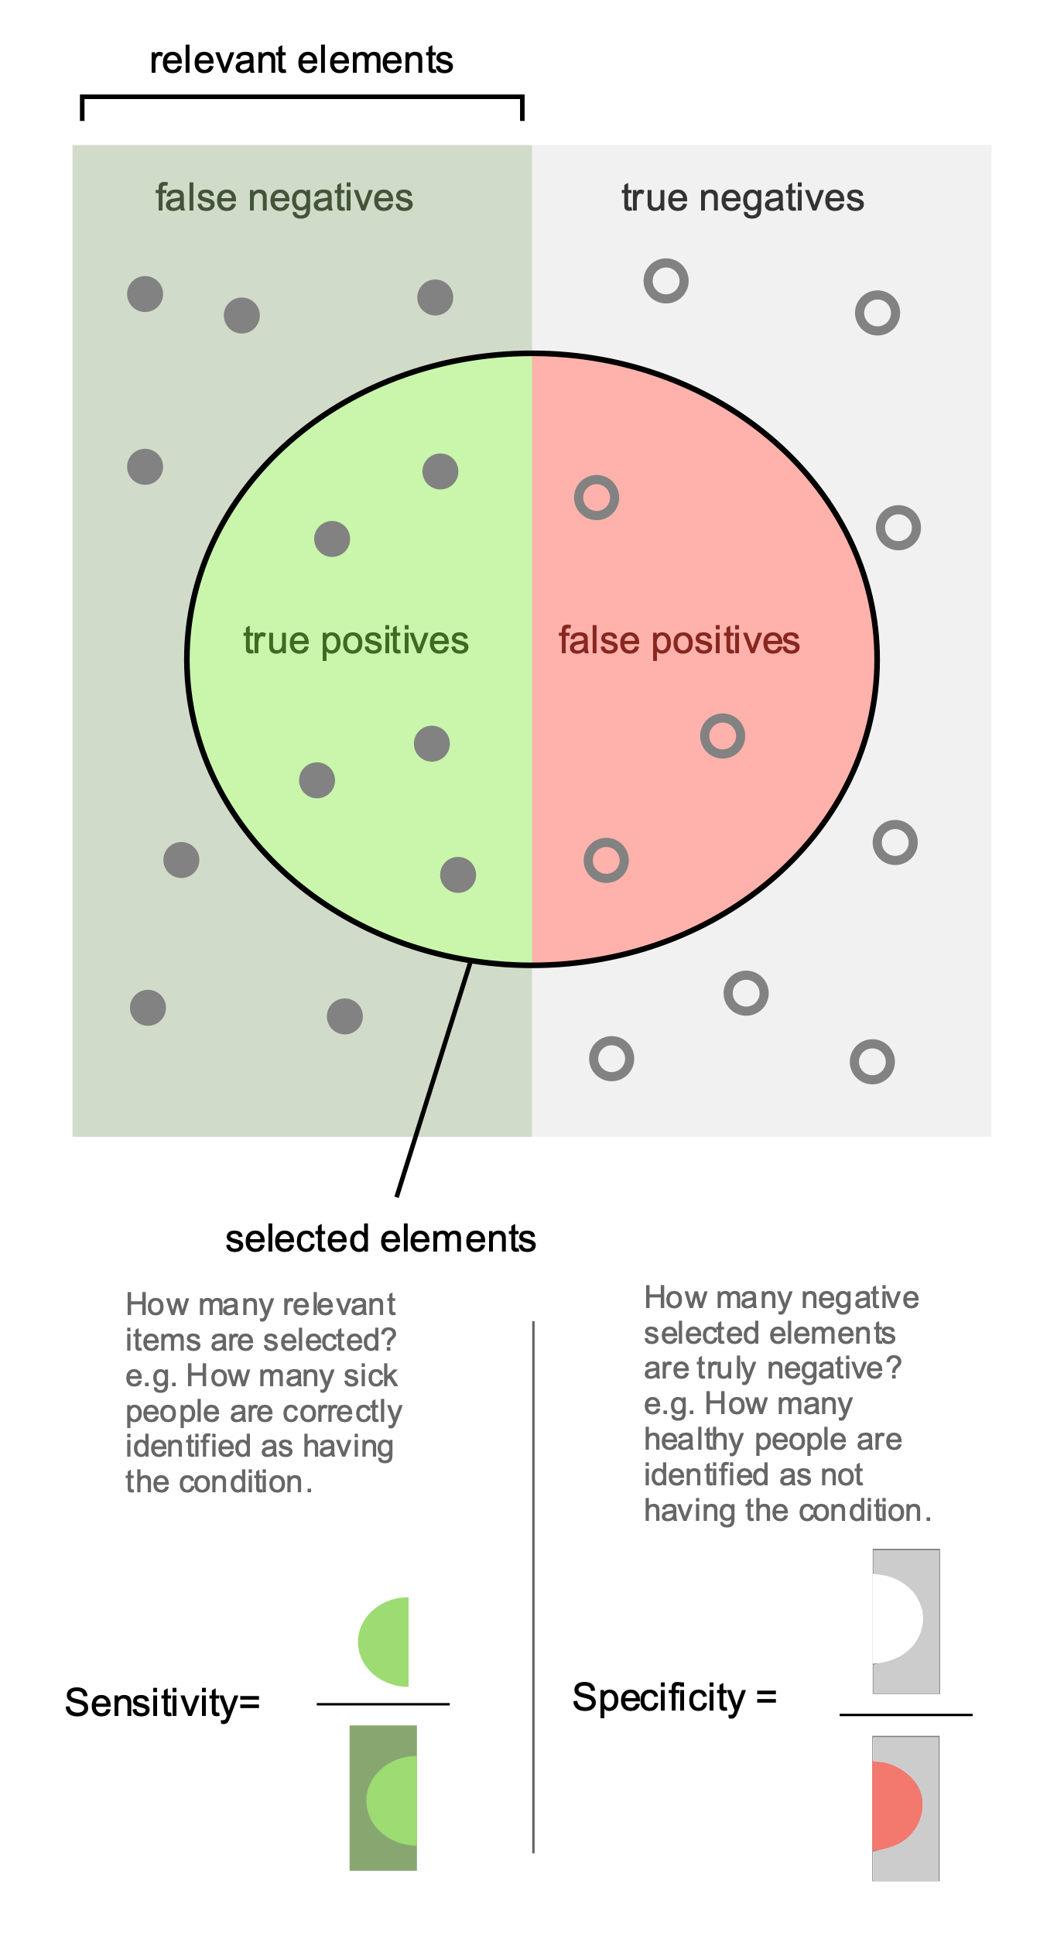
Sensitivity and Specificity
We all became more aware of this during COVID-19.
A test is said to be sensitive if it finds a high proportion of of people with the condition.
A test is said to be specific if it identifies a high proportion of the population who do not have the condition.

Slide 5
Diseases and diagnostic tests
In medicine, a condition is a particular disease or ailment e.g. SARS-COVID-19.
The whole population might or might not have the condition. If we were all powerful observers we could split the whole population into:
  “true positives” i.e. those people with the condition, and
  “true negatives” i.e. those people not having the condition
A diagnostic test is a procedure for determining whether someone has the condition or not:
  if for a particular person the test is positive then, If the person is a true positive then this is a true positive, otherwise it is a false positive.
  if for a particular person the test is negative then, If the person is a true negative then this is a true negative, otherwise it is a false negative.

Slide 6
Requirements and test selection criteria
In software, a system failing to have a requirement that is claimed for it is like a disease.
Our whole population is those systems that might or might not fail the requirement. If we were all powerful observers we could split the whole population into:
  “true positives” i.e. those systems that fail the requirement, and
  “true negatives” i.e. those systems passing the requirement
A diagnostic test is a procedure for determining whether a system fails to meet a requirement or not:
  if for a particular person the test is positive then, If the person is a true positive then this is a true positive, otherwise it is a false positive.
  if for a particular person the test is negative then, If the person is a true negative then this is a true negative, otherwise it is a false negative.

Slide 7
Specific A&T Principles
Sensitivity: a good test selection criterion should be “sensitive” in the sense that whatever particular tests are chosen to verify a requirement they should give you the same result.
Redundancy/Diversity: can we get “independent” reassurance that a system satisfies a requirement by using redundant/diverse methods
Restriction/Simplification: making the problem easier by coding in a restricted way OR changing the requirement OR both

Slide 8
Sensitivity
A test selection criterion is a process by which we select or construct a tests for a given purpose.
a test selection criterion works better if every selected test provides the same result, i.e., if the program fails with one of the selected tests, it fails with all of them (reliable criteria)
For example, suppose a system fails because some fixed area of storage is too small:
  A selection criterion might choose a range of different tests data some of which overflows the storage.
  The requirement might say that the system works for all test data.
  How does this violate sensitivity? How do we fix it?

Slide 9
Redundancy: making intentions explicit
Redundant checks can increase the capabilities of catching specific faults early or more efficiently.
  Static type checking is redundant with respect to dynamic type checking, but it can reveal many type mismatches earlier and more efficiently.
  Validation of requirement specifications is redundant with respect to validation of the final software but can reveal errors earlier and more efficiently.
  Testing and assertions of properties in the code are redundant, but are often used together to increase confidence

Slide 10
Restriction: making the problem easier
Suitable restrictions can reduce hard (unsolvable) problems to simpler (solvable) problems
  A weaker spec may be easier to check: it is impossible (in general) to show that pointers are used correctly, but the simple Java requirement that pointers are initialized before use is simple to enforce.
  A stronger spec may be easier to check: it is impossible (in general) to show that type errors do not occur at run-time in a dynamically typed language, but statically typed languages impose stronger restrictions that are easily checkable.

Slide 11
Partition: divide and conquer
Hard testing and verification problems can be handled by suitably partitioning the input space:
  both structural and functional test selection criteria identify suitable partitions of code or specifications (partitions drive the sampling of the input space)
  verification techniques fold the input space according to specific characteristics, grouping homogeneous data together and determining partitions

Slide 12
Visibility: Judging status
The ability to measure progress or status against goals
    X visibility = ability to judge how we are doing on X, e.g., schedule visibility = “Are we ahead or behind schedule,” quality visibility = “Does quality meet our objectives?”
Involves setting goals that can be assessed at each stage of development
    The biggest challenge is early assessment, e.g., assessing specifications and design with respect to product quality
Related to observability
  Example: Choosing a simple or standard internal data format to facilitate unit testing (e.g. using a good JSON editor)

Slide 13
Feedback: tuning the development process
Learning from experience: Each project provides information to improve the next.
This works best if you are developing similar products
Past experience can hamper solving new problems (because we focus excessively on the previous bad experience)
Examples
  Checklists are built on the basis of errors revealed in the past
  Error taxonomies can help in building better test selection criteria
  Design guidelines can avoid common pitfalls

Slide 14
Summary
The discipline of test and analysis is characterized by 6 main principles:
  Sensitivity: better to fail every time than sometimes
  Redundancy: making intentions explicit
  Restriction: making the problem easier
  Partition: divide and conquer
  Visibility: making information accessible
  Feedback: tuning the development process
They can be used to understand advantages and limits of different approaches and compare different techniques

