Slide 1
Professional Issues
James Garforth (He/Him)

Slide 2
Outline
Context
Introductions
Logistics
Initial Reflection

Slide 3
Context

Slide 4
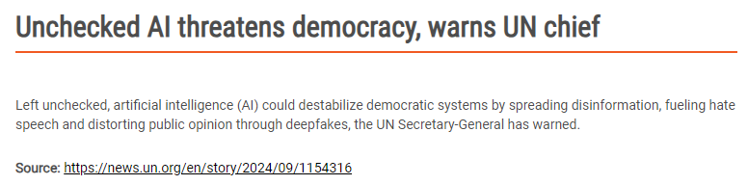
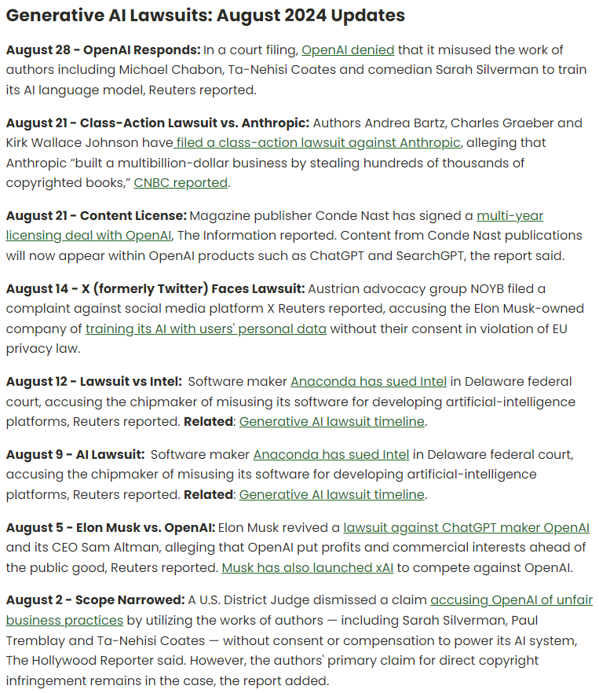
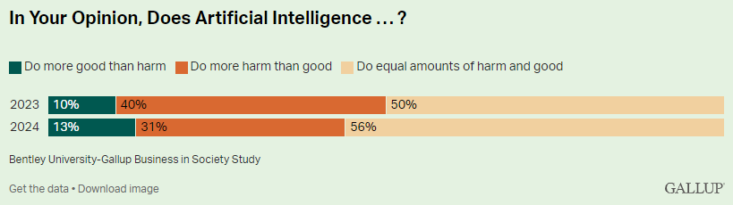

Slide 5




Slide 6


Slide 7

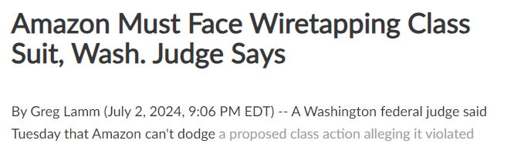
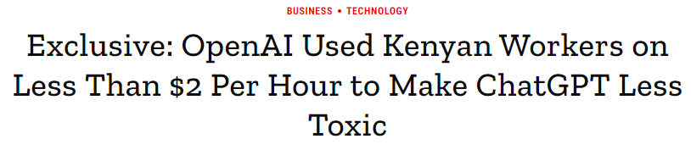


Slide 8
Introductions

Slide 9

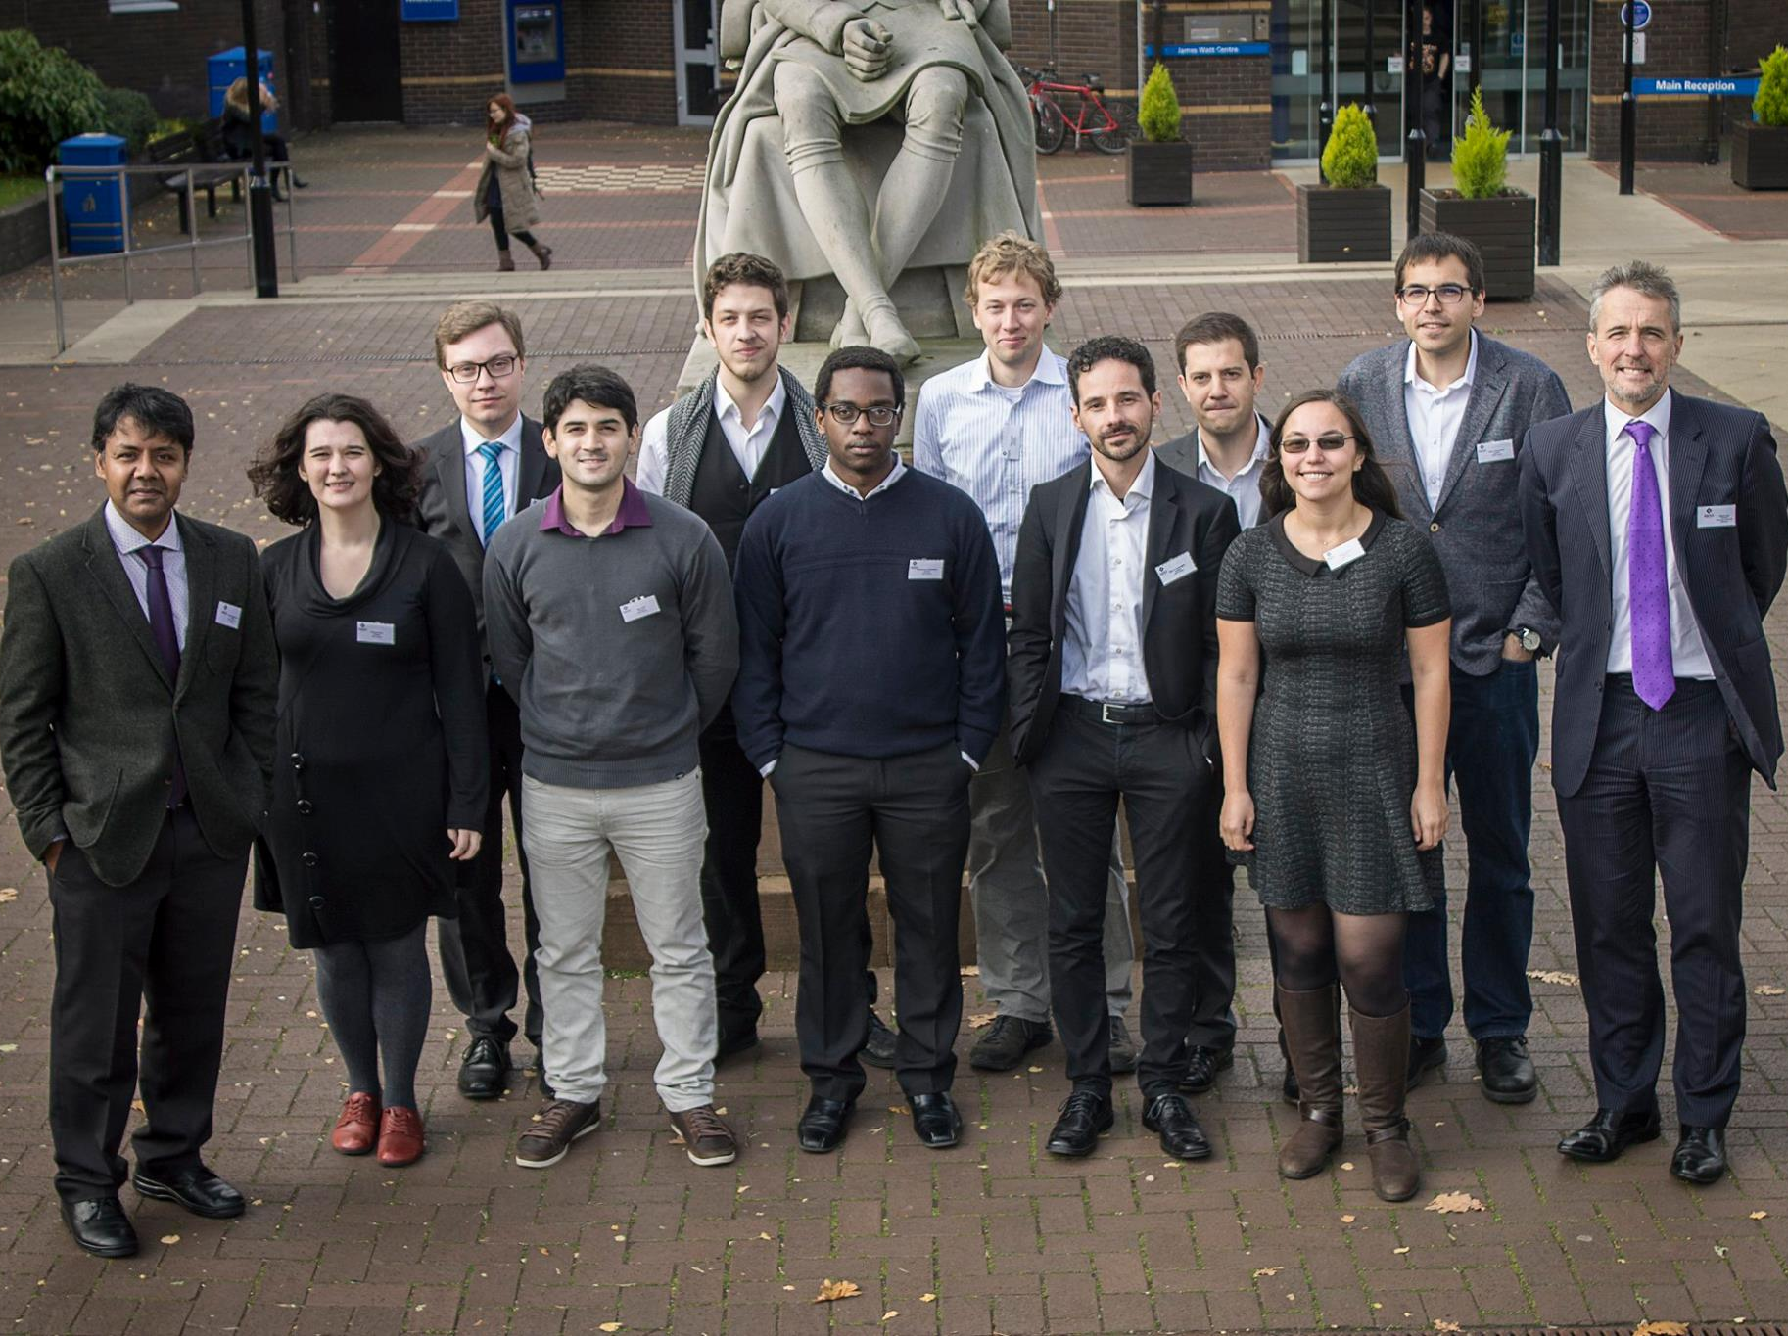

Slide 10


https://benedettacatanzariti.wordpress.com/

Slide 11
Logistics

Slide 12
Overview
Weekly structure
  Two whole class sessions
  1+ Readings
  Tutorial, or tutorial prep
Discussion focus
Comms

Slide 13
Topics
Fundamental Concepts
  Power, Responsibility
Example Harms
  Data, Bias, Automation
Potential Mitigations
  Virtue, Design Frameworks, Collective Action

Slide 14
Assessment
Essay 1 (40%)
Essay 2 (40%)
Peer Review 1 (5%)
Peer Review 2 (5%)
Tutorial submissions x4 (10%)

Slide 15
Tutorials
Fortnightly
Case study based
Prepare with subgroup
Submit prep notes

Slide 16
Expectations
Prepare to disagree
Be polite and considerate
Explore differences

Slide 17
Logistical Questions?

Slide 18
Initial Reflection
What is our field?
What is this course studying?
What is AI Ethics or Ethical AI?
Other terms
  Responsible, Trustworthy, Safe

Slide 19
Why are we studying this?

Slide 20
Why should we be studying this?

Slide 21
Key Takeaways
Not to believe you can answer ethical questions alone
Not to believe someone else will answer them for you

Slide 22
Final Comments
No quick or easy answers
Developing a skill
Course is the bare minimum
Talk to me

Slide 23
Questions?

