Slide 1
Leadership

Slide 2
Admin
Peer reviews
Late drafts
Tutorial 3

Slide 3
Admin
Peer reviews
Late drafts
Tutorial 3

Slide 4
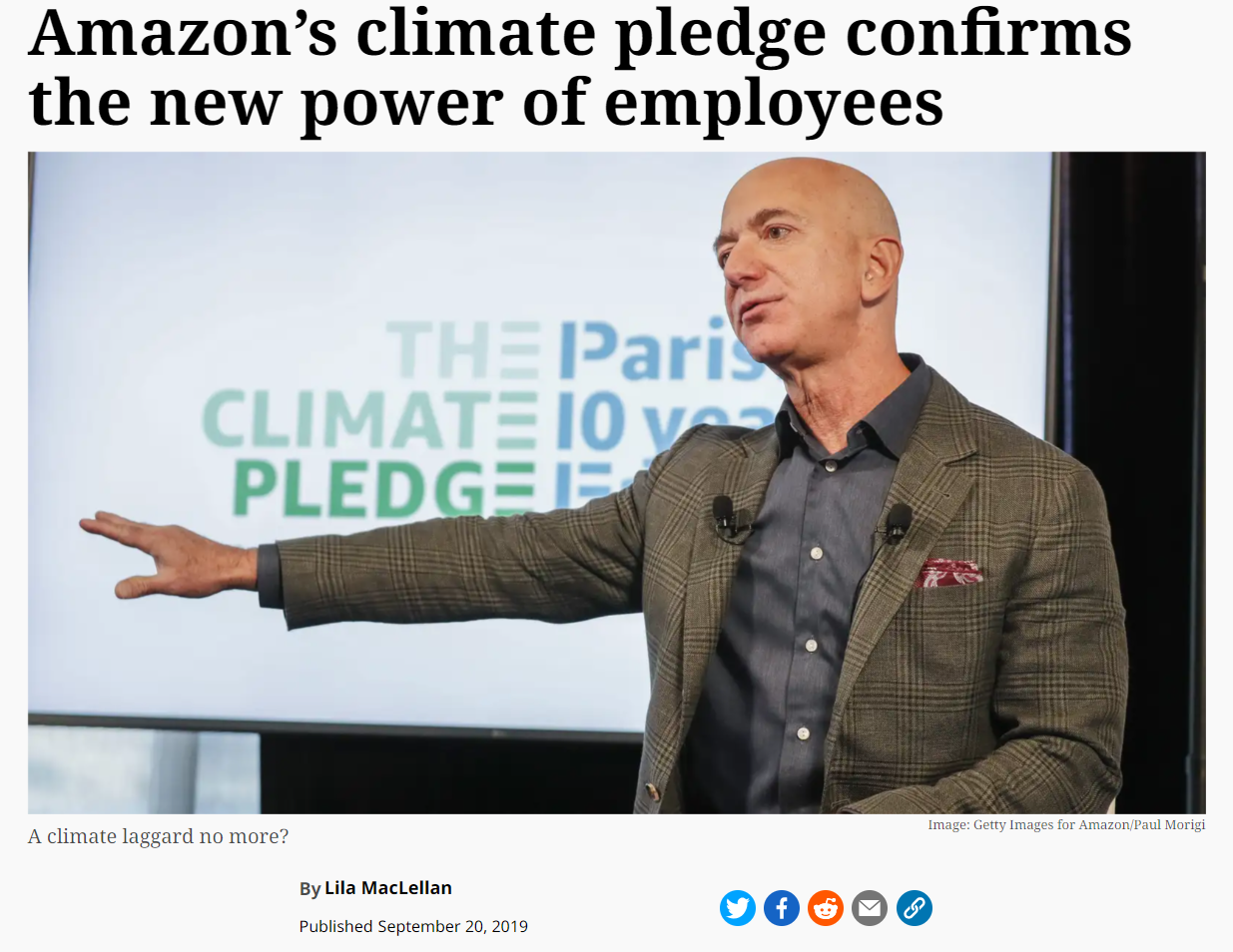
Intro
Recap
Mitigations
Individual/Team
"Leadership"

Slide 5
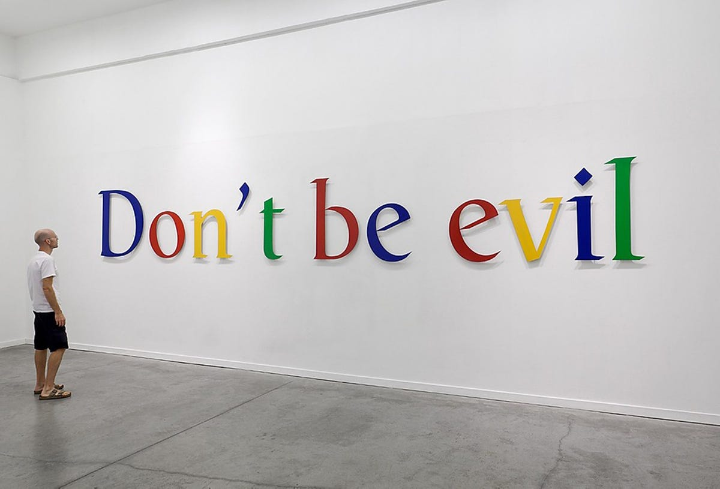
Guidelines
High level statements of intent
Vague
Unenforced
These can be their strengths

Slide 6
Codes of Conduct
More formalised
Concise expectations on behaviour
Lack instructions or justifications
Limited enforceability

Slide 7
Standards
More top-down approach
More specific, instructional
More natural buy-in
Limited scope

Slide 8
Legislation
Related to Standards
Most formal
Most enforceable
Very precise
Unexplained, hard to interpret

Slide 9
Ethicists
Alternative to written approaches
Flexible
Explained
Variable
Problems with scaling

Slide 10
Questions

