Slide 1
Test Automation and Code Review
Based on slides developed by Ian Sommerville and on GitLab CI

Slide 2
Test Automation
Automated testing is based on the idea that tests should be executable.
An executable test includes the input data to the unit that is being tested, the expected result and a check that the unit returns the expected result.
You run the test and the test passes if the unit returns the expected result.
Normally, you should develop hundreds or thousands of executable tests for a software product (or at least automate the production of such tests)

Slide 3
Automated Testing

Slide 4
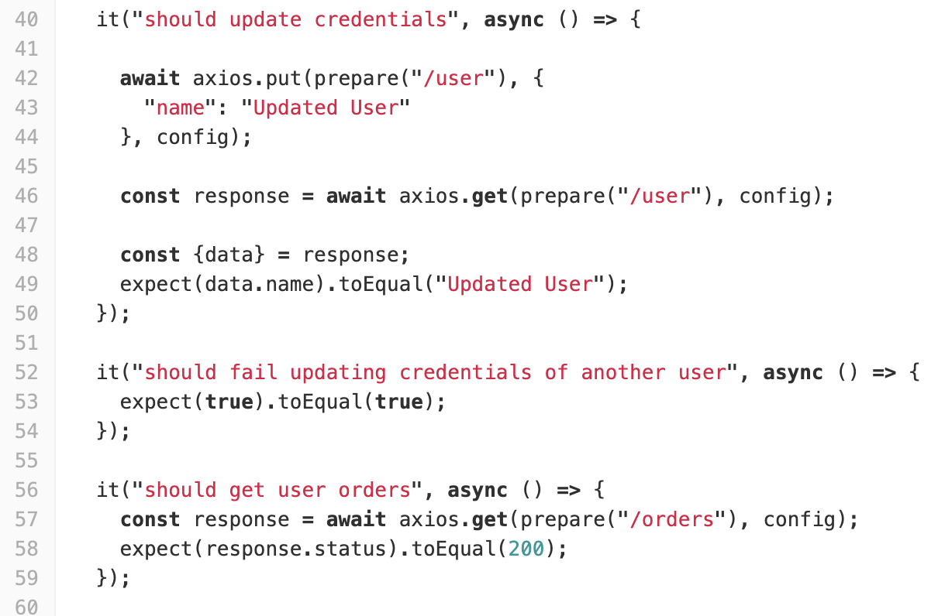
Example
The environment is already set up, e.g. the database with orders and users.
The automated test sets up the parameters,
Executes the function under test.
Expects a particular return value.

Slide 5
Automated Tests
It is good practice to structure automated functional tests into three parts:
  Arrange You set up the system to run the test. This involves defining the test parameters and, if necessary, mock objects that emulate the functionality of code that has not yet been developed (some of this is in the environment spanning many tests).
  Action You call the unit that is being tested with the test parameters.
  Assert You make an assertion about what should hold if the unit being tested has executed successfully.
If you use category partition to specify tests, ideally you should have several automated tests based on correct and incorrect inputs from each partition.
A test runner will run all of the tests (based on the scripts in the package description in the case of the JavaScript project). For a tutorial on the basic details for Jest, see: https://www.valentinog.com/blog/jest/

Slide 6
Test Pyramid

Slide 7
Automated system testing
Often, users access features through the system’s graphical user interface (GUI).
However, GUI-based testing is expensive to automate so it is best to design your system so that its features can be directly accessed through an API and not just from the user interface.
Tests can then access features directly through the API without the need for direct user interaction through the system’s GUI.
Accessing features through an API has the additional benefit that it is possible to re-implement the GUI without changing the functional components of the software (separating concerns).

Slide 8
Using an API for Testing Features

Slide 9
System Testing
System testing involves verifying system requirements that may involve simulating user behaviour.
System tests, involve some sort of UI as the way users will access the features of the system
You are looking for interactions between features that cause problems, sequences of actions that lead to system crashes and so on.
Manual system testing, when testers have to repeat sequences of actions, is boring and error-prone. In some cases, the timing of actions is important and is practically impossible to repeat consistently.
  Testing tools have been developed that record UI gestures and automatically replay these when a system is required – this can take the repetition out of system test

Slide 10
Gesture Capture for System Test

Slide 11
Test-driven development
Test-driven development (TDD) advocates writing a executable tests for code before you write the code. The test is a sort of specification.
Early users of the Extreme Programming advocated TDD, but it can be used with any incremental development approach.
Test-driven development works best for the development of individual program units and it is more difficult to apply to system testing.
Even the strongest advocates of TDD accept that it is challenging to use this approach when you are developing and testing systems with graphical user interfaces.

Slide 12
Test Driven Development

Slide 13
TDD Stages
Identify partial implementation
Break down the implementation of the functionality required into smaller mini-units. Choose one of these mini-units for implementation.
Write mini-unit tests
Write one or more automated tests for the mini-unit that you have chosen for implementation. The mini-unit should pass these tests if it is properly implemented.
Write a code stub that will fail test
Write incomplete code that will be called to implement the mini-unit. You know this will fail.
Run all existing automated tests
All previous tests should pass. The test for the incomplete code should fail.
Identify partial implementation
Break down the implementation of the functionality required into smaller mini-units. Choose one of these mini-units for implementation.
Write mini-unit tests
Write one or more automated tests for the mini-unit that you have chosen for implementation. The mini-unit should pass these tests if it is properly implemented.
Write a code stub that will fail test
Write incomplete code that will be called to implement the mini-unit. You know this will fail.
Run all existing automated tests
All previous tests should pass. The test for the incomplete code should fail.

Slide 14
TDD Benefits
A systematic approach to testing, tests are clearly linked to sections in the program code.
  Good confidence that tests cover all of the code and that there are no untested code sections.
The tests act as a written specification for the program code. It should be possible to understand what the program does by reading the tests.
Fault location may be simplified, when a program fails, you can immediately link this to the last increment of code that you added to the system (this failure could be uncovering a fault that needs fixing in the already developed code).
TDD can encourage simpler code. Programmers write code to be testable because often they also construct the unit tests.

Slide 15
TDD Problems
TDD can discourages radical program change
Significant change means more failed tests. If the number of passed tests motivates the developer they will avoid generating lots of failures
Tests are often insufficiently expressive
If we see tests as the specification then this can restrict what we spcify because some things are hard to test
If everything is “code” it’s hard to get a good overview
TDD can encourage a focus on details that might cause tests to pass or fail and discourages large-scale program revisions.
It is hard to write ‘bad data’ tests
Many problems involving dealing with messy and incomplete data. It is practically impossible to anticipate all of the data problems that might arise and write tests for these in advance.

Slide 16
Security testing
Security testing aims to find vulnerabilities that may be exploited by an attacker and to provide convincing evidence that the system is sufficiently secure.
The tests should demonstrate that the system can resist attacks on its availability, attacks that try to inject malware and attacks that try to corrupt or steal users’ data and identity.
Comprehensive security testing requires specialist knowledge of software vulnerabilities and approaches to testing that can find these vulnerabilities (but there are still unknown unknowns).

Slide 17
Typical Security Hazards
Unauthorized attacker gains access to a system using authorized credentials
Authorized individual accesses resources that are forbidden to them
Authorized individual accesses resources they are authorized to see but then releases them to unauthorised individuals.
Authentication system fails to detect unauthorized attacker
Attacker gains access to database using SQL poisoning attack
Improper management of HTTP session
HTTP session cookies revealed to attacker
Confidential data are unencrypted
Encryption keys are leaked to potential attackers

Slide 18
Hazard Analysis
Once you have identified hazards, you then analyze them to assess how they might arise. For example, an attacker gaining credentials there are several possibilities:
  Weak passwords that can be guessed are in use.
  The user has not set up two-factor authentication.
  An attacker has discovered credentials of a legitimate user through social engineering techniques.
Once you have done this you can estimate likelihood and severity and you have risks.
You can then prioritise what to mitigate and consider test to further characterise the risk.
  For example, you might include biometrics as part of the authorisation in mitigation.

Slide 19
Code reviews
Code reviews involve one or more people examining the code to check for errors and anomalies and discussing issues with the developer.
If problems are identified, it is the developer’s responsibility to change the code to fix the problems.
Code reviews complement testing. They are effective in finding bugs that arise through misunderstandings and bugs that may only arise when unusual sequences of code are executed.
Many software companies insist that all code has to go through a process of code review before it is integrated into the product codebase.

Slide 20
Review Process

Slide 21
Review Activities
Setup review
The programmer contacts a reviewer and arranges a review date.
Prepare code
The programmer collects the code and tests for review and annotates them with information for the reviewer about the intended purpose of the code and tests.
Distribute code/tests
The programmer sends code and tests to the reviewer.
Check code
The reviewer systematically checks the code and tests against their understanding of what they are supposed to do.
Write review report
The reviewer annotates the code and tests with a report of the issues to be discussed at the review meeting.
Discussion
The reviewer and programmer discuss the issues and agree on the actions to resolve these.
Make to-do list
The programmer documents the outcome of the review as a to-do list and shares this with the reviewer.
Make code changes
The programmer modifies their code and tests to address the issues raised in the review.

Slide 22
Checklist for Review
Are meaningful variable and function names used?
Meaningful names make a program easier to read and understand.
Have all data errors been considered and tests written for them?
It is easy to write tests for the most common cases but it is equally important to check that the program won’t fail when presented with incorrect data.
Are all exceptions explicitly handled?
Unhandled exceptions may cause a system to crash.
Are types used consistently?
If the language has a type system there should be conventions for its use that are observed e.g. naming
Is the code properly formatted?
There will be rules on how code should be displayed to avoid common difficulties cause by jumbled presentation of code.

Slide 23
Continuous Integration
I vividly remember one of my first sightings of a large software project. I was taking a summer internship at a large English electronics company. My manager, part of the QA group, gave me a tour of a site and we entered a huge depressing warehouse stacked full with cubes. I was told that this project had been in development for a couple of years and was currently integrating, and had been integrating for several months. My guide told me that nobody really knew how long it would take to finish integrating. From this I learned a common story of software projects: integration is a long and unpredictable process.
Martin Fowler on “Integration”

Slide 24
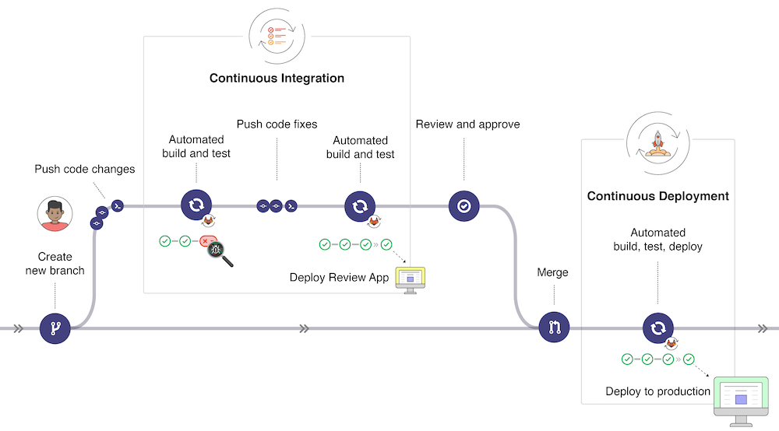
Continuous Integration in GitLab

Slide 25
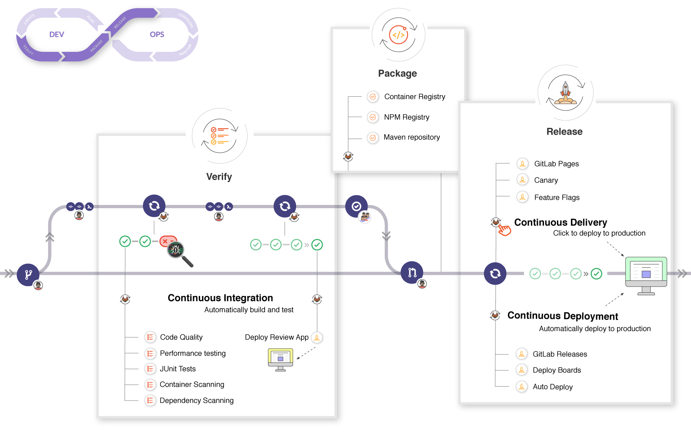
Continuous Integration in DevOps

Slide 26
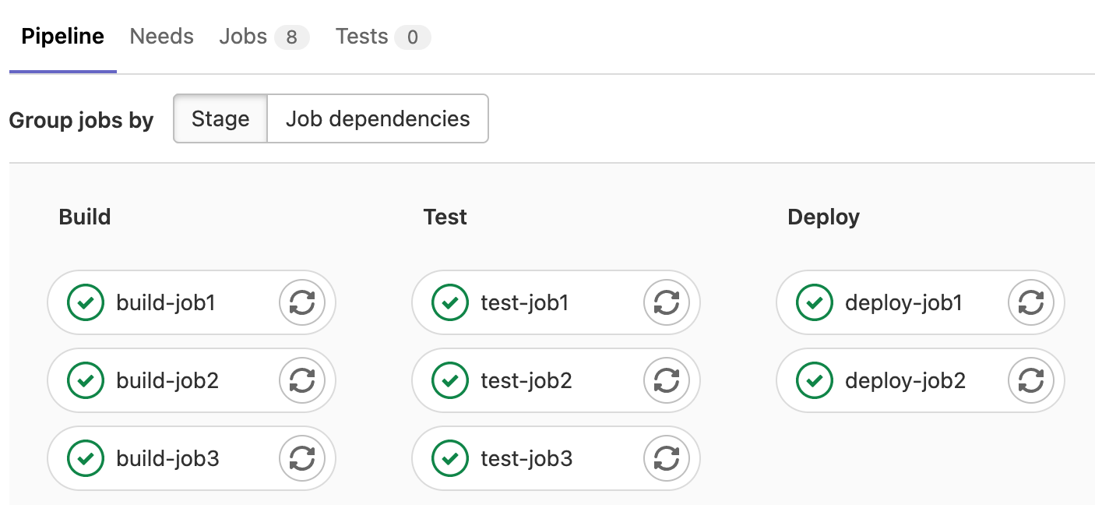
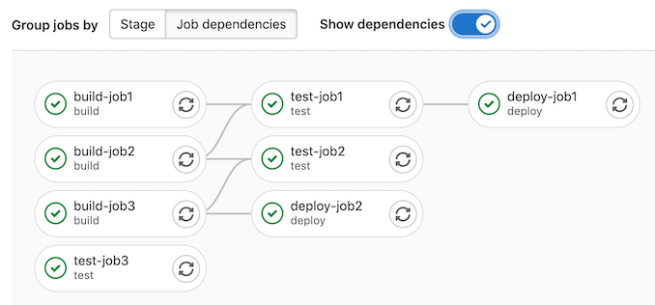
CI Pipelines

Slide 27
Summary
Testing should be automated as far as possible where there is low value from human interaction.
A risk-based approach can be helpful e.g. in security testing.
Review complements test.
There are quite complete automation tools now (e.g. GitLab).

