Slide 1
ISO 29119-3

Slide 2
Overview
ISO 29119-3 provides two examples of test processes:
  A traditional approach based on a waterfall-type process that is fully conformant to the standard.
  An agile process that provides an example of a “tailored” approach to conformance where the decision on what to include is risk-driven.
We will look at the agile process – please look at the traditional process
The standard specifies the main elements of test documentation and what they should record:
  6. Organizational test process documentation
  7. Test management processes documentation
  8 Dynamic test processes documentation

Slide 3
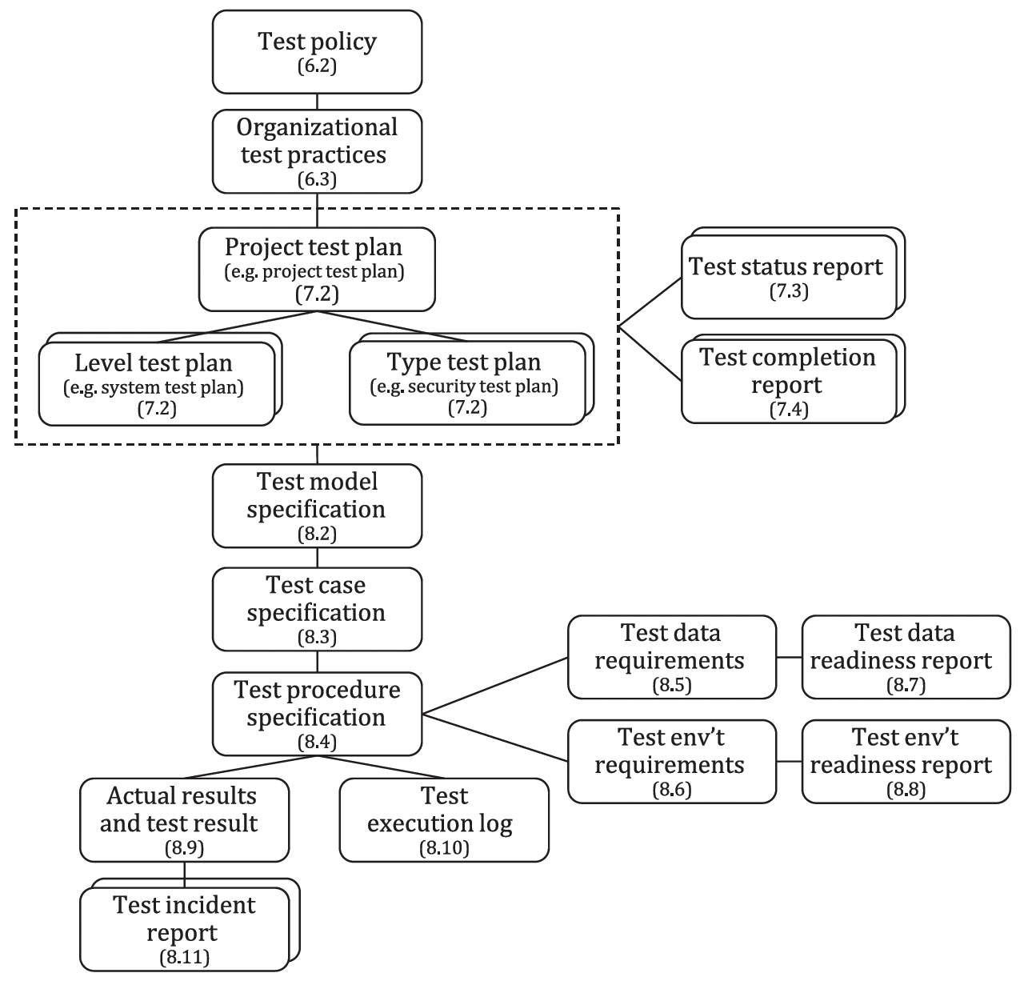
Overview of test documentation

Slide 4
Example Process: Traditional
Traditional Ltd is a small company that produces advanced analysis equipment for the farming industry. Some of their products are safety-critical, in the sense that incorrect analysis results risk causing the prescription of incorrect fertilizer doses (either too much or too little). The organization is hence required to produce the product according to an international standard that demonstrates and retains evidence of correct behaviour during testing, along with solid test planning, traceability and reporting. The example project features the development of the PC-based portion of a product called UV/TRT-14 33a. It is an apparatus to measure fertilizer components and their concentration in earth samples. The apparatus has a user interface working on a PC with wireless connection to the measuring system.

Slide 5
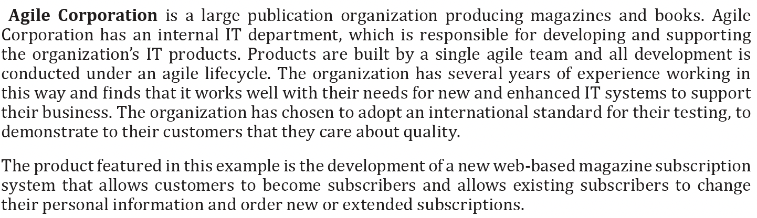
Example Process: Agile

Slide 6
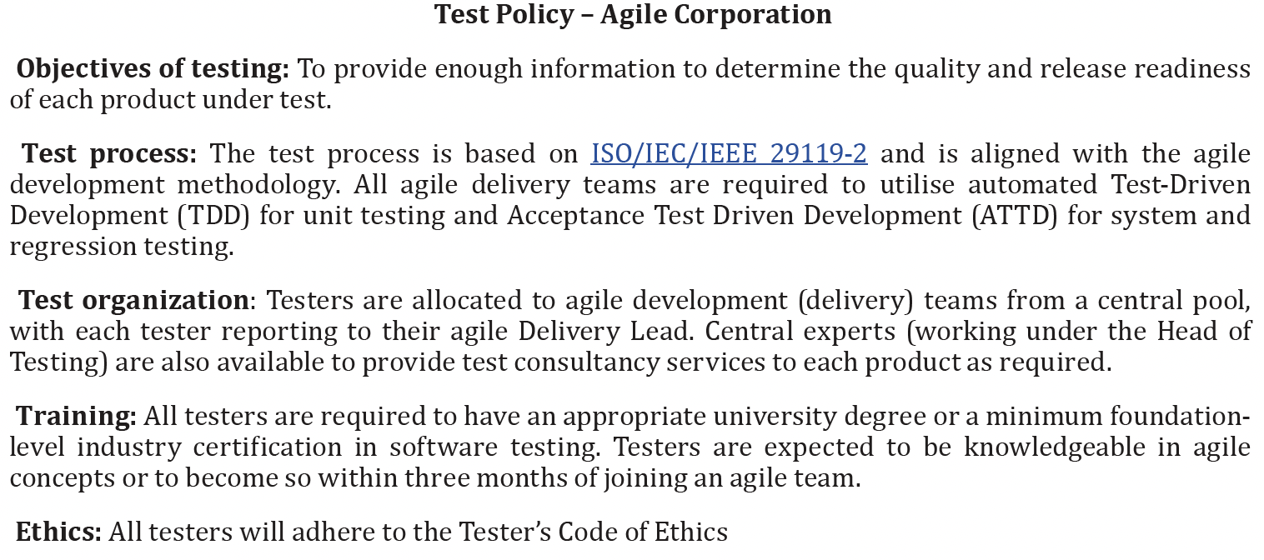
Test Policy: Agile

Slide 7
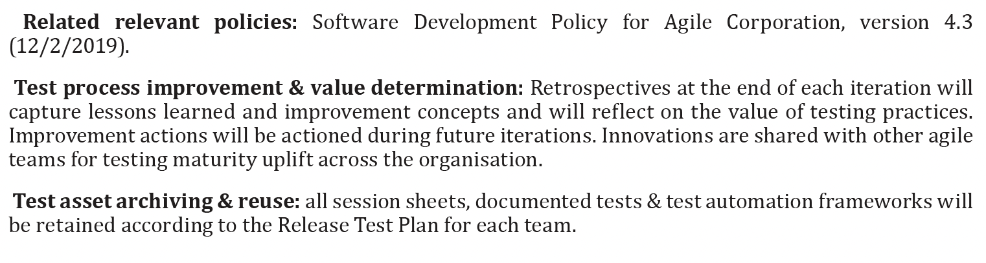
Test Policy: Agile

Slide 8
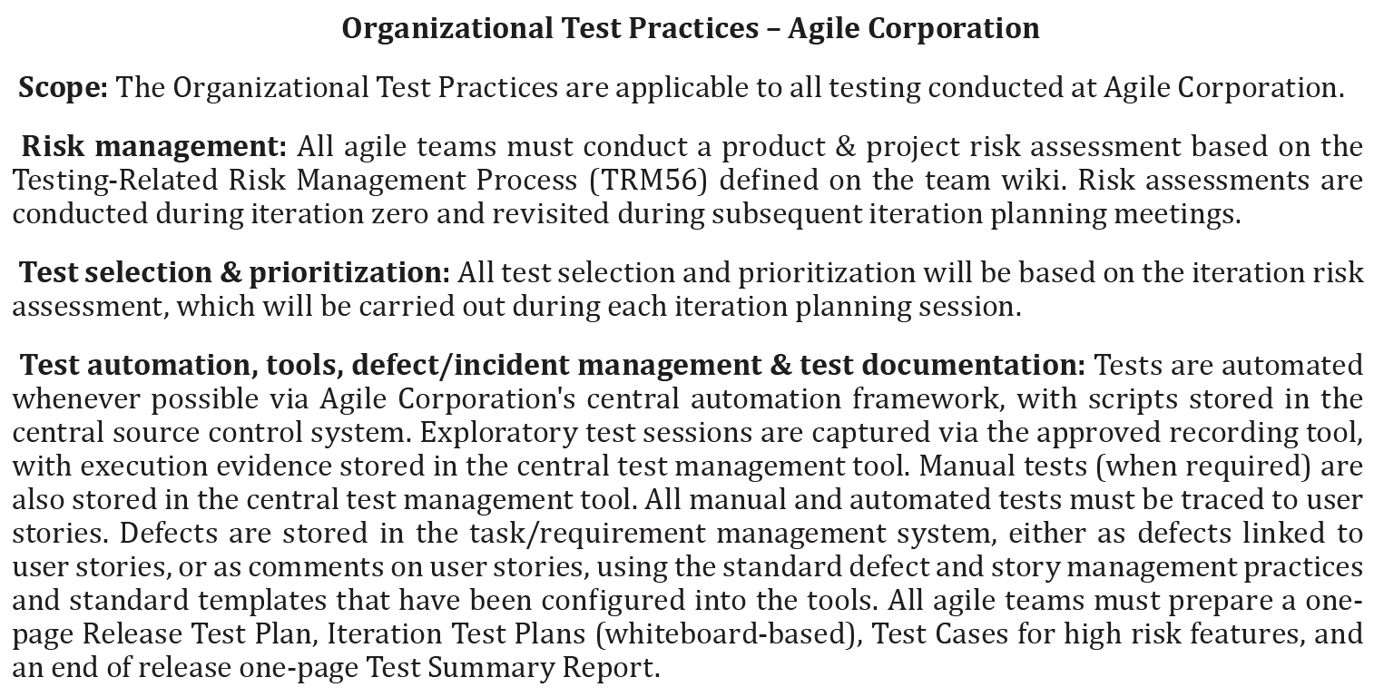
Organizational Test Practices: Agile

Slide 9
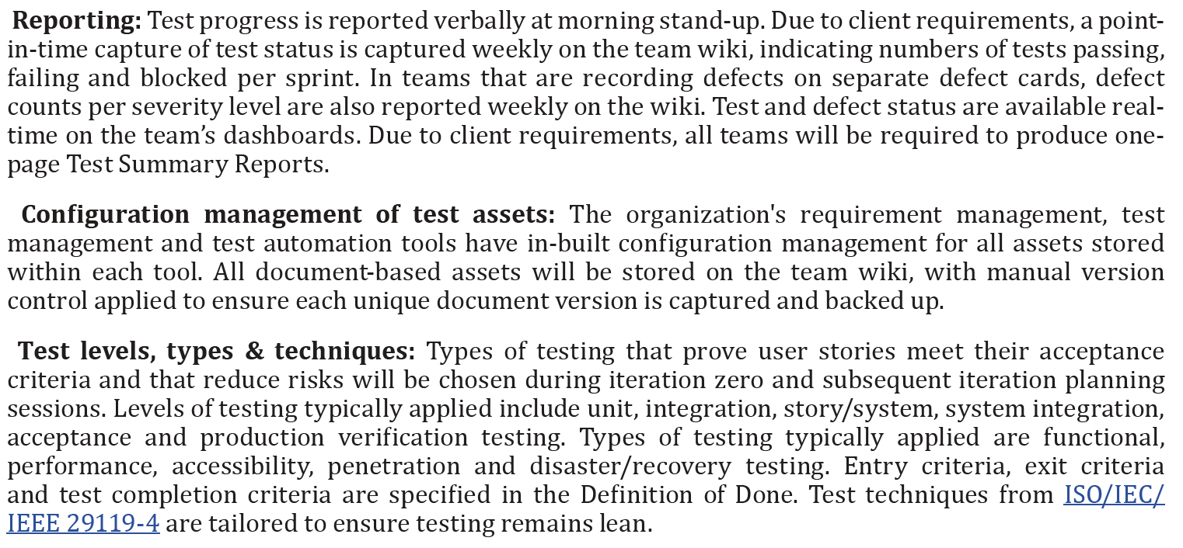
Organizational Test Practices: Agile

Slide 10
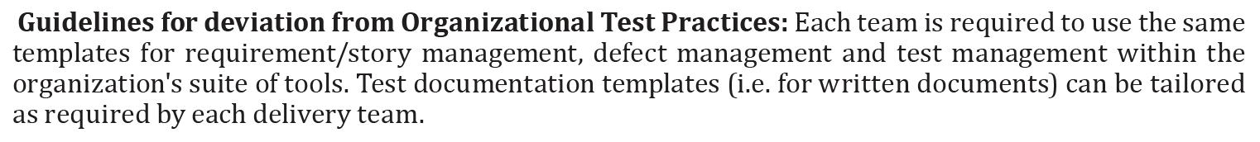
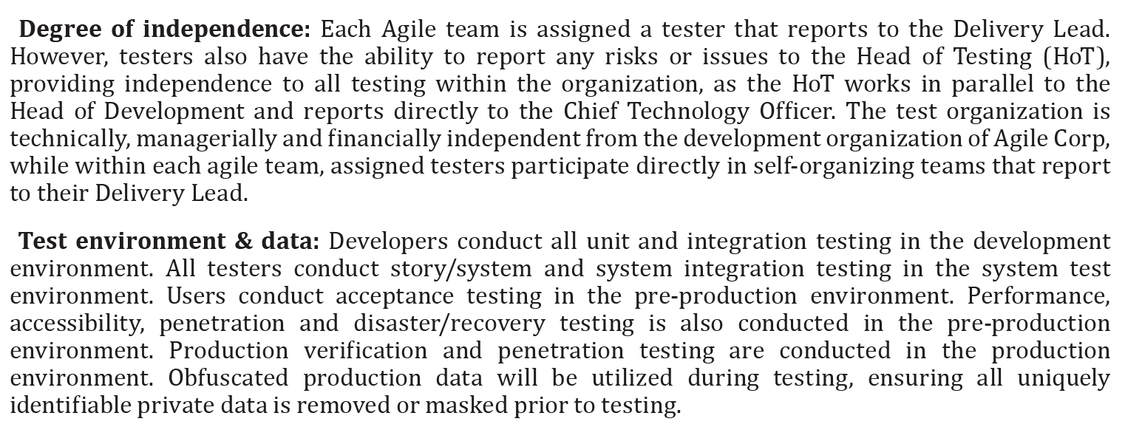
Organizational Test Practices: Agile

Slide 11
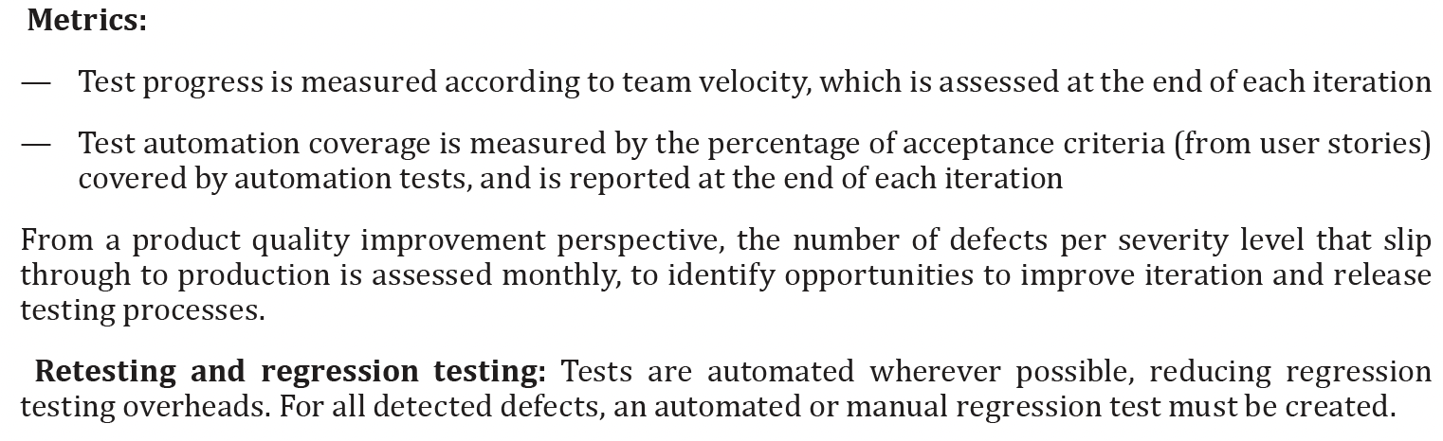
Organizational Test Practices: Agile

Slide 12
7. Test management processes documentation
7.2 Test Plan
7.3 Test Status Report
Context of Testing
Assumptions and Constraints
Stakeholders
Testing Communication
Risk Register
Test Strategy
Testing activities and estimates
Staffing
Schedule
Test status
Reporting Period
Progress against test plan
Factors blocking progress
Test measures
New and changed risks
Planned Testing

Slide 13
7. Test management processes documentation
7.3 Test Completion Report
Summary
Summary of testing performed
Deviations from planned testing
Test completion evaluation
Factors that blocked progress
Test measures
Residual risks
Test deliverables
Reusable test assets
Lessons learned
Section 7 of ISO 29119-3 covers the main test process documentation
These documents are described in generic terms
In appendices E-G these are elaborated relative to a traditional and agile lifecycle
What follows is a brief summary for the agile process

Slide 14
Test Plan: Agile
Context of Testing: Keep test types and levels on the story cards stored in the company requirements repo.
Assumptions and Constraints
Stakeholders: Product owner and delivery lead are the key stakeholders for testing, includes escalation to more senior levels.
Testing Communication: Lists the team: Delivery lead, Developers, Business analysts, User representatives, Testers, Product owners plus reporting arrangements
Risk Register: Risks recorded on story cards and wider risk register – methodology probably follows a standard such as ISO 16085 or NIST Risk Management Framework
Testing activities and estimates, Staffing, Schedule follow the agile process and strategy determined at strategy level

Slide 15
Test Plan: Agile
Test Strategy
  At start of iteration estimate the necessary effort including any backlog
  Use Test Driven Design to create and automate unit and integration tests in advance of coding, create system and acceptance tests
  Regression test features that may have been influenced by changes
  Design tests with a view to easing acceptance and taking risk of feature failure into account
  To mark a story DONE there must be no fatal or severe defects, remaining defects get made into new stories and added to the backlog
  Outline progress and identify blockers at daily stand-up meetings
  Ensure tests, scripts etc are available in the central repo
  Issue short summary of testing outcome at the end of iteration

Slide 16
Test Status Report: Agile
Test status: Weekly report on the team wiki
Reporting Period: The week this refers to.
Progress against test plan: Report against the user stories in play e.g. 8 DONE, 2 still open, focus on high risk stories and give coverage data, give profile of the risks at different severity, report on automation progress.
Factors blocking progress: things like delay caused by UI changes, how these were resolved, e.g. extra effort, …
Test measures: sessions sheets developed for new stories with some assessment of test ideas on those sheets.
New and changed risks: report on any new or modified risks
Planned Testing: activities planned in the coming week

Slide 17
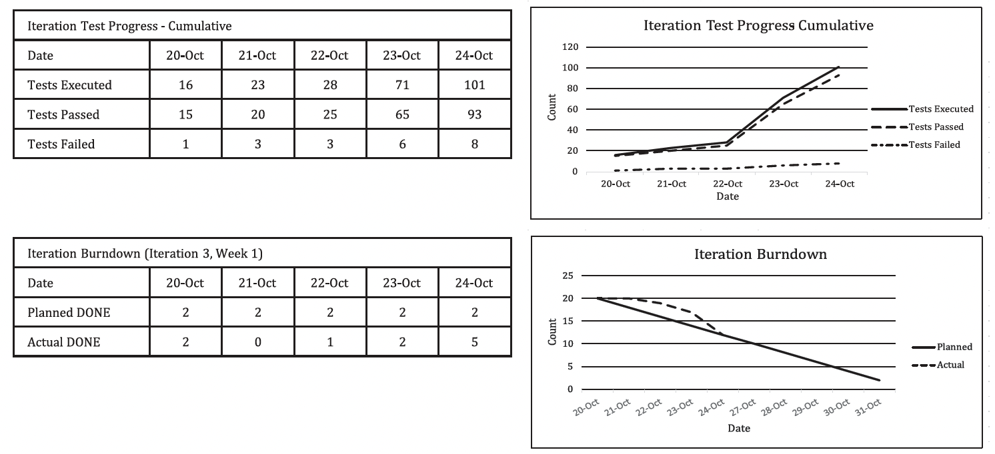
Test Status Report: Agile - measurement

Slide 18
Test Completion Report: Agile
Summary of testing performed: summarise what the report covers – usually a release of the software
Deviations from planned testing: this is covered by the agile process as the testing evolves in line with the needs of developers in TDD.
Test completion evaluation: to get to a release all the high-risk stories are marked DONE and residual risks accepted by the product owner
Factors that blocked progress: these will have been recorded in the log of the previous iterations
Test measures: these are built into the agile process
Residual risks: kept on the story cards and wider risk register all have been accepted by the product owner

Slide 19
Test Completion Report: Agile
Test deliverables:
  Report on the stories that are in play for the release, all must have passed the system integration testing (SIT) and the user acceptance testing (UAT)
  Measures of quality of the code, coverage measures, tests passed etc
  Report on remaining defects and how they have been moved forward into the next iteration (new stories).
  Report on product owner and user approval
  Other features, like accessibility testing, resource use, ethics etc.
Reusable test assets: built into the agile process tests are kept in the repo and can be reused and reworked
Lessons learned: suggestions to improve resourcing and resource estimation, suggestions for innovation in test techniques, identify the need for data from users (including necessary privacy preserving measures), …

Slide 20
Summary
Please read Appendices C-G of ISO 29119 – in particular the traditional approach the covers strict conformance using a traditional lifecycle.
This slideset covers the incorporation of test planning into an agile development process.
The example is covered in more detail in the standard.

