Slide 1


Slide 2
Test and Analysis Activities within a Software Process

Slide 3
Learning objectives
Identify how quality is incorporated into the development process
Build an overall picture of the quality process
Identify the main characteristics of a quality process
  visibility
  anticipation of activities
  feedback

Slide 4
Software Qualities and Process
Qualities cannot be added after development
  Quality results from a set of inter-dependent activities
  Analysis and testing are crucial but far from sufficient.
Testing is not a phase, but a lifestyle
  Testing and analysis activities occur from early in requirements engineering through delivery and subsequent evolution.
  Quality depends on every part of the software process
An essential feature of software processes is that software test and analysis is thoroughly integrated and not an afterthought

Slide 5
The Quality Process
Quality process: set of activities and responsibilities
  focused primarily on ensuring adequate dependability
  concerned with project schedule or with product usability
The quality process provides a framework for
  selecting and arranging activities
  considering interactions and trade-offs with other important goals.

Slide 6
Interactions and Tradeoffs
example
high dependability vs. time to market
Mass market products:
  better to achieve a reasonably high degree of dependability on a tight schedule than to achieve ultra-high dependability on a much longer schedule
Critical medical devices:
  better to achieve ultra-high dependability on a much longer schedule than a reasonably high degree of dependability on a tight schedule

Slide 7
Mass vs High Dependability?

Slide 8
What needs to be high dependability?

Slide 9
Properties of the Quality Process
Completeness: Appropriate activities are planned to detect each important class of faults.
Timeliness: Faults are detected at a point of high leverage (as early as possible)
Cost-effectiveness: Activities are chosen depending on cost and effectiveness
  cost must be considered over the whole development cycle and product life
  the dominant factor is usually the cost of repeating an activity through many change cycles.

Slide 10
Planning and Monitoring
The quality process
  Balances several activities across the whole development process
  Selects and arranges them to be as cost-effective as possible
  Improves early visibility
Quality goals can be achieved only through careful planning
Planning is integral to the quality process

Slide 11
Process Visibility
A process is visible to the extent that one can answer the question
  How does our progress compare to our plan?
  Example: Are we on schedule? How far ahead or behind?
The quality process has not achieved adequate visibility if one cannot gain strong confidence in the quality of the software system before it reaches final testing
  quality activities are usually placed as early as possible
    design test cases at the earliest opportunity (not ``just in time'')
    uses analysis techniques on software artifacts produced before actual code.
  motivates the use of “proxy” measures
    Ex: the number of faults in design or code is not a true measure of reliability, but we may count faults discovered in design inspections as an early indicator of potential quality problems

Slide 12
A&T Strategy
Identifies company- or project-wide standards that must be satisfied
  procedures required, e.g., for obtaining quality certificates
  techniques and tools that must be used
  documents that must be produced

Slide 13
A&T Plan
A comprehensive description of the quality process that includes:
  objectives and scope of A&T activities
  documents and other items that must be available
  items to be tested
  features to be tested and not to be tested
  analysis and test activities
  staff involved in A&T
  constraints
  pass and fail criteria
  schedule
  deliverables
  hardware and software requirements
  risks and contingencies

Slide 14
Quality Goals
Process qualities (visibility,....)
Product qualities
  internal qualities (maintainability,....)
  external qualities
    usefulness qualities:
      usability, performance, security, portability, interoperability
    dependability
      correctness, reliability, safety, robustness

Slide 15
Dependability Qualities
Correctness:
  A program is correct if it is consistent with its specification
    seldom practical for non-trivial systems
Reliability:
  likelihood of correct function for some ``unit'' of behavior
    relative to a specification and usage profile
    statistical approximation to correctness (100% reliable = correct)
Safety:
  preventing hazards
Robustness
  acceptable (degraded) behavior under extreme conditions

Slide 16
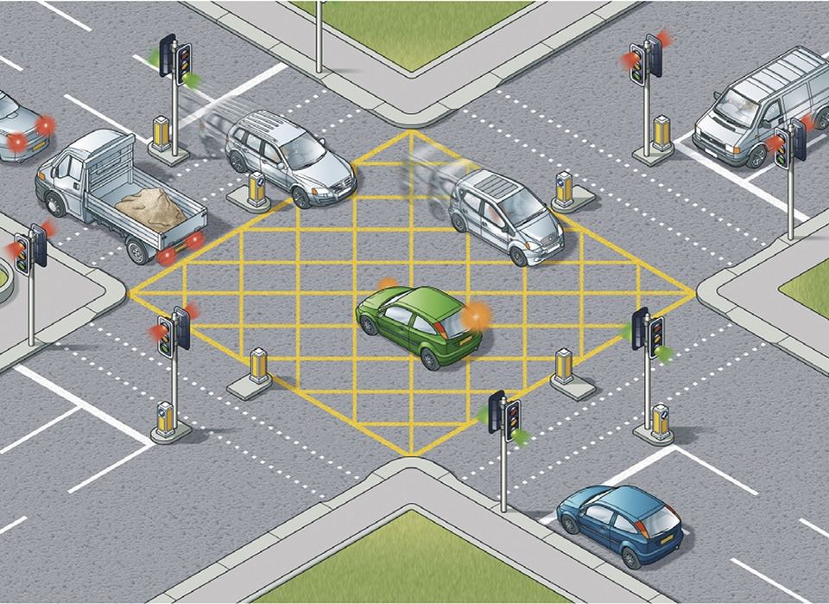
Example of Dependability Qualities
Correctness, reliability:
Robustness, safety:

Slide 18
Example of Dependability Qualities
Correctness, reliability: let traffic pass according to correct pattern and central scheduling
Robustness, safety: Provide degraded function when possible; never signal conflicting greens.
    Blinking red / blinking yellow is better than no lights; no lights is better than conflicting greens

Slide 19
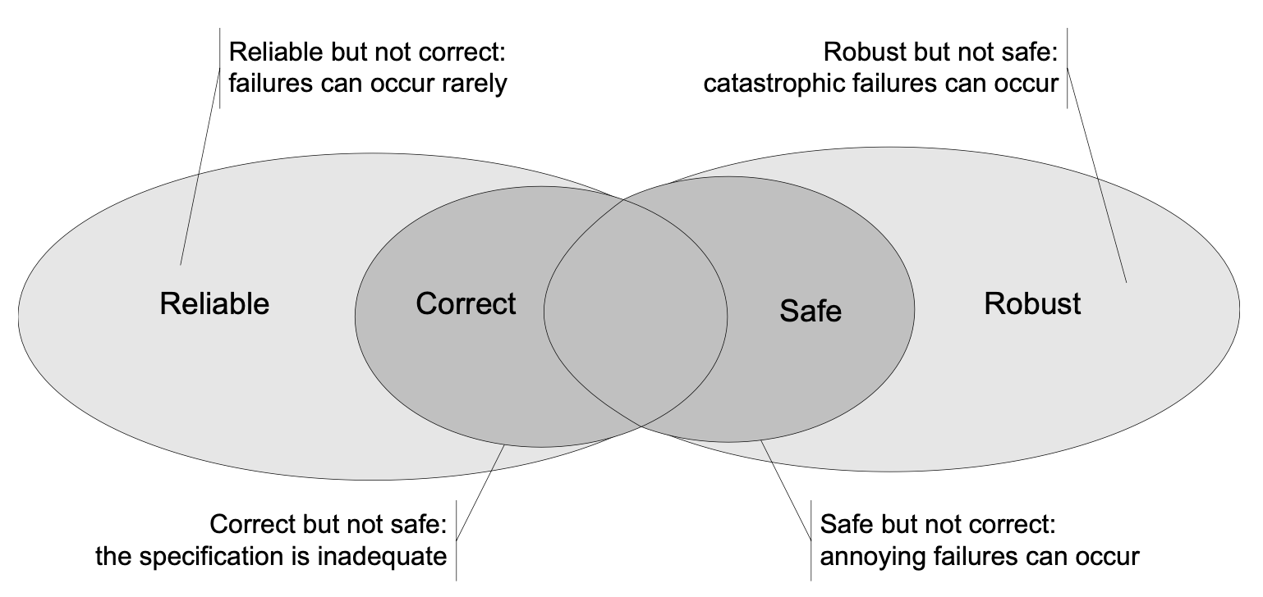
Relationships of Dependability Qualities

Slide 20
Analysis
analysis includes
  manual inspection techniques
  automated analyses
can be applied at any development stage
particularly well suited at the early stages of specifications a design

Slide 21
Inspection
can be applied to essentially any document
  requirements statements
  architectural and detailed design documents
  test plans and test cases
  program source code
may also have secondary benefits
  spreading good practices
  instilling shared standards of quality.
takes a considerable amount of time
re-inspecting a changed component can be expensive
used primarily
  where other techniques are inapplicable
  where other techniques do not provide sufficient coverage

Slide 22
Automatic Static Analysis
More limited in applicability
  can be applied to some formal representations of requirements models
  not to natural language documents
are selected when available
  substituting machine cycles for human effort makes them particularly cost-effective.

Slide 23
Testing
Formerly executed late in development but with Test-Driven Development can play a large part.
Start as early as possible
Early test generation has several advantages
  Tests generated independently from code, when the specifications are fresh in the mind of analysts
  The generation of test cases may highlight inconsistencies and incompleteness of the corresponding specifications
  tests may be used as compendium of the specifications by the programmers

Slide 24
Improving the Process
Long lasting errors are common
It is important to structure the process for
  Identifying the most critical persistent faults
  tracking them to frequent errors
  adjusting the development and quality processes to eliminate errors
Feedback mechanisms are the main ingredient of the quality process for identifying and removing errors

Slide 25
Organizational factors
Different teams for development and quality?
  separate development and quality teams is common in large organizations
  indistinguishable roles is postulated by some methodologies (extreme programming)
Different roles for development and quality?
  test designer is a specific role in many organizations
  mobility of people and roles by rotating engineers over development and testing tasks among different projects is a possible option

Slide 27
Example of Allocation of Responsibilities
Allocating tasks and responsibilites is a complex job:
we can allocate
  Unit testing
    to the development team (requires detailed knowledge of the code)
    but the quality team may control the results (structural coverage)
  Integration, system and acceptance testing
    to the quality team
    but the development team may produce scaffolding and oracles
  Inspection and walk-through
    to mixed teams
  Regression testing
    to quality and maintenance teams
  Process improvement related activities
    to external specialists interacting with all teams

Slide 28
Allocation of Responsibilities and rewarding mechanisms: case A
allocation of responsibilities
  Development team responsible development measured with LOC per person month
  Quality team responsible for quality
possible effect
  Development team tries to maximize productivity, without considering quality
  Quality team will not have enough resources for bad quality products
result
  product of bad quality and overall project failure

Slide 29
Allocation of Responsibilities and rewarding mechanisms: case B
allocation of responsibilities
  Development team responsible for both development and quality control
possible effect
  the problem of case A is solved
  but the team may delay testing for development without leaving enough resources for testing
result
  delivery of a not fully tested product and overall project failure

Slide 30
Summary
Test and Analysis are complex activities that must be suitably planned and monitored
A good quality process obeys some basic principles:
  visibility
  early activities
  feedback
aims at
  reducing occurrences of faults
  assessing the product dependability before delivery
  improving the process

