Slide 1


Slide 2
Planning and Monitoring the Process

Slide 3
Learning objectives
Be able to explain the role of monitoring in planning
Be able to distinguish strategies from plans and illustrate how a plan is derived from a strategy
Given a plan be able to provide examples of risks arising in plans
Given a quality process, be able to identify the role of monitoring in the quality process
Be able to explain the role of team organization in planning

Slide 4
What are Planning and Monitoring?
Planning:
  Scheduling activities (what steps? in what order?)
  Allocating resources (who will do it?)
  Devising clear milestones for monitoring
Monitoring: Measuring key process attributes of the process
  What do the measures tell about progress against the plan?
A good plan must have visibility :
  Ability to monitor key indicators, and to make informed judgments of progress against the plan
  Ability to justify where we are in the plan and what progress has been made.

Slide 5
Quality and Process
Quality process: Set of activities and responsibilities
  focused primarily on ensuring adequate quality
  concerned with project schedule or with product usability
A framework for
  selecting and arranging activities
  considering interactions and trade-offs
Follows the overall software process in which it is embedded
  Example: waterfall software process ––> “V model”: unit testing starts with implementation and finishes before integration
  Example: XP and agile methods ––> emphasis on unit testing and rapid iteration for acceptance testing by customers
  Example: DevOps CI/CD includes elements of validation as data is collected from operation
Notes:
20.2 Quality and process

Slide 6
Example Process: Cleanroom
Customer Requirements
Specification
Function
Usage
Incremental
Development
Planning
Functional specifications
Usage specifications
Formal Design
Correctness Verification
Statistical test case generation
Source code
Test cases
Statistical testing
Interfail times
Improvement Feedback
Quality Certification Model
MTTF statistics
Notes:
SIDEBAR -- example of ntertwining between development and quality activities

Slide 7
Example Process: Cleanroom
Activities and responsibilities focused on quality
Customer Requirements
Integrated into an overall development process
Specification
Function
Usage
Incremental
Development
Planning
Functional specifications
Usage specifications
Formal Design
Correctness Verification
Statistical test case generation
Source code
Test cases
Statistical testing
Interfail times
Improvement Feedback
Quality Certification Model
MTTF statistics
Notes:
SIDEBAR -- example of ntertwining between development and quality activities

Slide 9
Example Process: Software Reliability Engineering Testing (SRET)
Define “Necessary” Reliability
Development
Operational Profiles
Prepare
for Testing
Interpret Failure
Data
Execute tests
Requirements and Architecture
Design and
Implementation
System Test and
Acceptance Test
Notes:
SIDEBAR

Slide 10
Software Reliability Engineering Testing (SRET)
Define “Necessary” Reliability
Activities and responsibilities focused on quality
Development
Operational Profiles
Integrated into an overall development process
Prepare
for Testing
Interpret Failure
Data
Execute tests
Requirements and Architecture
Design and
Implementation
System Test and
Acceptance Test
Notes:
SIDEBAR

Slide 11
Example Process: Extreme Programming (XP)
Next version
Incremental
Release
Review,
Refine,
prioritize
Passed all unit tests
pass
Generate User
Stories
Create Unit
Tests
Pair
Programming
+ unit testing
Passed all
unit tests
Acceptance
Testing
Failed acceptance test
Create
Acceptance
Tests
Notes:
SIDEBAR

Slide 12
Extreme Programming (XP)
Activities and responsibilities focused on quality
Next version
Incremental
Release
Review,
Refine,
prioritize
Passed all unit tests
pass
Create Unit
Tests
Pair
Programming
+ unit testing
Passed all
unit tests
Acceptance
Testing
Generate User
Stories
Failed acceptance test
Create
Acceptance
Tests
Integrated into an overall development process
Notes:
SIDEBAR

Slide 13
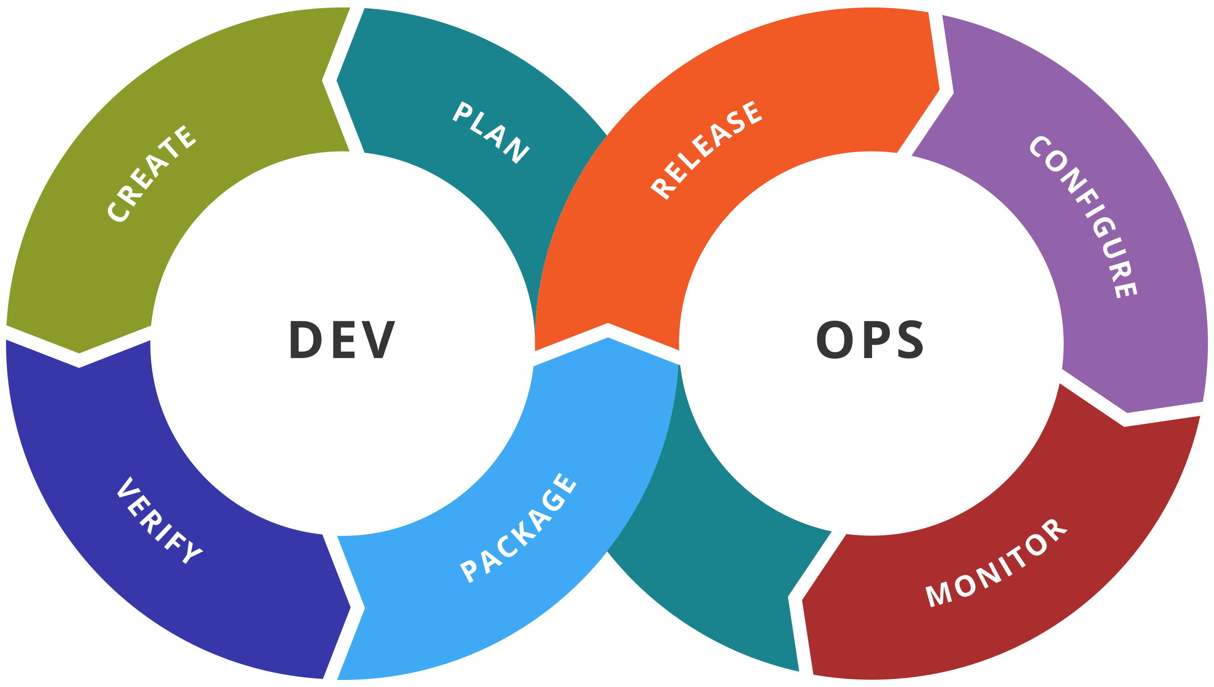
DevOps
Use monitoring data and other sources to identify quality issues and inform next steps
New functionality plus new monitoring code plus tests to justify deployment
Gathering key behavioural data to help assess quality and inform development
Using gathered data for statistical testing with “real-world” data

Slide 15
Overall Organization of a Quality Process
Key principle of quality planning
  the cost of detecting and repairing a fault increases as a function of time between creating the fault and detecting it (e.g the time is zero if we are perfect)
therefore ...
  an efficient quality plan includes matched sets of intermediate validation and verification activities that detect most important faults within a short time of their introduction [limits on resource mean we need to focus on important faults]
and ...
  V&V steps depend on the intermediate work products and on their anticipated defects

Slide 16
Verification Steps for Intermediate Artifacts
Internal consistency checks
  compliance with structuring rules that define “well-formed” artifacts of that type
  a point of leverage: define syntactic and semantic rules thoroughly and precisely enough that many common errors result in detectable violations
  Structural rules + frameworks can often simplify the testing of software
External consistency checks
  consistency with related artifacts
  Often: conformance to a “prior” or “higher-level” specification
Generation of correctness conjectures
  Correctness conjectures: lay the groundwork for external consistency checks of other work products
  Often: motivate refinement of the current product

Slide 17
Strategies vs Plans
 | Strategy | Plan
Scope | Organization | Project
Structure and content based on | Organization structure, experience and policy over several projects | Standard structure prescribed in strategy
Evolves | Slowly, with organization and policy changes | Quickly, adapting to project needs

Slide 18
Test and Analysis Strategy
Lessons of past experience
  an organizational asset built and refined over time – particularly if the organization develops a line of similar products
Body of explicit knowledge
  more valuable than islands of individual competence or tacit knowledge
  amenable to improvement
  reduces vulnerability to organizational change (e.g., loss of key individuals)
Essential for
  avoiding recurring errors
  maintaining consistency of the process
  increasing development efficiency
Notes:
20.3

Slide 19
Fitting a Strategy to an Organization
Structure and size
  example
    Distinct quality groups in large organizations, overlapping of roles in smaller organizations
    greater reliance on documents in large than small organizations
Overall process
  example
    Cleanroom requires statistical testing and forbids unit testing
      fits with tight, formal specs and emphasis on reliability
    XP prescribes “test first” and pair programming
      fits with fluid specifications and rapid evolution
Application domain
  example
    Safety critical domains may impose particular quality objectives and require documentation for certification (e.g,RTCA/DO-178B standard requires MC/DC coverage – a particular type of structural test)

Slide 20
Elements of a Strategy
Common quality requirements that apply to all or most products
  clear definition and measures
Set of documents normally produced during the quality process
  contents and relationships
Activities prescribed by the overall process
  standard tools and practices
Guidelines for project staffing and assignment of roles and responsibilities
See technical debt: https://en.wikipedia.org/wiki/Technical_debt strategies typically try to avoid this
Notes:
FOR AN EXAMPLE OF TEST STRATEGY SEE CHAPTER 24

Slide 21
Test and Analysis Plan
Answer the following questions:
What quality activities will be carried out?
What are the dependencies among the quality activities and between quality and other development activities?
What resources are needed and how will they be allocated?
How will both the process and the product be monitored?
There can be considerable variability in the order in which activities are carried out as long as the dependencies are respected.
Notes:
20.4 Test and analysis plan

Slide 22
Main Elements of a Plan
Items and features to be verified
  Scope and target of the plan
Activities and resources
  Constraints imposed by resources on activities
Approaches to be followed
  Methods and tools
Criteria for evaluating results

Slide 23
Quality Goals
Expressed as properties satisfied by the product
  must include metrics to be monitored during the project
  example: a new release of the product must undergo canary testing with successively larger populations before full release
  not all details are available in the early stages of development
Initial plan
  based on incomplete information
  incrementally refined

Slide 24
Task Schedule
Initially based on
  quality strategy
  past experience
Breaks large tasks into subtasks
  refine as process advances
Includes dependencies
  among quality activities
  between quality and development activities
Guidelines and objectives:
  schedule activities for steady effort and continuous progress and evaluation without delaying development activities
  schedule activities as early as possible
  increase process visibility (how do we know we’re on track?)

Slide 25
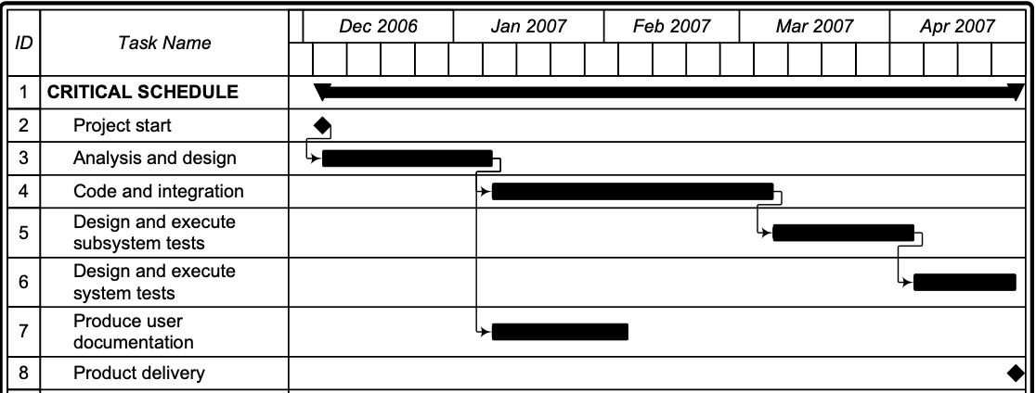
Sample Schedule
Notes:
The most commmon style of project schedule is the GANTT chart, like this example.
Simple idea: task breakdown with allocation in time, obeying task dependences.
Any “vertical slice” of the graph describes level of effort.
Next slide: we can evaluate the schedule risk in the schedule, and improve it.

Slide 26
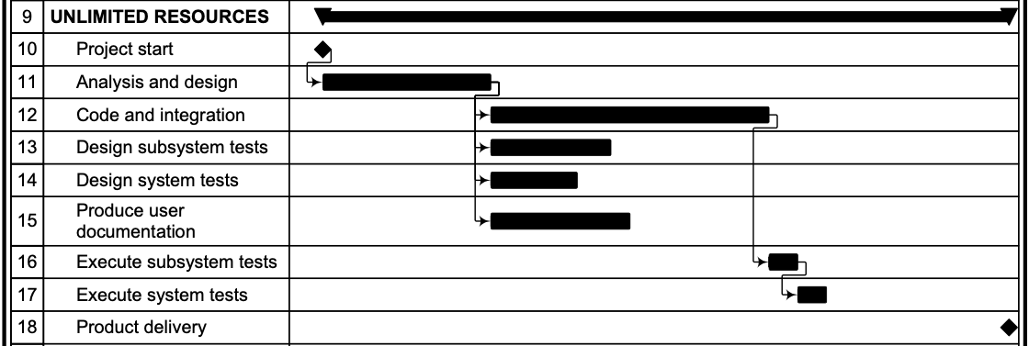
Sample Schedule
Notes:
The most commmon style of project schedule is the GANTT chart, like this example.
Simple idea: task breakdown with allocation in time, obeying task dependences.
Any “vertical slice” of the graph describes level of effort.
Next slide: we can evaluate the schedule risk in the schedule, and improve it.

Slide 27
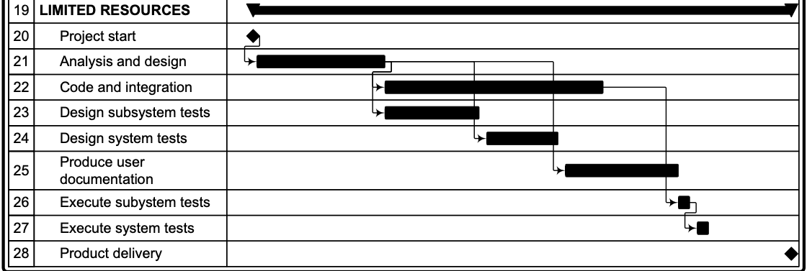
Sample Schedule
Notes:
The most commmon style of project schedule is the GANTT chart, like this example.
Simple idea: task breakdown with allocation in time, obeying task dependences.
Any “vertical slice” of the graph describes level of effort.
Next slide: we can evaluate the schedule risk in the schedule, and improve it.

Slide 28
Schedule Risk
critical path = chain of activities that must be completed in sequence and that have maximum overall duration
  Schedule critical tasks and tasks that depend on critical tasks as early as possible to
    provide schedule slack
    prevent delay in starting critical tasks
critical dependence = task on a critical path scheduled immediately after some other task on the critical path
  May occur with tasks outside the quality plan
  (part of the project plan)
  Reduce critical dependences by decomposing tasks on critical path, factoring out subtasks that can be performed earlier
Notes:
Where are the problems in the schedule?
A: The risks are where any schedule slippage will ripple through the whole
project. We can identify these “critical paths” and rearrange the schedule
to make it more resilient.
We must consider the whole project plan, not just the quality plan, to recognize
all the critical dependencies.
Sometimes the rearrangement requires further task breakdown (factoring) so that
some subtasks can be moved earlier.

Slide 29
Reducing the Impact of Critical Paths
Task name |  | January | Febrary | March | April | May
CRITICAL SCHEDULE
Project start
Analysis and design
Code and integration
Design and execute subsystem tests
Design and execute system tests
Produce user documentation
Product delivery
Notes:
Here (in a very waterfall-like schedule) we see an example of a critical path that we would like to improve,
so that we are not so vulnerable to any schedule slippage.
We can see that designing and executing tests are on the critical path. Factoring them can improve the schedule.

Slide 30
Reducing the Impact of Critical Paths
Task name |  | January | Febrary | March | April | May
UNLIMITED RESOURCES
Project start
Analysis and design
Code and integration
Design subsystem tests
Design system tests
Produce user documentation
Execute subsystem tests
Execute system tests
Product delivery
Notes:
By factoring “design and execute tests” into a test design activity and a test execution activity,
we can move the design tasks earlier in the schedule, and provide much more schedule flexibility.
The refactored schedule now has too much effort concentrated in mid-February, so next
we should level it out a bit ...

Slide 31
Reducing the Impact of Critical Paths
Task name |  | January | Febrary | March | April | May
LIMITED RESOURCES
Project start
Analysis and design
Code and integration
Design subsystem tests
Design system tests
Produce user documentation
Execute subsystem tests
Execute system tests
Product delivery
Notes:
Here we level the effort out, respecting dependences (drawn here as arrows).
We could do much more by breaking “Analysis and design” and “code and integration” into
smaller parts, and interspersing test execution as well as test design with the design and
construction effort.

Slide 32
Risk Planning
Risks cannot be eliminated, but they can be assessed, controlled, and monitored
Generic management risk
  Personnel (or more generally resource)
  Technology
  Schedule
Quality risk
  Development
  Execution
  Requirements
Notes:
The schedule rearrangement we just considered was an example of risk planning:
Making the project less vulnerable to a particular kind of risk
(the risk that some activities take longer than planned).
We don’t seek to eliminate risks, because we can’t. We seek to
Assess them: Explicitly consider what the risks are
Control them: Reduce (but not eliminate) vulnerabilities
Monitor them: The “visibility” aspect, making sure we are alerted
as soon as possible if some of the risks come to pass, so we can
minimize the cost of dealing with them.
The most important thing is to invest time and effort in thinking explicitly what
risks a project could be vulnerable to, as specifically as possible. The most
dangerous risks by far are those that were never considered in the plan.
In addition to this “schedule risk”, we need to control vulnerabilty to
several other kinds of risks (elaborated in subsequent slides).

Slide 33
Personnell
Example Risks
Loss of a staff member
Staff member under-qualified for task
Control Strategies
cross training to avoid over-dependence on individuals
continuous education
identification of skills gaps early in project
competitive compensation and promotion policies and rewarding work
including training time in project schedule
Notes:
20.5 Risk Planning
The most important resource in a software project is people, and the biggest risk
is losing people. This risk grows with the length and size of the project. For large
or long projects, it is very likely that some key people will leave before project completion.
We may reduce the likelihood of people leaving by making the job as attractive as possible
(and this requires much more than a good salary --- the work must be rewarding!). Since
we cannot make this risk very small, most of the control strategies involve making it easier
to recover when someone does leave.
Note that all of the control strategies have costs. We must balance the
potential cost of risks with the cost of risk control. (It is much more common
to invest too little in risk control than to invest too much.)

Slide 34
Technology
Example Risks
High fault rate due to unfamiliar COTS component interface
Test and analysis automation tools do not meet expectations
Control Strategies
Anticipate and schedule extra time for testing unfamiliar interfaces.
Invest training time for COTS components and for training with new tools
Monitor, document, and publicize common errors and correct idioms.
Introduce new tools in lower-risk pilot projects or prototyping exercises
Notes:
While technology risks are typically smaller than personnel risks, it is not
uncommon for a project to run into problems, especially with
commercial off-the-shelf (COTS) components that do not work or
integrate as well as anticipated. Early evaluation of COTS components
is therefore an important part of a good quality plan.
Similar considerations apply to adoption of new test and
analysis tools --- we must anticipate and make contingency
plans for them not working as expected and desired.
apply to new tools for auutom

Slide 35
Schedule
Example Risks
Inadequate unit testing leads to unanticipated expense and delays in integration testing
Difficulty of scheduling meetings makes inspection a bottleneck in development
Control Strategies
Track and reward quality unit testing as evidenced by low fault densities in integration
Set aside times in a weekly schedule in which inspections take precedence over other meetings and work
Try distributed and asynchronous inspection techniques, with a lower frequency of face-to-face inspection meetings
Notes:
These are just two examples of schedule risks and potential control strategies.
We have already discussed the generic strategy of refactoring tasks on
critical paths to reduce vulnerability to schedule slippage rippling through the whole
project.
Other schedule risks specific to quality activities can be anticipated primarily from experience with similar projects earlier.

Slide 36
Development
Example Risks
Poor quality software delivered to testing group
Inadequate unit test and analysis before committing to the code base
Control Strategies
Provide early warning and feedback
Schedule inspection of design, code and test suites
Connect development and inspection to the reward system
Increase training through inspection
Require coverage or other criteria at unit test level

Slide 37
Test Execution
Example Risks
Execution costs higher than planned
Scarce resources available for testing
Control Strategies
Minimize parts that require full system to be executed
Inspect architecture to assess and improve testability
Increase intermediate feedback
Invest in scaffolding

Slide 38
Requirements
Example Risk
High assurance critical requirements increase expense and uncertainty
Control Strategies
Compare planned testing effort with former projects with similar criticality level to avoid underestimating testing effort
Balance test and analysis
Isolate critical parts, concerns and properties

Slide 39
Contingency Plan
Part of the initial plan
  What could go wrong? How will we know, and how will we recover?
Evolves with the plan
Derives from risk analysis
  Essential to consider risks explicitly and in detail
Defines actions in response to bad news
  Plan B at the ready (the sooner, the better)
Notes:
Everything hinges on making an explicit, realistic consideration of project risks from the beginning.
(This seems to be a particularly difficult thing for students to do or appreciate.)

Slide 40
Evolution of the Plan
Preliminary plan
First release
Second release
Final plan
…
Emergency plan

Slide 41
Process Monitoring
Identify deviations from the quality plan as early as possible and take corrective action
Depends on a plan that is
  realistic
  well organized
  sufficiently detailed with clear, unambiguous milestones and criteria
A process is visible to the extent that it can be effectively monitored

Slide 42
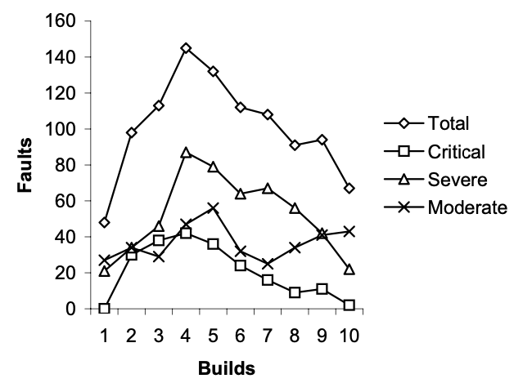
Evaluate Aggregated Data by Analogy
Notes:
How can we identify deviations from the quality plan with respect to effectiveness and quality, and not
just schedule of tasks? Our best tool is often analogy: Gather data and compare it to data from previous projects.
In typical projects, the total number of open faults rises during early stages of construction and then falls as the product nears readiness;
Severe and critical faults display this pattern more strongly than less critical faults.
Comparing fault data on the current project to the history of similar projects (preferably for the same organization, and as
similar as possible) provides a rough guide to progress. Large deviations from historical patterns should be explained.
If we don’t see the predicted rise in the number of detected faults early in the project, we need to learn whether it is
because of unusually high quality or unusually poor test and analysis. If we don’t see severe and criitical paths decreasing,
is it because development is still unstable, introducing new faults with changes?
Analysis by analogy (comparison to history) is far from perfect, but it is often the best tool available for
recognizing problems before they become critical.

Slide 43
Process Improvement
Monitoring and improvement within a project or across multiple projects:
Orthogonal Defect Classification (ODC)
Root Cause Analysis (RCA)
Notes:
The next several slides expand on process monitoring, considering not just how to trigger
a contingency plan, but also how to use analysis of fault data to improve the process
of the current project or of future projects. The generic term for this (for all aspects of
project management, as well as quality processes in particular) is “process improvement”.
We illustrate with two well-known approaches, orthogonal defect classification and root cause analysis.

Slide 44
Orthogonal Defect Classification (ODC)
Accurate classification schema
  for very large projects
  to distill an unmanageable amount of detailed information
Two main steps
  Fault classification
    when faults are detected
    when faults are fixed
  Fault analysis
Notes:
We already looked at analysis of overall trends (the curves showing number of critical, severe, and moderate
faults known over time). For process improvement we need to break the faults down further, classifying them
so that we can find ways to either prevent or detect them more efficiently. ODC is one way to do this,
especially for large projects with a large amount of raw data (e.g., a large number of bug reports in a
bug tracking database).

Slide 45
ODC Fault Classification
When faults are detected
  activity executed when the fault is revealed
  trigger that exposed the fault
  impact of the fault on the customer
When faults are fixed
  Target: entity fixed to remove the fault
  Type: type of the fault
  Source: origin of the faulty modules (in-house, library, imported, outsourced)
  Age of the faulty element (new, old, rewritten, re-fixed code)

Slide 46
ODC activities and triggers
Review and Code Inspection
  Design Conformance:
  Logic/Flow
  Backward Compatibility
  Internal Document
  Lateral Compatibility
  Concurrency
  Language Dependency
  Side Effects
  Rare Situation
Structural (White Box) Test
  Simple Path
  Complex Path
Functional (Black box) Test
  Coverage
  Variation
  Sequencing
  Interaction
System Test
  Workload/Stress
  Recovery/Exception
  Startup/Restart
  Hardware Configuration
  Software Configuration
  Blocked Test

Slide 47
ODC impact
Installability
Integrity/Security
Performance
Maintenance
Serviceability
Migration
Documentation
Usability
Standards
Reliability
Accessibility
Capability
Requirements

Slide 48
ODC Fault Analysis (example 1/4)
Distribution of fault types versus activities
  Different quality activities target different classes of faults
  Example:
    algorithmic faults are targeted primarily by unit testing.
      Expect a high proportion of faults detected by unit testing should belong to this class
    IF proportion of algorithmic faults found during unit testing is:
      unusually small OR larger than normal found at integration test
      THEN unit tests may not have been well designed
    IF proportion of algorithmic faults found during integration testing unusually large
      THEN integration testing may not focus strongly enough on interface faults
Notes:
In this example (spread over 4 slides), we consider analyses of
* (1) when each kind of fault is being detected (fault types versus activities)
* (2) what kind of test or use case triggered detection
* (3) how long faults remain in code before detection
* (4) trends in the kinds of faults being detected
Each of these can suggest problems (and opportunities for improvement) in test and analysis

Slide 49
ODC Fault Analysis (example 2/4)
Distribution of triggers over time during field test
  Faults corresponding to simple usage should arise early during field test, while faults corresponding to complex usage should arise late.
  The rate of disclosure of new faults should asymptotically decrease
  Unexpected distributions of triggers over time may indicate poor system or acceptance test
    IF triggers that correspond to simple usage reveal many faults late in acceptance testing THEN sample may not be representative of the user population
    IF continuously growing faults during acceptance test is observed THEN system testing may have failed

Slide 50
ODC Fault Analysis (example 3/4)
Age distribution over target code
  Most faults should be located in new and rewritten code
  The proportion of faults in new and rewritten code with respect to base and re-fixed code should gradually increase
Different age distributions
  may indicate holes in the fault tracking and removal process
  may indicate inadequate test and analysis that failed in revealing faults early
  Example
    increase of faults located in base code after porting may indicate inadequate tests for portability

Slide 51
ODC Fault Analysis (example 4/4)
Distribution of fault classes over time
  The proportion of missing code faults should gradually decrease (because the code is being provided)
  The percentage of extraneous faults may slowly increase, because missing functionality should be revealed with use and repaired.
  Examples:
    An increasing number of missing faults may be a symptom of instability of the product.
    A sudden sharp increase in extraneous faults may indicate maintenance problems

Slide 52
Improving the Process
Many classes of faults that occur frequently are rooted in process and development flaws
  examples
    Shallow architectural design that does not take into account resource allocation can lead to resource allocation faults
    Lack of experience with the development environment, which leads to misunderstandings between analysts and programmers on rare and exceptional cases, can result in faults in exception handling.
The occurrence of many such faults can be reduced by modifying the process and environment
  examples
    Resource allocation faults resulting from shallow architectural design can be reduced by introducing specific inspection tasks
    Faults attributable to inexperience with the development environment can be reduced with focused training
Notes:
20.7 Improving the Process

Slide 53
Improving Current and Next Processes
Identifying weak aspects of a process can be difficult
Analysis of the fault history can help software engineers build a feedback mechanism to track relevant faults to their root causes
  Sometimes information can be fed back directly into the current product development
  More often it helps software engineers improve the development of future products

Slide 54
Root cause analysis (RCA)
Technique for identifying and eliminating process faults
  First developed in the nuclear power industry; used in many fields.
Four main steps
  What are the faults?
  When did faults occur? When, and when were they found?
  Why did faults occur?
  How could faults be prevented?

Slide 55
What are the faults?
Identify a class of important faults
Faults are categorized by
  severity = impact of the fault on the product
  Kind
    No fixed set of categories; Categories evolve and adapt
    Goal:
      Identify the few most important classes of faults and remove their causes
      Differs from ODC: Not trying to compare trends for different classes of faults, but rather focusing on a few important classes

Slide 56
Fault Severity
Level | Description | Example
Critical | The product is unusable | The fault causes the program to crash
Severe | Some product features cannot be used, and there is no workaround | The fault inhibits importing files saved with a previous version of the program, and there is no workaround
Moderate | Some product features require workarounds to use, and reduce efficiency, reliability, or convenience and usability | The fault inhibits exporting in Postscript format. Postscript can be produced using the printing facility, but with loss of usability and efficiency
Cosmetic | Minor inconvenience | The fault limits the choice of colors for customizing the graphical interface, violating the specification but causing only minor inconvenience

Slide 57
Pareto Distribution (80/20)
Pareto rule (80/20)
  in many populations, a few (20%) are vital and many (80%) are trivial
Fault analysis
  20% of the code is responsible for 80% of the faults
    Faults tend to accumulate in a few modules
      identifying potentially faulty modules can improve the cost effectiveness of fault detection
    Some classes of faults predominate
      removing the causes of a predominant class of faults can have a major impact on the quality of the process and of the resulting product
Notes:
SIDEBAR
The pareto rule and variants (e.g., Zipf’s law) appear in many contexts. It’s good news for process improvement:
We can accomplish a lot if we focus on a few important issues. We can also waste a lot of effort if we focus
on the wrong issues, so it’s important to prioritize based on data rather than hunches.

Slide 58
Why did faults occur?
Core RCA step
  trace representative faults back to causes
  objective of identifying a “root” cause
Iterative analysis
  explain the error that led to the fault
  explain the cause of that error
  explain the cause of that cause
  ...
Rule of thumb
  “ask why six times”
Notes:
There is nothing magic about “six”. The point is to keep pushing back until we find the best opportunity for improvement,
whether that be more effective detection of some kinds of faults or practices that prevent those faults from occurring in
the first place.

Slide 59
Example of fault tracing
Tracing the causes of faults requires experience, judgment, and knowledge of the development process
example
  most significant class of faults = memory leaks
  cause = forgetting to release memory in exception handlers
  cause = lack of information: “Programmers can't easily determine what needs to be cleaned up in exception handlers”
  cause = design error: “The resource management scheme assumes normal flow of control”
  root problem = early design problem: “Exceptional conditions were an afterthought dealt with late in design”
Notes:
Root cause analysis is as likely to lead us to improved development processes as it is to suggest
better fault detection methods. In this example, we could have just designed better ways of
detecting memory leaks, but we will get much better improvements (and not limited to memory leaks)
if we recognize the root problem of not considering exceptional conditions at the appropriate point
in system design.
Note that, in process improvement, we really must consider test and analysis together with other
facets of software development.

Slide 60
How could faults be prevented?
Many approaches depending on fault and process:
From lightweight process changes
  example
    adding consideration of exceptional conditions to a design inspection checklist
To heavyweight changes:
  example
    making explicit consideration of exceptional conditions a part of all requirements analysis and design steps
Goal is not perfection, but cost-effective improvement (excellence is the enemy of the good)

Slide 61
The Quality Team
The quality plan must assign roles and responsibilities to people
assignment of responsibility occurs at
  strategic level
    test and analysis strategy
    structure of the organization
    external requirements (e.g., certification agency)
  tactical level
    test and analysis plan
Notes:
20.8 The Quality team

Slide 62
Roles and Responsibilities at Tactical Level
balance level of effort across time
manage personal interactions
ensure sufficient accountability that quality tasks are not easily overlooked
encourage objective judgment of quality
prevent it from being subverted by schedule pressure
foster shared commitment to quality among all team members
develop and communicate shared knowledge and values regarding quality

Slide 63
Alternatives in Team Structure
Conflicting pressures on choice of structure
  example
    autonomy to ensure objective assessment
    cooperation to meet overall project objectives
Different structures of roles and responsibilities
  same individuals play roles of developer and tester
  most testing responsibility assigned to a distinct group
  some responsibility assigned to a distinct organization
Distinguish
  oversight and accountability for approving a task
  responsibility for actually performing a task
Notes:
There is not a single “right” way to structure the quality team, because
of tension between conflicting design pressures (e.g., the need for objectivity
being a pressure for autonomy in conflict with the need for cooperation).
The degree to which developer and tester roles are separated or merged is a key
organizational design choice, ranging from complete merging (as in XP, where
every developer is also a tester) to complete organizational separation (as when
an outside organization is contracted for independent verification and validation (IV&V)).
In considering these choices, it is often useful to distinguish between oversight
responsibility and responsibility for carrying out a task. For example, if we give developers
responsibility for devising and executing unit tests, we can still have a separate monitoring
responsibility (whether peer review, manager review, or review by a separate team)
to approve adequate unit testing. Conversely, if we employ another organization for
IV&V, we will need an internal person assigned to oversee the IV&V effort.

Slide 64
Roles and responsibilities pros and cons
Same individuals play roles of developer and tester
  potential conflict between roles
    example
      a developer responsible for delivering a unit on schedule
      responsible for integration testing that could reveal faults that delay delivery
  requires countermeasures to control risks from conflict
Roles assigned to different individuals
  Potential conflict between individuals
    example
      developer and a tester who do not share motivation to deliver a quality product on schedule
  requires countermeasures to control risks from conflict
Notes:
This elaborates on the primary example of conflicting pressures from the previous slide.
It may be a good opportunity for class discussion:
What counter-measures can you think of?
Is one of the two conflicts easier to deal with than the other?
Many approaches are possible. We don’t know of any that are perfect.
An example approach: In development groups at Microsoft, developers and testers are distinct
but paired as “buddies”,
achieving a rough balance between cooperation and independence.

Slide 65
Independent Testing Team
Minimize risks of conflict between roles played by the same individual
  Example
    project manager with schedule pressures cannot
      bypass quality activities or standards
      reallocate people from testing to development
      postpone quality activities until too late in the project
Increases risk of conflict between goals of the independent quality team and the developers
Plan
  should include checks to ensure completion of quality activities
  Example
    developers perform module testing
    independent quality team performs integration and system testing
    quality team should check completeness of module tests
Notes:
One approach is to have a testing team distinct from the development team. This has some advantages (minimizing role conflict for individuals),
but increases risk of conflict between quality team and development team.
Considering the distinction between oversight and carrying out a task, it is possible for the independent testing team to
have oversight responsibility for some tasks (e.g., module testing) that is performed by the development team.
The project plan includes checks (process visibility) for satisfactory completion of quality activities.

Slide 66
Managing Communication
Testing and development teams must share the goal of shipping a high-quality product on schedule
  testing team
    must not be perceived as relieving developers from responsibility for quality
    should not be completely oblivious to schedule pressure
Independent quality teams require a mature development process
  Test designers must
    work on sufficiently precise specifications
    execute tests in a controllable test environment
Versions and configurations must be well defined
Failures and faults must be suitably tracked and monitored across versions
Notes:
If there is a quality team distinct from the development team,
communication and cooperation between teams must be
carefully managed. This separation is only likely to work when
there is a mature development process that includes developing
sufficiently precise specifications.

Slide 67
Testing within XP
Full integration of quality activities with development
  Minimize communication and coordination overhead
  Developers take full responsibility for the quality of their work
  Technology and application expertise for quality tasks match expertise available for development tasks
Plan
  check that quality activities and objective assessment are not easily tossed aside as deadlines loom
  example
    XP “test first” together with pair programming guard against some of the inherent risks of mixing roles
Notes:
XP is the other end of the spectrum from a separate team responsible for testing.
Whatever you think of XP as a whole, “test first” and pair programming
are interesting examples of devising counter-measures
to potential conflicts between roles of an individual.

Slide 68
Outsourcing Test and Analysis
(Wrong) motivation
  testing is less technically demanding than development and can be carried out by lower-paid and lower-skilled individuals
Why wrong
  confuses test execution (straightforward) with analysis and test design (as demanding as design and programming)
A better motivation
  to maximize independence
    and possibly reduce cost as (only) a secondary effect
The plan must define
  milestones and delivery for outsourced activities
  checks on the quality of delivery in both directions

Slide 69
Summary
Planning is necessary to
  order, provision, and coordinate quality activities
    coordinate quality process with overall development
    includes allocation of roles and responsibilities
  provide unambiguous milestones for judging progress
Process visibility is key
  ability to monitor quality and schedule at each step
    intermediate verification steps: because cost grows with time between error and repair
  monitor risks explicitly, with contingency plan ready
Monitoring feeds process improvement
  of a single project, and across projects
Notes:
These slides cover a lot of ground, and you might choose differently among key points to summarize here
depending on what you choose to emphasize or include.

