Slide 1

Models of Neurons 2:
The Hodgkin-Huxley Model
Angus Chadwick, ANC
School of Informatics, University of Edinburgh, UK
Computational Neuroscience (Lecture 4, 2024/2025)

Slide 2
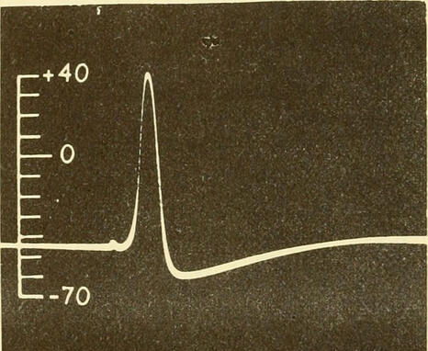
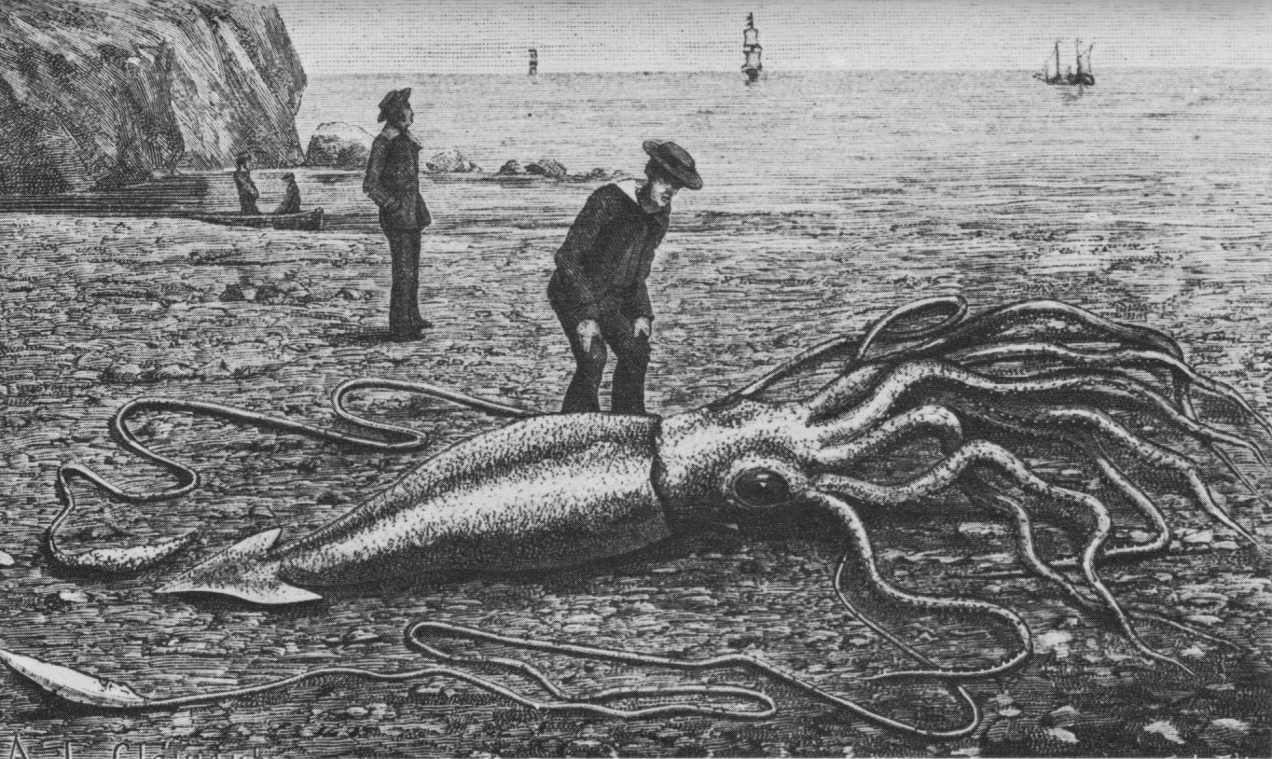
Outline of Lecture
Action potentials
The voltage clamp
Voltage-gated ion channels
Markov models for ion channel gating
The Hodgkin-Huxley model

Slide 3
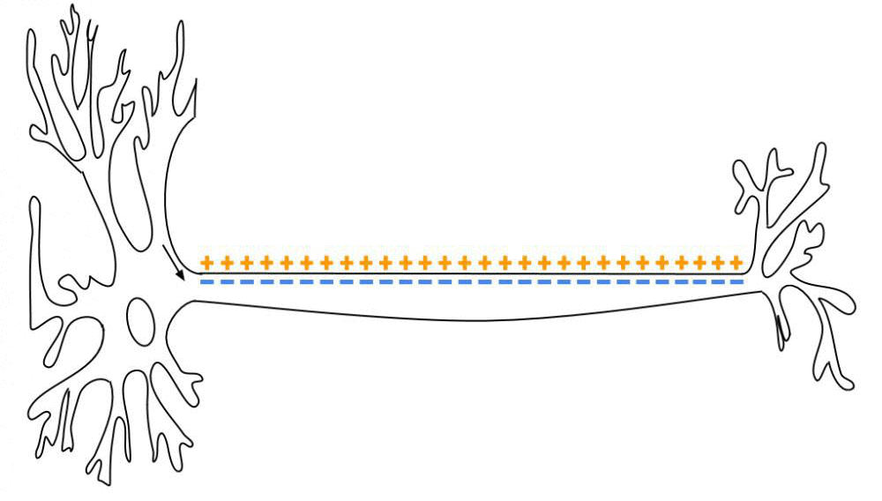
Action Potentials (or “Spikes”)
Action potentials propagate from the soma down the axon.
The speed of action potential propagation is generally quite slow (metres per second)
Action potentials are a noise-robust and energetically efficient method for communication over long distances

Slide 4
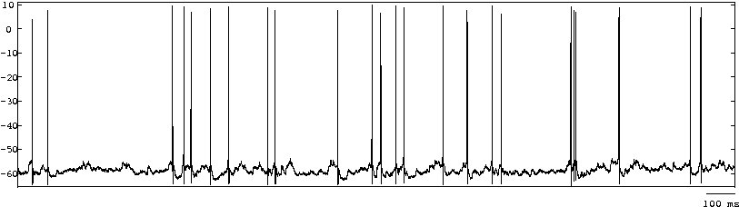
Action Potentials (or “Spikes”)

Slide 5
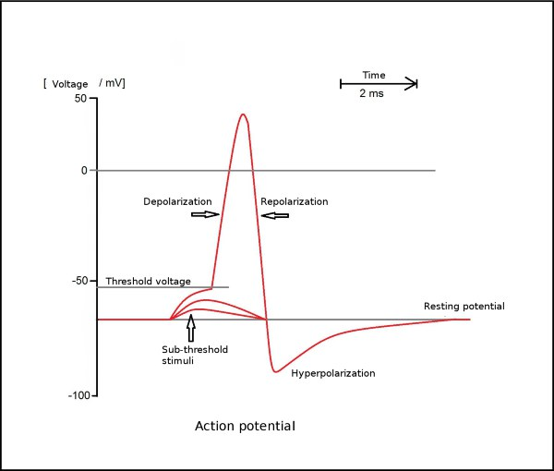
Action Potentials (or “Spikes”)

Slide 6
Recap – Membrane Potential
Neurons have multiple species of ions inside and outside, with different concentrations
Ions can flow in and out through open ion channels, due to concentration gradient and voltage
At the resting potential, no net current flows across the cell membrane
Using Ohm’s law, we find an equation for the dynamics of the membrane potential
This equation predicts a membrane time constant of around 20 ms, and can’t explain spikes which last around 1 ms

Slide 7
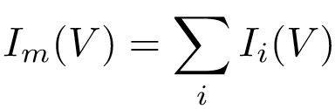

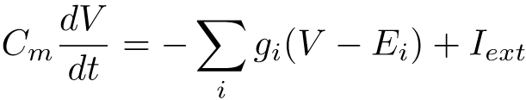
Recap – Membrane Potential Equations
Membrane current:
Membrane potential dynamics:

Slide 8

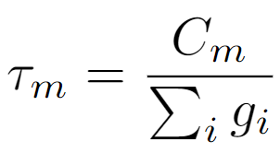
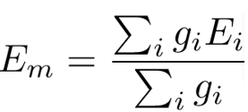
Recap – Membrane Potential Equations
Membrane current:
Membrane potential dynamics:
Rewriting in terms of a single membrane conductance:

Slide 9
Recap – Membrane Potential Equations
Membrane current:
Membrane potential dynamics:
Rewriting in terms of a single membrane conductance:
How can we decrease the time constant to get fast spikes? 1) Decrease Cm 2) Increase g’s…
1 is not biologically plausible, but 2 turns out to be basis of action potential!

Slide 10
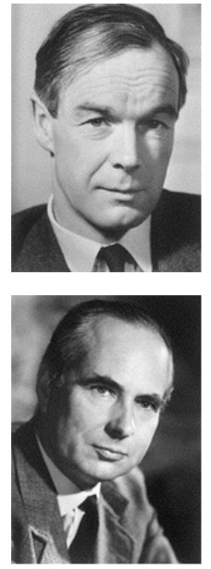
Some History
Alan Hodgkin and Andrew Huxley, working to discover the ionic basis of the action potential (1930s-1940s)
Working with the squid giant axon as a model system
Developing methods to record from and control the axon
They developed a mathematical model for the biophysics of the action potential and tested it experimentally
They won the Nobel Prize for this work in 1963

Slide 11
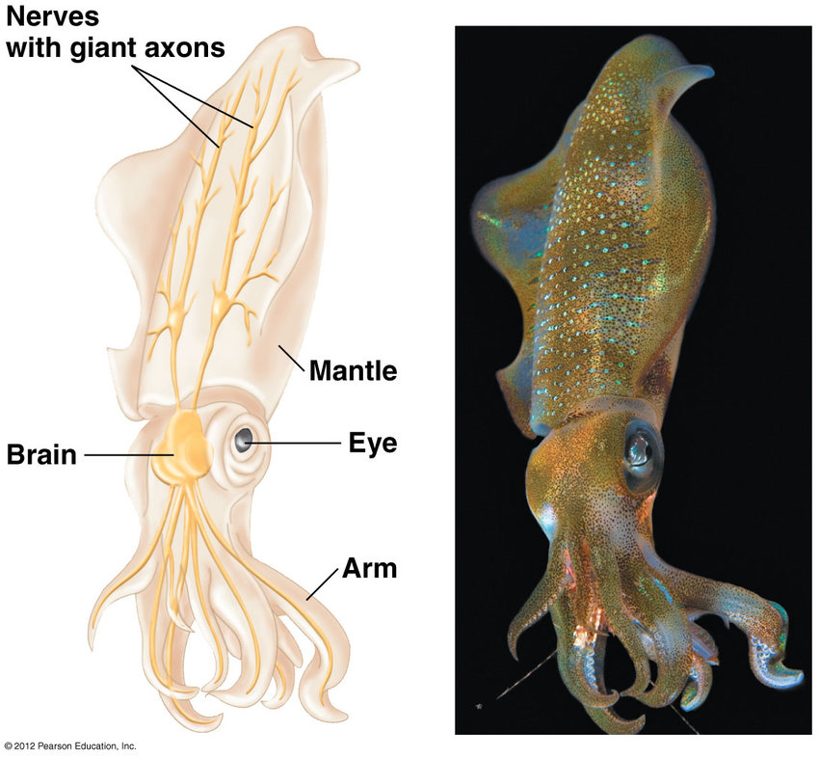
The Squid Giant Axon
The squid has a giant axon running through its whole body (diameter ~0.5 mm)
Why? Wider axons transmit signals faster, and this axon sends a signal to squirt water for jet propulsion to escape predators!
Hodgkin and Huxley could place an electrode directly inside the axon
They developed clever methods to study the various ionic currents that flow through the axon membrane, and came up with an elegant mathematical model to describe them

Slide 12
The Voltage Clamp
How can we measure the relationship between membrane potential and current flow experimentally? If we inject current to try to move the membrane potential to a set value, the neuron will start to spike!

Slide 13
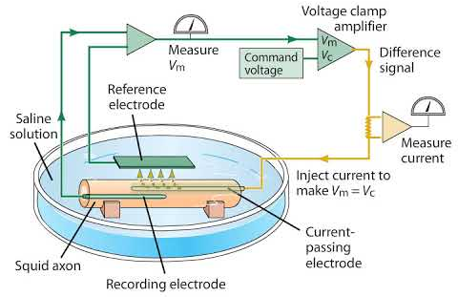
The Voltage Clamp
How can we measure the relationship between membrane potential and current flow experimentally? If we inject current to try to move the membrane potential to a set value, the neuron will start to spike!
Answer: the voltage clamp - use a feedback control system to rapidly adjust the injected current to keep the membrane potential at a set value.

Slide 14
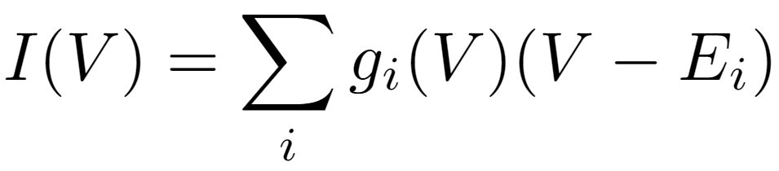
The Voltage Clamp
How can we measure the relationship between membrane potential and current flow experimentally? If we inject current to try to move the membrane potential to a set value, the neuron will start to spike!
Answer: the voltage clamp - use a feedback control system to rapidly adjust the injected current to keep the membrane potential at a set value.

Slide 15
The Voltage Clamp
How can we measure the relationship between membrane potential and current flow experimentally? If we inject current to try to move the membrane potential to a set value, the neuron will start to spike!
Answer: the voltage clamp - use a feedback control system to rapidly adjust the injected current to keep the membrane potential at a set value.
Can vary ion concentrations to set these
Set this
Measure
this
Can block ion channels pharmacologically to set some to zero.

Slide 16
Hodgkin-Huxley Model Equations
The membrane current is modelled as three ionic currents plus an external input current
The first term represents the leak current, i.e. any current through ion channels with fixed conductances (mostly chloride)
The second and third term represent the current flow through sodium and potassium channels, with conductances that depend on voltage and time
Hodgkin and Huxley combined experiment and mathematical modelling to find equations for these conductances

Slide 17
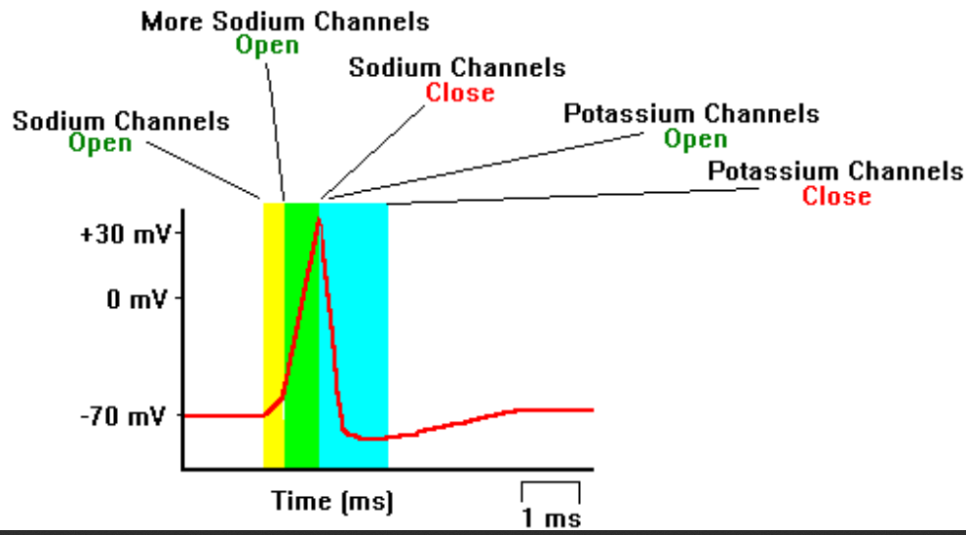
The Hodgkin-Huxley Model
Hodgkin and Huxley hypothesised that the permeability of ion channels is voltage-dependent
Sodium channels are closed at the resting potential but open at higher membrane potentials
When open, sodium ions flow into the cell, further increasing the membrane potential. As the membrane potential increases:
1) More sodium channels open, creating a positive feedback loop
2) potassium channels open, creating negative feedback
3) sodium channels close, halting positive feedback
(a “safety mechanism”)
Together, 1-3) explain the rapid rise and decay of the action potential

Slide 18
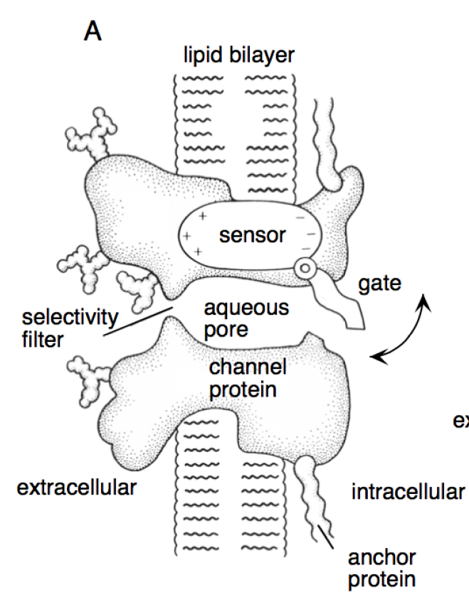
Active Ion Channels
Ion channels may open and close, actively controlling the flow of current into and out of the cell.
Various factors cause opening and closing – voltage, molecules that bind to the ion channel, and random/stochastic processes.
This figure shows a potassium channel, with a voltage sensor that opens a gate at high membrane potentials. It has a “selectivity filter” that only allows potassium through.

Slide 19
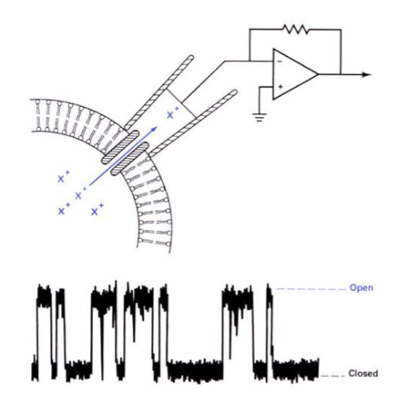
Active Ion Channels
We can now measure current through single ion channels – this was not possible at the time of Hodgkin and Huxley!

Slide 20
Membrane Conductance Revisited
Last lecture, we considered the membrane conductance for the cell membrane to each species of ion. We considered membranes with fixed conductances (“passive membranes”)
How does the conductance change when ion channels open and close?

Slide 21
Membrane Conductance Revisited
Last lecture, we considered the membrane conductance for the cell membrane to each species of ion. We considered membranes with fixed conductances (“passive membranes”)
How does the conductance change when ion channels open and close?
The total conductance depends on the number of open channels and the conductance of each channel:
number of
open channels
conductance
per channel
number of
channels
probability of
channel being open
conductance if all channels are open

Slide 22
Membrane Conductance Revisited
Last lecture, we considered the membrane conductance for the cell membrane to each species of ion. We considered membranes with fixed conductances (“passive membranes”)
How does the conductance change when ion channels open and close?
The total conductance depends on the number of open channels and the conductance of each channel:
Fixed
Variable
number of
open channels
conductance
per channel
number of
channels
probability of
channel being open
conductance if all channels are open

Slide 23
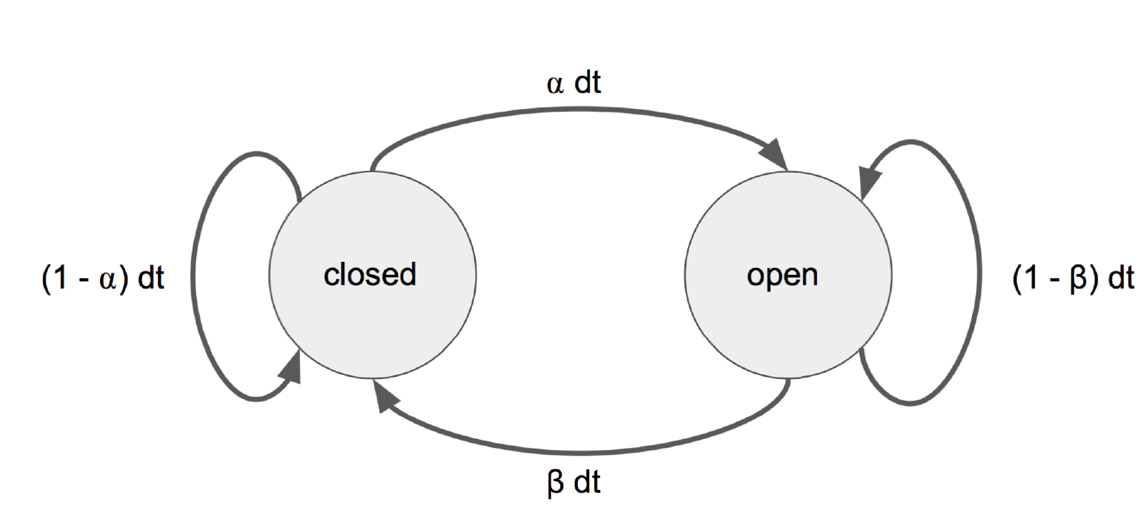
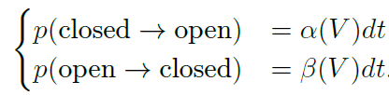
Markov Model For Channel Opening/Closing
Markov assumption: probability of state (open/closed) at time t+dt depends only on state at time t.

Slide 24
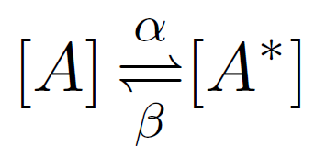

Markov Model For Channel Opening/Closing
closed
open
change in number open
open to closed
closed to open

Slide 25

Markov Model For Channel Opening/Closing
closed
open
change in number open
open to closed
closed to open
Fraction open + fraction closed = 1

Slide 26
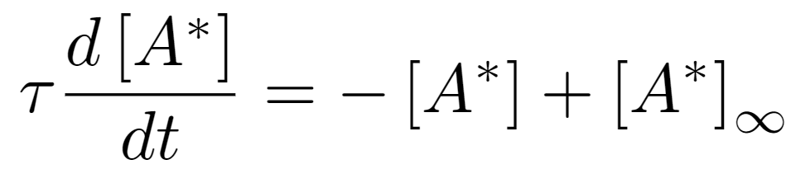


Solution to Markov Model
The Markov equation is of the same form as the passive membrane potential dynamics equation - we can rewrite as:

Slide 27
Solution to Markov Model
The Markov equation is of the same form as the passive membrane potential dynamics equation - we can rewrite as:
So we already know the solution:

Slide 28
Summary Markov Models for Ion Channel Gating
Ion channels stochastically open and close
A simple model is to assume that opening/closing occurs at a fixed rate, with no history- or time-dependence (Markov assumption)
This model predicts that the fraction of open gates will relax exponentially towards a fixed asymptotic value
The asymptotic value and relaxation time constant depend on the Markov transition rates

Slide 29
Summary Markov Models for Ion Channel Gating
Ion channels stochastically open and close
A simple model is to assume that opening/closing occurs at a fixed rate, with no history- or time-dependence (Markov assumption)
This model predicts that the fraction of open gates will relax exponentially towards a fixed asymptotic value
The asymptotic value and relaxation time constant depend on the Markov transition rates
BUT!!! This turns out to be insufficient to explain ion channels for two reasons:
1) Transition rates are voltage-dependent 2) Ion channels have multiple gates

Slide 30
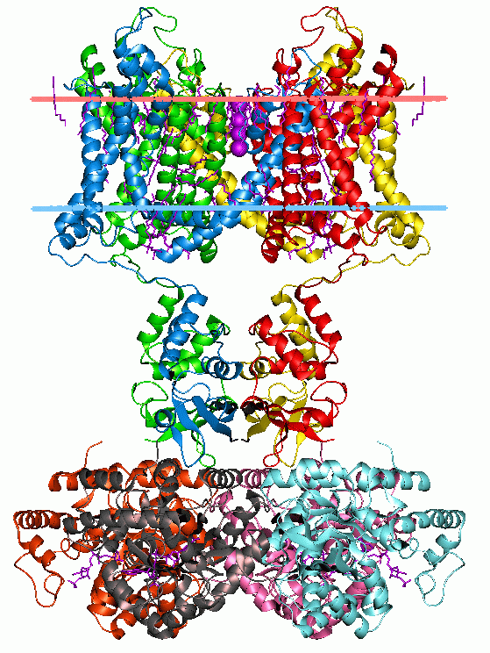
Voltage-Gated Potassium Channels
Molecular structure of a voltage-gated potassium channel

Slide 31
Voltage-Gated Potassium Channels
Molecular structure of a voltage-gated potassium channel
Voltage-Sensor
There are actually
4 of these!!!
The channel is only open when all 4 gates are open…

Slide 32
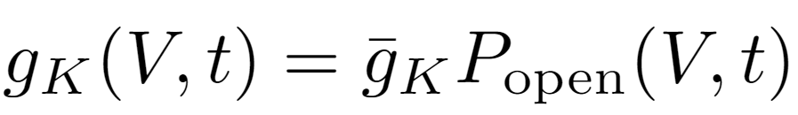
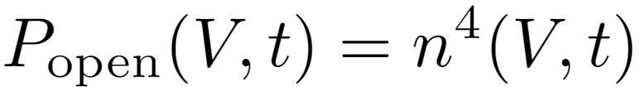
Application to Potassium Channels
Each potassium channel has 4 gates, all of which need to be open for ions to pass through

Slide 33
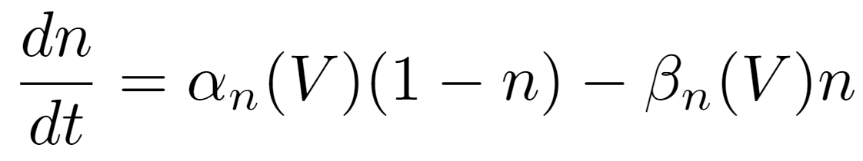
Application to Potassium Channels
Each potassium channel has 4 gates, all of which need to be open for ions to pass through
Markov dynamics for each gate

Slide 34
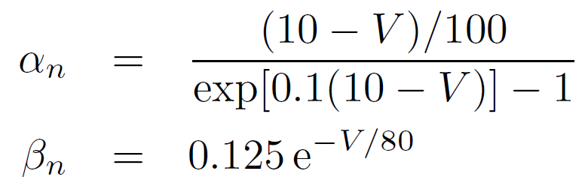
Application to Potassium Channels
Each potassium channel has 4 gates, all of which need to be open for ions to pass through
Markov dynamics for each gate
These functions are essentially fit to data based on voltage clamp experiments

Slide 35
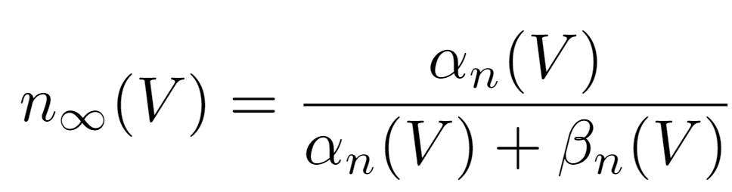
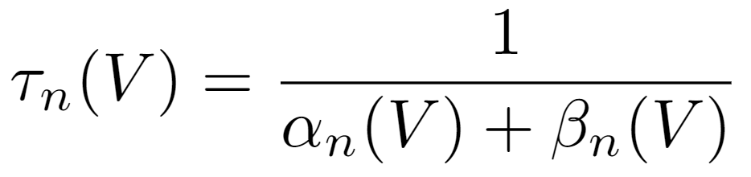
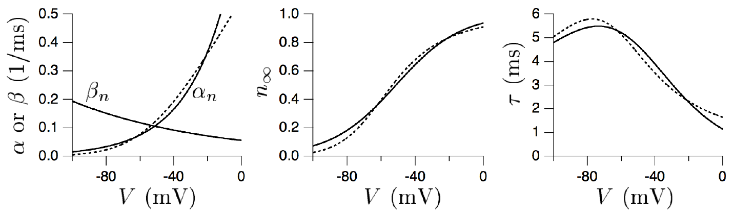
Fitting the Model to Potassium Channels
Fraction open at equilibrium
(clamped at V)
Time to approach equilibrium
(clamped at V)

Slide 36
Fitting the Model to Potassium Channels
Fraction open at equilibrium
(clamped at V)
Time to approach equilibrium
(clamped at V)

Slide 37
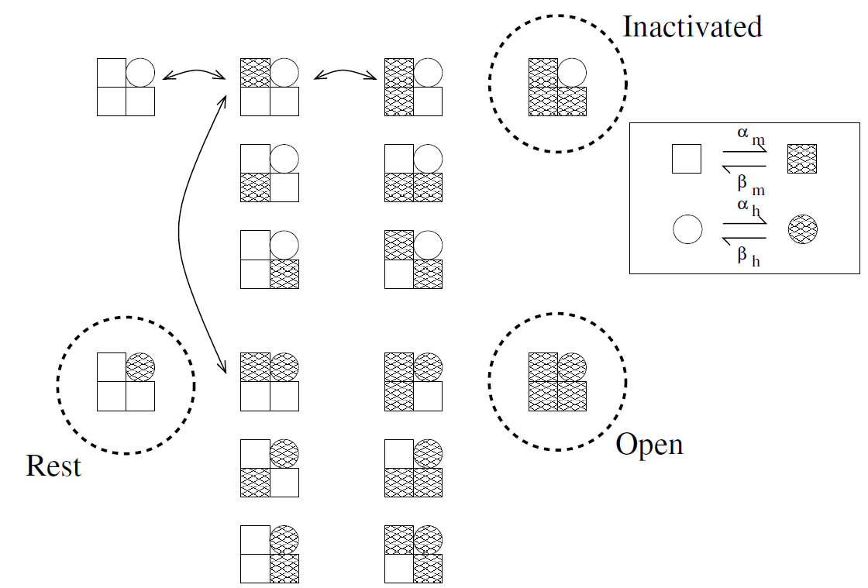
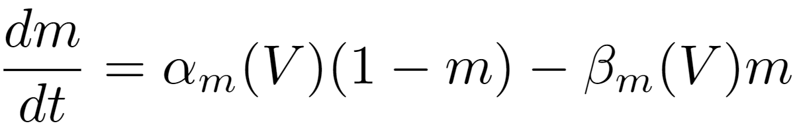
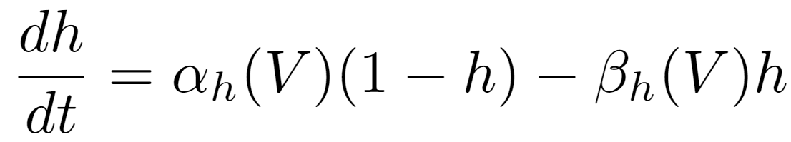
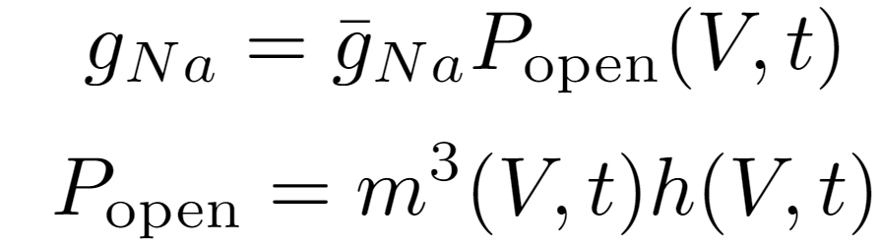
Sodium Channels
3 activation gates (m) + 1 inactivation gate (h)
– need all open for ions to pass through!

Slide 38
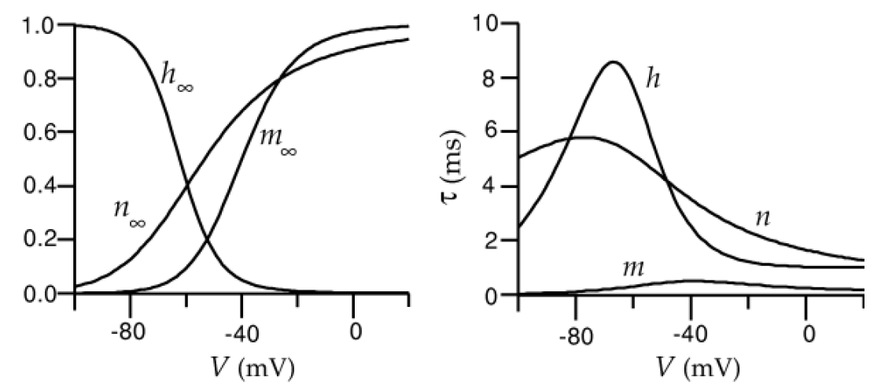
Sodium Channels
The h and m sodium variables are modelled/fit in the exactly the same as way as the n potassium variables, but with different experimentally-derived parameter values:

Slide 39
Putting it all together…
The Hodgkin-Huxley model is a set of 4 coupled nonlinear differential equations (1 voltage + 3 gating variables)
Potassium gate
It has no known analytical solution. It can be solved numerically using the Euler method (or other ODE solvers).
Sodium activation gate
Sodium inactivation gate

Slide 40
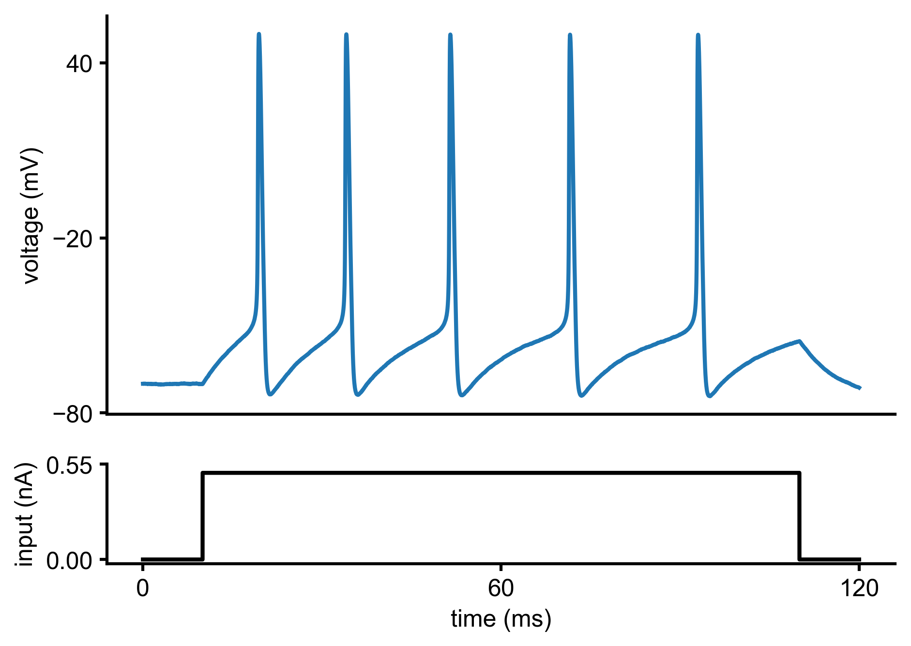
Behaviour of the Hodgkin-Huxley Model

Slide 41
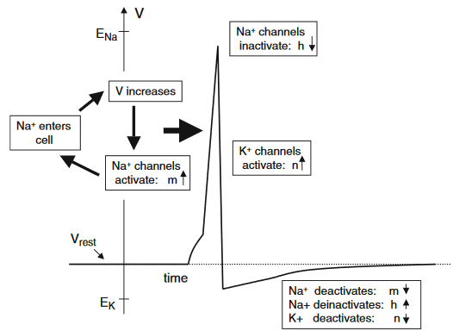
Overview of the Hodgkin-Huxley Model

Slide 42
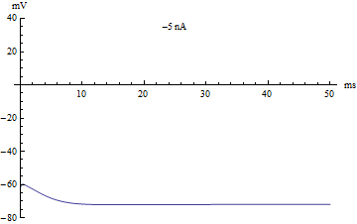
The “Threshold” in the Hodgkin-Huxley Model
If the Hodgkin-Huxley neuron is injected with a constant input current, it will not fire any action potentials below a certain strength of current
The current strength at which the neuron switches from non-spiking to spiking is called the threshold
There is no well-defined voltage threshold in the Hodgkin-Huxley model, only a current threshold

Slide 43
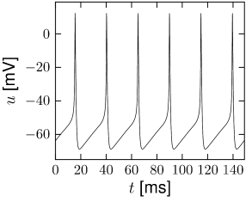
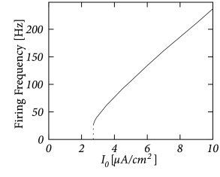
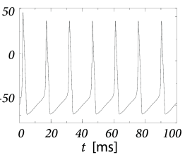
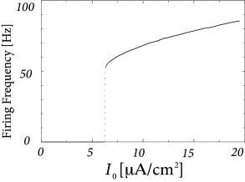
The f-I Curve in the Hodgkin-Huxley Model
Changes in model parameters can produce different types of firing rate vs input current (f-I curves)
Different neurons in the brain also exhibit these different f-I curves

Slide 44
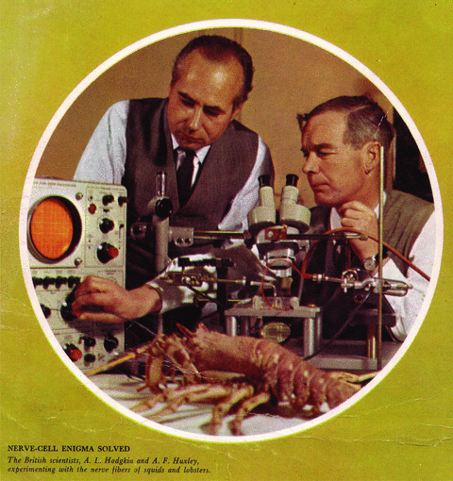
Why is the Hodgkin-Huxley Model a Good Model?
The Hodgkin-Huxley model is one of the most successful models in neuroscience to date
They were awarded the Nobel Prize in 1963
It has led to many experimental predictions that have been subsequently confirmed (e.g., in terms of kinetics of ion channels, changes with temperature, blocking with TTX, etc.)
It can be augmented to account for many more biological phenomena – additional currents, more complex cellular morphology, stochastic ion channels gating, etc.
It provides crucial insight into the biophysical processes which govern electrical signalling in neurons

Slide 45
Summary
Action potentials are generated via the interplay of two voltage-gated ion channels (sodium and potassium)
Voltage changes cause ion channels to open or close, which causes current to flow or stop, which causes voltage to change
The dynamics of these processes can be described by the Hodgkin-Huxley model – a 4D dynamical system describing the time evolution of the membrane potential and sodium and potassium channel states
The model is too complex to be solved analytically – it has to simulated, or approximated by simpler models (e.g., Fitzhugh-Nagumo, integrate and fire)

Slide 46
Bibliography
Neuronal Dynamics Ch. 1 (Gerstner et al.) https://neuronaldynamics.epfl.ch/online/index.html
Theoretical Neuroscience Ch. 5-6 (Dayan and Abbott)
Mathematical Foundations of Neuroscience Ch. 1 (Ermentrout and Terman)
Dynamical Systems in Neuroscience Ch. 1-2 (Izhikevich) https://www.izhikevich.org/publications/dsn.pdf

