Slide 1
Standards Working Together
SCSD Lecture
Thursday 29 February

Slide 2
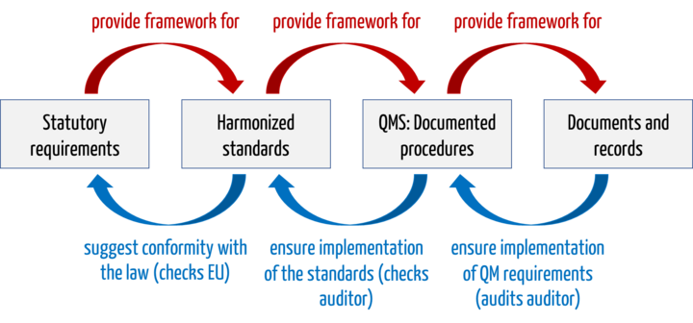
Standards and Regulation
Johner Institute

Slide 3
Harmonized Standards
Standards compliance:
  Is voluntary on the part of the complying organization.
  Can be part of establishing regulatory compliance.
  In the EU this can be particularly important as part of Harmonization across member states.
Definition: EU Regulation 1025/2012 defines the term harmonized standard as "a European standard adopted on the basis of a request made by the Commission for the application of Union harmonisation legislation."
Examples
  harmonized standards include:
    EN IEC 62304: Software life-cycle processes for medical devices.
    EN IEC 62366-1: Application of usability to medical devices
    EN ISO 14971: Application of risk management to medical devices
    EN IEC 60601-1: Medical electrical equipment and systems: Basic safety and essential performance
    EN ISO 13485: Medical devices - Quality management systems - Requirements for regulatory purposes
Inadequacy

Slide 4
Z annexes
These record the extent to which meeting a standard is accepted as complying with a regulation.
For more technical standards this can be a close match.
More procedural regulatory requirements are often more difficult to match in a standard:
  Standards will not cover issues like registering products.
  International standards generated by SDOs will avoid being too specific.

Slide 5
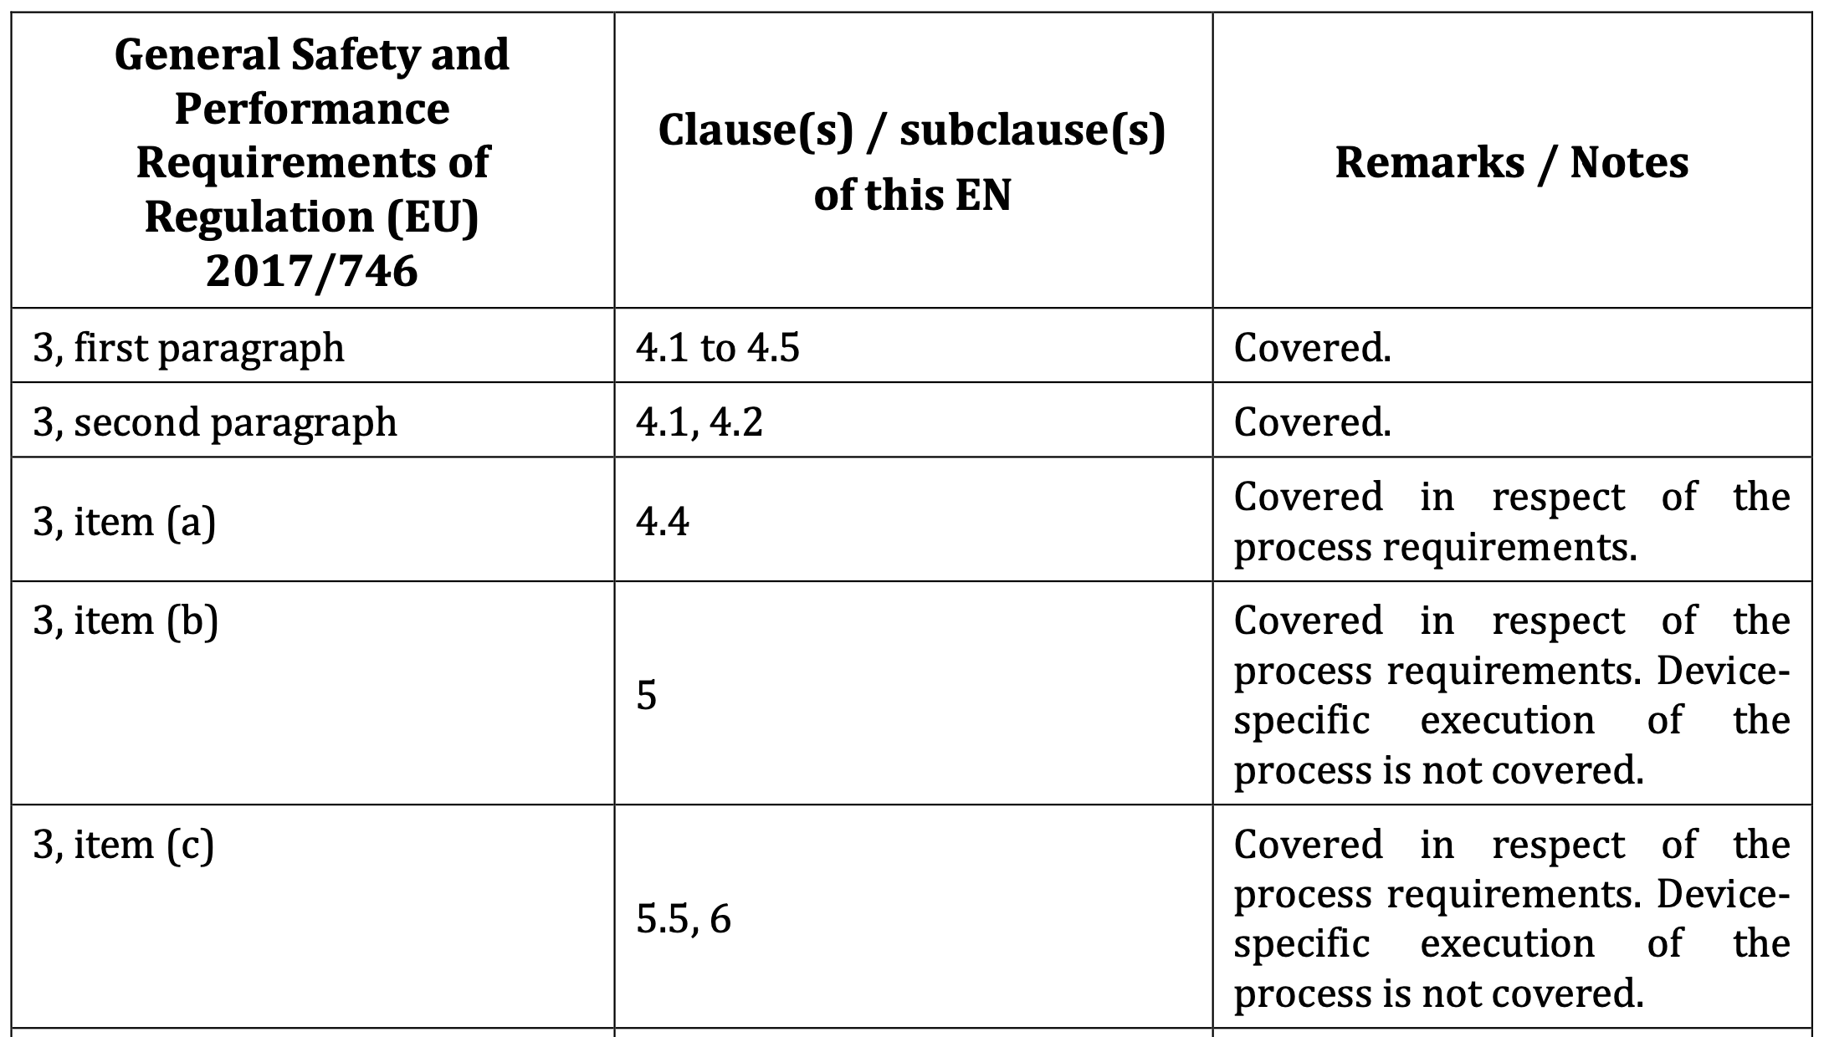
Z Annexe of ISO 14971 (Risk Management, Medical Devices)

Slide 6
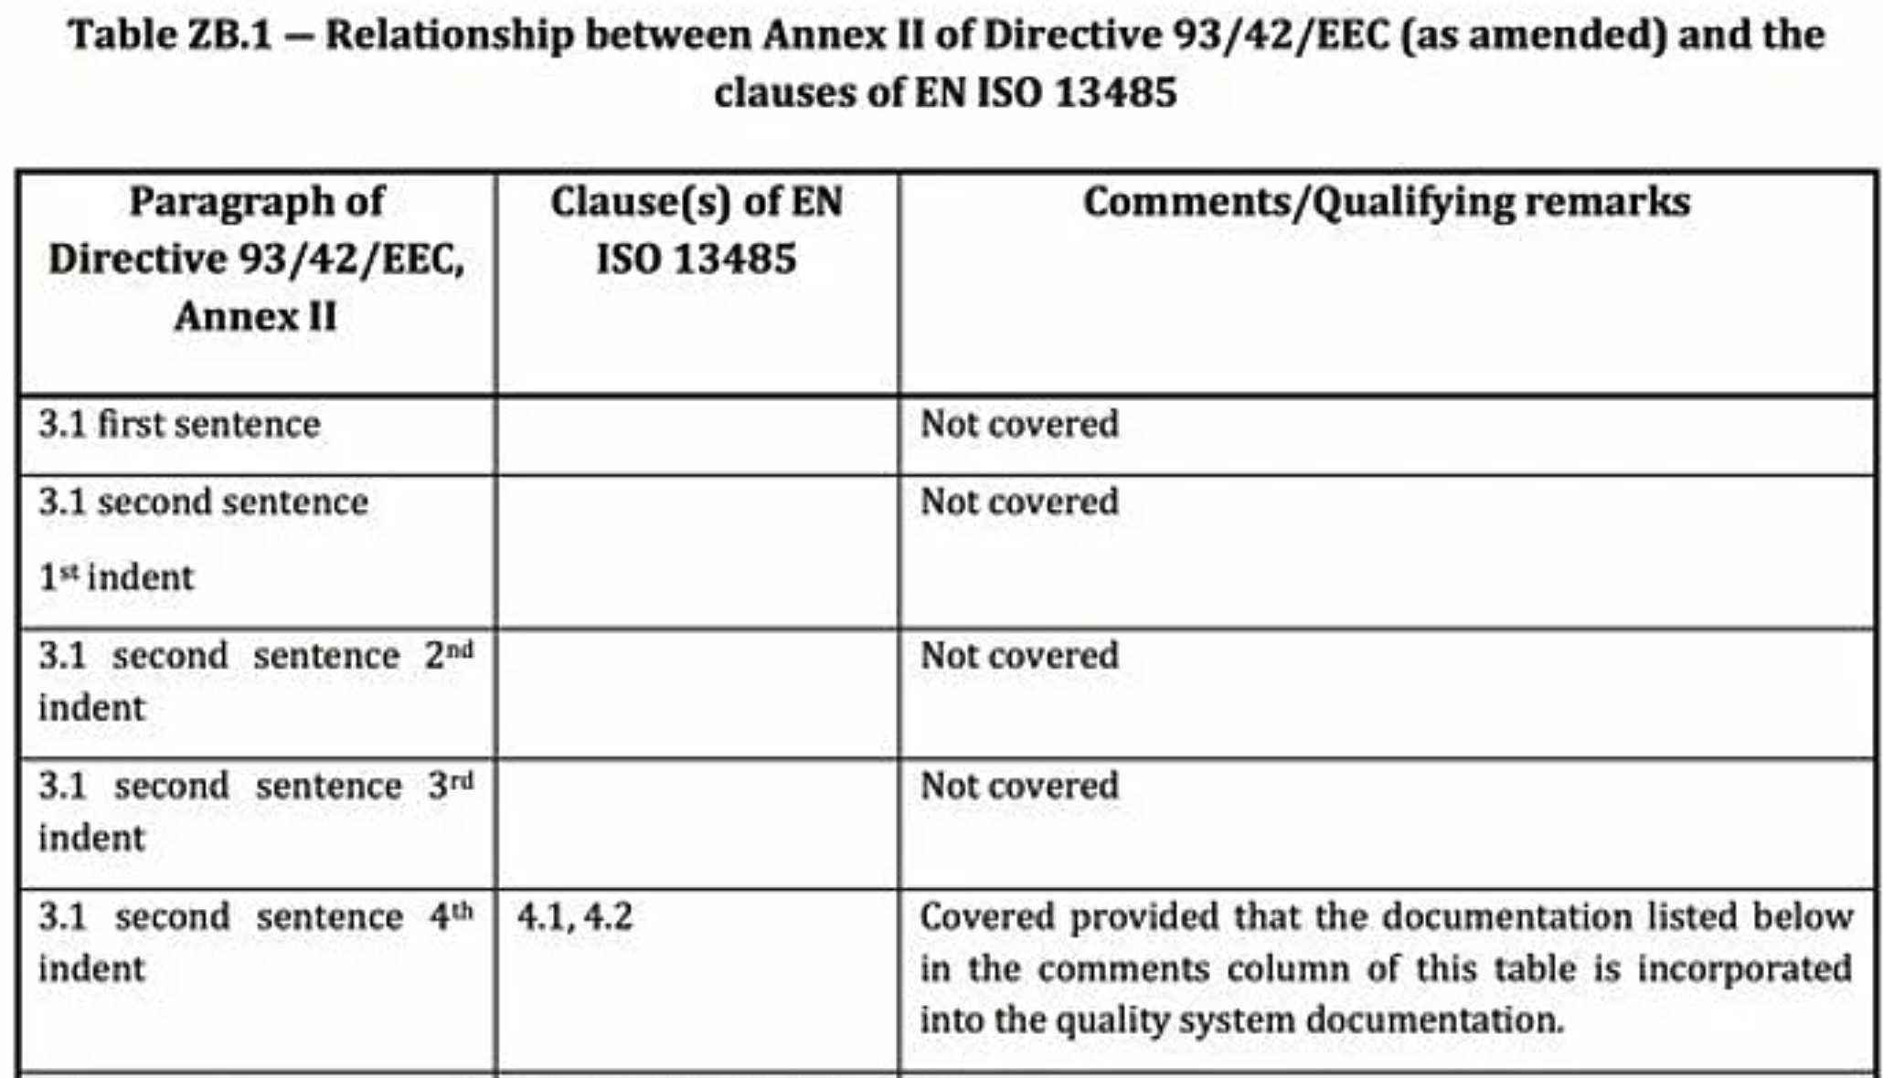
Z Annexe of ISO 13485

Slide 7
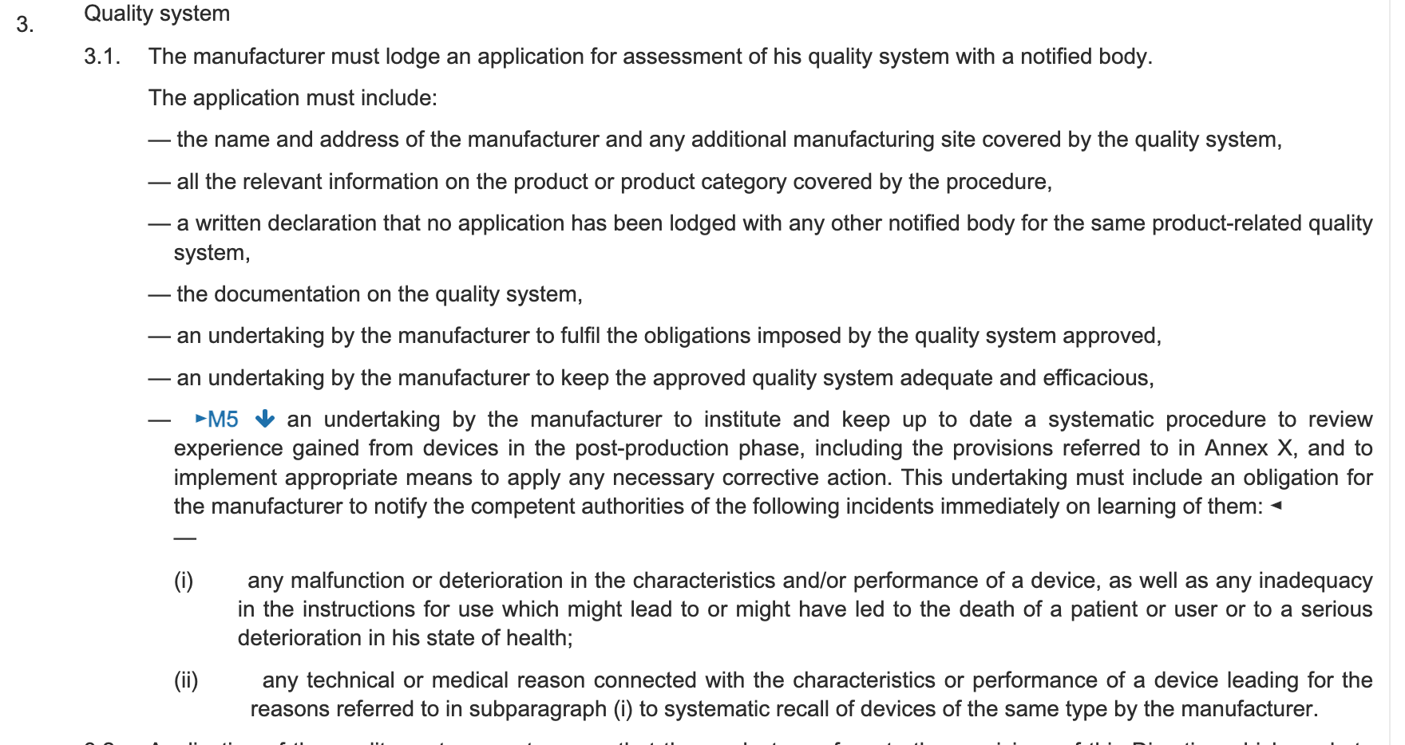
Council Directive 93/42/EEC

Slide 8
What Standards are necessary?
Regulation: If the developer of a product requires regulatory compliance to a European regulator, this will often be achieved by meeting a harmonized standard.
International standards reflect international consensus and this results in standards where compliance will allow considerable variation in implementation.
Regional: These capture the needs of particular regions. For example, at the moment the EU is considering how best to harmonize data protection for cross-border data flows that will likely result in a harmonized standard.
National: These are necessary to capture national difference. For example, there are differences in Medical Device approval between UK and EU.
Cross Reference: Standards cross-refer and influence each other – most standards will list relevant other standards.

Slide 9
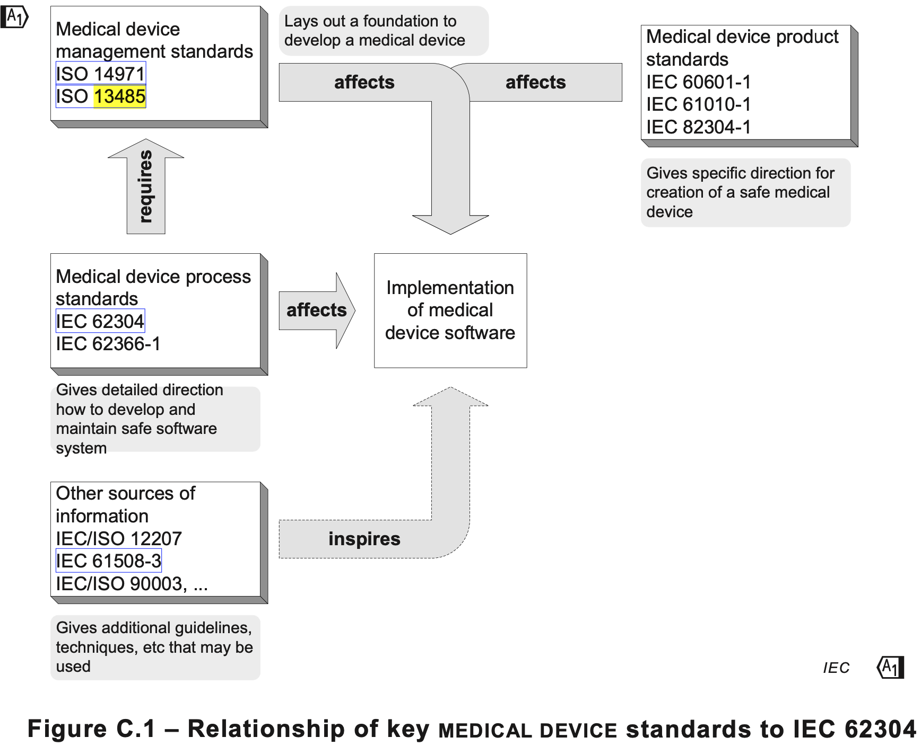

Slide 10
Deciding what standards are needed?
For many organisations standards adoption will be considered because:
  Standards capture good practice in the sector and demonstrating good practice can be important in mitigating product liability.
  Standards compliance can widen access to markets e.g. compliance to harmonized standards can give access to EU markets.
  Compliance can help expand market share. For example, compliance to sustainability standards can increase market share.
  Standards can contribute to interoperability of interoperating products.
Harmonization can make compliance essential to enter the market.

Slide 11

Product Liability

Slide 12
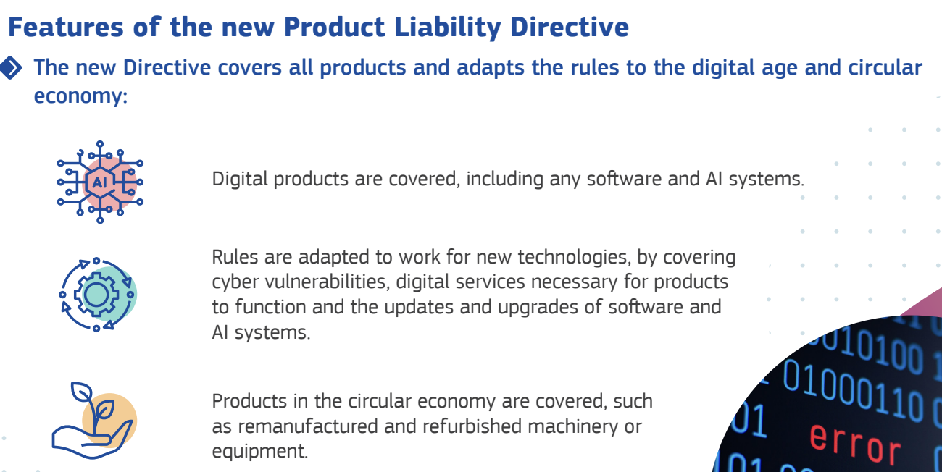
Liability covers digital

Slide 13
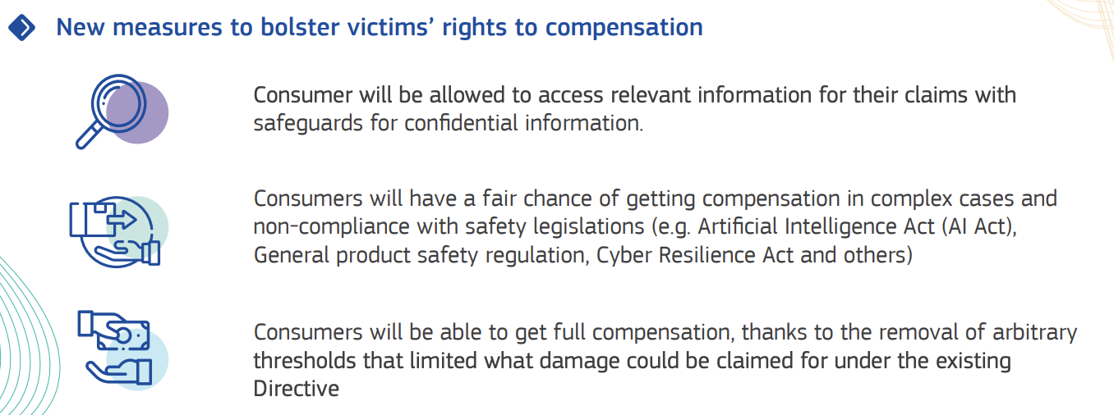
Liability arising from non-compliance

Slide 14
Checking for omissions and consistency
When considering a developing a product there are considerations that go beyond the immediate domain-specific standards. This may involve a considering the relevance of at least:
  Security
  Data Protection
  Product liability
  Safety
  Sustainability
  Accessibility
  Equity
  Transparency

Slide 15
Constraints on systems
Risk: DO 178C
Engineering:
  Interoperability: IEEE 802.11
  Architecture: AutoSAR
  Best practice in a domain will help define products that are recognized for quality.
    Many products are similar to existing products.
    This is often recognized by regulators.
    In the USA, the FDA has a Medical Device approval route named 510k that is based on establishing a product is similar to an already approved product.

Slide 16
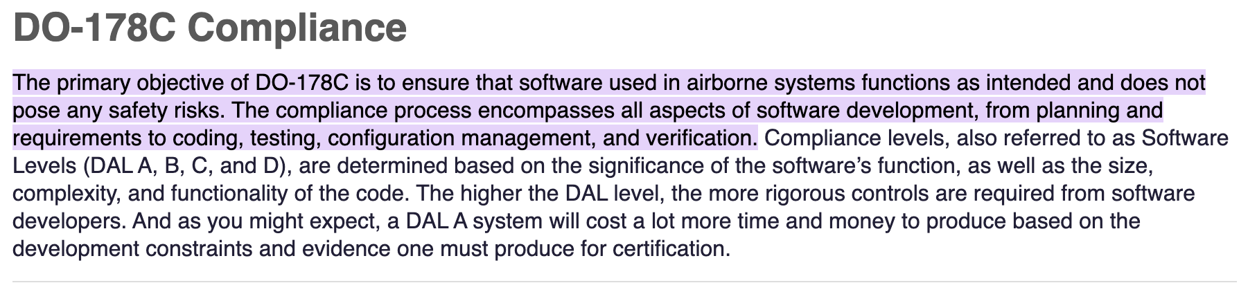
DO178 C
https://www.jamasoftware.com/blog/what-are-do-178c-and-ed-12c#:~:text=The%20primary%20objective%20of%20DO,%2C%20configuration%20management%2C%20and%20verification.

Slide 17
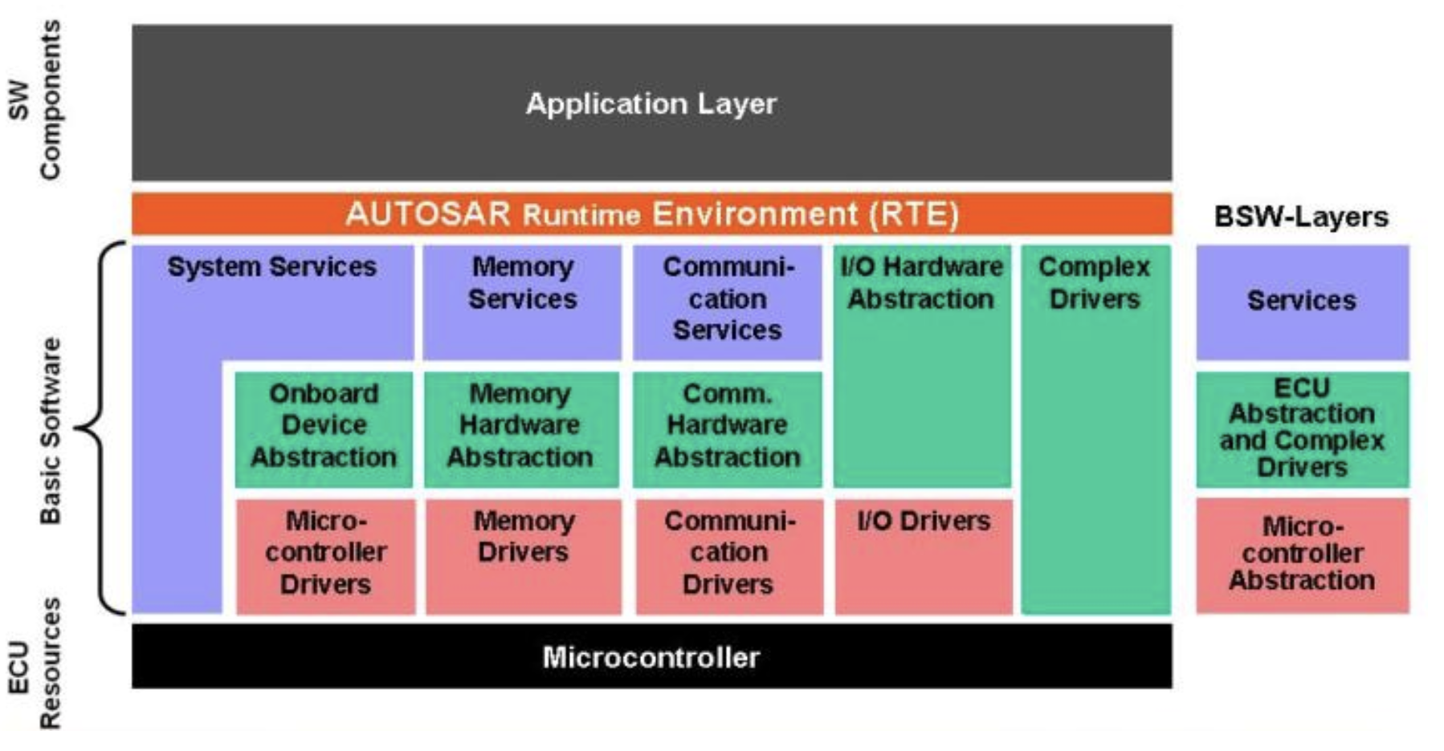
Autosar architecture
https://gi.de/informatiklexikon/autosar-the-standardized-software-architecture

Slide 18
Product Related Constraints on Systems
Compliance to Data Standards: DICOM, JSON, HTML, …
Compliance to Coding Standards: MISRA C
Compliance to other National/Local Law e.g. Equality act.

Slide 19

DICOM
https://www.dicomstandard.org/about

Slide 20
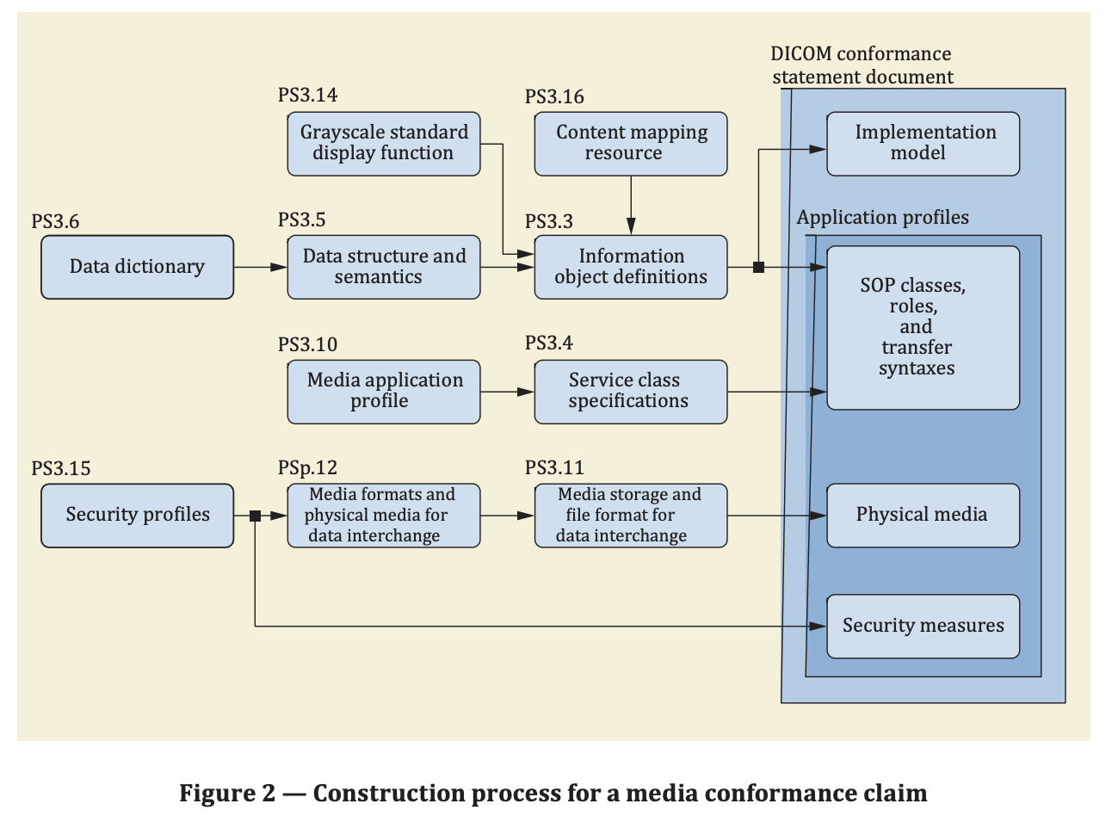
DICOM Conformance

Slide 21
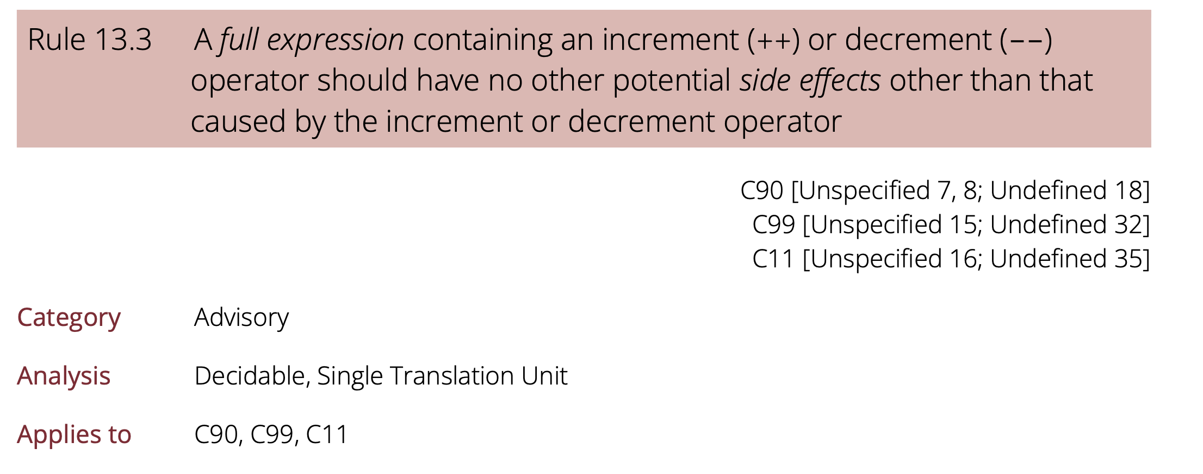
Typical MISRA-C constraint

Slide 22
Process Related constraints on systems
Specific roles and responsibilities: AI roles described in ISO 42001
Lifecycle stages: ISO 15288: Systems and software engineering — System life cycle processes
Process standards
  Risk Management: ISO 14971 for medical devices
  Quality Management: ISO 13485 for medical devices

Slide 23
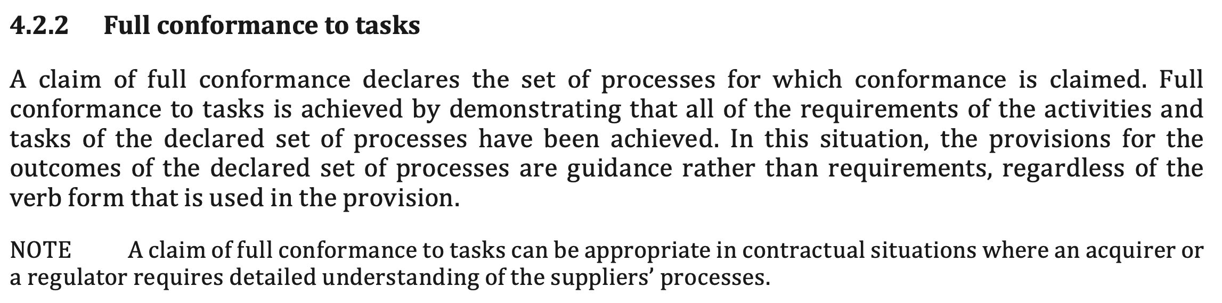
BS ISO/IEC/IEEE 15288

Slide 24
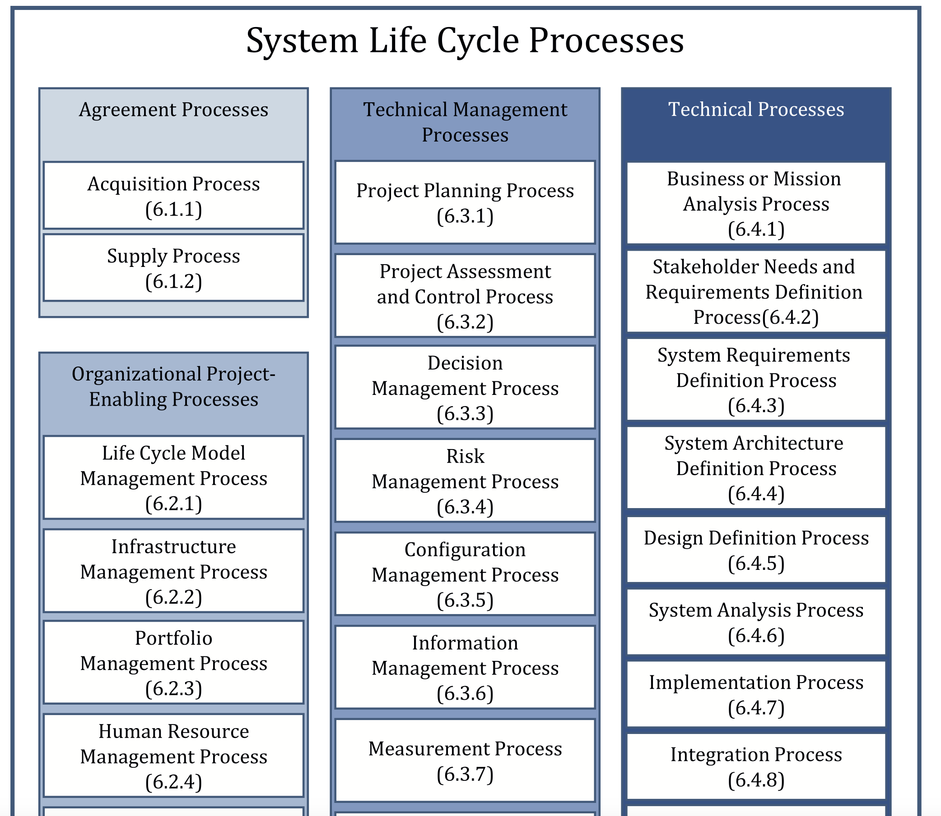
BS ISO/IEC/IEEE 15288

Slide 25
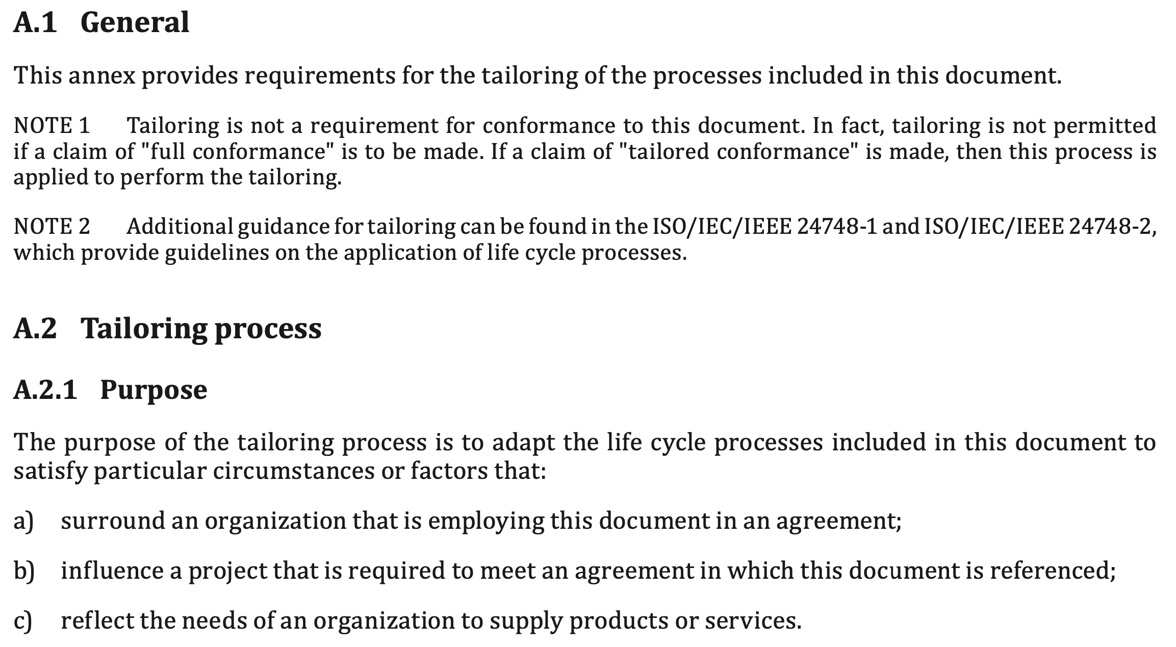
BS ISO/IEC/IEEE 15288

Slide 26
Summary
We have considered collections of standards.
How standards are interrelated.
How standards constrain products and processes.

