Slide 1
Final Year Projects
Notes:
Some people have been asking how to follow up on this course if this is an area you want to get into
Philosophy AI Ethics course, if your programme allows 20 credits of outsides
Policy internships
Within Informatics, you have two open ended project opportunities: SDP and your Honours Project
Going to talk about the honours project primarily, but these should all be examples for the kinds of thing you could work on in the future no matter where you go

Slide 2
Overview
Independent work, supported by regular supervision
Assessed via a thesis, double marked
Literature review
Methodology
Results
Discussion
Notes:
Informatics is a broad church, even if we don't count Design Informatics (who handle projects separately)
Projects should be built around some demonstration of technical competency
But the domain, and the extent to which you do more consideration/thought-based work around that, are very flexible
There can be extensive user community involvement, discussion of the wider implications of results, or limitations of a technology,
Or you can still do a very technically focused project and aim to solve a socially relevant problem, even one technology is causing

Slide 3
Process
Later this year, starting end of April
List of projects proposed by staff
Contact them, demonstrate suitability
Rank 5 "suitable" projects
https://homepages.inf.ed.ac.uk/hshimoda/proj/
Notes:
Informatics is a broad church, even if we don't count Design Informatics (who handle projects separately)
Projects should be built around some demonstration of technical competency
But the domain, and the extent to which you do more consideration/thought-based work around that, are very flexible
There can be extensive user community involvement, discussion of the wider implications of results, or limitations of a technology,
Or you can still do a very technically focused project and aim to solve a socially relevant problem, even one technology is causing

Slide 4
Self-Proposal
Earlier deadline
Have to find and convince a supervisor
Better odds in allocation
Notes:
Informatics is a broad church, even if we don't count Design Informatics (who handle projects separately)
Projects should be built around some demonstration of technical competency
But the domain, and the extent to which you do more consideration/thought-based work around that, are very flexible
There can be extensive user community involvement, discussion of the wider implications of results, or limitations of a technology,
Or you can still do a very technically focused project and aim to solve a socially relevant problem, even one technology is causing

Slide 5
Novelty
Not strictly expected of undergrads
Using an existing approach on a new problem
Developing a new approach to an existing problem
Notes:
Informatics is a broad church, even if we don't count Design Informatics (who handle projects separately)
Projects should be built around some demonstration of technical competency
But the domain, and the extent to which you do more consideration/thought-based work around that, are very flexible
There can be extensive user community involvement, discussion of the wider implications of results, or limitations of a technology,
Or you can still do a very technically focused project and aim to solve a socially relevant problem, even one technology is causing

Slide 6
How Will You Evaluate Success?
Approach/
Theoretical
Proof
Problem/
Practical
Experiment
Analysis
Acceptance
User Study
Impact
Notes:
Informatics is a broad church, even if we don't count Design Informatics (who handle projects separately)
Projects should be built around some demonstration of technical competency
But the domain, and the extent to which you do more consideration/thought-based work around that, are very flexible
There can be extensive user community involvement, discussion of the wider implications of results, or limitations of a technology,
Or you can still do a very technically focused project and aim to solve a socially relevant problem, even one technology is causing

Slide 7
Section Balance: Proof / Mathematical
Literature review
Methodology
Results
Discussion

Slide 8
Section Balance: Ideas / Discussive
Literature review
Methodology
Results
Discussion

Slide 9
Section Balance: ML Application
Literature review
Methodology
Results
Discussion

Slide 10
Section Balance: Design / User-Focused
Literature review
Methodology
Results
Discussion

Slide 11
Section Balance: Data Science / Analysis
Literature review
Methodology
Results
Discussion

Slide 12
Questions so far?

Slide 13
Projects in Ethical Tech
Notes:
Some people have been asking how to follow up on this course if this is an area you want to get into
Philosophy AI Ethics course, if your programme allows 20 credits of outsides
Policy internships
Within Informatics, you have two open ended project opportunities: SDP and your Honours Project
Going to talk about the honours project primarily, but these should all be examples for the kinds of thing you could work on in the future no matter where you go

Slide 14
Considerations
Still have to be Informatics projects
Somewhat at the mercy of the second marker
Helpful to focus on a specific kind of contribution/evaluation
Notes:
Informatics is a broad church, even if we don't count Design Informatics (who handle projects separately)
Projects should be built around some demonstration of technical competency
But the domain, and the extent to which you do more consideration/thought-based work around that, are very flexible
There can be extensive user community involvement, discussion of the wider implications of results, or limitations of a technology,
Or you can still do a very technically focused project and aim to solve a socially relevant problem, even one technology is causing

Slide 15
Thinking of Ideas
e.g. Vision for Good
Technical Skills
Social Good
e.g. Tools for Ethical AI

Slide 16
Narrowing Focus
New algorithms
Usefulness or impact
e.g. Vision for Good
Technical Skills
Social Good
e.g. Tools for Ethical AI
Extensive experiments
Ideas and discussion

Slide 17
Thinking of Ideas
Two possible directions:
Starting with technical topic and finding a "good" application:
Vision for Good
Starting with social / ethical problem and finding a solution
Tools for AI Ethics

Slide 18
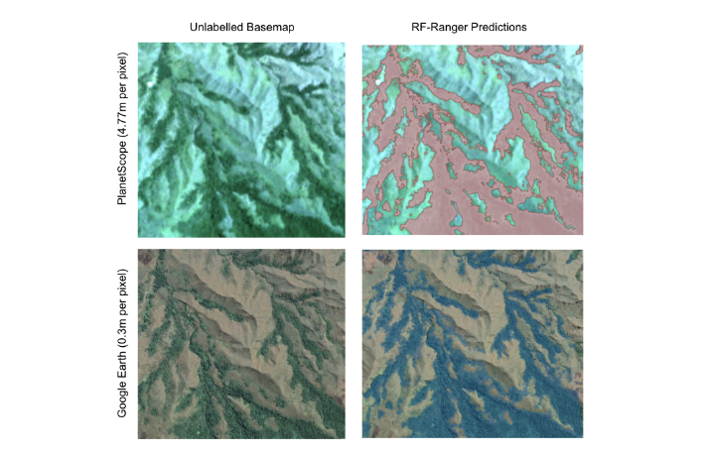
Vision for Good examples: Geospacial
Flood extent prediction
Monitoring forest restoration
Tree canopy modelling
Windthrow detection
Invasive species tracking
Machine Learning for Monitoring Forest Restoration (Mark Swan)

Slide 19
Machine Learning for Monitoring Forest Restoration (Mark Swan)

Slide 20
Improving on LiDAR data: tree canopy modelling (Adam Noach)

Slide 21
Vision for Good examples: Anti-AI AI
Detecting DeepFake images/video
Detecting satellite DeepFakes
Adversarial attacks, such as retrieving DNN training data

Slide 22
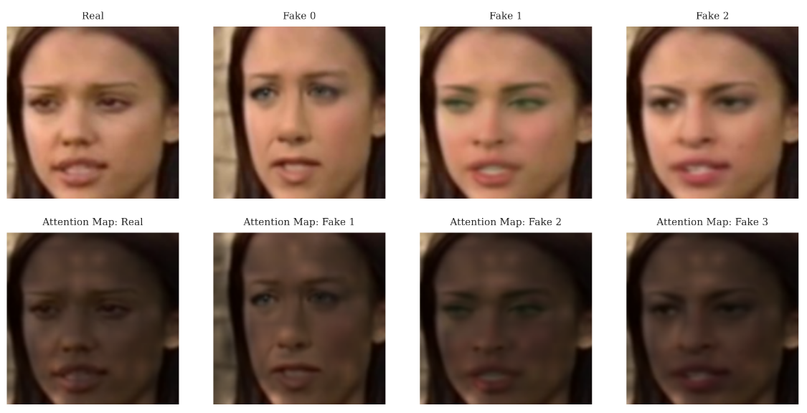
Deepfake Video Detection (Sakib Ahamed)

Slide 23
Robotics for Good examples
Soft robotic mannequin for diverse representation
Parameterising human shapes / robot actuation
Sensing soft component shape
Integrating robotic or virtual reality tools into education

Slide 24
Tools for Ethical AI examples: UI/UX
Collaborations with the Data for Children Collaborative
Ethics process management tools
DataCard creation tool

Slide 25
Tools for Ethical AI examples: Auditing
Detecting and mitigating racial bias in visual datasets
Long-run simulations for investigating algorithmic bias
Links between social media and public sentiment or economy

Slide 26
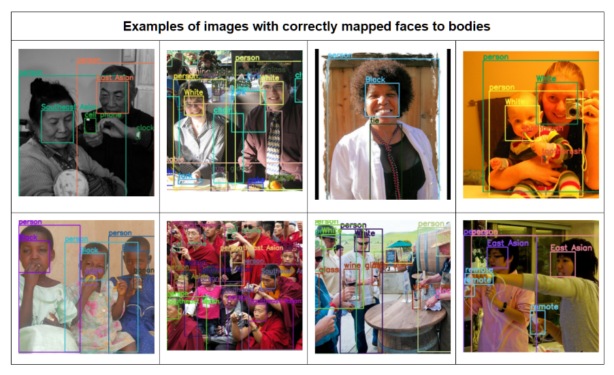
A Semi-Automated Tool for Detecting and Mitigating Racial Bias in Visual Datasets (Liana Mostafa)

Slide 27
Tools for Ethics Education
Case study database (UI)
Essay topic modelling (ML)
Curriculum development (Ideas/Discussion)

Slide 28
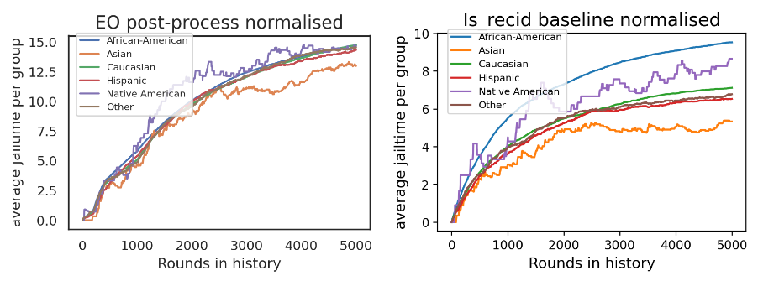
Enriching Long-Run Simulations for Investigating Algorithmic Bias (Fiona Meltzer)

Slide 29
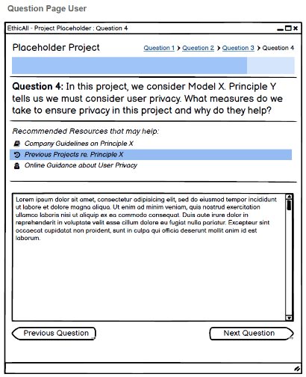
EthicAll Review (Ben McCafferty)

Slide 30
What now?
Plenty of time, so no need to rush
Have an explore of what research has been done in areas you're interested in (Google Scholar)
Chat to me, find a potential supervisor

Slide 31
Questions?

