Slide 1
Introduction to Algorithms and Data Structures
Quicksort and limitations of sorting algorithms

Slide 2
The Quicksort algorithm
Mergesort was based on the Merge procedure for joining the sorted sub-arrays into a sorted array.
Quicksort first divides the array into two parts
the low side and the high side,
such that the low side contains smaller elements than the high side.
This is done via the Partition procedure.
Then it calls itself recursively.
The two parts are joined, but this is trivial.

Slide 3
Mergesort vs Quicksort Philosophy
Mergesort
The splitting into two parts is trivial.
The combining of the two parts is based on the Merge procedure.
Quicksort
The splitting into two parts is based on the Partition procedure.
The combining into two parts is trivial.

Slide 4
The Partition procedure
2
8
7
1
3
5
6
4
8
Two pointers, red and blue.
Sometimes we will swap the element $e_{r}$ pointed by red with the element $e_{b}$ pointed by blue.
In particular when $e_{r}≤$ pivot
Red is incremented in every step, blue is incremented only if a swap has taken place.

Slide 5
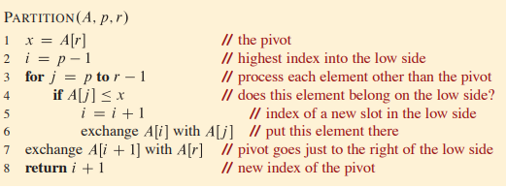
The Partition procedure
CLRS pp 184
What is the running time of partition?
Running time O(n)

Slide 6
Correctness of Partition
Loop invariant: Everything $<$ than $e_{b} \text{is}≤$ pivot Everything $≥$ $e_{b }$and $<$ $e_{r}$ $\text{is}$ $>$ pivot
Details: CLRS 7.1

Slide 7
The Partition procedure
2
8
7
1
3
5
6
4
8
Loop invariant: Everything $<$ than $e_{b} \text{is}≤$ pivot Everything $≥$ $e_{b }$and $<$ $e_{r}$ $\text{is}$ $>$ pivot

Slide 8
The Quicksort algorithm
2
8
7
1
3
5
4
Sort this using
Quicksort
Sort this using
Quicksort
Algorithm Quicksort(A[i,…,j]) y = Partition(A[i,…,j]) Quicksort(A[i,…,y-1]) Quicksort(A[y+1,…,j])

Slide 9
Running time of Quicksort
Can it be as fast as Mergesort?
Can it be slower than Mergesort?
Can it be faster than Mergesort?
This will depend on the pivot element!

Slide 10
Running time of Quicksort
Mergesort: T(n) ≤ 2T(n/2) + cn
Quicksort: T(n) ≤ T(n1) + T(n2) + cn
When n1 = n2 , the running time is the same as Mergesort.
What is the worst possible running time?

Slide 11
Running time of Quicksort
Consider the case where we have an unbalanced partitioning in every step. n1 = n-1 n2 = 0
We get T(n) = T(n-1) + cn
What is the solution to this recurrence?
T(n) = Θ(n²)

Slide 12
Why “Quick”sort?
Think about it: What is the running time when we have a 9 to 1 split?
Consider the average case:
i.e., every possible of the n! possible input arrays appears with the same probability.
Some calls will be reasonably well-balanced, some will be fairly unbalanced.
In fact, about 80% of the splits will be reasonably well-balanced.
What does that mean? A 9 to 1 split.
The average case running time of Quicksort is Θ(n lg n).

Slide 13
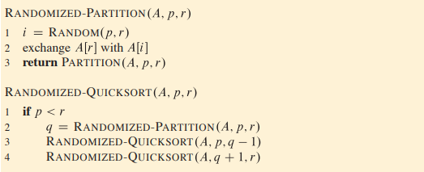
Randomized Quicksort
The average case gives us an idea: What if we choose the pivot element at random?
CLRS pp 192
The expected worst case running time of Quicksort is Θ(n lg n).

Slide 14
Back to the worst case
Can it be as fast as Mergesort? Yes
Can it be slower than Mergesort? Yes
Can it be faster than Mergesort? ??

Slide 15
Lower bound for (comparison-based) sorting
We will prove that no algorithm that is based on performing comparisons between the elements of the array can not run in time asymptotically faster than n log n
In other words, we will prove that for any such algorithm, the running time is Ω(n log n).

Slide 16
Lower bound for (comparison-based) sorting
Is a1 < a2 ?
No
Yes
Is a1 < a3 ?
Is a2 < a3 ?
a2 a1 a3
Is a2 < a3 ?
Is a1 < a3 ?
a1 a2 a3
a3 a2 a1
a2 a3 a1
a3 a1 a2
a1 a3 a2

Slide 17
Lower bound for (comparison-based) sorting
We need as many comparisons as the depth of the tree (length of the longest path from the root to the leaves).
The decision tree has n! leaves
A leaf is a permutation of {a1, a2, … , an}
Every possible permutation can appear as a leaf, since every possible permutation is a valid output.

Slide 18
Lower bound for (comparison-based) sorting
Fact: Every binary tree of depth d has at most 2^{d} leaves.
Therefore the minimum number of comparisons is log(n!)
We claim that log(n!) = Ω(n log n)
Why is that the case? Ideas?
log(n!) = log (1 * 2 * … * n) = log(1) + log(2) + … + log(n) ≥ log(n/2) + … + log(n) (half) ≥ log(n/2) + … + log(n/2) = (n/2) * log(n/2)

Slide 19
Proving lower bounds
Consider some criterion A that we would like to minimise (could be running time, memory, etc).
We want to find the best algorithm (asymptotically) for criterion A.
The best possible achievable performance is Θ(g(n)) for some function g(n).
Upper bound: We construct an algorithm that has performance O(g(n)) for criterion A.
Lower bound: We show that for any algorithm, the performance for criterion A is Ω(g(n)).

Slide 20
Proving lower bounds
The best possible achievable performance is Θ(g(n)) for some function g(n).
How do we find this function?
No easy answer!
We try to design algorithms which are as good as possible and when we feel that we can not improve more, we try to prove the matching lower bound.

Slide 21
Proving lower bounds
The best possible achievable performance is Θ(g(n)) for some function g(n).
We want to find the best algorithm (asymptotically) for criterion A.
This is only true if g(n) is not a constant function.
This is more relevant for approximation algorithms.

