Slide 1
Insurance and Digital Harm
Guest Lecture by Daniel Woods (University of Edinburgh)
Professional Issues Course (2024-2025)

Slide 2
What does personal cyber insurance covers?

Slide 3
What do we mean by cyber insurance?
Wind storm blows the roof of your building
Frenemy guesses iCloud password and steals personal photos
Smart fridge is turned off by malware, causing defreeze and food to go off
Flood destroys external hard drive storing personal photos
Source: Böhme, R., Laube, S., & Riek, M. (2019). A fundamental approach to cyber risk analysis. Variance, 12(2), 161-185.

Slide 4
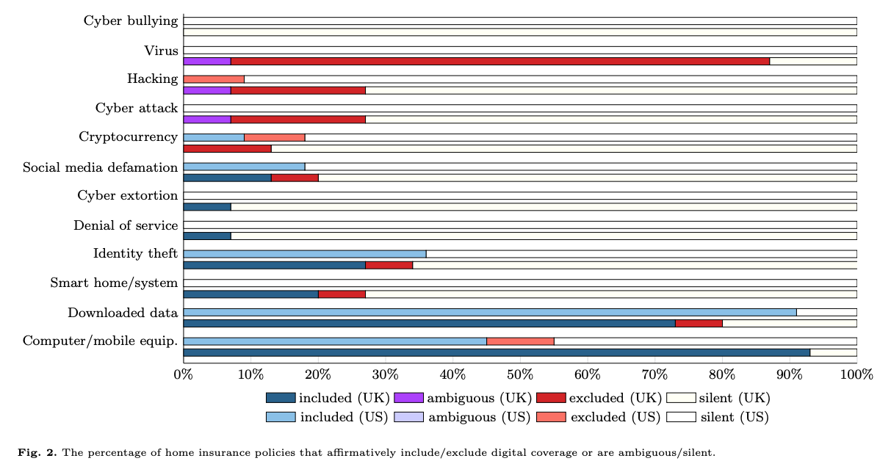
Does home insurance cover cyber losses?
Source: Jain, R., Hrle, T., & Woods, D. W. (2024). Insurance vs Digital Harm: A Content Analysis of Home and Cyber Insurance Policies in the US and UK. Available at SSRN 4731131.

Slide 5
High-Level Summary
Home insurance covers losses arising out of physical force
Even if it impacts information assets
Downloaded data, computer equipment etc included
UK home insurance excludes losses arising out of logical attacks
Even if it impacts physical assets
Virus, cyber attack, hacking etc excluded

Slide 6
What does personal cyber insurance cover?

Slide 7
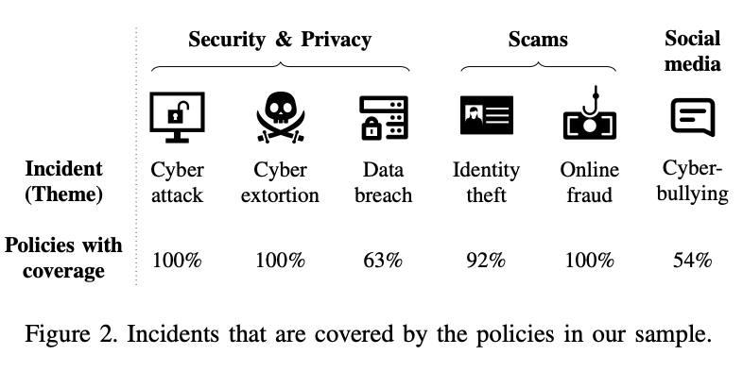
What does personal cyber insurance cover?
Source: Jain, R., Hrle, T., Marinetti, M., Jenkins, A., Böhme, R., & Woods, D. W. (2024, September). “Why would money protect me from cyber bullying?”: A mixed-methods study of personal cyber insurance. In 46th IEEE Symposium on Security and Privacy.

Slide 8
How would you evaluate personal cyber insurance?
… our study evaluated
Comprehensibility
Expected frequency/losses
Uncertainties about the product

Slide 9
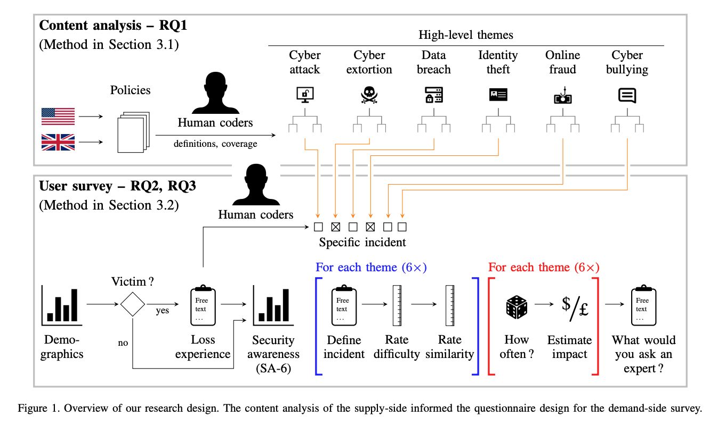
A user study on consumer cyber insurance
Source: Jain, R., Hrle, T., Marinetti, M., Jenkins, A., Böhme, R., & Woods, D. W. (2024, September). “Why would money protect me from cyber bullying?”: A mixed-methods study of personal cyber insurance. In 46th IEEE Symposium on Security and Privacy.

Slide 10
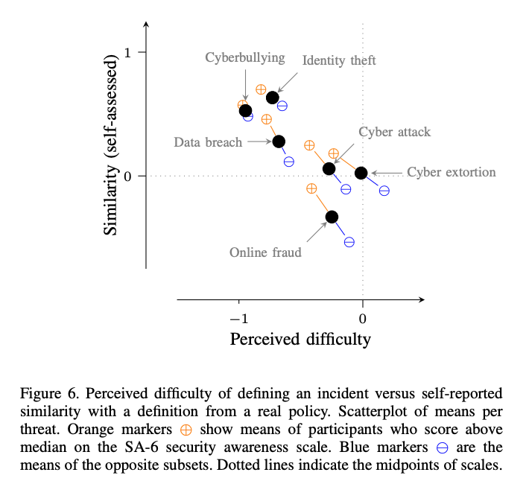
Do users understand cyber perils?
Source: Jain, R., Hrle, T., Marinetti, M., Jenkins, A., Böhme, R., & Woods, D. W. (2024, September). “Why would money protect me from cyber bullying?”: A mixed-methods study of personal cyber insurance. In 46th IEEE Symposium on Security and Privacy.

Slide 11
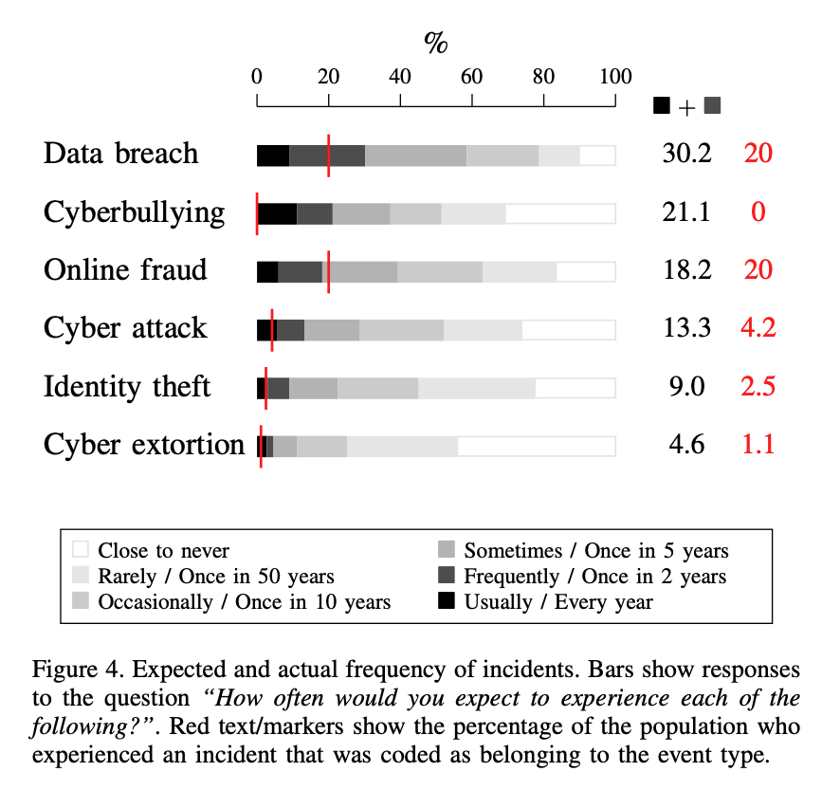
Expected frequencies of each cyber peril
Source: Jain, R., Hrle, T., Marinetti, M., Jenkins, A., Böhme, R., & Woods, D. W. (2024, September). “Why would money protect me from cyber bullying?”: A mixed-methods study of personal cyber insurance. In 46th IEEE Symposium on Security and Privacy.

Slide 12
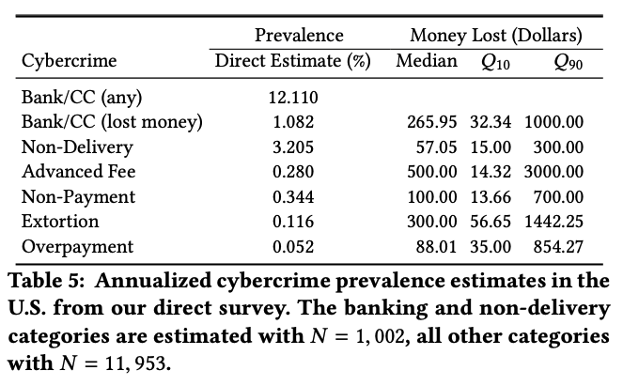
Are frequency estimates calibrated with crime statistics?
Source: Breen, C., Herley, C., & Redmiles, E. M. (2022, April). A large-scale measurement of cybercrime against individuals. In Proceedings of the 2022 CHI conference on human factors in computing systems (pp. 1-41).

Slide 13
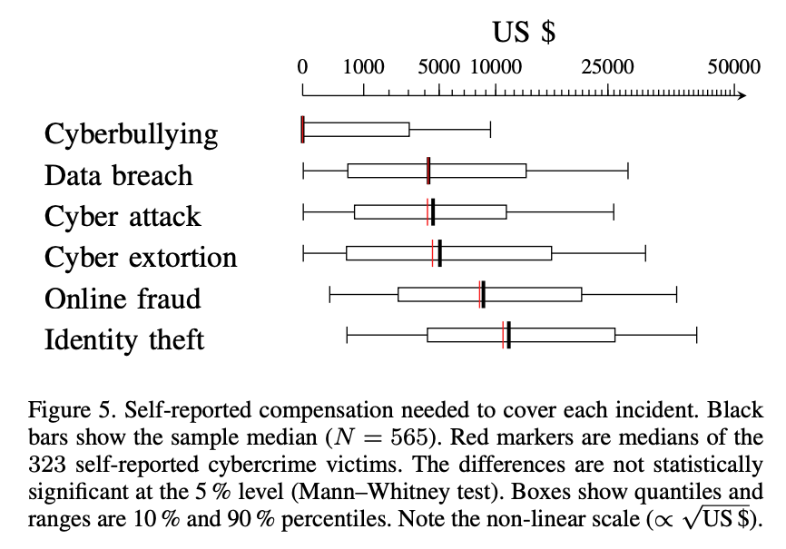
Expected impacts of each cyber peril
Source: Jain, R., Hrle, T., Marinetti, M., Jenkins, A., Böhme, R., & Woods, D. W. (2024, September). “Why would money protect me from cyber bullying?”: A mixed-methods study of personal cyber insurance. In 46th IEEE Symposium on Security and Privacy.

Slide 14
Are impact estimates calibrated with cybercrime statistics?
Source: Breen, C., Herley, C., & Redmiles, E. M. (2022, April). A large-scale measurement of cybercrime against individuals. In Proceedings of the 2022 CHI conference on human factors in computing systems (pp. 1-41).

Slide 15
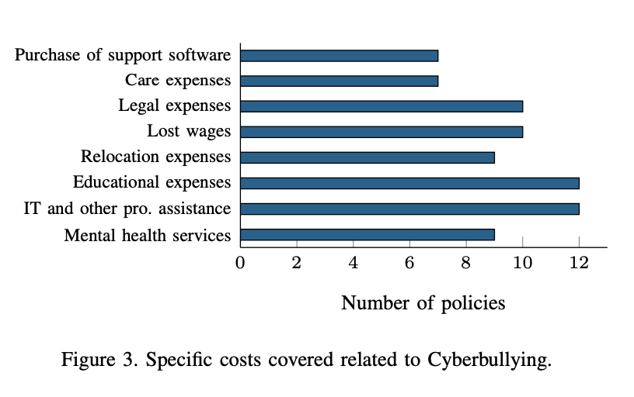
What is covered under cyber bullying?
Source: Jain, R., Hrle, T., Marinetti, M., Jenkins, A., Böhme, R., & Woods, D. W. (2024, September). “Why would money protect me from cyber bullying?”: A mixed-methods study of personal cyber insurance. In 46th IEEE Symposium on Security and Privacy.

Slide 16
What is covered under identity theft?
Source: Jain, R., Hrle, T., & Woods, D. W. (2024). Insurance vs Digital Harm: A Content Analysis of Home and Cyber Insurance Policies in the US and UK. Available at SSRN 4731131.

Slide 17
How responsible are users for risk prevention?
Cyber attack/extortion
Vulnerabilities introduced by software developers
Phishing/clicking links can be blamed on user
but usable security says the vendor is at fault
Data breach + identity theft
Almost entirely managed by companies
Cyberbullying
Managed by social media platforms + users
Online fraud
Some say users are at fault
UK Government changed the law to make sending/receiving banks jointly liable
… probably also depends on the scam?

Slide 18
What harms are not covered by cyber insurance?

Slide 19
Questions…

