Slide 1
Who’s Responsible for Responsible AI?
Fabio Tollon
University of Edinburgh
Centre for Technomoral Futures, Edinburgh Futures Institute
Unit for the ethics of technology, Stellenbosch University
Centre for AI research (CAIR), University of Pretoria
Notes:
45 min long, followed by 15 minutes of questions.

Slide 2
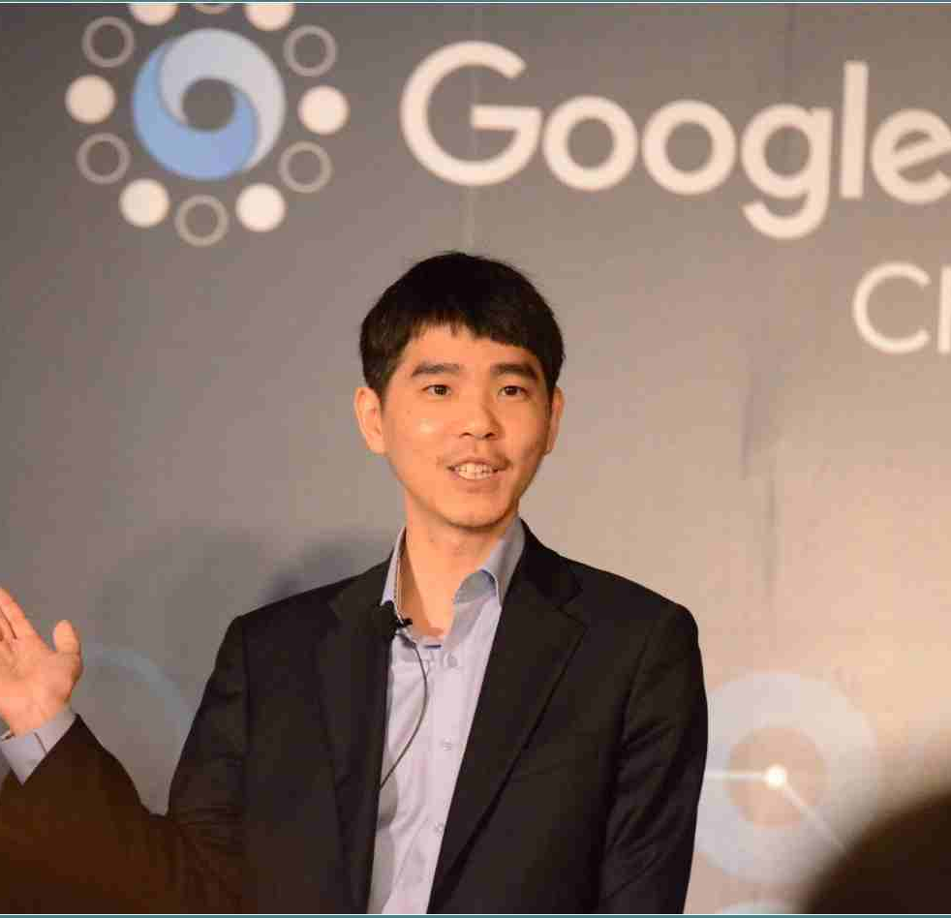
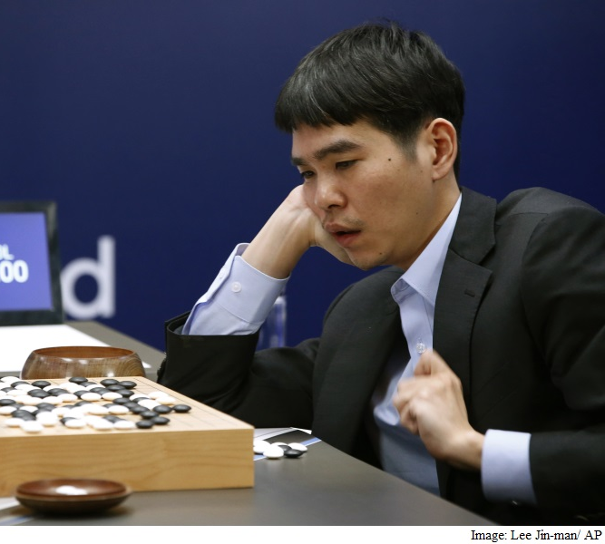
AlphaGo
In 2016 Lee Sedol was bested by AlphaGo, a computer program developed by DeepMind
AlphaGo had been “training” before the match by playing games against itself
None of the humans who developed the program were able to understand the strategies of AlphaGo on the day of the match
Who, if anybody, should receive credit (praise?) for the victory over Lee Sedol?
Notes:
In the “Google DeepMind Challenge Match” in South Korea in March of 2016, the 18-time world champion of the sophisticated board game Go, Lee Sedol, faced off against AlphaGo, a computer program developed by Google DeepMind. Lee Sedol won the fourth out of five games. But all four other games were won by AlphaGo. It had previously been thought that although computers can beat human chess players, it would be much more difficult or perhaps even impossible to create an artificially intelligent computer program that could beat humans at the ancient game of Go. AlphaGo proved that to be wrong.
Notably, the computer program had been “training” in preparation for the game by playing numerous games against itself. Once it was time for the match, none of the humans who had developed the computer program were able to understand the strategies of AlphaGo. A human performed the part of moving the pieces on the board around. But this person did so on the basis of instructions from AlphaGo, without knowing exactly why the computer program wanted to make those particular moves.
2018 Elaine Herzberg became the first pedestrian to be involved in a fatal accident with an Uber self-driving car in 2018. First the image recognition system in the car classified Herzberg as a road sign, then as a bike (she was walking with a bicycle), then as a person – and then it kept going back and forth between different classifications (Keeling 2020). No appropriate action was taken – the car did not break – and the human “safety driver” in the car also did not notice Herzberg in time. The result was that neither the artificial intelligence in the car, nor the human safety driver, stopped the car in time, and the car ran into Herzberg. She sustained deadly injuries and died in the ambulance on the way to the hospital. Who was to blame for this? The safety driver in the car, the AI in the car, Uber, or who exactly
In the aftermath of the incident, Uber suspended all testing of its self-driving vehicles.
The fallout from the accident, however, is quite instructive. After Hertzberg’s death, there were numerous attacks on self-driving cars. In Chandler, Phoenix, for example, Waymo vans (a driverless car company owned by Google) have been thrown with rocks, had their tires slashed, and, in one case, had a man wave a firearm at the backup driver (Romero, 2018). In the latter case, the man specifically referred to Herzberg’s death as one of the reasons he “despises” self-driving cars (Romero, 2018). While it was clear that the autonomous car was causally responsible for the harm, the car itself cannot be held responsible in the full sense (due to it lacking certain capacities). However, there is still a worry that such an apportioning of responsibility would not satisfy many peoples retributive intuitions. The question then becomes how common these intuitions are, and how they ought to matter in our moral theorizing

Slide 3
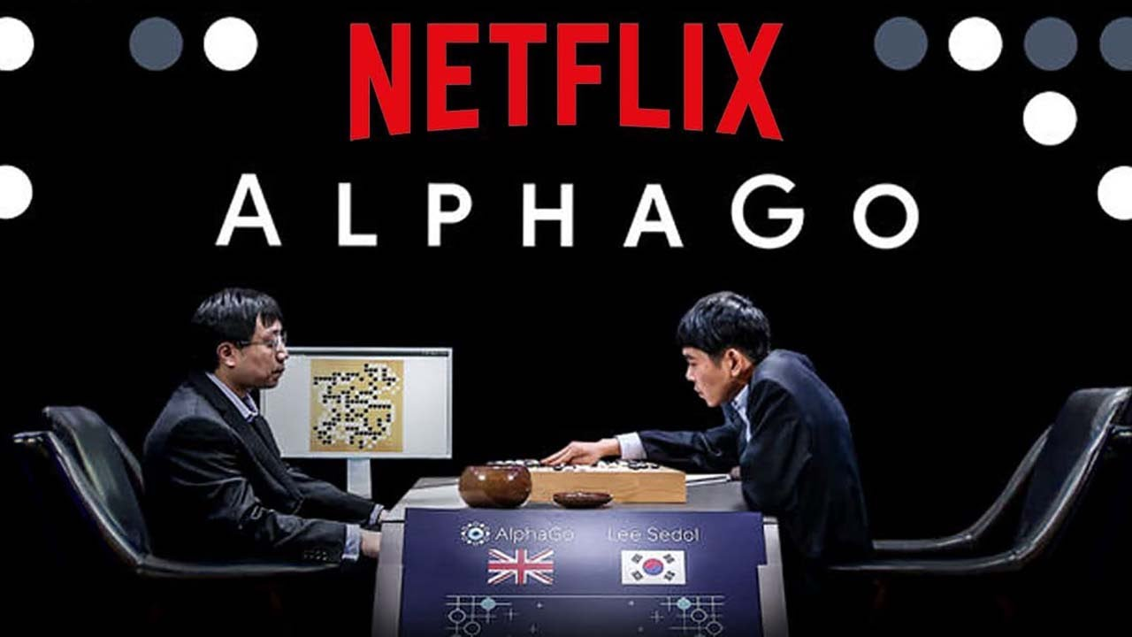
Notes:
We see who takes credit when things go RIGHT

Slide 4

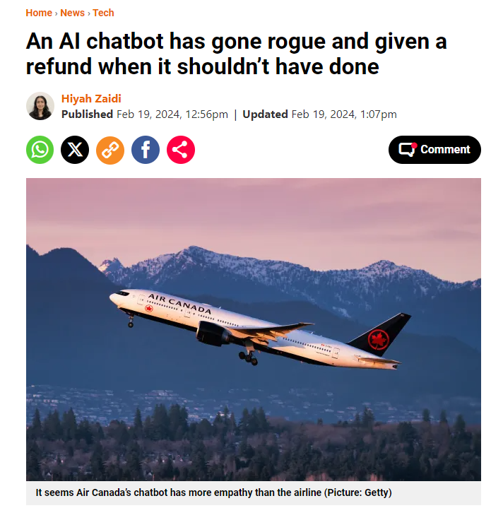
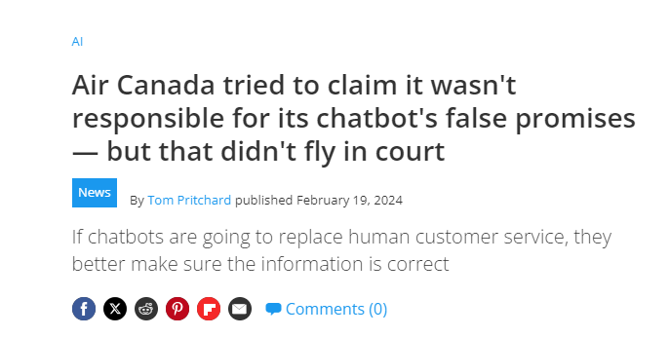
Notes:
And when things go wrong
#
In what could be a landmark case for the use of AI in business, Air Canada must pay for a man’s partial refund for his flight ticket – which the airline chatbot promised.
Jake Moffatt was flying to Toronto from Vancouver after the death of his grandmother in November 2022 and asked their airline’s AI support chatbot if it offered any bereavement fares – his ticket cost C$1,640 (£965).
The chatbot said the airline does offer discount fares and that he should book his ticket then request a refund within 90 days.
However, it seems the AI has more empathy than Air Canada. The airline’s actual policy does not include a post-flight refund and states that any discount must be approved beforehand.
‘Air Canada’s bereavement travel policy offers an option for our customers who need to travel because of the imminent death or death of an immediate family member,’ the site said.
‘Please be aware that our Bereavement policy does not allow refunds for travel that has already happened.’
Incredibly, during the civil tribunal, Air Canada argued that the chatbot is a ‘separate legal entity’ to the company and the airline could not be held responsible for its words to customers.
In a move that would give AI autonomy, the firm claims the airline is also not responsible for the information given by ‘agents, servants or representatives – including a chatbot’.
However, tribunal member Christopher Rivers said that the airline must follow through with the chatbot’s promised discount, as it committed ‘negligent misrepresentation’.

Slide 5
Responsibility Gaps and AI
Some suggest that there could be a ‘responsibility gap’ with respect to AI
Cases where we have some harm, and nobody to attribute responsibility to
How realistic?

Slide 6
What about some other cases?
Self-driving cars
Surgical robots
Autonomous Weapons

Slide 7
What’s the claim?
Seems to be something like this:
  Certain AI-systems undermine key conditions for responsibility
  Knowledge
  Control

Slide 8
Can we get around these issues?
Knowledge:
  Based on the assumption that there are ‘black box’ AI-systems
Control
  Based on the assumption that AI-systems can act autonomously

Slide 9
Resolution
We are often responsible for things that are outside of our control and that we lack knowledge of
I am responsible for my dog
If I drive over an animal, through no fault of my own, I am still responsible
But in what sense?

Slide 10
Responsibility as answerability
I have a responsibility to answer for what I have done
Justify/explain/offer apology/make an attempt to help
This is a more helpful way of understanding responsibility in the context of AI, and means we do not have to worry about ‘gaps’

Slide 11
‘Responsible AI’ VS ‘Responsibililty’
So we can tell one story of ‘who’s responsible’
What about ‘Responsible AI’?
Lack of a clear understanding of what ‘Responsible AI’ (R-AI) means
R-AI used by many different stakeholders from different disciplines and sectors, with different background assumptions about what ‘responsible’ means

Slide 12
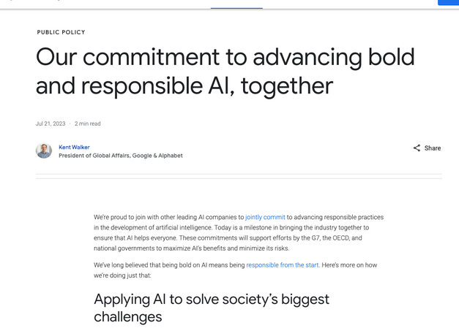

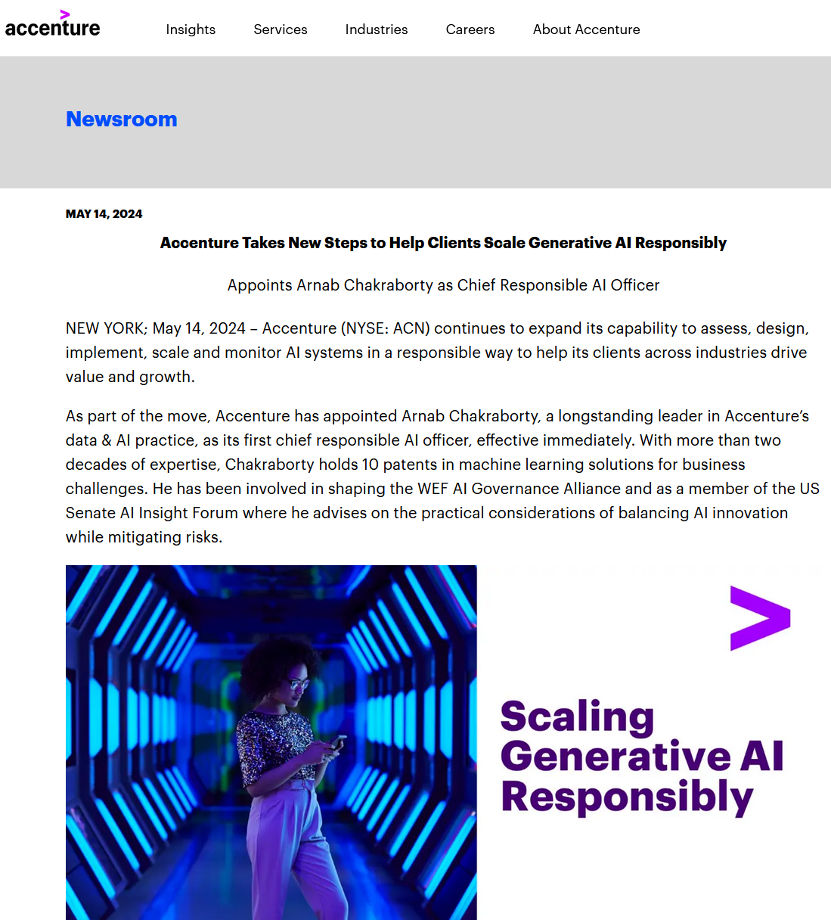


Slide 13
‘Responsible’
Something like ‘he is a responsible parent’
Takes care, is patient, attentive, etc.
Applied to AI?
  AI development and deployment that is fair, transparent, accountable, explainable, etc.

Slide 14
‘Responsible’ AI?
Discussions surrounding the ‘responsible’ use, development, and deployment of AI-systems have received widespread treatment in academic literature as well as policy documents
Governments, individuals, policymakers, and academics have all taken a keen interest in contributing to this debate.
Responsible AI (R-AI) has emerged as a frame for this collective enterprise, and while it remains hugely popular and influential, at base there is conceptual uncertainty as to its proper meaning

Slide 15
Purposes of R-AI
Wielded by:
  Industry to project an image of trustworthiness and safety
  Government bodies and agencies to define the aims of AI policy, investment, and regulation;
  Civil society organisations to demand accountability and redress for AI-driven harms
Diverse range of stakeholders assert material, moral, and political authority on how the term is used

Slide 16
Emergence of R-AI
An interdisciplinary field of academic/industry research
A stated governance agenda
A desired type of AI product
A broad community or ecosystem of stakeholders

Slide 17
R-AI is an interdisciplinary field of academic/industry/NPO research
FAccT, AIES, etc.
Non profits (AI Now Institute, Ada Lovelace Institute, Alan Turing Institute)
To be engaged in ‘responsible’ AI is to be engaging across academic and industry boundaries, with different kinds of expertise coming together in the hope of tackling the potentially novel problems thrown up by AI

Slide 18
R-AI is a stated governance ambition
Google, Meta, OpenAI, Microsoft, as well as Accenture (to name but a few) all have all generated internal R-AI policy documents
‘Responsible AI’ here, then, is an aspiration that private companies aim to realize with internal processes and guidelines
Courtiers also put forward their own guidelines (eg. US RMF), as well as multinational organizations (UNESCO)

Slide 19
R-AI as a desired type of AI product
Responsible Research and Innovation (RRI), which has the explicit goal of fostering ‘responsible’ innovation processes in the service of socially desirable products
The sense of ‘responsible’ in RRI, then, is less about ‘who’ or ‘what’ is responsible for some outcome, but rather centres on questions of the specific technology under consideration
‘Responsible’, here, means that the product is likely to produce an impact that is ‘socially benign’ or ‘socially beneficial’

Slide 20
R-AI is a broad community or ecosystem of stakeholders
The lack of a clear understanding of what R-AI means, and the different background assumptions of the multiple stakeholders involved in R-AI, demonstrate that there is an urgent need to bring some order to this debate, and ensure the concept can do the work for society that we need it to do

Slide 21
What do we want R-AI to do?
Ecological model of R-AI
  Aims at a future in which responsibility appropriately infuses and guides the complex interaction between communities and stakeholders, and the planetary and social impacts of AI-systems
  Normative aim of social and moral health: flourishing

Slide 22
Guiding Questions
Who are the different communities and interests that constitute the R-AI ecosystem?
What does ‘Responsible AI’ mean to these different actors and communities, and what concept(s) of ‘responsibility’ anchor it?
Why do we need R-AI – what are the ends/goals/aims that a flourishing R-AI ecosystems/community would realize?

Slide 23
Implications
There is no ‘thing’ that we can call responsible AI
Rather, it is a set of communities and practices
These communities all hang together and influence each other
We need to see R-AI in this light: as an ecosystem

Slide 24
Responsible and Ethical
Responsible: inherently positive
Ethics: an open-endedness and undecidedness
  ‘AI ethics’, therefore, has a far broader remit than R-AI, and is concerned with more foundational questions, such as what it means to be human in the face of AI. These are questions that private companies might not have an interest in answering (or asking ).
Notes:
One possible reason for why the R-AI frame made sense from a business perspective is, as mentioned in the introduction, its inherent, positively valanced normativity. To do work on AI in a ‘responsible’ manner is good, and further questioning regarding the nature of that good, its specific content, how it might relate to practice, etc. can be left undefined.
‘Ethics’, by contrast, suggests an open-endedness and undecidedness that ‘responsible’ does not. When we do ethics, we are, for example, trying to figure out the difference between right and wrong, how to live a good life, and what we mean by ‘justice’. These are not questions that are easy to answer, and sometimes we would do well to admit that our questions themselves might be misguided in some important way. ‘AI ethics’, therefore, has a far broader remit than R-AI, and is concerned with more foundational questions, such as what it means to be human in the face of AI. These are questions that private companies might not have an interest in answering (or asking ).

Slide 25
Conclusion
For AI and responsibility gaps: Focus less on who we need to blame, rather who needs to answer for the system
For R-AI: See R-AI as an ambition and a process, not as a problem to be solved
Taking these two points together we can build and sustain a responsible configuration of AI in society

Slide 26
THANK YOU!
Questions/Discussion ftollon@ed.ac.uk

Slide 27






