Slide 1
Guidance on Essay Writing
Professional Issues 2025 – Week 2
Lara Dal Molin
Science, Technology and Innovation Studies ¦ Social Data Science
University of Edinburgh & University of Copenhagen

Slide 2
Overview
Essay ingredients: basics
Essay ingredients: Essay 1
The Project
A good introduction
The Essay
Making an argument

Slide 3
What are the ingredients of a good essay?
Please use the next 5 minutes to discuss this with your neighbour.

Slide 4
Essay Ingredients: Basic
Introduction
Body paragraph
Body paragraph
Body paragraph
[add body paragraphs as needed]
Conclusion

Slide 5
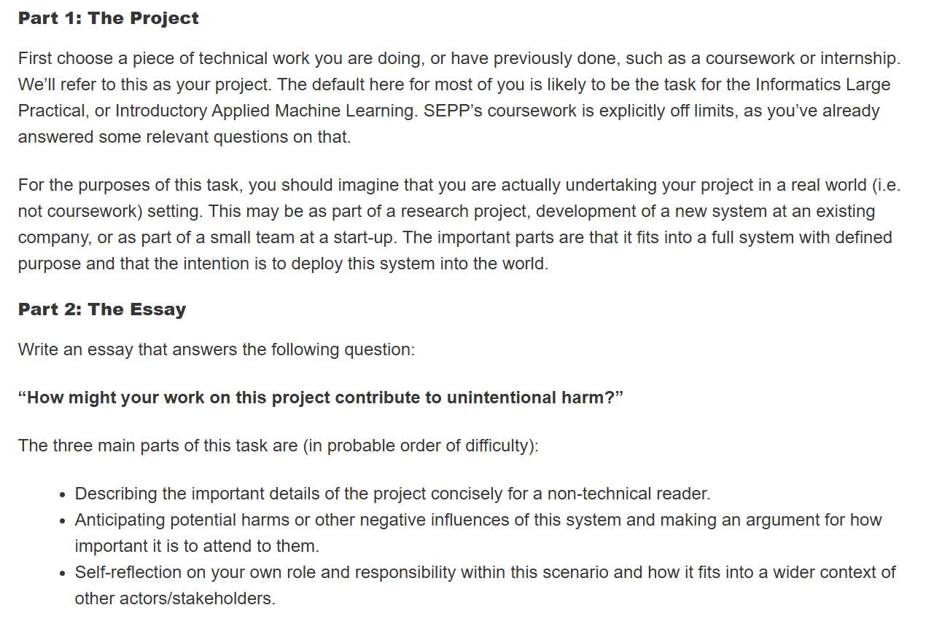
Professional Issues: Essay 1
“Identifying Professional Considerations”
Two sections: The Project & The Essay
1000 words
The sections can be explicitly separate but should still flow together

Slide 6
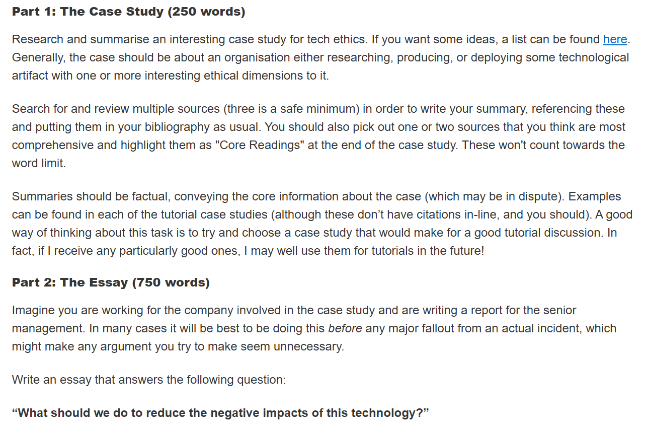
Professional Issues: Essay 2
“Advocating Professional Interventions”
Similar structure to Essay 1: two sections
1000 words: 250 and 750
Perhaps we can take inspiration from the structure of Essay 2 for Essay 1...

Slide 7
Essay Ingredients: Essay 1
The Project (200-250 words)
  Summary of the selected piece of technical work
The shorter and more concise “The Project”, the more wordcount for “The Essay”!
The Essay (750-800 words)
  Details of project for non-technical readers
  Anticipating harms and making an argument for how important it is to address them
  Self-reflection on your role and responsibility

Slide 8
Essay Ingredients: Essay 1
The Project (200-250 words)
  Summary of the selected piece of technical work
  in a way that is understandable to non-technical audiences
The shorter and more concise “The Project”, the more wordcount for “The Essay”!
The Essay (750-800 words)
  Details of project for non-technical readers
  Anticipating harms and making an argument for how important it is to address them
  Self-reflection on your role and responsibility

Slide 9
Essay 1: The Project
200-250 words
Introducing and summarising a project you’ve worked on
Use terminology that is understandable to non-technical audiences and define keywords and key terms!
  E.g. “I worked on an OCR system” -> “I worked on an Optical Character Recognition (OCR) system that digitises handwritten text”
  E.g. “I built an agent-based simulation” -> “Through a game engine, I built a virtual environment that simulates the interactions of single individuals”
Top marks: briefly outline which part(s) or section(s) of the project you will discuss in The Essay

Slide 10
A Good(ish) Introduction
Mirror Prompting: A Design Justice-Inspired Approach to Studying Gender Bias in Large Language Models through Prompt Engineering
This contribution illustrates Mirror Prompting, a community-oriented approach to investigating gender bias in Large Language Models (LLMs) through prompt engineering. This study borrows the mirror metaphor from [Vallor 2024] to describe how LLMs reproduce gender bias and to frame the reflexive exercise through which study participants confronted that bias. Inspired by the Design Justice framework, Mirror Prompting proposes a workshop-based setting where community members co-design prompts for an open-source LLM, observe its responses live and critically investigate the gender stereotypes it reproduces. This paper describes four workshops conducted at the University of Edinburgh and a fifth at the 2024 Scottish AI Summit, for a total of 50 participants. Findings describe participants' narratives of the exercise, their process of constructing meaning around the model, the approaches to prompt engineering they designed, the methods they devised to investigate gender bias in artificially-generated text, the themes they explored while prompting and their observations on the model's behavior. The paper then thematically analyses these through the theoretical lenses of Symbolic Interactionism in Science and Technology Studies. Overall, Mirror Prompting attempts to subvert deterministic narratives on LLMs through grounding user agency in community-building, establishing these as forms of resistance to algorithmic bias.
The What
Terminology
The What
The How
Essay Outline
The Why

Slide 11
A Good Introduction
What are you writing about?
Why are you writing about it?
Define key terminology
How are you going to write about it?
(this is a good time to mention any examples/case studies you will use)
Essay outline
Re-iterate key concept

Slide 12
Essay Ingredients: Essay 1
The Project (200-250 words)
  Summary of the selected piece of technical work
  in a way that is understandable to non-technical audiences
The shorter and more concise “The Project”, the more wordcount for “The Essay”!
The Essay (750-800 words)
  Anticipating harms and making an argument for how important it is to address them
  Self-reflection on your role and responsibility

Slide 13
Essay Ingredients: Basic
Introduction
Body paragraph
Body paragraph
Body paragraph
[add body paragraphs as needed]
Conclusion
The Essay (750-800 words)
  Anticipating harms and making an argument for how important it is to address them
  Self-reflection on your role and responsibility

Slide 14
Essay Ingredients: Essay 1
Introduction
Body paragraph – harm 1
Body paragraph – harm 2
Body paragraph – self-reflection
[conclusion]
The Essay (750-800 words)
  Anticipating harms and making an argument for how important it is to address them
  Self-reflection on your role and responsibility

Slide 15
Essay Ingredients: Essay 1
Introduction
Body paragraph – harm 1
Body paragraph – harm 2
Body paragraph – self-reflection
[conclusion]
The Essay (750-800 words)
  Anticipating harms and making an argument for how important it is to address them
  Self-reflection on your role and responsibility
Body paragraphs should be organised thematically.
This means that each body paragraph should have a different theme/topic.
Do you struggle with staying on-topic?
Use subtitles and paragraph headings!

Slide 16
The Missing Ingredient
The Project (200-250 words)
  Summary of the selected piece of technical work
  in a way that is understandable to non-technical audiences
The shorter and more concise “The Project”, the more wordcount for “The Essay”!
The Essay (750-800 words)
  Anticipating harms and making an argument for how important it is to address them
  Self-reflection on your role and responsibility

Slide 17
What is the difference between a judgement, an opinion and an argument?
Please use the next 5 minutes to discuss this with your neighbour.

Slide 18

Judgements, Opinions, Arguments
“Red socks are objectively better than green socks.”
“I prefer red socks over green socks.”
“In the context of cotton socks, some studies on textiles [references] suggest that red tints tend to soften and fluff up the fabric. Therefore, users may prefer red socks over green socks.”

Slide 19
An Argument…
The Essay (750-800 words)
  Anticipating harms and making an argument for how important it is to address them
Has a thesis
“I want to demonstrate that red socks are better than green socks”
Is supported by evidence
to be found in the scholarly literature on the topic and/or in the architecture or functionality of a particular system (sometimes in both)
  E.g. Large Language Models (LLMs) can reproduce gender stereotypes [references]. It is important to anticipate this potential harm in my shopping assistant chatbot as it may subject certain groups of users to upsetting/toxic stereotypes.
The argument and its evidence are presented step-by-step logically
A = B, B = C, therefore A = C.
It may highlight a limitation in your system
this is not a bad thing, but a natural part of being a computer scientist!

Slide 20
Self-reflection
“Self-reflection on your own role and responsibility within this scenario and how it fits into a wider context of other actors/stakeholders.”
“There are no harms in this system”
“There are no harms but if there were I wouldn’t be responsible”
“There are harms but I bear no responsibility”
“There are harms, I bear some responsibility but I cannot change things because I don’t have the power to do so”

Slide 21
Self-reflection
“There are harms, I bear some responsibility but I cannot change things because I don’t have the power to do so.”
This may be how some developers feel, in contexts in which they are solely rewarded to think about commercialisation and revenue
Perception of power VS reality of power
If you feel this way, this essay invites to think about where your power lies within this complex scenario

Slide 22
Questions?
Lara Dal Molin
l.dal-molin-1@sms.ed.ac.uk

