Slide 1
Final Year Projects
Notes:
Some people have been asking how to follow up on this course if this is an area you want to get into
Philosophy AI Ethics course, if your programme allows 20 credits of outsides
Policy internships
Within Informatics, you have two open ended project opportunities: SDP and your Honours Project
Going to talk about the honours project primarily, but these should all be examples for the kinds of thing you could work on in the future no matter where you go

Slide 2
Recap
Independent work, supported by regular supervision
Assessed via a thesis, double marked
Notes:
Informatics is a broad church, even if we don't count Design Informatics (who handle projects separately)
Projects should be built around some demonstration of technical competency
But the domain, and the extent to which you do more consideration/thought-based work around that, are very flexible
There can be extensive user community involvement, discussion of the wider implications of results, or limitations of a technology,
Or you can still do a very technically focused project and aim to solve a socially relevant problem, even one technology is causing

Slide 3
Process
End of Semester 2
List of projects proposed by staff
Contact them, demonstrate suitability
Rank 5 "suitable" projects
https://homepages.inf.ed.ac.uk/hshimoda/proj/
Notes:
Informatics is a broad church, even if we don't count Design Informatics (who handle projects separately)
Projects should be built around some demonstration of technical competency
But the domain, and the extent to which you do more consideration/thought-based work around that, are very flexible
There can be extensive user community involvement, discussion of the wider implications of results, or limitations of a technology,
Or you can still do a very technically focused project and aim to solve a socially relevant problem, even one technology is causing

Slide 4
Self-Proposal
Earlier deadline
Have to find and convince a supervisor
Better odds in allocation
Notes:
Informatics is a broad church, even if we don't count Design Informatics (who handle projects separately)
Projects should be built around some demonstration of technical competency
But the domain, and the extent to which you do more consideration/thought-based work around that, are very flexible
There can be extensive user community involvement, discussion of the wider implications of results, or limitations of a technology,
Or you can still do a very technically focused project and aim to solve a socially relevant problem, even one technology is causing

Slide 5
Novelty?
Not strictly expected of undergrads
Using an existing approach on a new problem
Developing a new approach to an existing problem
Notes:
Informatics is a broad church, even if we don't count Design Informatics (who handle projects separately)
Projects should be built around some demonstration of technical competency
But the domain, and the extent to which you do more consideration/thought-based work around that, are very flexible
There can be extensive user community involvement, discussion of the wider implications of results, or limitations of a technology,
Or you can still do a very technically focused project and aim to solve a socially relevant problem, even one technology is causing

Slide 6
Balance of Work
Literature Review
Methodology
Results
Discussion
Notes:
Informatics is a broad church, even if we don't count Design Informatics (who handle projects separately)
Projects should be built around some demonstration of technical competency
But the domain, and the extent to which you do more consideration/thought-based work around that, are very flexible
There can be extensive user community involvement, discussion of the wider implications of results, or limitations of a technology,
Or you can still do a very technically focused project and aim to solve a socially relevant problem, even one technology is causing

Slide 7
Section Balance: Proof / Mathematical
Literature review
Methodology
Results
Discussion

Slide 8
Section Balance: Ideas / Discussive
Literature review
Methodology
Results
Discussion

Slide 9
Section Balance: ML Application
Literature review
Methodology
Results
Discussion

Slide 10
Section Balance: Design / User-Focused
Literature review
Methodology
Results
Discussion

Slide 11
Section Balance: Data Science / Analysis
Literature review
Methodology
Results
Discussion

Slide 12
Projects in Ethical Tech
Notes:
Some people have been asking how to follow up on this course if this is an area you want to get into
Philosophy AI Ethics course, if your programme allows 20 credits of outsides
Policy internships
Within Informatics, you have two open ended project opportunities: SDP and your Honours Project
Going to talk about the honours project primarily, but these should all be examples for the kinds of thing you could work on in the future no matter where you go

Slide 13
Considerations
Still have to be Informatics projects
Somewhat at the mercy of the second marker
Helpful to focus on a specific kind of contribution/evaluation
Notes:
Informatics is a broad church, even if we don't count Design Informatics (who handle projects separately)
Projects should be built around some demonstration of technical competency
But the domain, and the extent to which you do more consideration/thought-based work around that, are very flexible
There can be extensive user community involvement, discussion of the wider implications of results, or limitations of a technology,
Or you can still do a very technically focused project and aim to solve a socially relevant problem, even one technology is causing

Slide 14
Anticipating Concerns
Jobs want balanced graduates who demonstrate more than just technical skills in their projects (same for PhDs)
This can serve as practice and/or demonstration
You're not necessarily being held to the same standards
These projects do very well*
Notes:
Informatics is a broad church, even if we don't count Design Informatics (who handle projects separately)
Projects should be built around some demonstration of technical competency
But the domain, and the extent to which you do more consideration/thought-based work around that, are very flexible
There can be extensive user community involvement, discussion of the wider implications of results, or limitations of a technology,
Or you can still do a very technically focused project and aim to solve a socially relevant problem, even one technology is causing

Slide 15
Idea Generation
Notes:
Some people have been asking how to follow up on this course if this is an area you want to get into
Philosophy AI Ethics course, if your programme allows 20 credits of outsides
Policy internships
Within Informatics, you have two open ended project opportunities: SDP and your Honours Project
Going to talk about the honours project primarily, but these should all be examples for the kinds of thing you could work on in the future no matter where you go

Slide 16
Thinking of Ideas
Approach
Domain

Slide 17
Narrowing Focus
New algorithms
Usefulness or impact
e.g. Vision for Good
Tech
"Good"
e.g. Tools for Ethical AI
Extensive experiments
Ideas and discussion

Slide 18
Possible Directions
  Problem you're passionate about
    Think of a way to address it with tech
  Technical skill you want to flex / develop
    Think of a domain it might be helpful in

Slide 19
Approach Examples
  Machine Learning (LLMs, Computer Vision, etc.)
  Design (Human-Computer Interaction)
  Data Science

Slide 20
Domain Examples
  Automated Decision Making
  Geospacial
  Education
  Other Technologies

Slide 21
How Will You Evaluate Success?
Approach
Proof
Domain
Experiment
Analysis
Acceptance
User Study
Impact
Notes:
Informatics is a broad church, even if we don't count Design Informatics (who handle projects separately)
Projects should be built around some demonstration of technical competency
But the domain, and the extent to which you do more consideration/thought-based work around that, are very flexible
There can be extensive user community involvement, discussion of the wider implications of results, or limitations of a technology,
Or you can still do a very technically focused project and aim to solve a socially relevant problem, even one technology is causing

Slide 22
Examples
Notes:
Some people have been asking how to follow up on this course if this is an area you want to get into
Philosophy AI Ethics course, if your programme allows 20 credits of outsides
Policy internships
Within Informatics, you have two open ended project opportunities: SDP and your Honours Project
Going to talk about the honours project primarily, but these should all be examples for the kinds of thing you could work on in the future no matter where you go

Slide 23
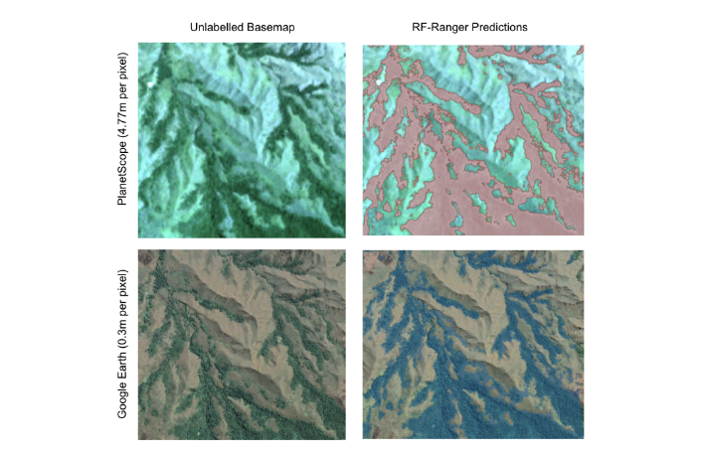
Vision for Good
Flood extent prediction
Monitoring forest restoration
Tree canopy modelling
Windthrow detection
Invasive species tracking
Machine Learning for Monitoring Forest Restoration (Mark Swan)

Slide 24
Anti-AI AI
Detecting DeepFake images/video
Detecting satellite DeepFakes
Adversarial attacks, such as retrieving DNN training data

Slide 25
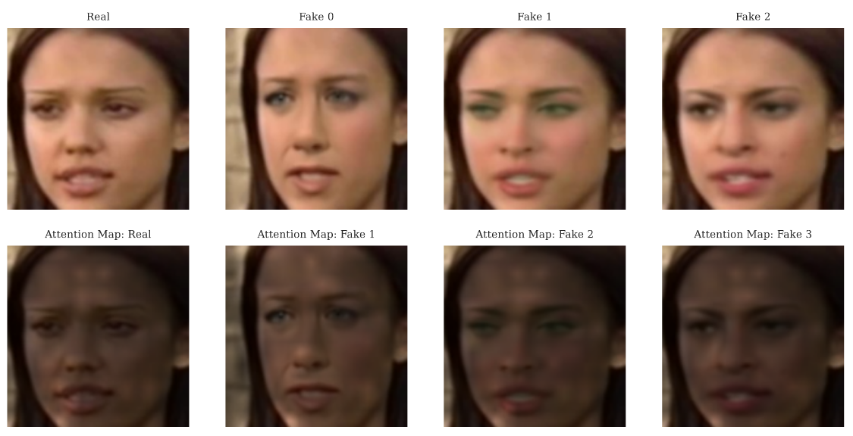
Deepfake Video Detection (Sakib Ahamed)

Slide 26
Critique
Evaluating the quality of synthetic medical data
Long-run simulation to analyse automated decision consequences
Detecting bias in dataset representation

Slide 27
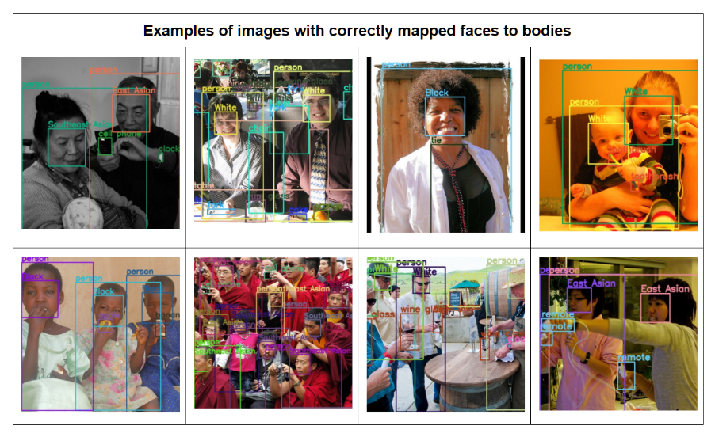
A Semi-Automated Tool for Detecting and Mitigating Racial Bias in Visual Datasets (Liana Mostafa)

Slide 28
Robotics mannequin
(domain: representation, approach: robotics)
Soft robotic mannequin for diverse representation
  Parameterising human shapes / robot actuation
  Sensing soft component shape
  Integrating robotic or virtual reality tools into education

Slide 29
Tools for Ethical AI
Ethics process management (with Unicef DCC)
DataCard creation
Auditing

Slide 30
Tools for Ethical AI examples: Auditing
Detecting and mitigating racial bias in visual datasets
Long-run simulations for investigating algorithmic bias
Links between social media and public sentiment or economy

Slide 31
Tools for Ethics Education
Case study database
Essay topic modelling
Curriculum development and website

Slide 32
Current Undergrad Topics
Landslide / coastal erosion detection from satellites
Spellchecker bias for non-English names
Impact of health wearables on self-control
Impact of AI EdTech on humility
Search and summary for AI legislation

Slide 33
PhD Student – Alex Gillespie

Slide 34
Particular Interests
Care (grief, elder care, mental health)
Education (both teaching ethics and ethical EdTech)
Translation (turning theory into practical methods/advice)
Epistemics (how tech and knowledge interact)

Slide 35
What now?
Plenty of time, so no need to rush
Have an explore of what research has been done in areas you're interested in (Google Scholar)
Chat to me, find a potential supervisor

Slide 36
Thanks and good luck!

