Slide 1

Computational Neuroscience
Angus Chadwick
School of Informatics, University of Edinburgh, UK
Computational Neuroscience (Lecture 1, 2025/2026)

Slide 2
Outline of Lecture
Course outline and formalities
Motivation and introduction to computational neuroscience
Q and A

Slide 3
Welcome to CNS
Goal of CNS: Understand how the brain works, including biophysics of neurons, how the nervous system processes information and performs computations, how these computations generate perception, cognition and behaviour
Highly interdisciplinary field: Combines ideas from computer science, maths, physics, biology, psychology, artificial intelligence, machine learning, etc.
Learning outcomes: understand computational models of brain function, think critically about how to model aspects of brain function, implement models in code and analyse them mathematically

Slide 4
Is CNS for You?
CNS is a course about the brain and computation in the nervous system
We make extensive use of mathematics and computational/numerical techniques to build and interpret models of brain function
Problems in CNS are often open-ended with no correct answer, the biology is messy, the brain is too complex to modelled exactly – you need to be comfortable with vagueness and uncertainty, and willing to do some independent reading!
Computational neuroscience is an extremely interesting and exciting field!

Slide 5
Relationship to Other Courses
Computational Cognitive Neuroscience (CCN: Semester 2) – stronger focus on cognition and on the field of computational psychiatry. Some overlap, but CNS is good preparation for CCN.
Computational Cognitive Science (CCS: UG3 Semester 1) – less focus on biology/brain, more cognitive and algorithmic

Slide 6
Requirements for this Course - Maths
You need to know: calculus, linear algebra, probability theory, differential equations
Not very advanced but used extensively. Solving equations and performing analytical derivations is required for the labs, assignment, and exam
Examples: linear first order ODE, Poisson process, matrix/vector algebra, Taylor expansion, limits of functions for small or large arguments, Dirac delta function
Mathematics is the primary tool we use to study the brain in this course - if you do not enjoy studying model systems mathematically to gain insight into their behaviour, you will not enjoy this course!

Slide 7
Requirements for this Course - Coding
Coding: Numerical computing, to implement models and investigate their properties
The computer labs assume Python, but you are free to use another language if you prefer (e.g., Julia, Matlab)
You will need to solve differential equations numerically, plot the results, etc.
Coding is never the end goal/learning outcome in this course, it is used only as a tool to study models of the brain. Correctness of code is required but the primary goal is to critically interpret your findings in the context of biology. Code is never assessed.

Slide 8
Requirements for this Course - Biology
We will cover a lot of biology in this course, be prepared!
No formal knowledge of neurobiology is required (but much to be learned)
We aim to provide the bare minimum of biology needed to understand the key concepts, but there is a whole world of messy biological details out there!

Slide 9
Requirements for this Course - Physics
Many models in computational neuroscience involve tools/knowledge of physics
We will cover some basic physics concepts (capacitance, conductance, voltage, etc.)
No prerequisites, we will introduce concepts as they come up
The physics concepts we cover are roughly at mid high school level

Slide 10
Assessment
25% assessed coursework, 75% exam
1x assignment (25%). Implement a model in Python. Simulate, critically evaluate, and discuss your findings. May also involve some mathematical analysis. Some questions may be open-ended and might not have a single definitive answer.
Last year’s assignment is on the course website for reference
Deadlines:
- Assignment 1 (released 07/11, due 21/11) [25%]
- Exam (date tbd) [75%]

Slide 11
Lectures
Lectures delivered in person – recordings available on Learn, slides etc. on https://opencourse.inf.ed.ac.uk/cns/schedule
Lecture times: 3.10pm Tuesday and Friday [note: rooms change regularly!]
Feel free to interrupt and ask questions during lectures, especially if something was unclear or too fast. Interactions are encouraged!

Slide 12
Computer Labs
Labs every two weeks (Week 1, 3, 5, 7, 9). 2 hours each, in Appleton Tower 6.06
Two labs: Thursday 2.10pm, Friday 1.10pm. Labs are “Drop-In” (i.e. you can attend either of them)
Format of labs: 1) coding and implementation of models in Python 2) some tutorial/exam style questions
Labs are good practice for the assignment and exam! The TAs will also provide additional derivations/extensions of material covered in lectures
Lab this week: learn to solve differential equations in Python. Please attend!

Slide 13
Office Hours, Discussion, etc.
Office Hour: catch me after lectures or talk to one of the TAs in a computer lab
On Piazza: Post questions/discussion about the course. Will be monitored by lecturer and TAs. Peer interactions also encouraged.

Slide 14
Course Contacts
First point of contact should always be Piazza! Post a private question if it is confidential, you should only email the lecturer in exceptional circumstances (e.g., can’t gain access to Piazza)
Lecturer/Course Organiser: Angus Chadwick (angus.chadwick@ed.ac.uk)
TAs: Hongkun Wu and Akshay Gautam
Markers: Hongkun Wu and Akshay Gautam

Slide 15
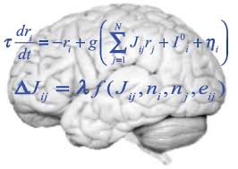
What is Computational Neuroscience?
“Computational neuroscience is the field of study in which mathematical tools and theories are used to investigate brain function. It can also incorporate diverse approaches from electrical engineering, computer science and physics in order to understand how the nervous system processes information.”
Nature (academic journal)

Slide 16
What is Science? [Philosophical Interlude]
Broadly speaking, scientists attempt to explain things about the world using theories
Theories are usually a set of equations, and the behaviour of the equations is compared to experimental measurements of the system in question
A good theory should have explanatory power: it should generalise across situations, it should explain disparate observations in terms of a smaller set of underlying principles, and it should provide conceptual insight (“understanding”)
Theories are always approximations/abstractions - they have a domain of application and break down when assumptions are violated
In most cases, scientists proceed by breaking a problem down into simpler manageable subproblems, solving those, and hoping that that these simpler problems give insight into the real world (i.e., reductionism)

Slide 17
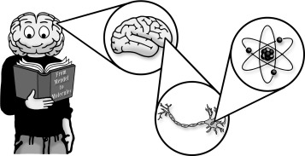
Why is Understanding the Brain Hard?
The brain is a highly complex system, with collective and emergent behaviour
Breaking the brain down into parts is possible (e.g., we can study neurons), but the whole is more than the sum of its parts (networks of neurons behave differently to isolated neurons) – reductionism doesn’t work!
We can simulate complex models of the brain, but simulations don’t give understanding (e.g., why did this simulation behave this way, how does the qualitative behaviour depend on the parameters?)

Slide 18
What Do(n’t) We Know About the Brain?
We have collected many facts about the brain, but have no coherent understanding of how it works
We also don’t know how to find out how the brain works… (e.g., if we can’t even understand a deep network, how can we hope to understand the brain?)
In this course you will learn many interesting facts about the brain, but the deepest and most interesting questions will remain unanswered

Slide 19
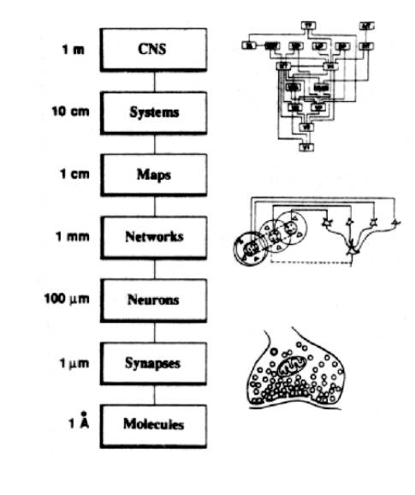
The Scales of Neurobiology
The brain is a complex system spanning multiple
spatial and temporal scales
(molecular to behavioural, milliseconds to years)
To understand the brain, we need:
- models/theories that address each scale
- organising principles which span these scales
- theories of various kinds (what, why, how?)
Our understanding of the brain is still rudimentary

Slide 20
Questions of Computational Neuroscience
Computational neuroscience:
Emphasises understanding how computations are performed in the brain. Cognition and behaviour are the result of such computations
Central question:
How does the brain work? How are perception, learning, memory, decision making, language, etc. generated by the concerted action of billions of neurons?

Slide 21
Tools of Computational Neuroscience
Computational Neuroscience: uses computational/mathematical tools to understand the brain, by developing:
Theories about the brain (using maths)
Computer simulations (“in silico” experiments)
Data analysis methods (e.g., machine learning, statistical models)
Try to answer:
What? Descriptive/phenomenological/statistical explanation
Why? “Teleological”/functional/normative explanation (in terms of optimality, i.e. evolution)
How? “Mechanistic” explanation, i.e. causal or physical explanation in terms of biology

Slide 22
The Data of Neuroscience
Human and animal studies: primates, cats, rodents, birds, insects, etc.
Measurements of behaviour: e.g., psychophysics, memory, linguistic tasks
Measurements of neural activity: e.g., EEG, fMRI, intracellular recordings, many more…
Perturbations of neural activity or behaviour: e.g., pharmacological, electrical, optical
Lesion studies: e.g., accidental injuries (gunshot wounds, WW1), result of brain disease, result of corrective surgery (e.g., split brain patients)
Case studies: neurological disorders (blindsight, hemispatial neglect, face blindness…)

Slide 23
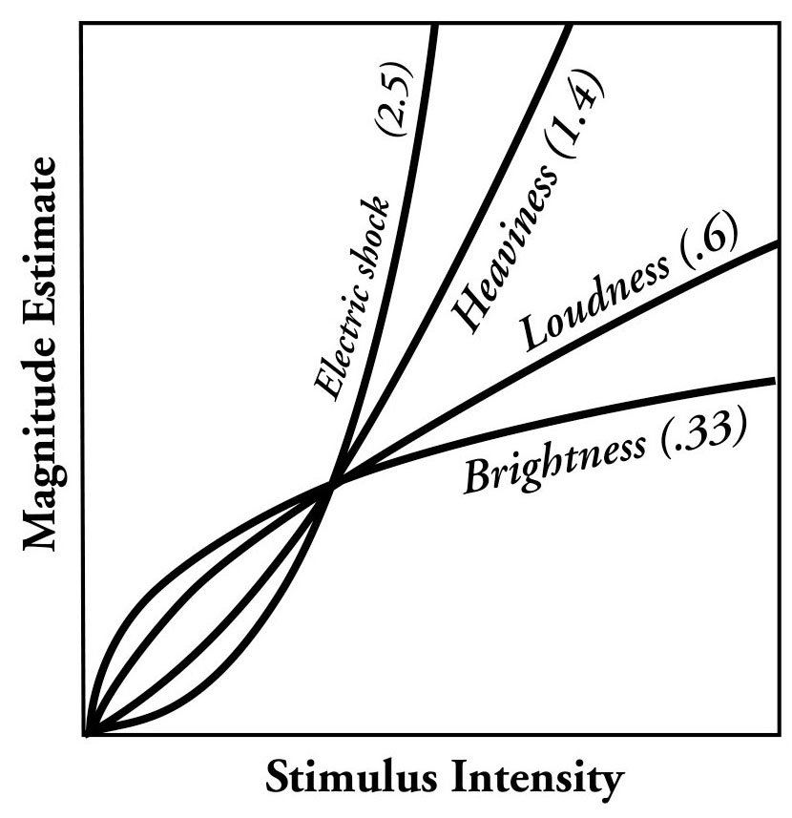

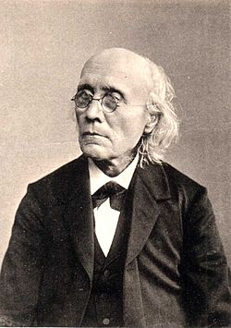
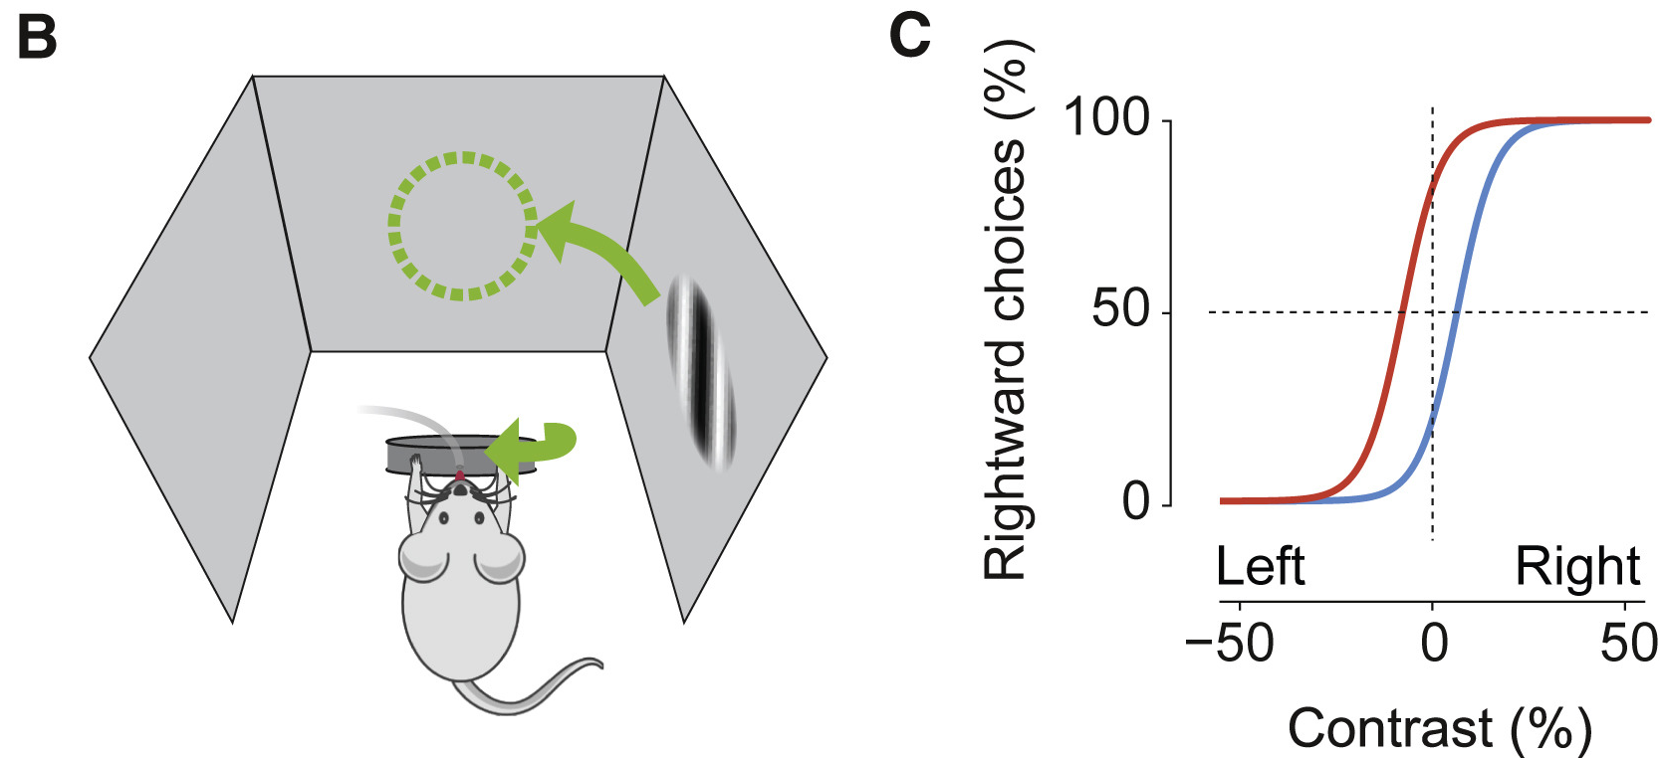
Measuring Behaviour/Perception
Human Psychophysics:
Behavioural report of perception
Left: How intense? (Fechner’s law)
Middle: Faces or vase?
Right: Gustav Fechner
Animal Psychophysics:
Left: Mouse behavioural task
Right: Measured Psychophysical curves

Slide 24
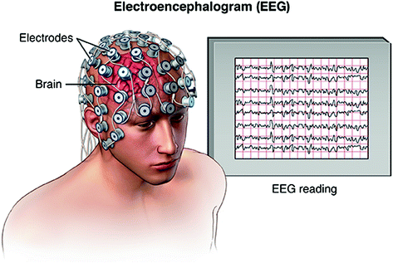
Measuring Neural Activity – Non-invasive Imaging
fMRI
EEG – high temporal but low spatial resolution. Noisy, contaminated, indirect measurement of brain’s electrical field.
Low temporal but high spatial resolution. Measures BOLD signal (blood flow)

Slide 25
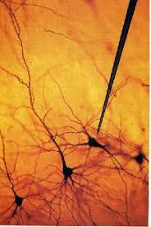
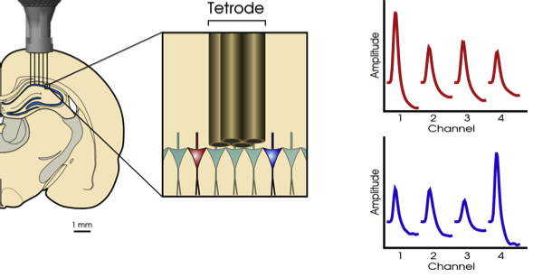
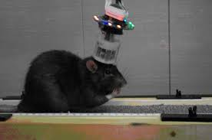
Measuring Neural Activity – Invasive Electrodes
Electrodes: intracellular or extracellular.
Pros: measure from single neurons at high temporal resolution, measure electrical activity
Cons: Invasive, limited to working with animals, can’t record from many cells simultaneously, data pre-processing tricky

Slide 26
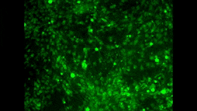
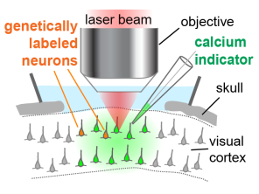
Measuring Neural Activity – Invasive Imaging
Two-photon calcium imaging
Primary visual cortex
Pros: Image many cells at once, high spatial resolution
Cons: Invasive, measure only calcium fluorescence, low temporal resolution, data pre-processing tricky

Slide 27
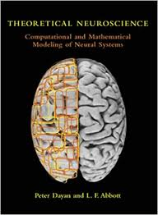
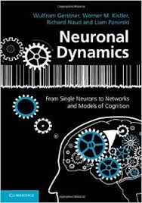
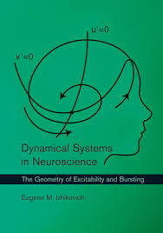

Textbooks
Much of the lecture material is adapted from these books – these are available on course Resource List. Use these to supplement the lecture material
We also have detailed lecture notes from a previous course (Neural Computation) that covers much of the material in this course

Slide 28
Overview of Upcoming Lectures
Lecture 2: Overview of (computational) neuroscience
Lectures 3-5: Biophysics of single neurons
Lecture 6: Neural spike statistics
Lecture 7: The visual system
Lectures 8-10: Neural coding
Lectures 11-12: Networks
Lectures 13-15: Plasticity, learning and memory
Lab only (final lab): Neural data analysis

Slide 29

Questions

