Slide 1

RRI Tools -
Anticipate
Dependable and Deployable AI for Robotics
Barbara Webb

Slide 2
The AREA framework for RRI
Anticipate outcomes
Reflect on motivation, processes and products
Engage with stakeholders
Act responsively
“Anticipating possible outcomes of research and innovation. This includes considering both intended and unintended outcomes, and can help you to think about why the work is worth doing, and also what might “go wrong” or cause problems in the future”.
“Reflecting on your (and others) motivations, processes and products. Even within a single research or innovation project we all face different and competing demands on our time and energy. By setting aside time to deliberately reflect we can help to ensure that we are still heading in a good direction and using our time well”.
“Acting accordingly to address issues revealed. RRI practices should make a real difference to what we do and how we do it”.
https://rai.ac.uk/toolkits/rri-toolkit/

Slide 3
Established tools for anticipation
Technology assessment/roadmapping
Cost-benefit analysis
Life-cycle assessment
Risk assessment
Each of the above can be extended to include responsibility:
Incorporate the wider social context and the relevant values in the assessment
Ensure a wider group of stakeholders are considered in (and ideally, have input into) the analysis
Allow for diverging opinions, uncertainty, qualitative decision heuristics
Make processes more continuous to monitor alignment to (changing) social values

Slide 4
Example
How could responsibility considerations be introduced at each step?
Daim et al. (2018) https://www.sciencedirect.com/science/article/pii/S0040162517307734*
Road-mapping of robotics technology for the power industry:
Identify experts using bibliometric analysis
Identify technology alternatives (four robotic systems)
Develop evaluation model based on: functionality, design (e.g. size, robustness, flexibility), technology (e.g. for positioning, precision, processing time), usability (including interface, upgradeable, maintainable), "electronic" (e.g. remote operation, visual capability, data transmission)
Ask experts to rate alternatives (including estimate for future advances) against criteria
Construct hierarchical decision model and calculate technology value of each alternative
*Note this was chosen as an illustrative example for the field, rather than as exemplary practice

Slide 5
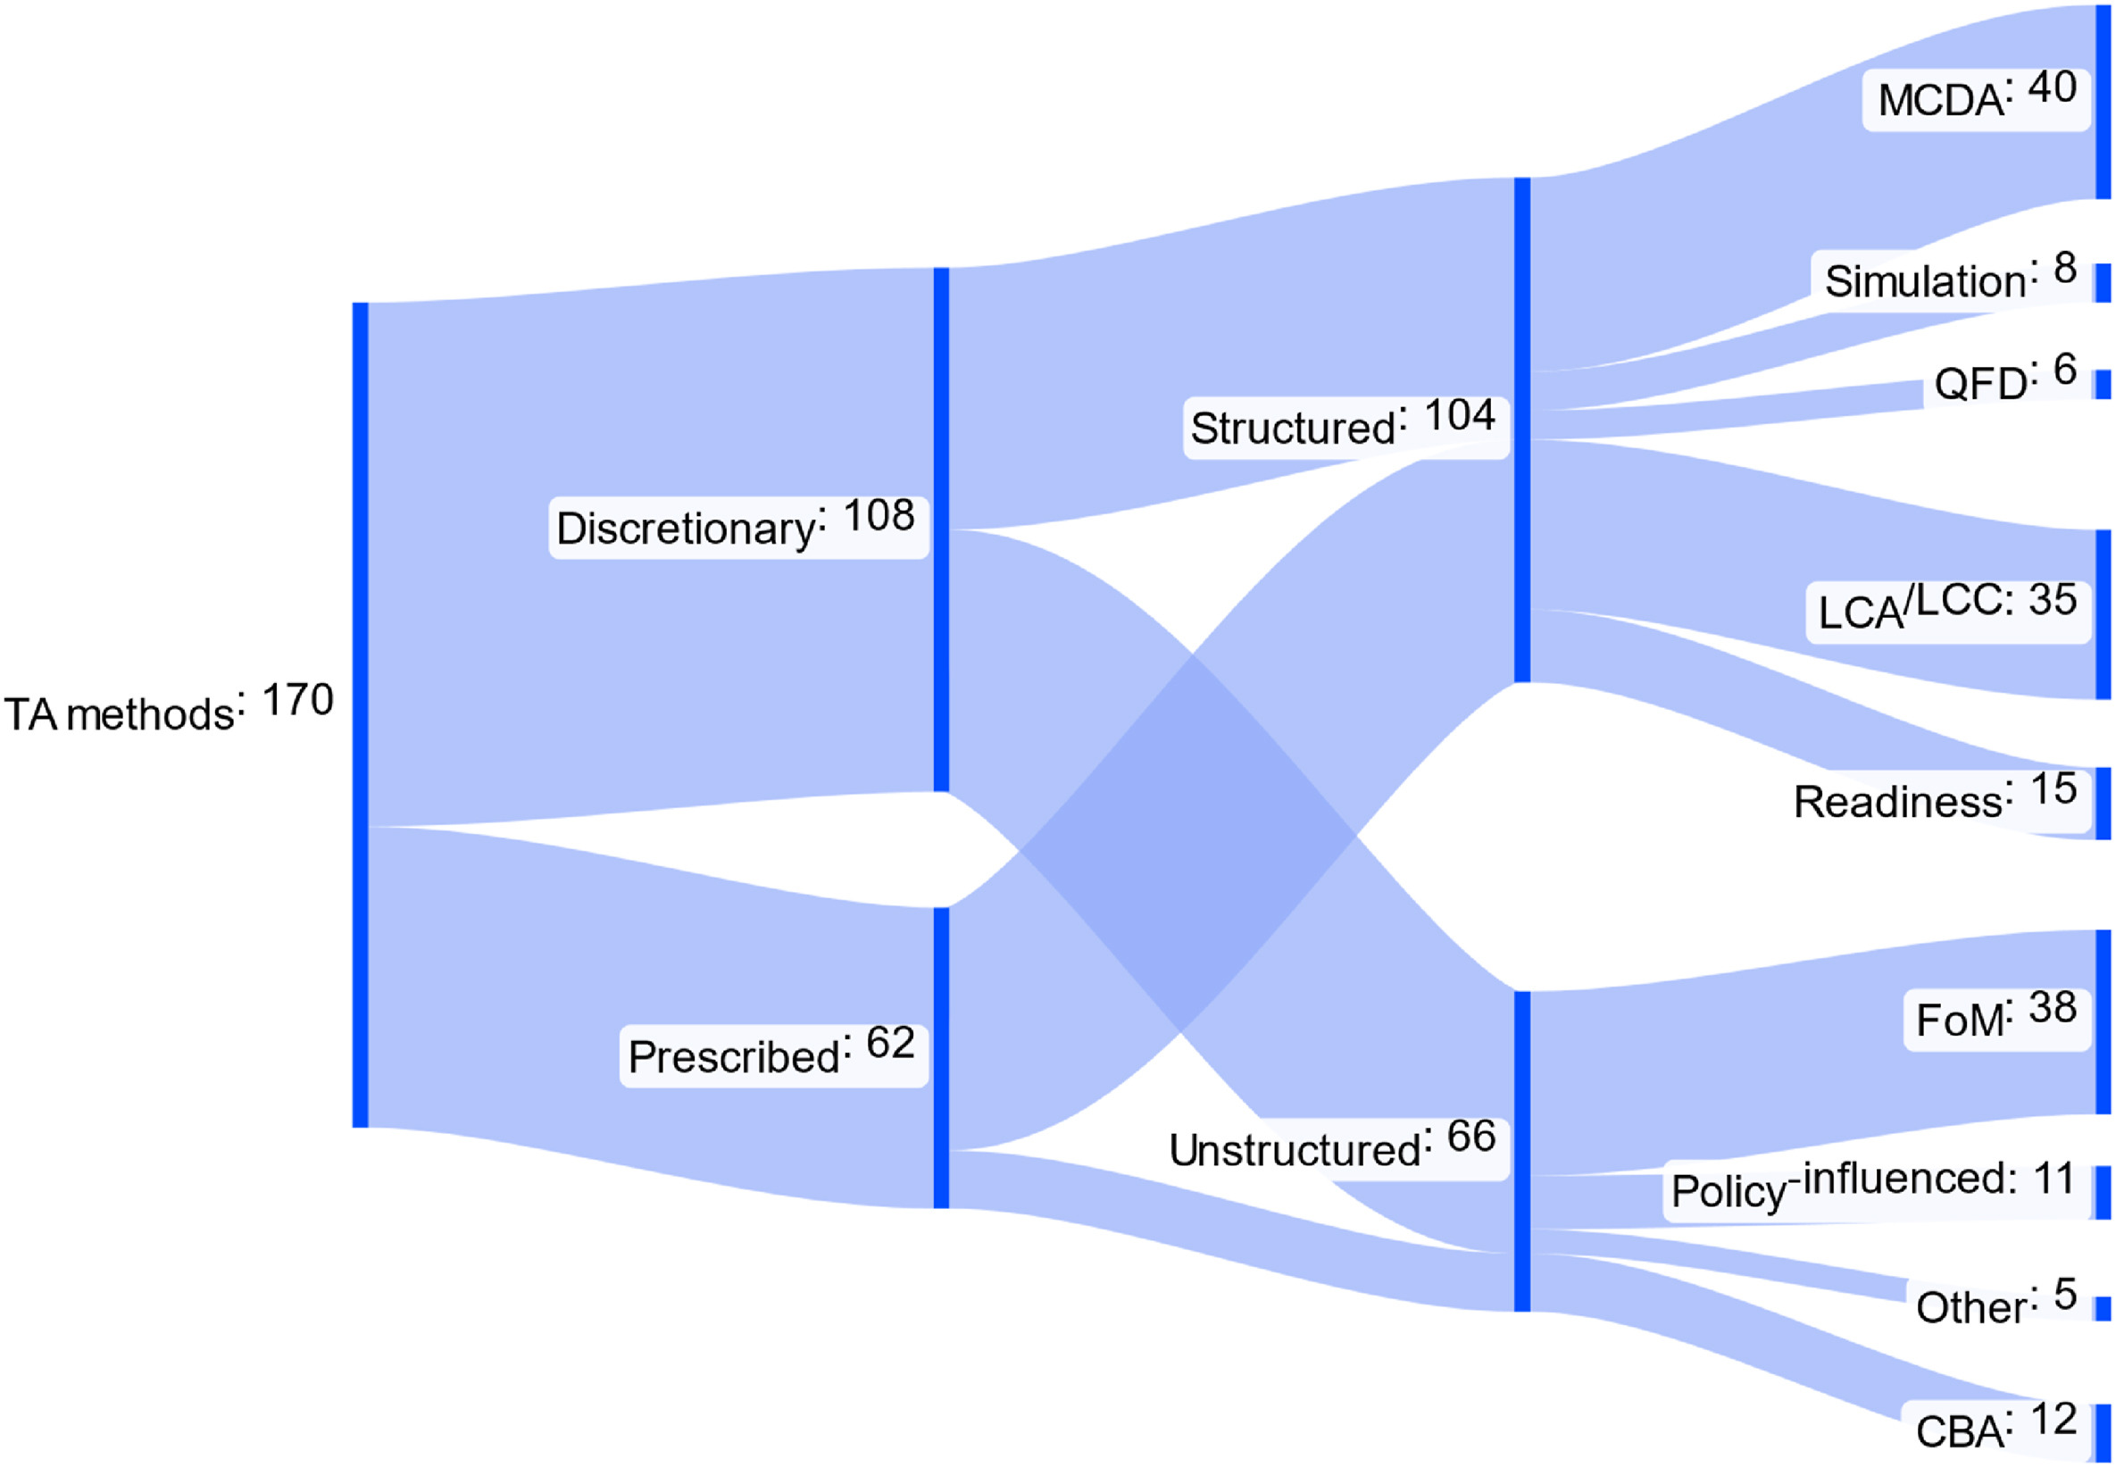
Technology assessment tools
Parolin et al (2023) How can technology assessment tools support sustainable innovation? https://doi.org/10.1016/j.technovation.2023.102881
MCDA: Multicriteria decision analysis
QFD: Quality Function Deployment
LCA/LCC: Life Cycle Assessment/Costing
FoM: Figures of Merit (Key Performance Indicators)
CBA: Cost Benefit Analysis

Slide 6
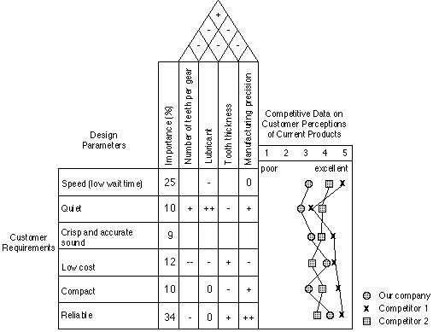
Quality function deployment
Identify critical customer attributes (rows)
Establish importance weightings
Identify design parameters relevant to performance with respect to the attributes (columns)
Fill in relationship matrix
Identify relationships between design parameters ("roof")
Many other tools, e.g. see here:
https://www.ifm.eng.cam.ac.uk/research/dstools/

Slide 7
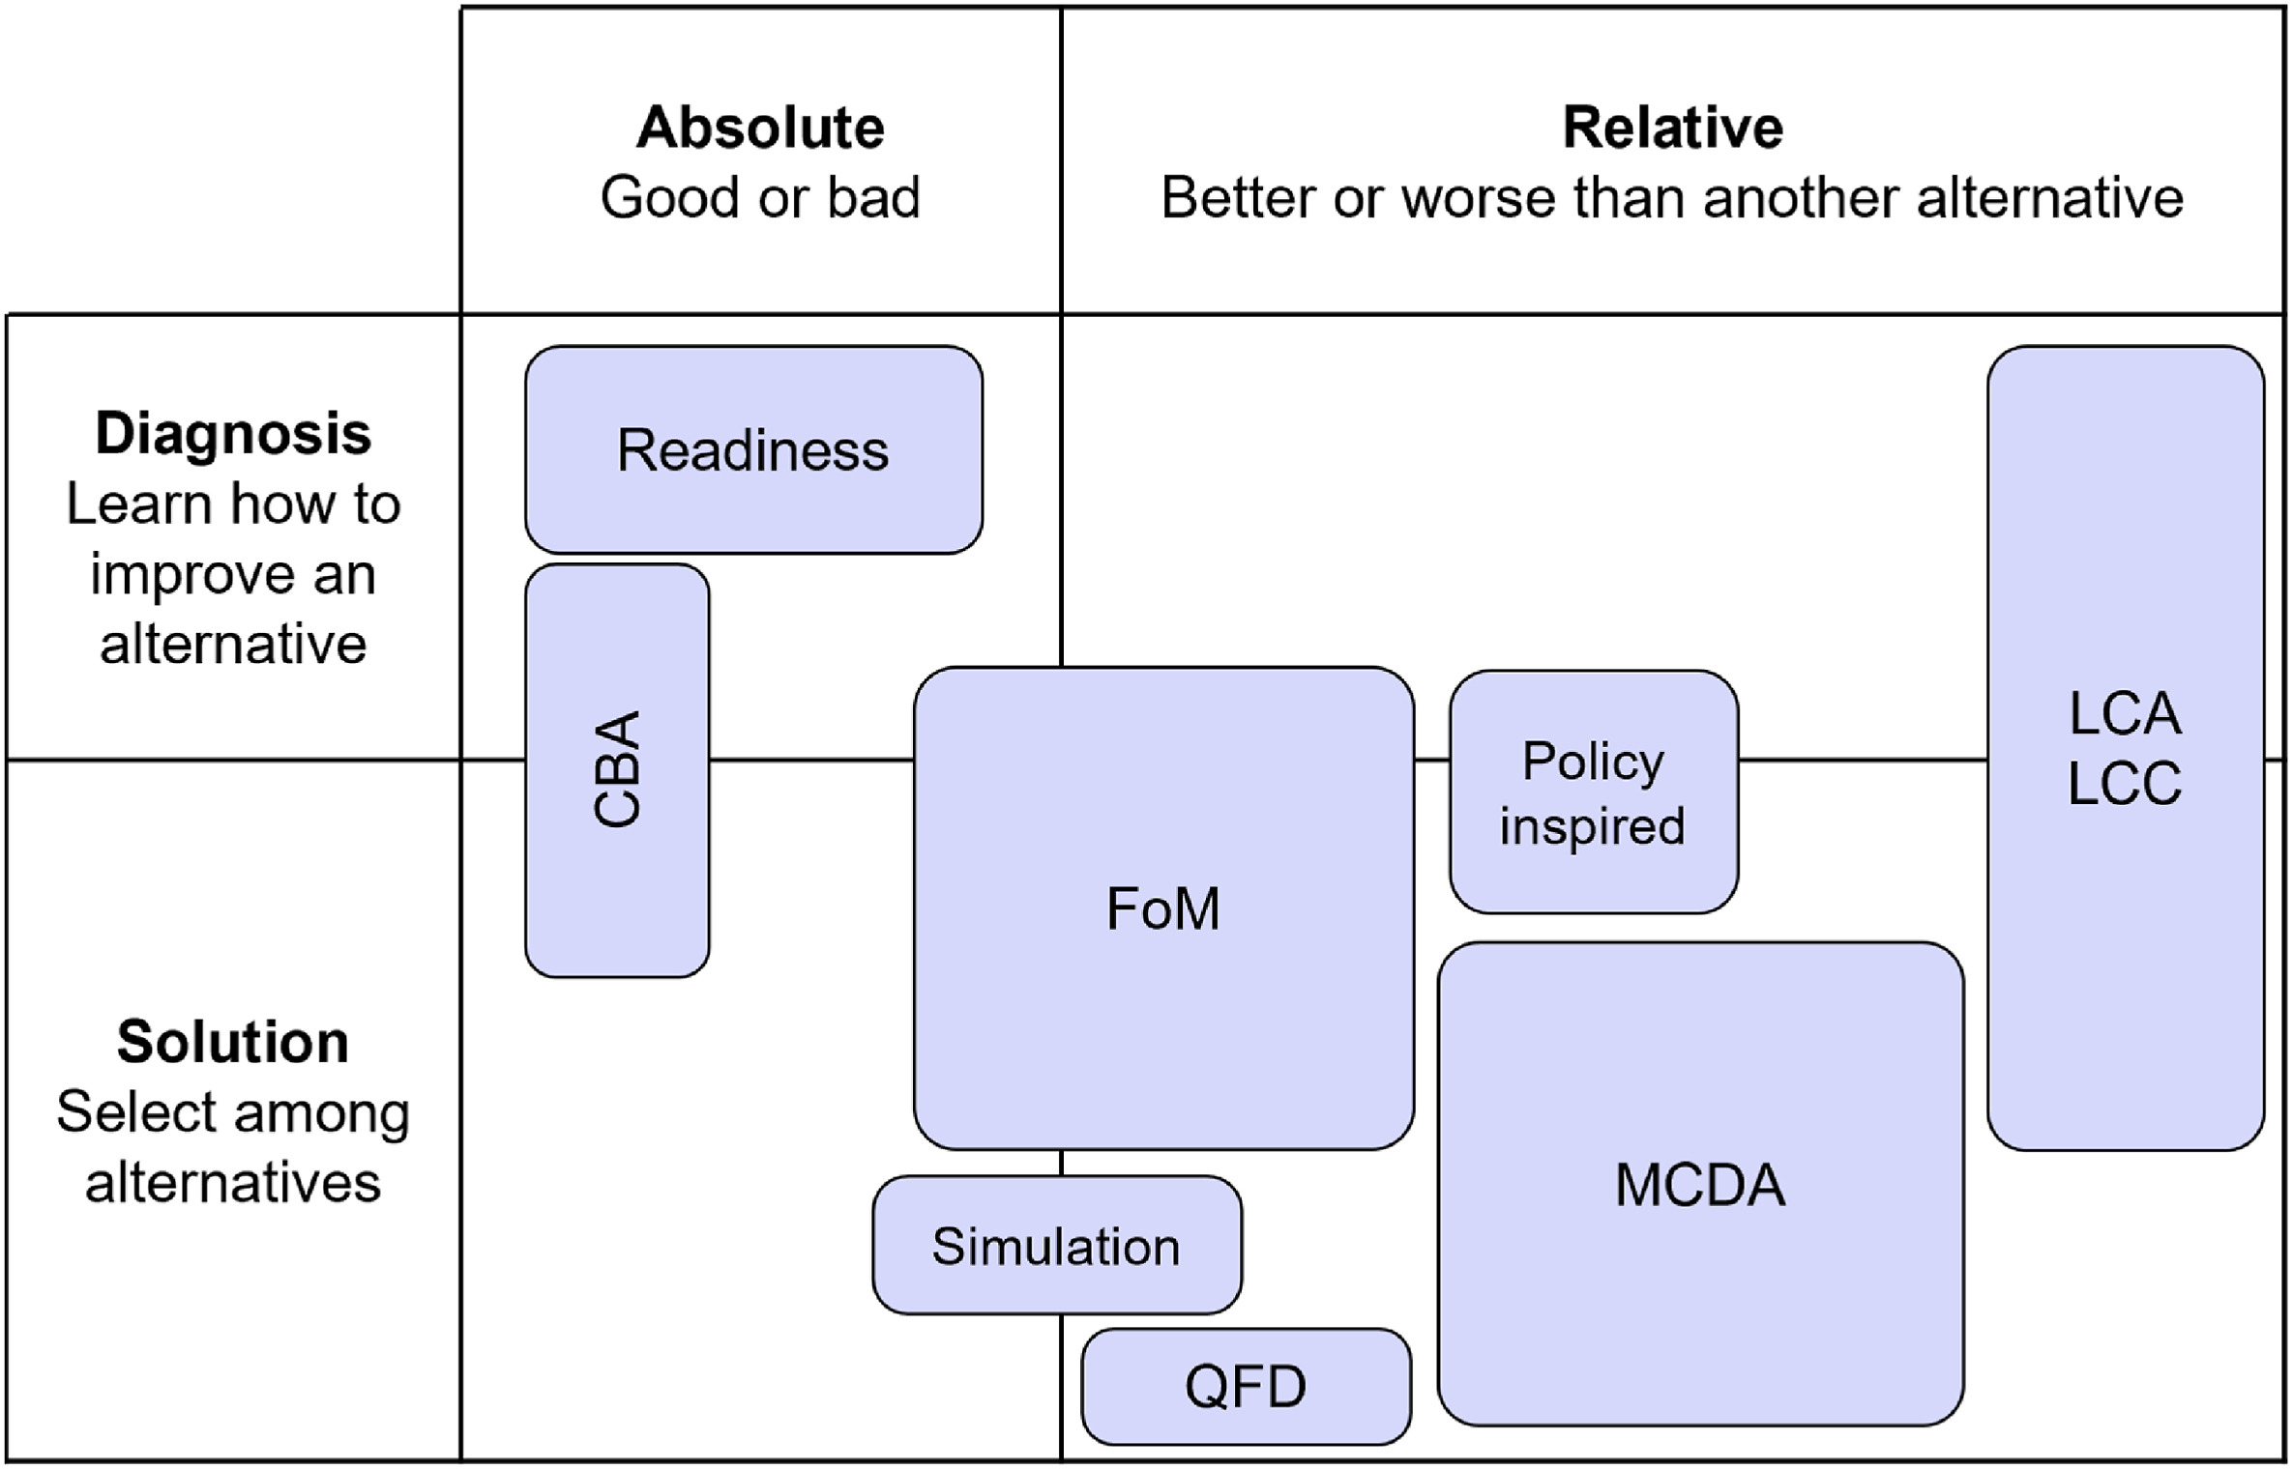
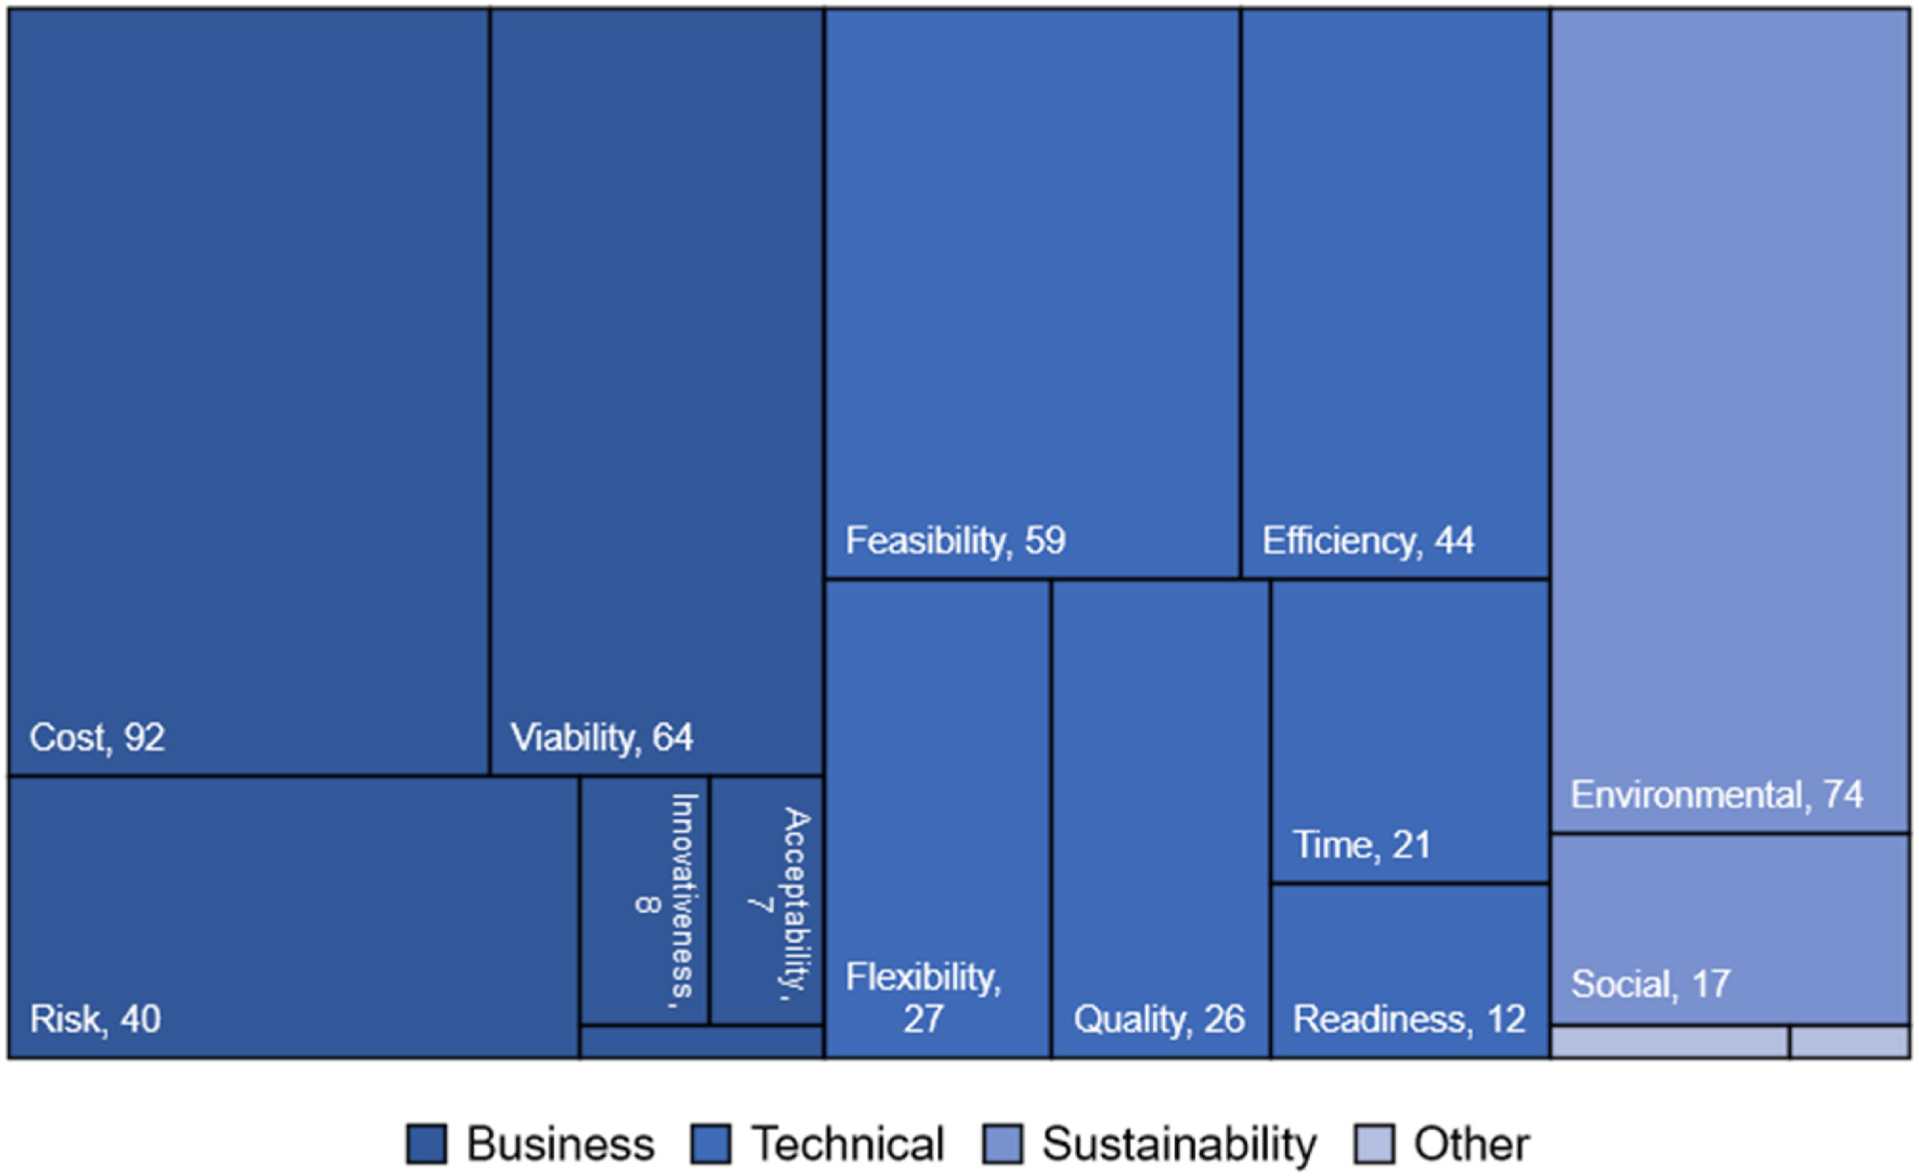
Technology assessment tools
Parolin et al (2023) How can technology assessment tools support sustainable innovation? https://doi.org/10.1016/j.technovation.2023.102881

Slide 8
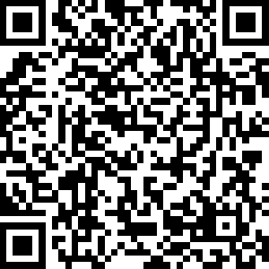
Exercise: Tarot cards of Tech
https://tarotcardsoftech.artefactgroup.com/

Slide 9
RRI Tools -
Reflect
http://self-check-tool.innovation-compass.eu/faq
Dependable and Deployable AI for Robotics
Barbara Webb

Slide 10
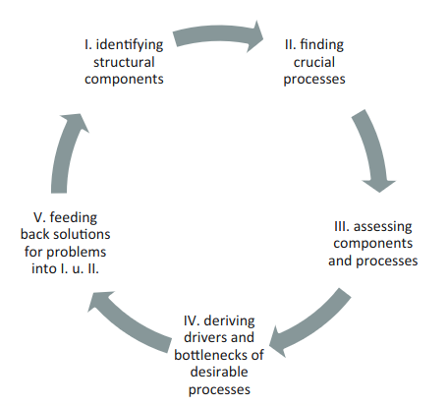
Assessing an innovation system
From Werker 2020 https://www.taylorfrancis.com/reader/download/43374892-69da-4b07-a730-3b4c3a0d26a2/chapter/pdf
Components includes actors, relationships, institutions
Activities include knowledge advance and sharing, methods selection, development of markets
Assessment might consider: actors missing, or lack capability, relations too weak or strong, missing formal institutions; lack of knowledge development or sharing; lack of processes to identify best structures or solutions

Slide 11
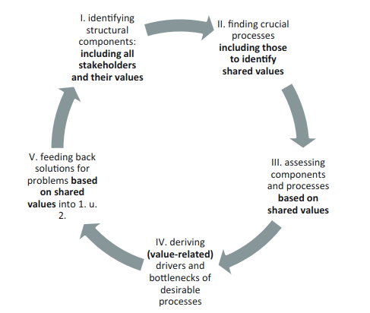
Assessing Responsible Innovation
From Werker 2020 https://www.taylorfrancis.com/reader/download/43374892-69da-4b07-a730-3b4c3a0d26a2/chapter/pdf
Additional problems:
Not including all stakeholders and all their values
Lack of processes to collaborate towards shared values
Failure to compensate stakeholders disadvantaged by the innovation
Solution-finding approaches don't account for values

Slide 12
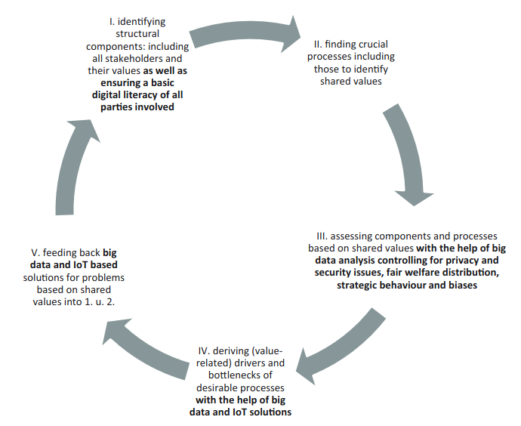
Using AI tools to assess Responsible Innovation
From Werker 2020 https://www.taylorfrancis.com/reader/download/43374892-69da-4b07-a730-3b4c3a0d26a2/chapter/pdf
The process of assessment could be enhanced by AI tools for analysing complex systems
But use of AI tools introduces further considerations related to their responsible use

Slide 13
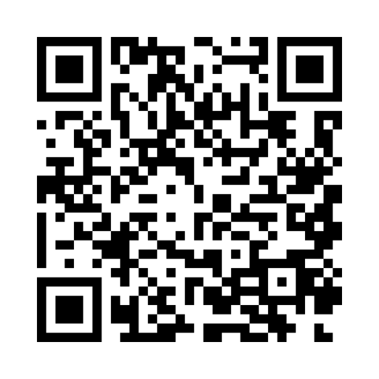
Informal reflection on your own research
Why are you doing this research? Why is important that you carry on? Who is it for?
Exercise: write a letter to a relative or friend who does not understand what you do, explaining and justifying your research.
Are there people/groups or organisations who might be opposed to the work? Are there reasons not to do it? Think in advance how you might respond to such objections.
Who might be excluded from the benefits of the work? Can it be made more accessible?
What priorities, privileges and biases might you be bringing to the work?
Self-assessment: https://innovation-compass.eu/self-check/
(note this is described in the context of a company but many considerations are relevant to a researcher or research group)

Slide 14
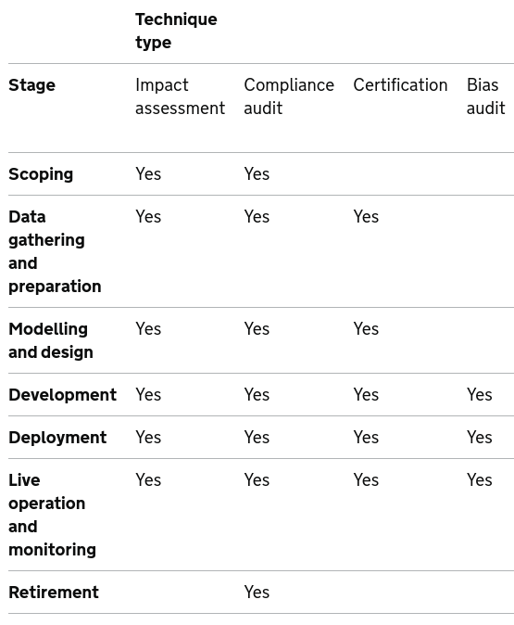
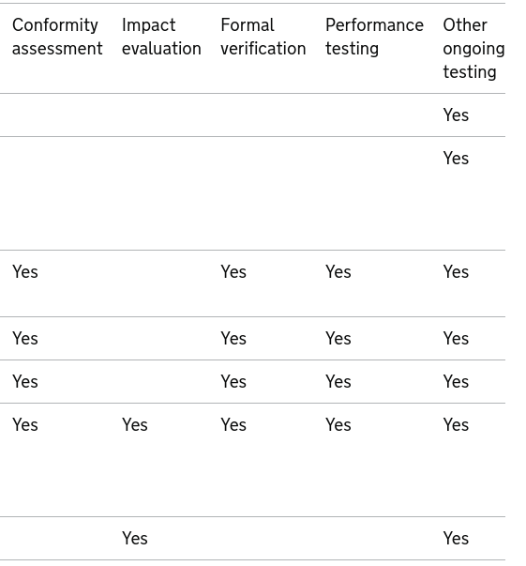
Formal methods https://www.gov.uk/guidance/portfolio-of-ai-assurance-techniques

Slide 15
RRI Tools -
Act
Dependable and Deployable AI for Robotics 2
Barbara Webb

Slide 16
Barriers to action
Lukien et al (2024) Embedding responsible innovation into R&D practices: A case study of socially assistive robot development https://doi.org/10.1016/j.jrt.2024.100091
Project actively engaged in anticipation, e.g., identified need to safeguard human dimension, avoid unintentional deception, ethical and legal aspects of recording in home environment; awareness that AI algorithms might exacerbate issues of human oversight, privacy and transparency.
Few follow-up actions in the research activity: ‘too late’ to do much in the design to address issues; lack of explicit obligations (team structure diluted engagement); other tasks prioritised, not embedded in workplan, postponed for later consideration.
Some codesign activities but tended to focus on substantiating existing assumptions about design, with lack of reflexivity about researcher's values and interests.

Slide 17
Practical considerations
What is the right balance of time/effort/money to spend on anticipation, reflection and engagement?
How can these be efficiently and effectively integrated into your research plan?
Within a team, how directly should you be involved in these processes?
How should you monitor, assess and report the effect of anticipation, reflection and engagement on your research?
Potentially useful:
https://thinkingtool.eu/tool
https://tas.ac.uk/responsible-research-innovation/rri-prompts-and-practice-cards/

Slide 18
Preparing a responsible action plan
Early stages:
What additional information do you need and how will you get it?
Are you up-to-date on the relevant background and context?
Are you aware of the relevant sociotechnology configuration and the actors within it?
Have efforts been made to give a role to societal values, needs and expectations in defining the research aims?
Have diverging opinions on the problem/approach been considered?
Have you tried to identify long-term as well as short-term impacts?
Can you identify the most suitable methods for anticipation, reflection and engagement?
Later stages:
- How can you build in reflection on impacts; and alignment to and changes in societal values, needs and expectations during the project?

