Slide 1

ILP / 7
Cristina Adriana Alexandru, PhD

Slide 2
This lecture
More on the next ILP courseworks (CW2, CW3, CW4)
More on the oral exam
Some advice for doing well
Time for your questions

Slide 3
Assessment overview
Assignment | Weight/effort | Dates | Extension rules | GenAIRules
CW1 (Programming- medication delivery service 1) | 25%, 10 hours | Launch: 29/09 Submit: 20/10 12:00 Feedback: 10/11 | Rule 1: Extensions (4 days) and ETAs (7 days) permitted. Penalties (5%/day) applied to late submissions. | AI tools should not be used
CW2 (Programming- medication delivery service 2) | 33%, 20 hours | Launch: 03/11 Submit: 24/11 12:00 Feedback: 15/12 | Rule 1 | AI tools should not be used
CW3 (Your choice of implementation) | 20%, 12 hours | Launch: 03/11 Submit: 01/12 12:00 Feedback: 22/12 | Rule 1 | AI tools should not be used to generate content, but can be used with acknowledgement to identify ideas, key themes, and plan work.
CW4 (Video presentation of CW3 implementation) | 12%, 6 hours | Launch: 03/11 Submit: 01/12 12:00 Feedback: 22/12 | Rule 1 | As in CW3
Oral exam | 10%, 5-7 minutes | Held between 08/12-19/12 | Rule 2: No Extensions and no ETAs permitted. Late submissions score zero. | AI tools should not be used

Slide 4
CW2
Topics:
  More testing (and fixing your code)
  More endpoints: doing checks, planning drones
  Given deliveries, return path(s) that drones have to do such that distribution with as few as possible drones and flights
    Return in GeoJSON format so that can be rendered on e.g. https://geojson.io/
Submit: Docker image and source code
  Include README.MD to explain how to get it running
Marking: fully auto-marked; results provided in email report

Slide 5
CW2- Important things to consider
Data retrieved from an external REST service
  Data may change between calls. Retrieve data for each call!
  Use a dynamic service URL (environment variable, or data attribute passed in)
The data that you receive won’t be incorrect, but it may not work (e.g. too many deliveries for drones)
  You will need to handle JSON and JSON data objects a lot; Revise!

Slide 6
CW2- Important things to consider
Check available drones first!
  Consider constraints:
    Of drones: availability, distance, capacity, cold/ hot storage, no fly zones, returning etc
    Of orders: cold/ hot storage, emergency supplies, packaging size
Devise planning strategy for the paths before applying those paths!
  Consider possible path optimisations, e.g. multiple deliveries along same path, picking drones from other central locations
    Essential: Deliveries are made by drones which can make them!
    Perfect path optimisation not expected
  Optimisation by reducing algorithm complexity less important than the above
Create a Docker tar file and properly test it before submission!!

Slide 7

Questions?

Slide 8
CW3
Topics:
  Anything in relation to the contents of ILP in either Java, Python, JavaScript, Go, Rust, C#, React, Angular, or HTML-5
    E.g: UI, background implementation, audit solution, data pipeline, etc.
    Simple extension for existing endpoints will get fewer marks
    Interesting and useful solutions will get higher marks
Submit:
  Docker image with source code
  PDF (see next slide)- take time to prepare this PDF!
  README.MD file (in MarkDown: https://www.markdownguide.org/basic-syntax/) describing steps to build

Slide 9
CW3
PDF max 1000 words and including max 2 screenshots explaining:
  Which problem was solved
  Who is the recipient (customer)
  Why the submission is relevant
  Which language was used and why
  The approach used
  The tools used (here including GenAI, if used) and why
  Observations / Special contributions

Slide 10
CW3
Marking:
  3 markers give ratings (Poor-Excellent) on following rubric:
    Innovation/ Idea/ Benefit (20%): whether innovation/ idea visible and a contribution
    Execution/ Implementation (40%): quality of underlying design, usage of tools, other SE aspects
    Completeness (20%): whether covering the aspects of given scenario
    Style & Architecture (20%): quality of style in design and architecture
  Main object for marking is PDF, with code as evidence/ point to investigate
  Mark = the average of their marks to reduce bias
  More than 50% more words will lead to 25% mark penalty

Slide 11
Questions?

Slide 12
CW4
Same dates as CW3!
Topic: nothing new to implement, based on CW3 solution
Submit: 5-7 minute video including:
  Background
  Motivation
  Target audience
  Full demo of implementation
  + special requirements to make sure it is you: Show id next to face, move hand left/ right/ left with open fingers in front of face, show Guardian homepage

Slide 13
CW4
Marking:
  3 markers give ratings (Poor-Excellent) on following rubric:
    Background elaboration/ target audience (20%)
    Problem statement (20%)
    Explanation of choices made (30%)
    Presentation (30%)
  Mark = the average of their marks to reduce bias
  10% deduction for every extra minute in video

Slide 14
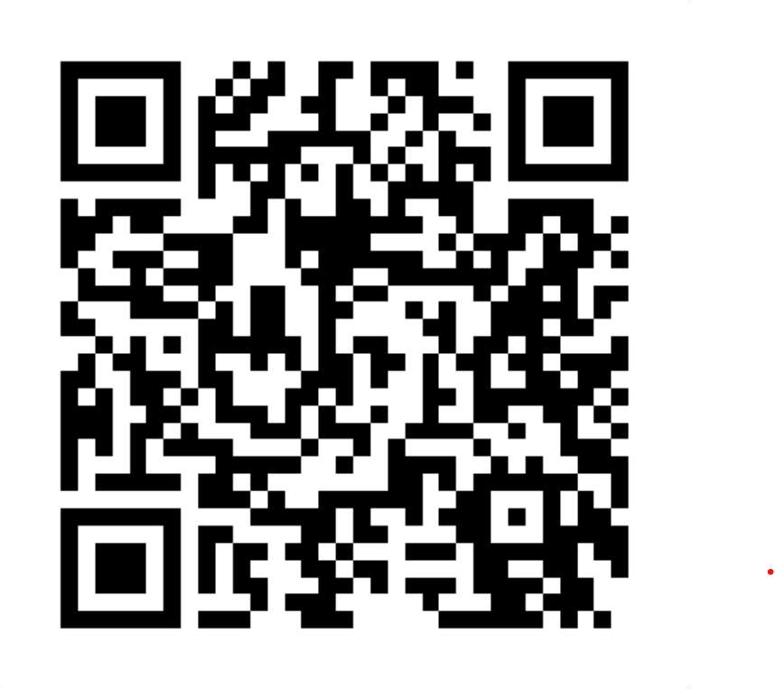
Your advice on the presentation

Slide 15
Tips for preparing a good presentation
Take your time to prepare it!
Make it structured
  Intro (what is the tool for?) – body – summary (top conclusions)
  A few slides (e.g one per topic) can help
Make it focused
  Goal: imagine this was a product launch!
  Requirements, but also marking scheme
4. Prioritise important information

Slide 16
Tips for preparing a good presentation
5. Grab attention at the beginning, close with a dynamic end
6. Use audiovisual aids wisely
Don’t speak too fast! Less, with most important info, is more!
Don’t read as it will sound very monotonous!
Avoid filled pauses (umm, err)
9. Be yourself!

Slide 17
Tips for preparing a good video presentation
Take your time to prepare it! Iterations watch yourself - improve
Think of yourself and your surroundings: how you look, lighting, background, sounds, framing of your face
Have your camera always on!
If you can, use a good camera and microphone
Make eye contact (with the camera)
Imaging speaking to someone (voice pitch, volume, pace, pauses)
Facial expression and hand movements help!
Going beyond allotted time will look unprepared!

Slide 18
Tips for preparing a demo
Don't just list features, but tell a story
Script your walkthrough
Set up a clean demo environment
Make sure text is visible when sharing
Don’t switch windows too frequently
Run the system, don’t just show it
Move mouse/ speak slower so that listener can understand

Slide 19
Questions?

Slide 20
Oral exam
Organised over certain days (TBC) during exam diet (8-19 December)
5-7 minutes questioning (alternative format for learning adjustments TBC case-by-case)
3 markers present (including one lecturer/TA)
Types of questions:
  Theory: 2-3 from pool of around 20 from topics in lectures, tutorials, reading
  From your CW3/4 submissions
Marking: individual on rubrics by markers; their average is final mark

Slide 21
Tips for preparing for an oral exam
Study and know the theory: lectures, tutorials, reading
Make a list of questions you think you might be asked
Prepare answers: written, then practice giving them verbally
Be punctual!
Be confident
Listen question carefully, take time to think, ask clarification
Smiling helps project confidence
Be clear and concise (time limit!)
Teach the examiner

Slide 22
Questions?

Slide 23
Some useful resources
On making a presentation:
  https://usic.sheffield.ac.uk/blog/how-to-improve-your-presentation-skills
  https://professional.dce.harvard.edu/blog/10-tips-for-improving-your-public-speaking-skills/#Here-Are-My-10-Tips-for-Public-Speaking
  https://hbr.org/2013/06/how-to-give-a-killer-presentation
  https://presentationzen.com/blog
  https://presentationzen.com/blog/13-ways-to-elevate-your-next-online-presentation
On making a demo: https://www.storylane.io/blog/how-to-prepare-a-great-software-demo-presentation

Slide 24
Some useful resources
On preparing for an oral exam:
  https://www.wikihow.com/Survive-an-Oral-Exam
  https://www.educationcorner.com/oral-tests/

