Slide 1
Slide 1
Informatics 1
Critical Skills & Practices
INF1-CRISP (INFR07003)
Week 7, Lecture 1
Slides: https://f.ast.io/crisp7.1

Slide 2
Slide 2
QR
Attendance

Slide 3
Slide 3: Provisional lecture plan
W | Mon | Tue | Thu
7 | Reflection & Critical Practice 1 | Reflection & Critical Practice 2 | Guest Lecture
8 | Informatics as a Profession | Writing & Communication | Guest Lecture
9 | Human Computer Interaction | Working with Data | Guest Lecture
10 | Design & Requirements | Bias & Cognitive Bias | Guest Lecture
11 | Technology & Society | Sustainability | Argue with Evidence + Methodology
👉

Slide 4
Slide 4: Week 7
👉 Monday: Reflection & Critical Practice I
Tuesday: Reflection & Critical Practice II
Thursday: Industry Speakers:
Peter Cannon from Canon Medical Research
Jean-Baptiste Doyon from ENODA

Slide 5
Slide 5: Today
How do I start thinking critically as an informatician?
Learn about UK 2020 exam prediction controversy (a mini case study)
Introduction to critical and reflexive practice
Learn about Schön’s ‘method’ for reflexive practice

Slide 6
Slide 6
UK 2020 exam prediction controversy

Slide 7
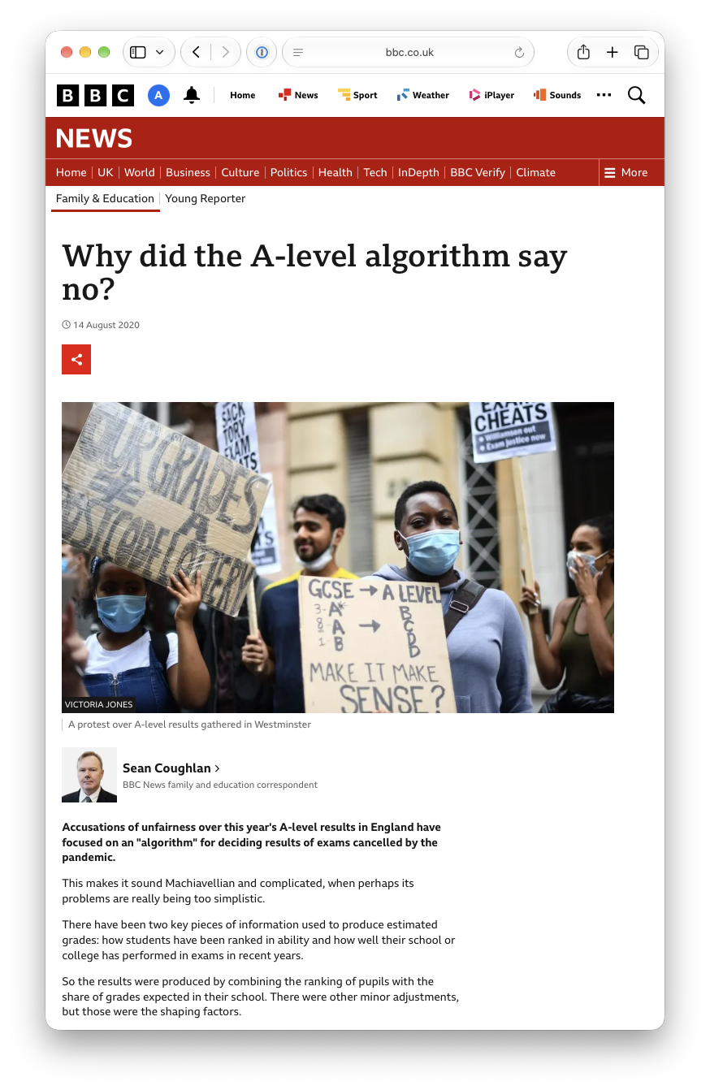
Slide 7: Pandemic (2020) exam prediction controversy
What happened here?
Who was impacted?
How were any problems resolved?
www.bbc.co.uk/news/education-53787203
en.wikipedia.org/wiki/2020_United_Kingdom_school_exam_grading_controversy
Notes:
Why are these outcomes occurring?
What assumptions are embedded in the model?
What values are being privileged?
Have we framed fairness incorrectly?

Slide 8
Slide 8: What happened here?
Historic data → model distribution
Teacher grades and rank
Predictions based on distributions and ranks
Historic
1 A*
2 As
4 Bs
3 Cs
Student | Teacher Grade | Rank
Alice | A* | 1
Ben | A* | 2
Chloe | A | 3
David | A | 4
Emma | B | 5
…
Rank | Student | Final Grade
1 | Alice | A*
2 | Ben | A
3 | Chloe | A
4 | David | B
5 | Emma | B
…

Slide 9
Slide 9: Who was impacted?
Who:
Classes/subjects with relatively small numbers of candidates (e.g. < 15)
Insufficient historical data for reliable statistical standardisation.
In many of these cases, teacher assessments carried much greater weight.
This mattered because:
Independent/private schools have smaller classes.
State schools have larger cohorts.
The consequence:
Many private-school students kept teacher-assessed grades.
Students in larger state-school cohorts more likely to be adjusted by the model.

Slide 10
Slide 10: How were any problems resolved?
What happened:
UK government and regulator (Ofqual) backtracked, revising students’ marks in-line with teacher predictions.
There were civil service and regulator resignations and regulator apology.
What changed:
Top grades increased by almost 40% in one year.
Universities were oversubscribed.

Slide 11

Slide 11: Poll
In hindsight, what should the development team have done:
Improve the model’s accuracy
Release the model with a warning
Investigate the source/training data
Consult affected communities
Reconsider the entire approach and goals
https://app.wooclap.com/XILZDQE

Slide 12


Slide 13
Slide 13
Introduction to critical and reflective practice

Slide 14
Slide 14: Reflection & Critical Practice
***
THIS WILL MAKE YOU OUTSTANDING INFORMATICIANS
***
How do we systematically and methodically:
reflect on what we do
(e.g., the technology we design and build, the results we produce)?
critically examine what happened and the implications
develop a practice where reflection and critical practice starts from the beginning (to limit failure, bias and catastrophe)

Slide 15
Slide 15:
Trade-offs
Notes:
What risks, what harms, what inequities, what changes to the structures of society are we willing to experiment with and what values are we willing to forgo?

Slide 16

Slide 16:
https://cinematimes.com/uk/edinburgh/movies/the-social-reckoning-2026/

Slide 17
Slide 17: A quick note on critical thinking
Critical (and reflective) thinking:
Disciplined judgement:
examining evidence, assumptions, values, power relationships and consequences
technical success as only one part of problem
Connects to course learning outcomes:
LO4: design, plan and implement in a range of technical, practice-based situations
LO5: demonstrate critical thinking, including in the social, ethical, and professional contexts
Notes:
Much of the course will help build this thinking for you. Today we want to provide you with some foundations or building blocks

Slide 18
Slide 18: Two related theories for reflection & critical practice
Donald Schön’s reflexive practice:
how you conduct yourself, professionally
Phil Agre’s critical technical practice:
how you should think about and approach tech design and R&D
👉

Slide 19
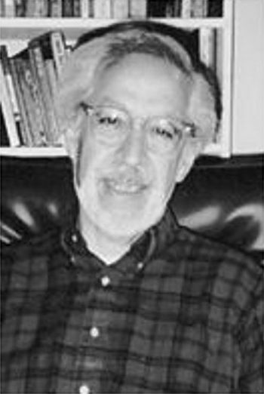
Slide 19
Schön’s ‘method’ for reflexive practice
Donald Schön Philosopher, Professor of Urban Studies & Education, MIT (Wikipedia)

Slide 20
Slide 20: Donald Schön’s “Reflective Practice”
Three ways engineers, architects, designers, teachers, etc. approach design:
Technical rationality applies established theory to a clearly defined problem.
Reflective practice addresses uncertainty, uniqueness, instability and conflicting values.
Reflection-in–action where knowledge and expertise are gained through practice — a “reflective conversation with the situation.”
Donald A. Schön (2017)
The Reflective Practitioner: How Professionals Think In Action. Routledge.
Notes:
Let’s start with the idea of reflection and draw on Schön’s notion of “reflective practice”.
Schön was a urban planner at MIT who sought to push back on what he called ‘technical rationality’.
In his eyes technical rationality was very limited in the real world.
He recognised that many of the problems faced in designing things had to grapple with the distinct qualities of a setting or context.

Slide 21
Slide 21: Reflection in computing and informatics
In computing and informatics, reflection invites you to stand back from technical rationality.
Rather than thinking about what you do as moving linearly from problem to solution, see your practice as a perpetual dialogue with what you are developing and the context you are developing it for.
How do we stand back from a focus on problem-solving?
How familiar are you with these words:
Iteration
Prototyping
Experimentation
Sensemaking

Slide 22
Slide 22: “Framing the problem”
For Schön ‘framing the problem’ is key:
Problem setting is often more important than problem solving.
‘Technical rationality’ places the emphasis on solving problems.
We need to learn how to understand a context and discover the problem, to frame the problem.
Problems are often ‘messy’:
Unclear goals
Conflicting stakeholder values
Ambiguous evidence
Multiple possible interpretations
For example: “How do we predict school students’ grades?” Which students? What data? To what end?
Notes:
https://www.leadingsapiens.com/problem-setting-problem-solving/

Slide 23
Slide 23: The frame creates a world of action
For the algorithmic approach used in exam prediction:
Problem: “How do we keep the overall distribution similar to previous years?”
Frame: statistical reliability, e.g., grade inflation, comparability with previous years, maintaining public confidence, university admissions stability.
A technical problem.
BUT many students and teachers framed the situation differently:
Problem: “How to fairly recognise what each student has achieved under exceptional circumstances.”
Frame: fair predictions that account for inequality, e.g., individual attainment, educational disruption, student wellbeing, social mobility, equity
A social or sociotechnical problem
Notes:
https://www.leadingsapiens.com/problem-setting-problem-solving/

Slide 24
Slide 24: Reflection-in-action
Unexpected outcomes included:
High-performing students being downgraded.
Schools with strong individual performers receiving lower grades.
Differential impacts across socioeconomic groups.
Think of these outcomes as the situation “talking back.”
Before and during implementation ask:
Who benefits from this model? Who might be disadvantaged? What values are embedded in the algorithm? Whose definition of fairness is being used? What counts as evidence of success? Who is excluded from the framing process?

Slide 25
Slide 25: Schönian Summary of the exam controversy
Using Schön's ideas of reflexive practice, the 2020 UK exam controversy:
Problem setting mistaken for settled technical issue rather than open political and ethical question.
Reflection-in-action insufficient during design and implementation of grading model.
Unexpected outcomes should have prompted earlier reframing.
Reflexive practice would have exposed hidden assumptions about fairness, merit, and statistical legitimacy.
Eventual reversal was more than a policy change. It was a fundamental reframing of what the problem was thought to be.
Most significant error — not the algorithm but failure to continuously question the frame through which the grading problem had been understood.

Slide 26
Trade-offs
Slide 26
Notes:
For you, which is the most pressing issue/concern that you’d be unwilling to give up on?
assumption, bias, privilege, motive, power relationship or limitation that influenced the decision

Slide 27
Slide 27: Next week: Phil Agre’s Critical Technical Practice
Schön focuses on reflection-in-action and problem framing.
Agre provides a method for critically examining the conceptual assumptions that shape how technical problems are framed in the first place.

Slide 28
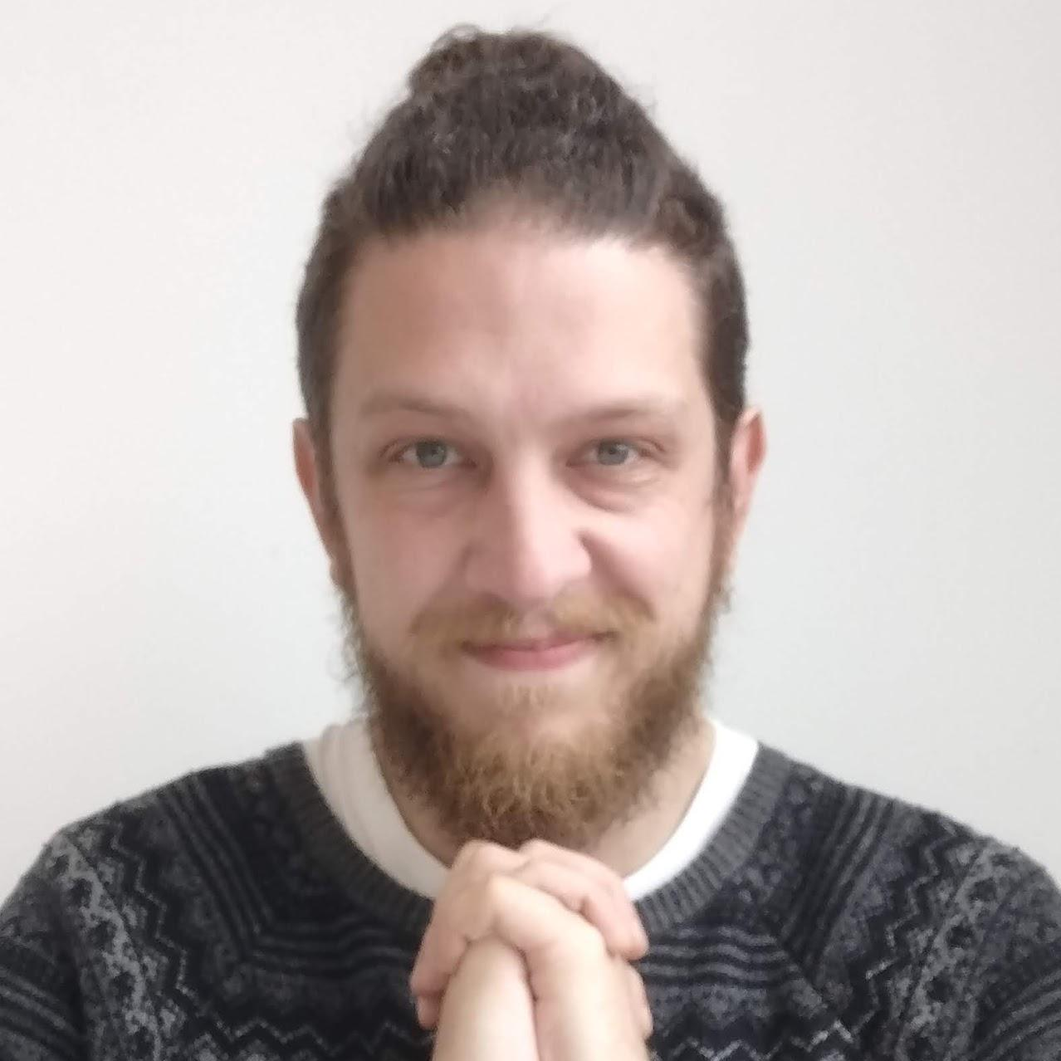


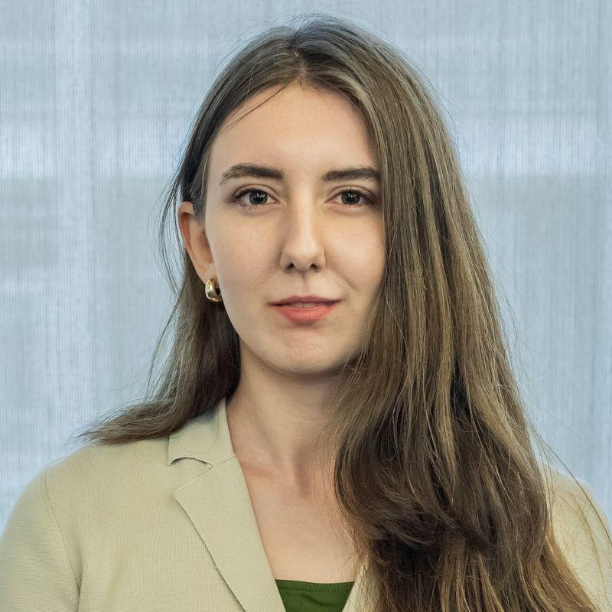
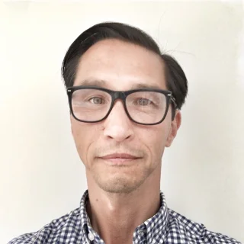

Teaching Staff
Lecturers
Teaching Assistants (TAs)
James Garforth
Alex Gillespie
Persie Rolley-Parnell
Sarah Immel
Alex Taylor
Kimberly Paradis

Slide 29
Important Links
Open Course: https://opencourse.inf.ed.ac.uk/inf1-crisp
EdStem: https://edstem.org/eu/courses/3351/discussion
Course Catalogue: http://www.drps.ed.ac.uk/26-27/dpt/cxinfr07003.htm
InfPALS: https://infpals.github.io/index.html

Slide 30
Contact us?
If you have course specific concerns, use EdStem. Ask a question anonymously if you’re more comfortable with that (though not anonymous to the teaching staff).
  EdStem CriSP Link
If you have personal concerns, use the CriSP email address (don’t forget to introduce yourself in the email).
It’s very unlikely we will reply to you outside of our working hours. We will do our best to reply within 48 hours (usually sooner) not counting weekends.
If there is an emergency, the phone numbers and email addresses for University security are on the back of student cards.
If someone is in danger of harm, call the emergency services on 999.

