Slide 1
Designing a Toolkit for Auditing AI
CS-NLP Week 3
Prof. Frauke Zeller, Ella Markham

Slide 2
AI Auditing, how?
An audit will typically assess the organisation’s procedures, processes, records and activities in order to:
ensure that appropriate policies and procedures are in place;
verify that those policies and procedures are being followed;
test the adequacy of controls in place;
detect breaches or potential breaches of compliance; and
recommend any required changes in control, policy and procedure.
  (A Guide to ICO Audit: Artificial Intelligence [AI] Audits)

Slide 3
AI Auditing, how?
Let’s start developing more concrete ideas around AI auditing
These will be the ground work for your upcoming assessment 2
This week and next week, you will be provided with some material on how to actually conduct an AI audit
These materials come from different sources, national backgrounds, with differing intentions and differing understandings of what an AI audit is
It is up to you to make sense of the myriad of information and to come up with a concrete toolkit, including benchmarks etc.
We will be discussing the progress in class

Slide 4
AI Auditing - What we are asking you to do…
Look at the main points of an AI audit, e.g. fairness, transparency, accountability, privacy, security*, etc.
Find concrete points/guides/benchmarks how to assess them
It is up to you to decide how many you need
The outcome should be pragmatic and actually usable
Use the Learn Discussion environment to present your progress and results. Discuss among the whole group.
(*https://professional.dce.harvard.edu/blog/building-a-responsible-ai-framework-5-key-principles-for-organizations/#What-Are-the-5-Key-Principles-of-Ethical-AI-for-Organizations)

Slide 5
How can we assure research quality?
Quality in research faces evaluation and assessment challenges on three core levels: micro, meso and macro/

Slide 6
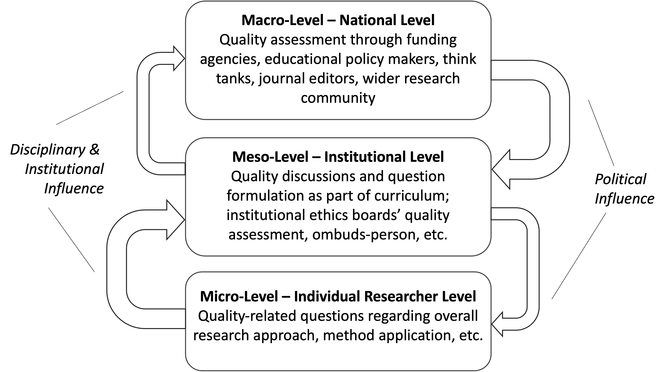
Zeller, F., & Woods, J. (2025). Qualitative research quality in social media research. In U. Flick (Ed.), The Sage Handbook of Qualitative Research Quality SAGE Publications. https://doi.org/10.4135/9781529674354.n19
Notes:
“The need to auditing AI systems results from a confluence of top-down and bottom-up pressures. The former includes the regulatory mandates and normative expectations placed on technology providers by external stakeholders like policymakers and advocacy groups. The latter includes voluntary measures taken by technology providers to stay competitive in their industries, including continuous improvements in software development and testing procedures (Mökander, 2023, p.8, see also figure below).

Slide 7
Materials
All of you, watch video:
https://www.ted.com/talks/helen_toner_how_to_govern_ai_even_if_it_s_hard_to_predict
(optional) https://www.youtube.com/watch?v=noivN2hIXLY
Additional materials will be provided through our course website on Learn
https://www.gov.uk/government/publications/ai-playbook-for-the-uk-government/artificial-intelligence-playbook-for-the-uk-government-html#acknowledgementsc
https://www.gov.uk/government/publications/generative-ai-framework-for-hmg

