Slide 1
ISO 61508 Development
SCSD Lecture 21 Mar 2024

Slide 2
Overview
This lecture is based on IEC 61508-5 and -6
IEC 61508-7 considers a range of techniques but many of those are outdated.
IEC 61508 is focused on safety functions in controlling equipment
It has however, had considerable influence on other software standards
The focus is on safety functions whose typical mode of operation is:
  To be called on infrequently by the control software or from other sources
  This ”demand” should result in the system being moved into a safe state.
So, the focus for safety function is the probability of failure on demand.
IEC 61508 also considers systems with much more frequent demand or the need to operate continuously

Slide 3
Safety Integrity Level
Safety Integrity is defined as “The probability of a Safety Instrumented Function (SIF) satisfactorily performing the required safety functions under all stated conditions within a stated period of time”.
Safety Integrity Level (SIL): levels 1-4 are categories of safety integrity used in specifying the safety integrity requirements of safety functions.

Slide 4
Definitions of SIL levels
Safety Integrity level | Probability of Failure on Demand | Risk Reduction Factor
SIL 4 | 10-5≥ PofD <10-4 | 100,000 to 10,000
SIL 3 | 10-4≥ PofD <10-3 | 10,000 to 1,000
SIL 2 | 10-3≥ PofD < 10-2 | 1,000 to 100
SIL 1 | 10-2≥ PofD < 10-1 | 100 to 10

Slide 5
Risk and Safety Integrity
Risk is concerned with the overall likelihood and consequences of an event (for the whole system).
Safety integrity applies to the electrical, electronic and programmable parts of the system together with other risk reduction measures.
Safety integrity is a measure of the likelihood that these measures achieve the required risk reduction for the safety functions.
Once tolerable risk has been identified (and the risk of operating the system without any risk reduction is identified) the necessary risk reduction will be determined and safety integrity requirements can be determined (and SIL level allocated to functions).

Slide 6
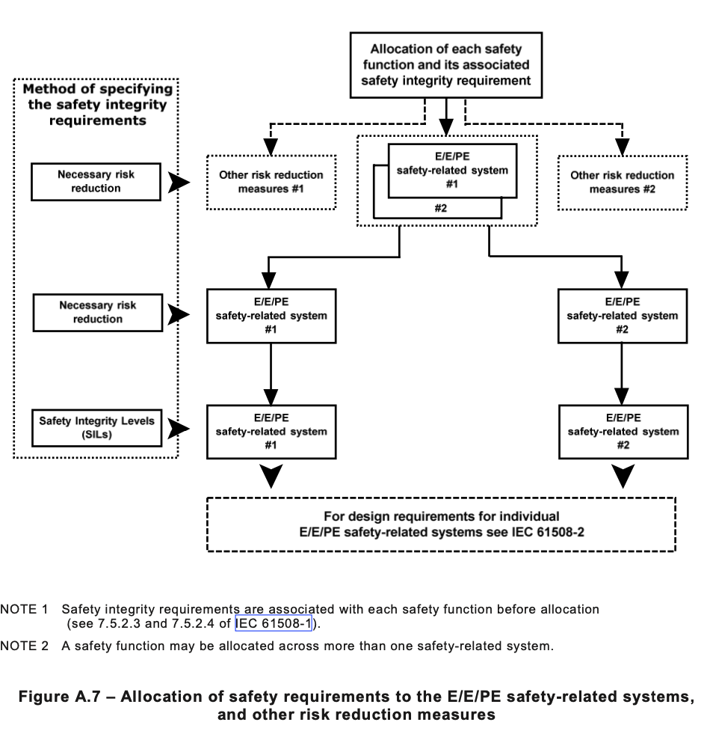
Safety Requirements

Slide 7
Methods for Determining SIL requirements
The following should be taken into account:
  the risk acceptance criteria that need to be met. Some of the techniques will not be suitable if it is required to demonstrate that risk has been reduced to as low as reasonably practicable;
  the mode of operation of the safety function. Some methods are only suitable for low demand mode;
  the knowledge and experience of the persons undertaking the SIL determination and what has been the traditional approach in the sector;
  the confidence needed that the resulting residual risk meets the criteria specified by the user organisation. Some of the methods can be linked back to quantified targets but some approaches are qualitative only;
  more than one method may be used. One method may be used for screening purposes followed by another more rigorous approach if the screening method shows the need for high safety integrity levels;
  the severity of the consequences. More rigorous methods may be selected for con- sequences that include multiple fatalities;
  whether common cause occurs between the E/E/PE safety related systems or between the E/E/PE safety related system and demand causes.

Slide 8
Methods for determining SILs
ALARP
Quantitative method
Risk Graph
Layer of Protection Analysis
Hazardous event severity matrix

Slide 9
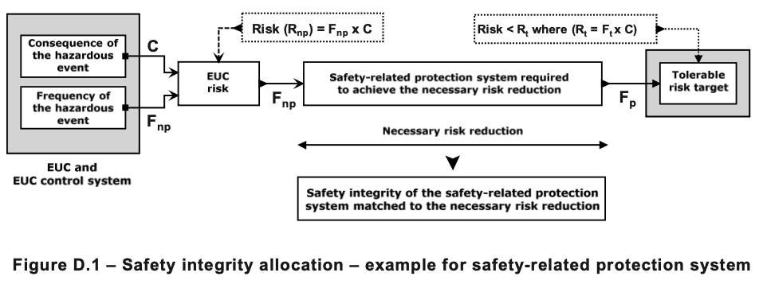
Quantitative Method

Slide 10
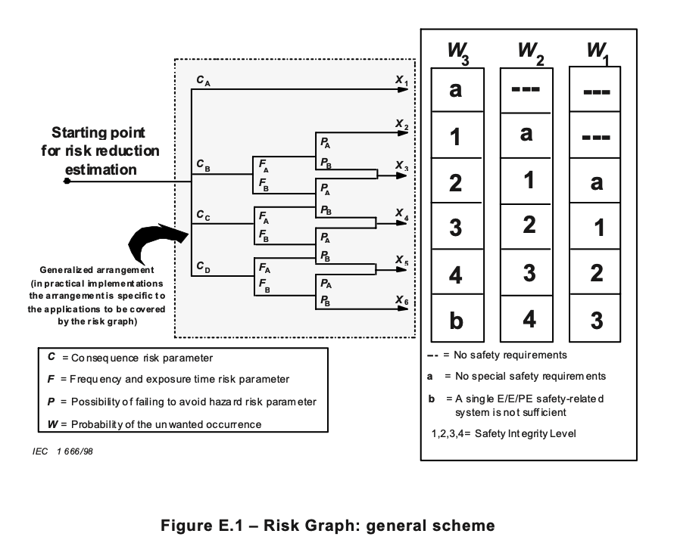
Risk Graph
The parameter W captures the required risk reduction for the system.

Slide 11
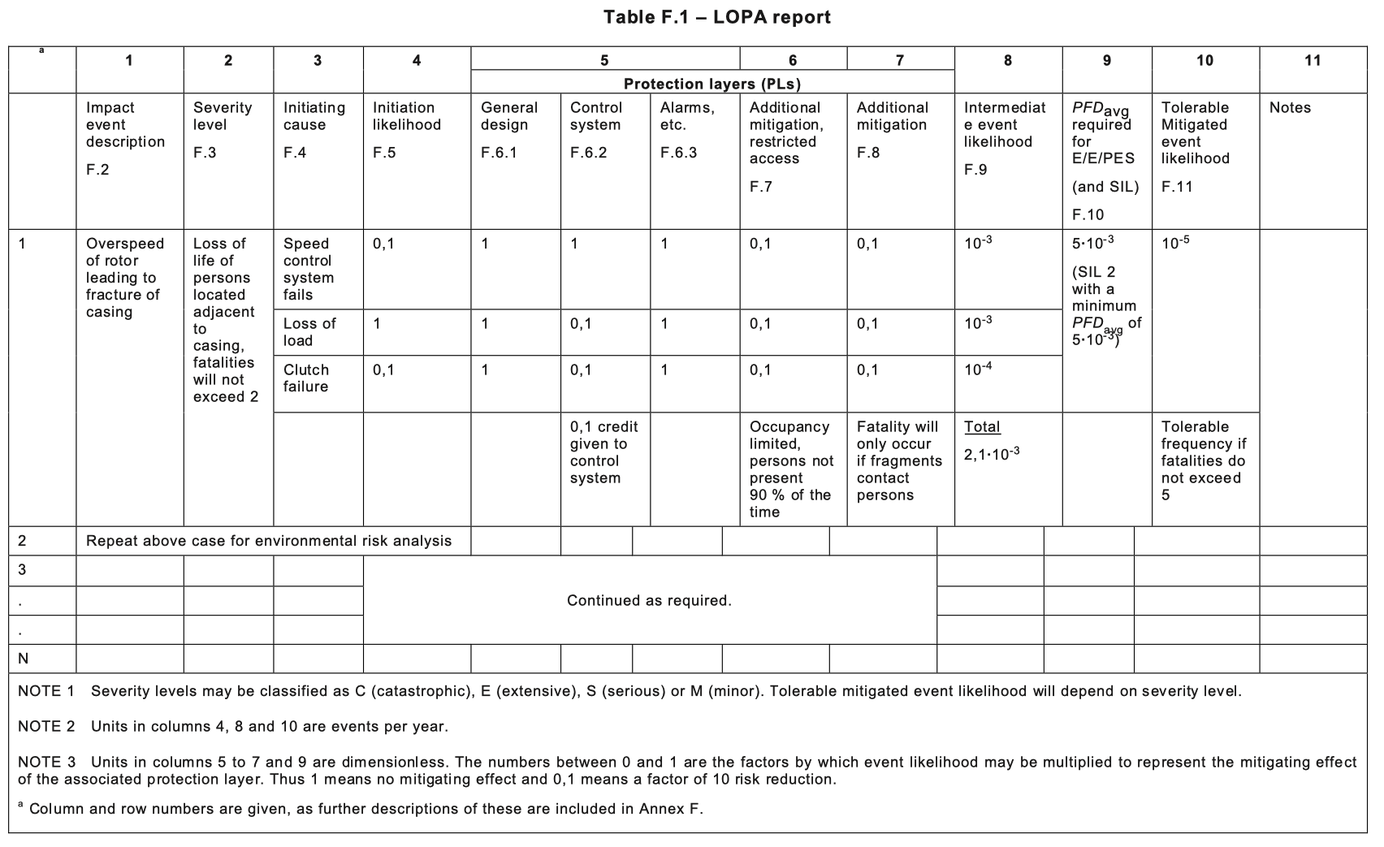
Layer of Protection Analysis

Slide 12
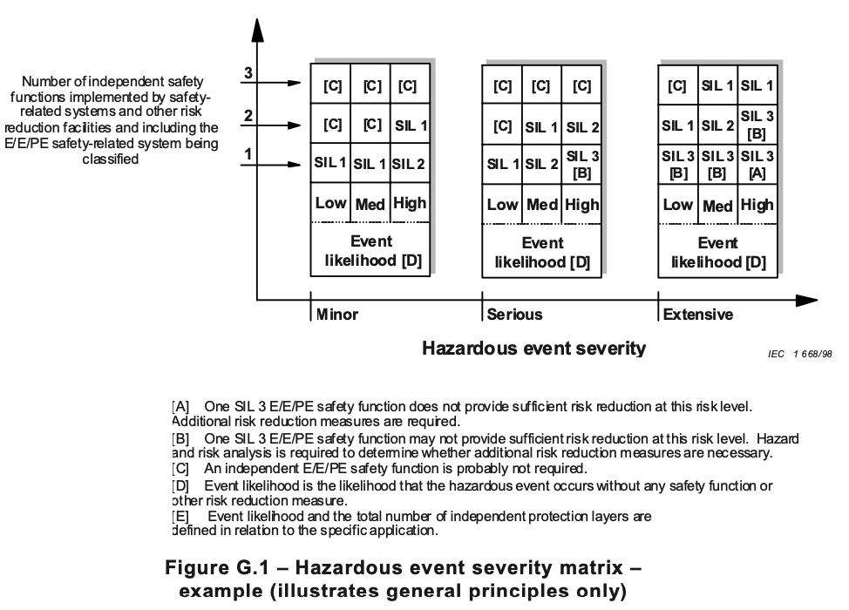
Hazardous Event Severity Matrix

Slide 13
Development Process
Each of the tables in IEC 61508-3 are populated for the application.
What follows is the example in IEC 61508-6 for a SIL3 system
Each of the stages in the development process spells out the use of particular techniques.

Slide 14
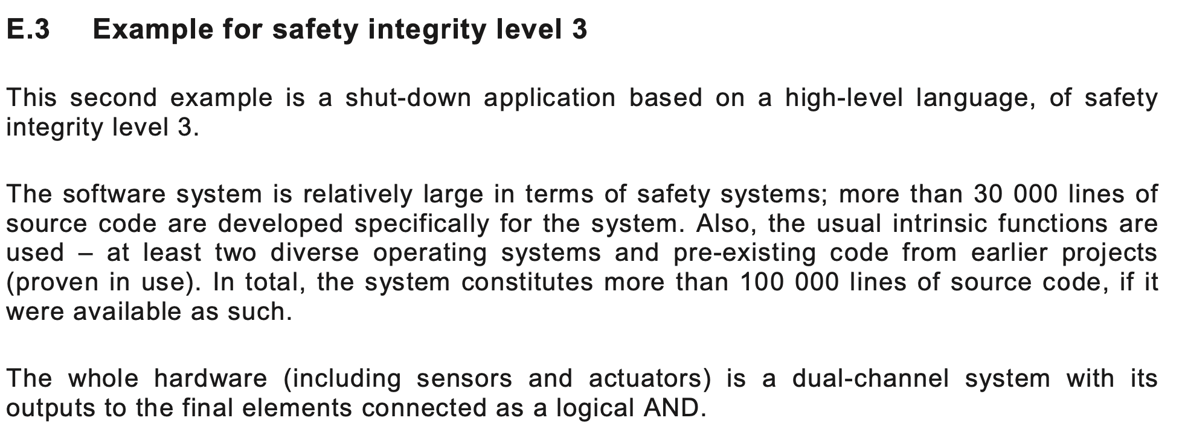
Example introduction

Slide 15
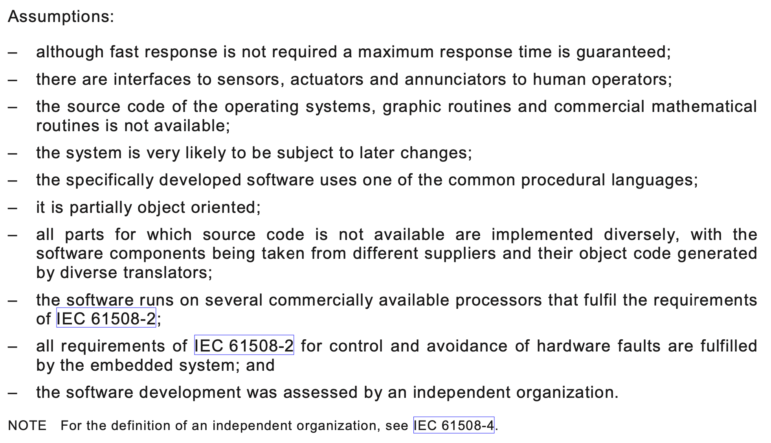
Example assumptions

Slide 16
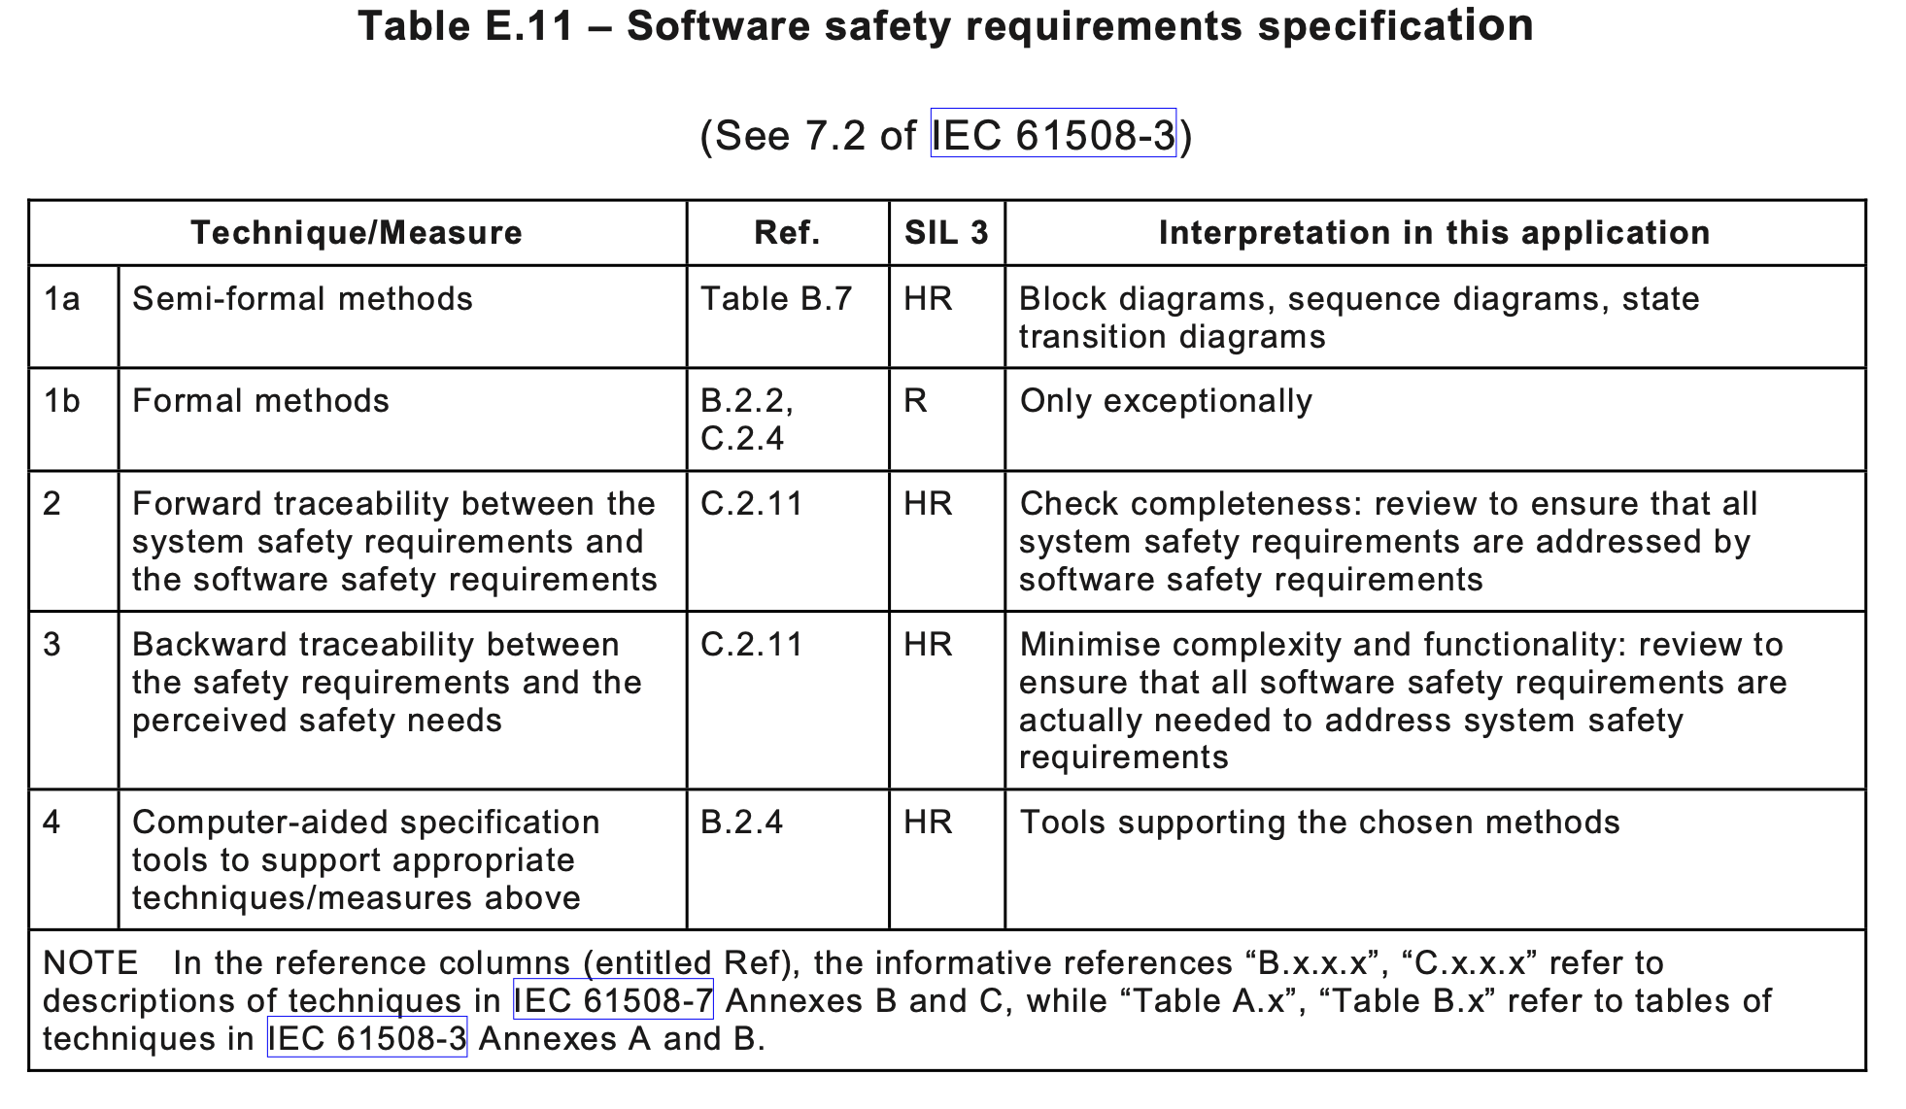
Requirements

Slide 17
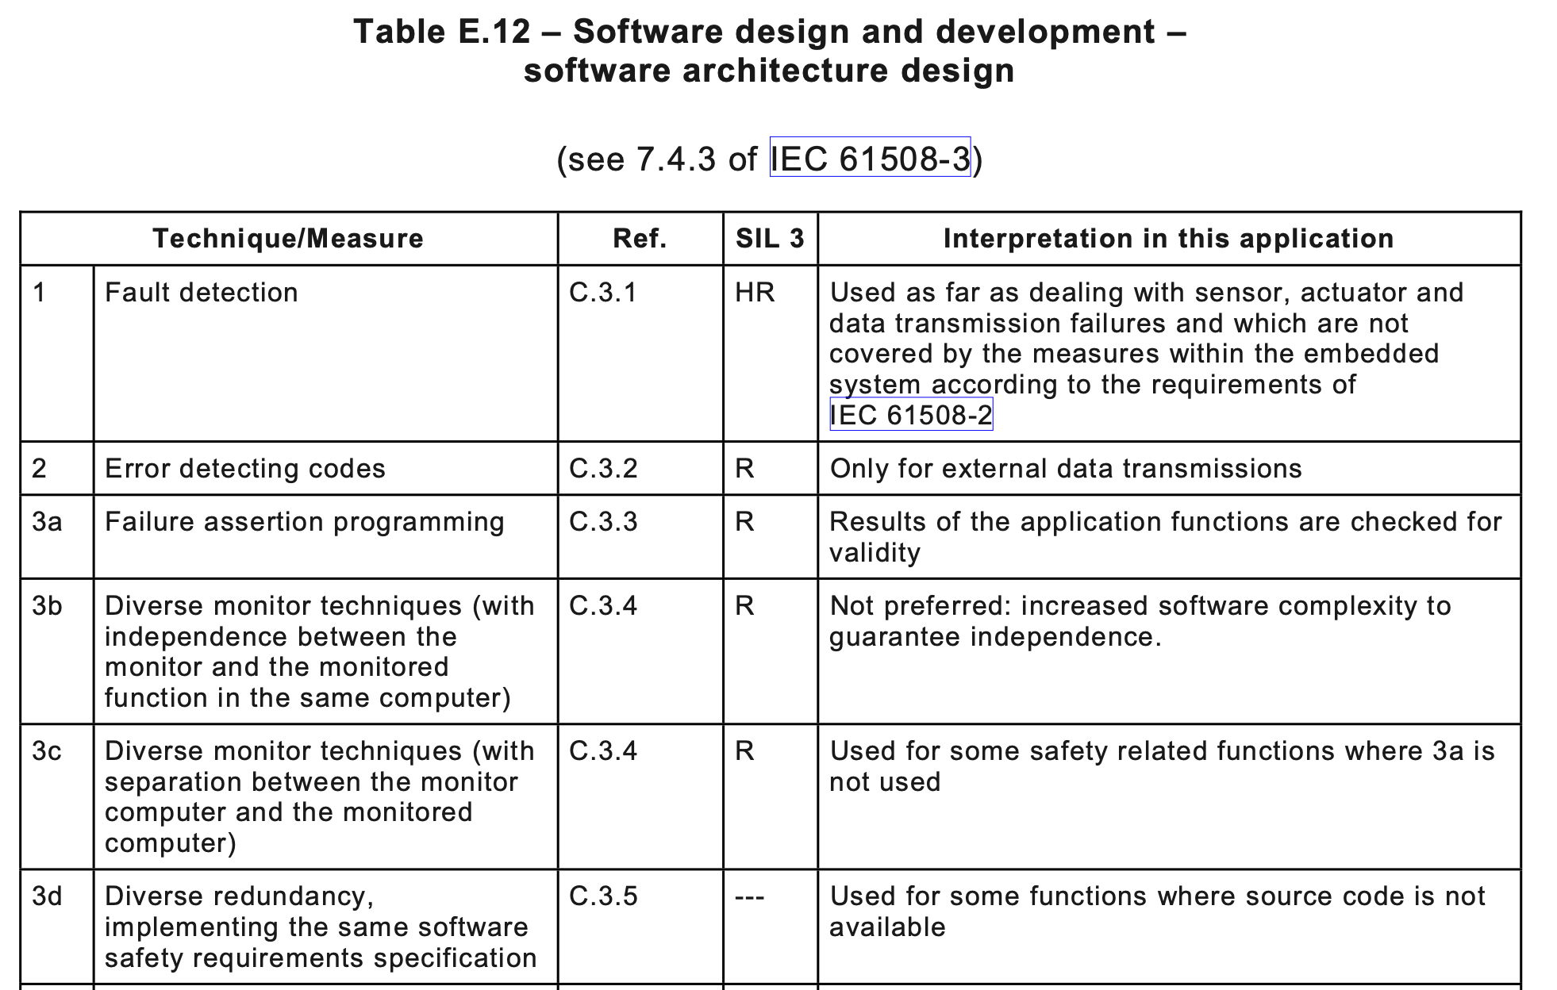
Architecture

Slide 18
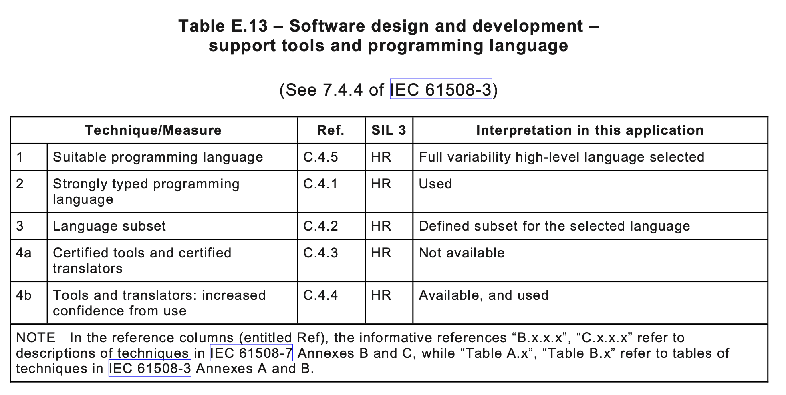
Support Tools

Slide 19
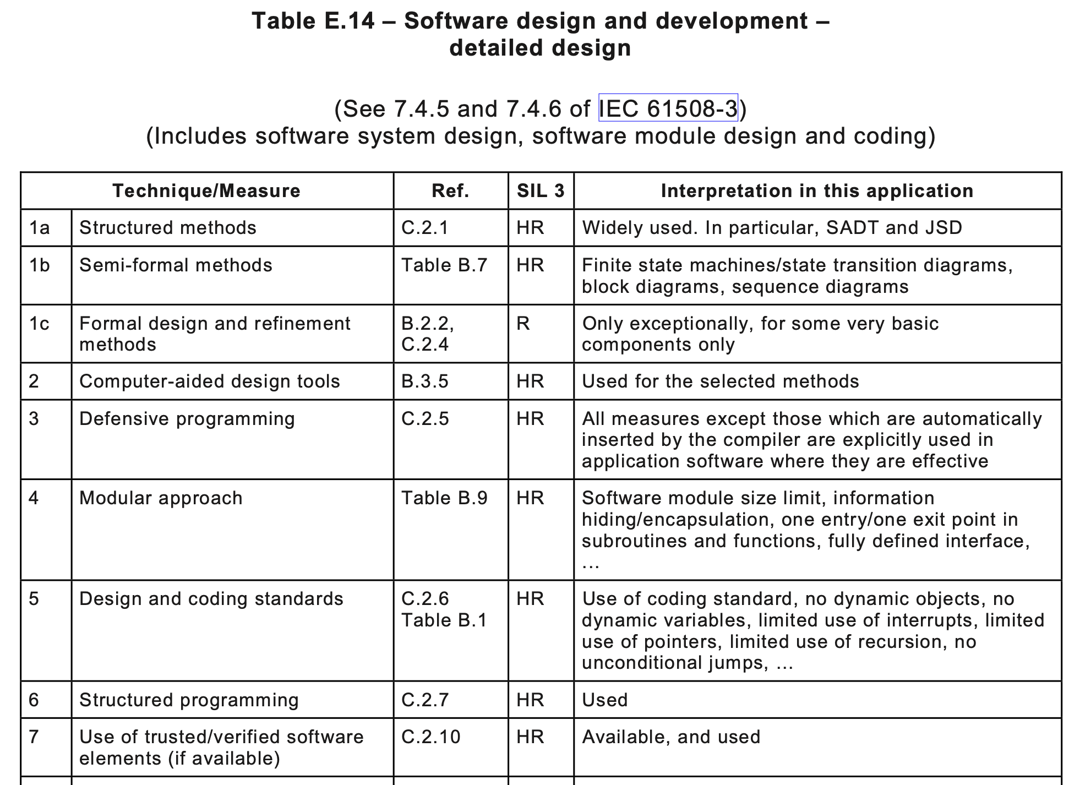
Detailed Design

Slide 20
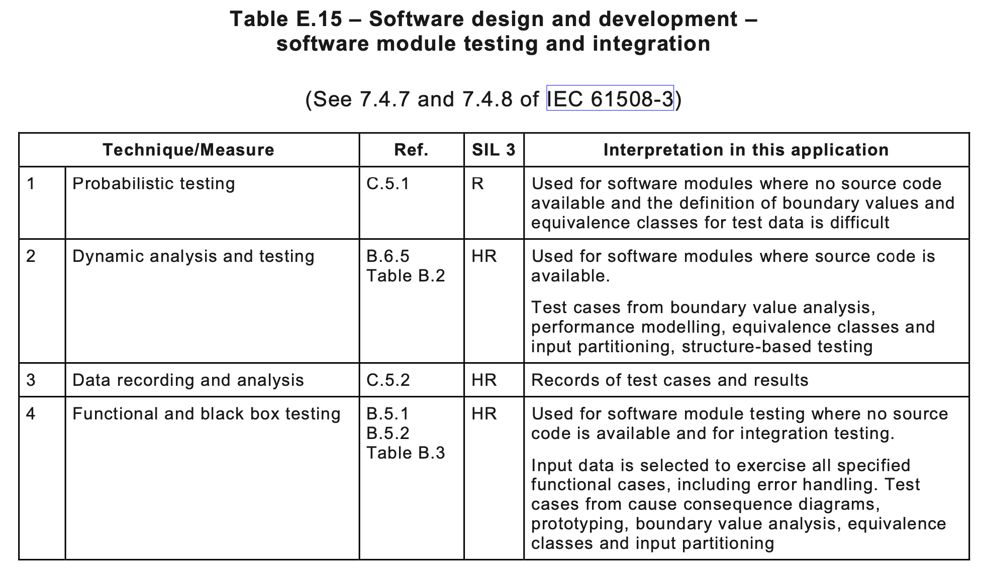
Test

Slide 21
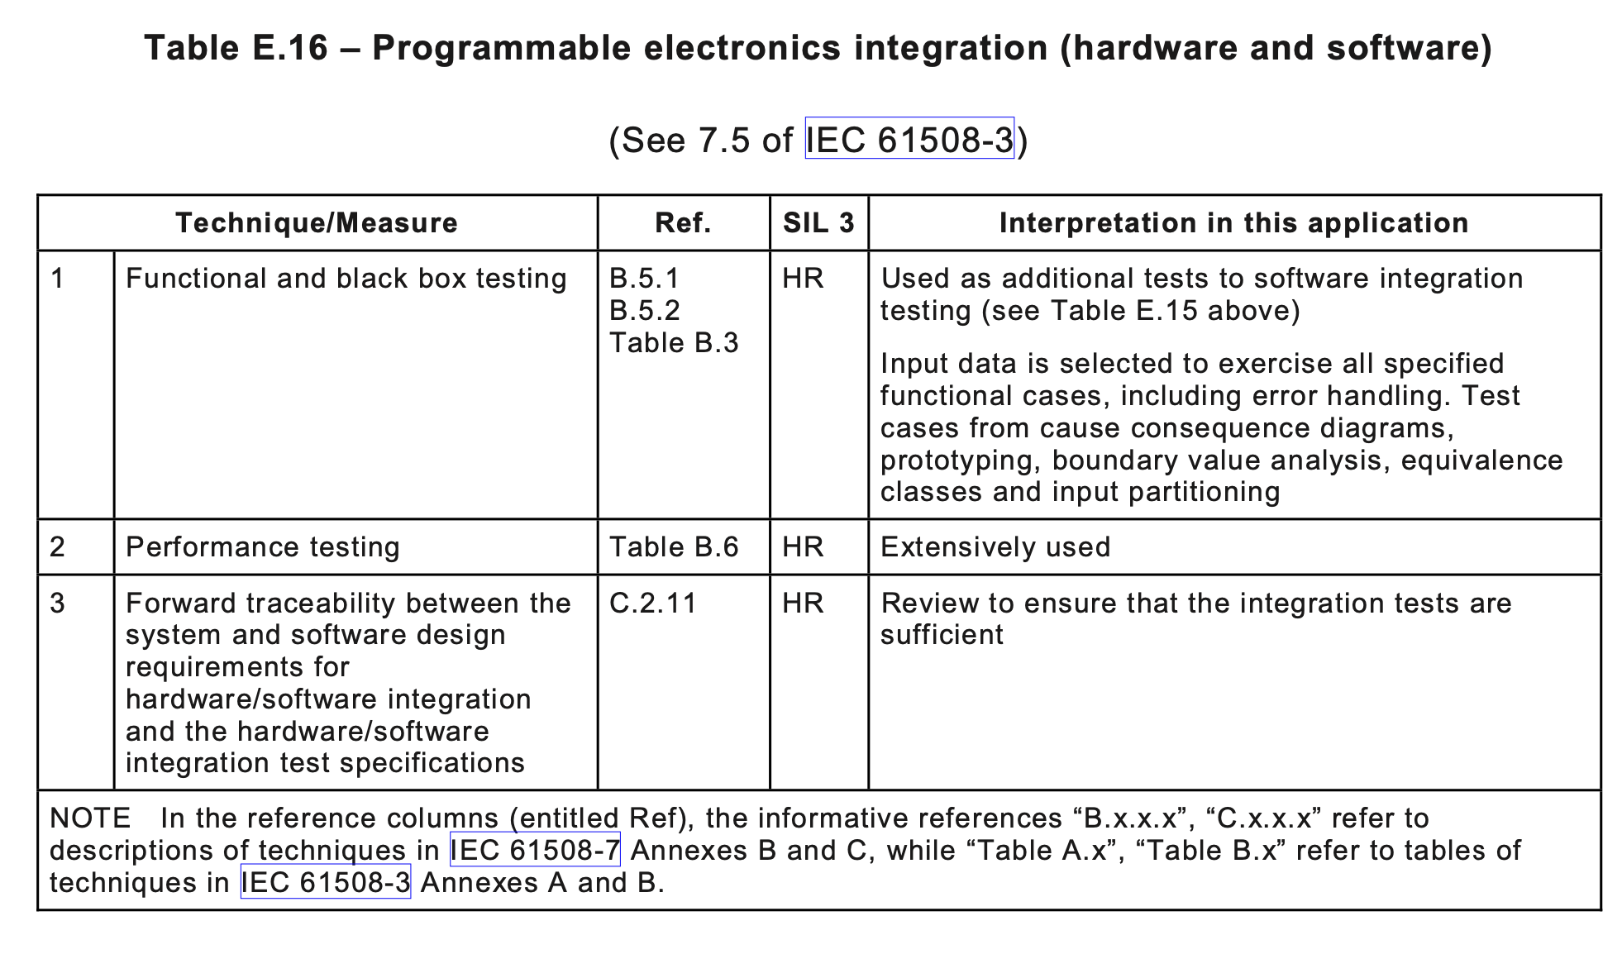
Integration

Slide 22
Summary
Safety Integrity
SILs
Determining SILs
Using SILs to determine development process

