Slide 1
The Anatomy of ISO 42001
SCSD Lecture 1 Feb 2024

Slide 2
The Foreword
No responsibility, liability, etc
Users take the risk
Who is a ”professional”?
What is “correct application”?

Slide 3
How should it help us?

Slide 4
It should help with processes

Slide 5
What does this mean?
The first point relates to requirements on the process: why are you using AI at all? What is the aim of the organization? Who are the stakeholders?
Risk management is an essential aspect of any process management system (and there is a generic approach to it that gets specialized).
The next point is a list of “concerns” around others – can you think of others?
The final point raises the issue of the ”AI supply chain” what does it look like and who is involved in creating and deploying models.

Slide 7
The scope tells you what the standard is for

Slide 8
What is the scope telling you
What: the standard sets out to do: “This documents specifies the requirements….”
Who: the standard sets out who should be interested in using the standard: “intended for use by an organization providing or using products or services that utilize AI systems.”

Slide 9
Other standards, and terminology

Slide 10
Terminology

Slide 11
Main body of the standard

Slide 12
Requirements

Slide 13
Explanatory notes

Slide 14
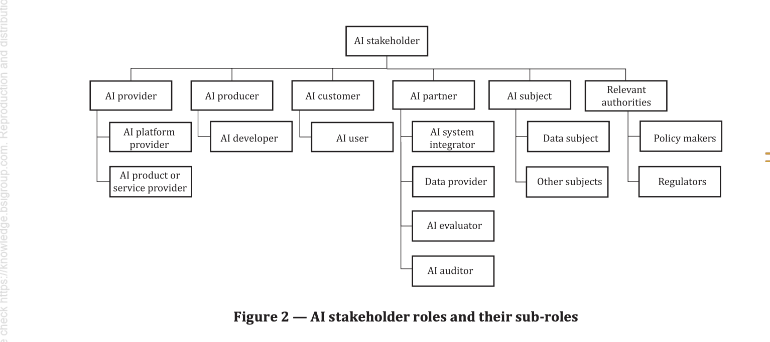
Referring to Standards
BS EN ISO/IEC 22989:2023
Information technology — Artificial intelligence — Artificial intelligence concepts and terminology

Slide 15
Testable?

Slide 16
Documentation

Slide 17
Organizational perspective

Slide 18
Organisational Policy

Slide 20
Planning

Slide 21
Risk

Slide 22
Summary
Although we have looked at ISO 42001 this lecture has started to look at the general structure of management/quality standards.
Standards generally avoid legally binding commitments
Standards often sit inside closely related standards
Standards attempt to have focused scope and refer to other standards.
Standards requirements should be testable
Standards often mandate documentation of policies, assessments, plans, …
Risk is a key concept in planning

