Slide 1
Automating Analysis and Test

Slide 2
Learning objectives
Be able to explain the main purposes of automating software analysis and testing
Identify activities that can be fully or partially automated
Be able to use cost/benefit trade-offs to decide on automation
Be able to separate publicity from important features in descriptions of commercial A&T tools

Slide 3
Potential Roles of Automation
Necessary for introducing a task
  example: coverage tools enable measuring structural coverage of test suites
Useful to reduce cost
  example: capture and replay tools reduce the costs of reexecuting test suites
Useful to increase (human) productivity
  example: software inspection is a manual activity, but tools to organize and present information and manage communication increase the productivity of people
Essential to automate CD/CI activities

Slide 4
Approaching Automation
Prioritize automation steps based on
  variations in impact, maturity, cost, scope of the technology
  fit and impact on the organization and process
Three (non-orthogonal) dimensions for automation
  value and current cost of the activity
  extent to which the activity requires or is made less expensive by automation
  cost of obtaining or constructing tool support
Notes:
23.1: Overview

Slide 5
Automation Costs Vary Enormously
Some tools are so simple to develop that they are justifiable even if their benefits are modest
  example: generate test cases from finite state machine models
Some tools that would be enormously valuable are simply impossible
  example: identify exactly which parts of a program can never be executed (a provably undecidable problem)

Slide 6
Costs May Depend on Scope
Sometimes a general-purpose tool is only marginally more difficult to produce than a tool specialized for one project
  example: general capture and replay for Windows applications vs capture and replay for a specific Windows application
  Investment in the general-purpose tool, whether to build it or to buy it, can be amortized across projects
In other cases, simple, project-specific tools may be more cost effective
  Tool construction is often a good investment in a large project
  example: simulators to permit independent subsystem testing

Slide 7
Focusing Where Automation Pays
Simple repetitive tasks are often straightforward to automate
  humans are slow and make errors in repetitive tasks
But ...judgment and creative problem solving remain outside the domain of automation
Example: Humans are
  Very good at identifying relevant execution scenarios that correspond to test case specifications
  Very inefficient at generating large volumes of test cases or identifying erroneous results within a large set of outputs from regression tests
Automating the repetitive portions of the task reduces costs, and improves accuracy as well

Slide 8
Planning: The Strategy Level
Prescribes tools for key elements of the quality process
Can include detailed process and tool prescriptions
Recommends different tools contingent on aspects of a project
  (application domain, development languages, size, overall quality,...)
Often included in the A&T strategy: tools for
  Organizing test design and execution
  Generating quality documents
  Collecting metrics
  Managing regression test suites
Less often included: tools for
  Generating test cases
  Dynamic analysis
Notes:
23.2 Automation and Planning

Slide 9
Planning: The Project Level
The A&T Plan Indicates
  Tools inherited from the strategy
  Additional tools selected for that project
  For new or customized tools, the A&T plan must include
    Costs (including training)
    Implied activities
    Potential risks
The plan positions tools within the development process and the analysis and test methodology
  Avoid waste of cost and effort from lack of contextualization of the tools
  Example: tools for measuring code coverage
    simple and inexpensive
    (if not properly contextualized) an annoyance, producing data not put to productive use

Slide 10
Process Support:
Planning & Monitoring

Slide 11
Automation in Process Management
Managing a process involves ...
  planning a set of activities with appropriate cost and quality trade-offs
  monitoring progress to identify risks as early as possible
  avoiding delays by adjusting the plan as needed
... and requires ...
  human creativity and insight for which no tool can substitute
Tools can support process management and improve decision making by
  organizing and monitoring activities and results
  facilitating group interaction
  managing quality documents
  tracking costs
Notes:
23.3 Process Management

Slide 12
Classic Planning Tools
Facilitate task scheduling, resource allocation, and cost estimation by arranging tasks according to resource and time constraints
Can be specialized to A&T management with features for deriving relations among tasks, launching tasks, and monitoring completion of activities
Examples: tools to
  recognize delivery of a given artifact
  schedule execution of a corresponding test suite
  notify test designer of test results
  record the actual execution time of the activity
  signal schedule deviations to the quality manager
Most useful when integrated in the analysis and test environment

Slide 13
Version and Configuration Control Tools
Analysis and testing involve complex relations among a large number of artifacts
Version and configuration management tools
  relate versions of software artifacts
  trigger consistency checks and other activities
  support analysis and testing activities like they control assembly and compilation of related modules
    example: trigger execution of the appropriate test suites for each software modification
Improve efficiency in well-organized processes
  not a substitute for organization

Slide 14
Monitoring
Integrated quality tracking
  improves efficiency in a well-structured process,
  does not by itself bring order out of chaos
Progress must be monitored in terms of
  schedule (actual effort and completion times vs plan)
  level of quality
Quality of the final product
  cannot be directly measured before its completion
  but we can derive useful indications
    example: orthogonal defect classification [see chapter 20]

Slide 15
Quality Tacking
Essential function: recognize deviations from expectation as early as possible to reduce consequences
Proxy measures
  must be computed early
  must be interpreted in a way that avoids misleading conclusions or distorted incentives
Example: lines of code
    useful as a simple proxy for productivity
    must be carefully interpreted to avoid creating both an incentive for verbosity and a disincentive for effective reuse
Example: number of faults detected
    useful to detect deviations from the norm
    one should be as concerned about the causes of abnormally low numbers as high
Collection, summary, and presentation of data can be automated
Design and interpretation cannot be automated
Notes:
Reminder: A proxy measure is something that we use as an indication of some quality we would like to measure.
For example, we might like to measure reliability early in a project, but we can’t --- so we use something else,
such as defect density (faults found per 1000 lines of code) as a proxy for reliability. Proxies are never perfect,
but we prefer imperfect indicators to pure wishful thinking.

Slide 16
Managing People
People may work
  in different groups
  in different companies
  distributed across time zones and continents
A large proportion of a software engineer's time is devoted to communication
We need to
  facilitate effective communication
  limit disruptions and distractions of unmanaged communication

Slide 17
Managing Communication
Simple general-purpose tools (e-mail, chat, forum, ...)
  balance synchronous with asynchronous communication
  examples
    When excessive interruptions slow progress, we may replace synchronous with asynchronous communication
    Conversely, when communication is splintered into many small exchanges punctuated by waits for reply, we may replace asynchronous with synchronous communication
Communication is most effective when all parties have immediate access to relevant information
  Task-specific tools can improve on general-purpose support
  Example: tools for distributed software inspections
    Extend chat interfaces or forum with
      Managed presentation of the artifact to be inspected
      Appropriate portions of checklists and automated analysis results

Slide 18
Measurement

Slide 19
Metrics
Measuring progress & results is necessary for managing processes
... but often we cannot measure what we really care about
  e.g., actual progress toward goals or effort remaining; projected reliability; ...
Metrics are proxy measures (rough guides) based on what we can measure
  Anything that is correlated with the real measure of interest under typical conditions
  Usually require calibration to local conditions

Slide 20
Static Metrics: Size
Static metrics measure some software properties, often to estimate other properties (i.e., as proxies for things we can’t measure)
Size is the most basic property
  strongly correlated with schedule and cost
  several possible variations, depending on white space, comments, programming style
Course measures include counts of modules or interfaces
  functions, methods, formal parameters, etc
Many more complex measures ...
  but lines of code is about as good (or bad) as complex measures for judging effort
Notes:
23.4 Static Metrics

Slide 21
Measuring Complexity
Intuitive rationale: If we could measure how complicated a program or its parts were, we could ...
  Focus test & analysis on most error-prone parts of a system
  Make better plans and schedules
  Consider redesign of excessively complex subsystems
But we can’t measure true (logical) complexity directly.
Control flow complexity is a proxy.

Slide 22
Cyclomatic complexity
Among attempts to measure complexity, only cyclomatic complexity is still commonly collected
cyclomatic complexity V(g)
=
number of independent paths through the control flow graph
=
e - n + 2
(edges - nodes + 2)
Notes:
sidebar

Slide 23
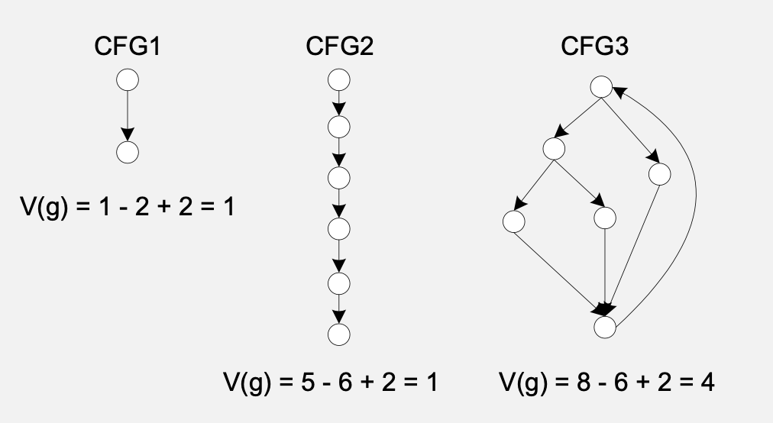
Cyclomatic metrics and complexity

Slide 24
Interpreting Cyclomatic Complexity
V(g) < 20
  Low to moderate cyclomatic complexity
  simple program
V(g) > 20
  high cyclomatic complexity
  complex programs
V(g) > 50
  very high cyclomatic complexity
  programs very difficult or impossible to thoroughly test
Cyclomatic vs logical complexity
  sign of complex control flow structure
  does not capture other aspects of logical complexity that can lead to difficulty in testing
Notes:
End of sidebar

Slide 25
Metrics & Quality Standards
Quality standards
  May be prescribed (e.g., by contract)
  May be adopted voluntarily as guidance
A quality standard like ISO/IEC 9126 requires measurement of user-perceived quality
  but doesn’t say how to measure it
To implement ... We must find objective indicators (metrics) for each required quality

Slide 26
ISO/IEC 9126 Metrics (level 1)
Functionality | Ability to meet explicit and implicit functional requirements
Reliability | Ability to provide the required level of service when the software is used under appropriate conditions
Usability | Ease of understanding, teaching, and using
Efficiency | Ability to guarantee required performance under given conditions
Maintainability | Ability to be updated, corrected, and modified
Portability | Ability to be executed in different environments and interoperate with other software
Broad qualities require refinement and mapping to objectively measurable properties
Notes:
These are broken down to the level of the table on page 446 of the text in the optional slides.
Suggestion for class interaction: Ask students to take one of the characteristics and suggest ways of mapping it to measurements.
It may be useful to consider one of functionality or reliability (for which they should be able to choose approaches from earlier chapters of this book),
and one of the others, such as portability. How might one provide an objective measure of portability?
Look for practical approaches that consider reasonable, pragmatic goals. For example, it might be reasonable to require
a web application to work on a certain set of popular web browsers and platforms, but impractical to require identical
functioning on every possible browser. Likewise, regarding maintainability, one might require demonstrations and analysis regarding
the ease of making certain classes of change, but the accuracy of this estimate will depend to a very large degree on
whether one has made a realistic assessment of important and likely changes to the software over time.

Slide 27
Automating Program Analysis, Test Case Generation, and Test Execution

Slide 28
Test Case Generation and Execution
Automation is important because
  It is large fraction of overall test and analysis costs
  can become a scheduling bottleneck near product delivery deadlines
Designing a test suite
  involves human creativity
Instantiating and executing test cases
  is a repetitive and tedious task
  can be largely automated to
    reduce costs
    accelerate the test cycle
Notes:
23.5 Test Case Generation and Execution
This is mentioned in chapter 23, but the main content is in (many) prior chapters

Slide 29
Automated Testing - Stages
Push the creative work as far forward as possible
  E.g., designing functional test suites is part of the specification process
  At each level, from systems requirements through architectural interfaces and detailed module interfaces
Construct scaffolding with the product
Automate instantiation and execution
  So they are not a bottleneck
  So they can be repeated many times
Notes:
Relevant chapters here include combinatorial testing (Ch 11) and test execution (Ch 17).

Slide 30
Static Analysis and Proof
Effective for
  Quick and cheap checks of simple properties
    Example: simple data flow analyses can identify anomalous patterns
  Expensive checks necessary for critical properties
    Example: finite state verification tool to find synchronization faults

Slide 31
Design for Verification
Decompose Verification Problems
  Design: enforce design rules to accommodate analysis
    example: encapsulate safety-critical properties into a safety kernel
  Verification: focus on encapsulated or simplified property
    example:
    prove safety properties of the (small) kernel
    check (cheaply, automatically) that all safety-related actions are mediated by the kernel

Slide 32
Undecidability and Automated Analysis
Some tools report false alarms in addition to real violations of the properties they check
  example: data flow analyzers
Some tools avoid false alarms but may also fail to detect all violations
  example: bug finders
Some tools are heavyweight with respect to requirement for skilled human interaction and guidance to provide strong assurance of important general properties
  examples
  Finite state verification systems (model checkers)
    can verify conformance between a model of a system and a specified property
    require construction of the model and careful statement of the property
  Theorem provers
    execute with interactive guidance
    requires specialists with a strong mathematical background to formulate the problem and the property interactively select proof strategies

Slide 33
Complex analysis tools
Verifiers based on theorem proving
  verify a wide class of properties
  require extensive human interaction and guidance
Finite state verification tools
  restricted focus
  execute completely automatically
  almost always require several rounds of revision to properly formalize a model and property to be checked

Slide 34
Simple analysis tools
Restricted to checking a fixed set of simple properties
  do not require any additional effort for specification
Type checkers
  typically applied to properties that are syntactic = enforce a simple well-formedness rule
  violations are easy to diagnose and repair
  Often rules are stricter than one would like
Data flow analyzers
  sensitive to program control and data flow
  often used to identify anomalies rather than simple, unambiguous faults
Checkers of domain specific properties
  Web site link checkers
  …

Slide 35
Cognitive Aids
Supporting creative, human processes

Slide 36
Cognitive Aids: Problems to Address
Nonlocality
  Information that requires a shift of attention
  Example: following a reference in one file or page to a definition on another
  creates opportunities for human error
Information clutter
  Information obscured by a mass of distracting irrelevant detail

Slide 37
Cognitive Aids: Approaches
Nonlocality and clutter
  increase the cognitive burden of inspecting complex artifacts (requirements statements, program code, test logs,…)
  decrease effectiveness and efficiency
Can be reduced by automatically focusing and abstracting from irrelevant detail
Browsing and visualization aids
  Often embedded in other tools and customized to support particular tasks
    Pretty-printing and program slicing
    Diagrammatic representations

Slide 38
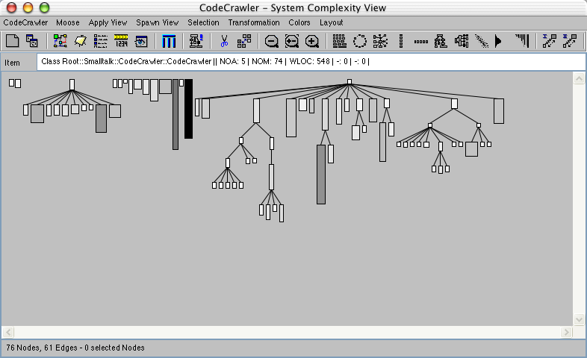
Diagrammatic Representations
Example: Code Crawler
Characteristics of classes in class hierarchy summarized and represented by color, width, and height

Slide 39
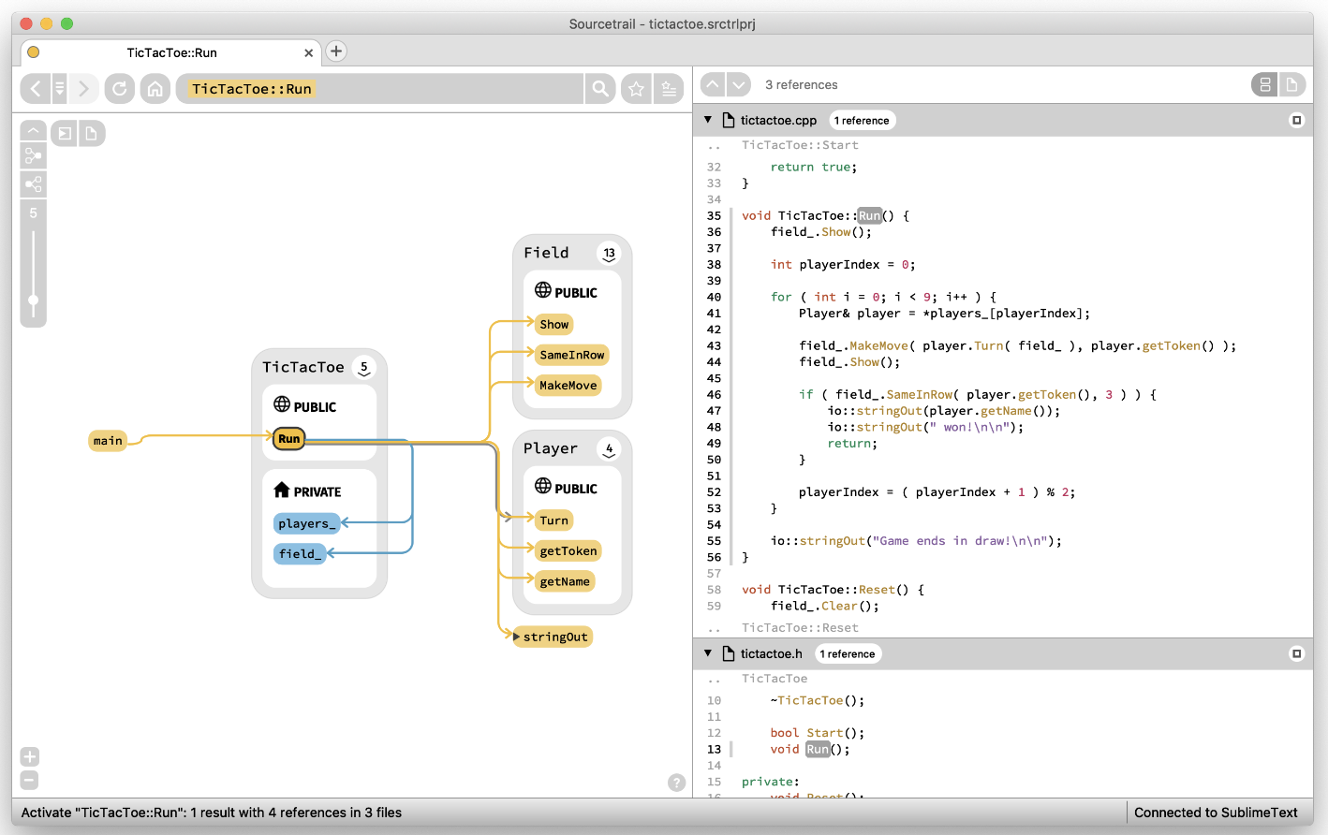
More Modern Example: sourcetrail

Slide 40
Related Tools: Version control, Debugging

Slide 41
Version Control
Record versions and releases of each part of an evolving software system
  From very simple version management (CVS, SVN) to very complex configuration management systems
Useful for maintaining test artifacts (plans, test cases, logs, etc.)
  Test artifacts are versioned with the product
Integrate with process support
  E.g., it is possible to trigger re-testing on changes, or require successful test before committing to baseline
Provide historical information for tracing faults across versions and collecting data for improving the process

Slide 42
Debugging ≠ Testing
Testing = detecting the presence of software faults
Debugging = locating, diagnosing, and repairing faults
Responsibility for testing and debugging typically fall to different individuals
Debugging starts with a set of test cases
  A small, simple test case that invariably fails is far more valuable in debugging than a complex scenario, particularly one that may fail or succeed depending on unspecified conditions
  larger suites of single-purpose test cases are better than a small number of comprehensive test cases

Slide 43
Run-time Debugging Tools
All modern deguggers ...
  Allow inspection of program state
  Pause execution
    at selected points (breakpoints)
    when certain conditions occur (watchpoints)
    after a fixed number of execution steps
  Provide display and control at the level of program source code
Specialized debugging support may include
  Visualization (e.g., for performance debugging)
  Animation of data structures
  Differential debugging compares a set of failing executions to other executions that do not fail

Slide 44
The Ecosystem has developed from Y&P
The emergence of DevOps has seen the emergence of a wide variety of tools
Testing has developed somewhat but the basic techniques are still in line with Y&P but are more automated via platforms that orchestrate a wide range of tools
The following slide give some indication of the array of tools in use in typical DevOps environments

Slide 45
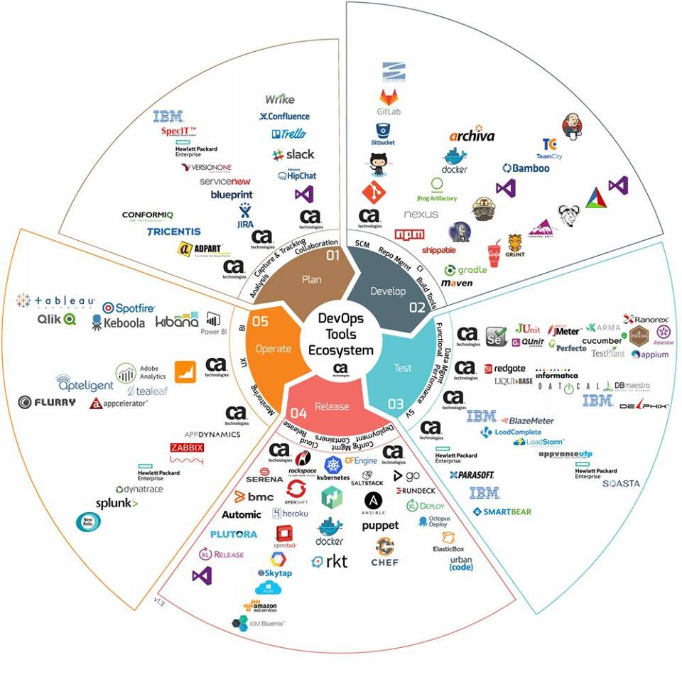
Image Source: https://www.blazemeter.com/blog/ultimate-devops-tools-ecosystem-tutorial-part-1

Slide 46
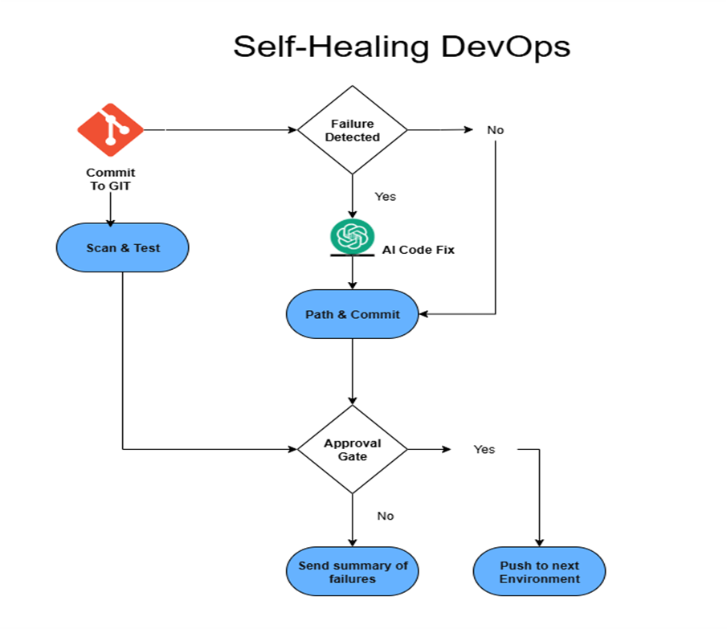
DevOps Including Machine Learning
Image source: https://dzone.com/articles/ai-powered-devops-self-healing-pipelines

Slide 47
Automation Strategy
(summary)

Slide 48
Choosing and Integrating tools
Tools and approaches must fit ...
  development organization, process, and application domain
Simple rule: Identify significant costs (money or schedule) for automation
  Example: automated module testing
    of little use for organizations using the Cleanroom process
    essential for organizations using XP
  Example:
    organizations building safety-critical software can justify investment in sophisticated tools for verifying the properties of specifications and design organization that builds rapidly evolving mass market applications is more likely to benefit from good support for automated regression testing
Also consider activities that require automation
  Missed by analysis of current testing & analysis costs

Slide 49
Think Strategically
Evaluate investments in automation beyond a single project and beyond the quality team
Reusing common tools across projects reduces
  cost of acquiring and installing tools
  cost of learning to use them effectively
  impact on project schedule
Think globally
  Often quality tools have costs and benefits for other parts of the software organization

Slide 50
Summary
Automation
  Can improve the efficiency of some quality activities
  Is a necessity for implementing others
  Is never a substitute for a rational, well-organized quality process
  Can incrementally improve processes that makes the best use of human resources
  Must be carefully evaluated to balance costs and benefits
  Continuous Integration and Deployment depend on good automation to underpin quality processes

